Slide 1
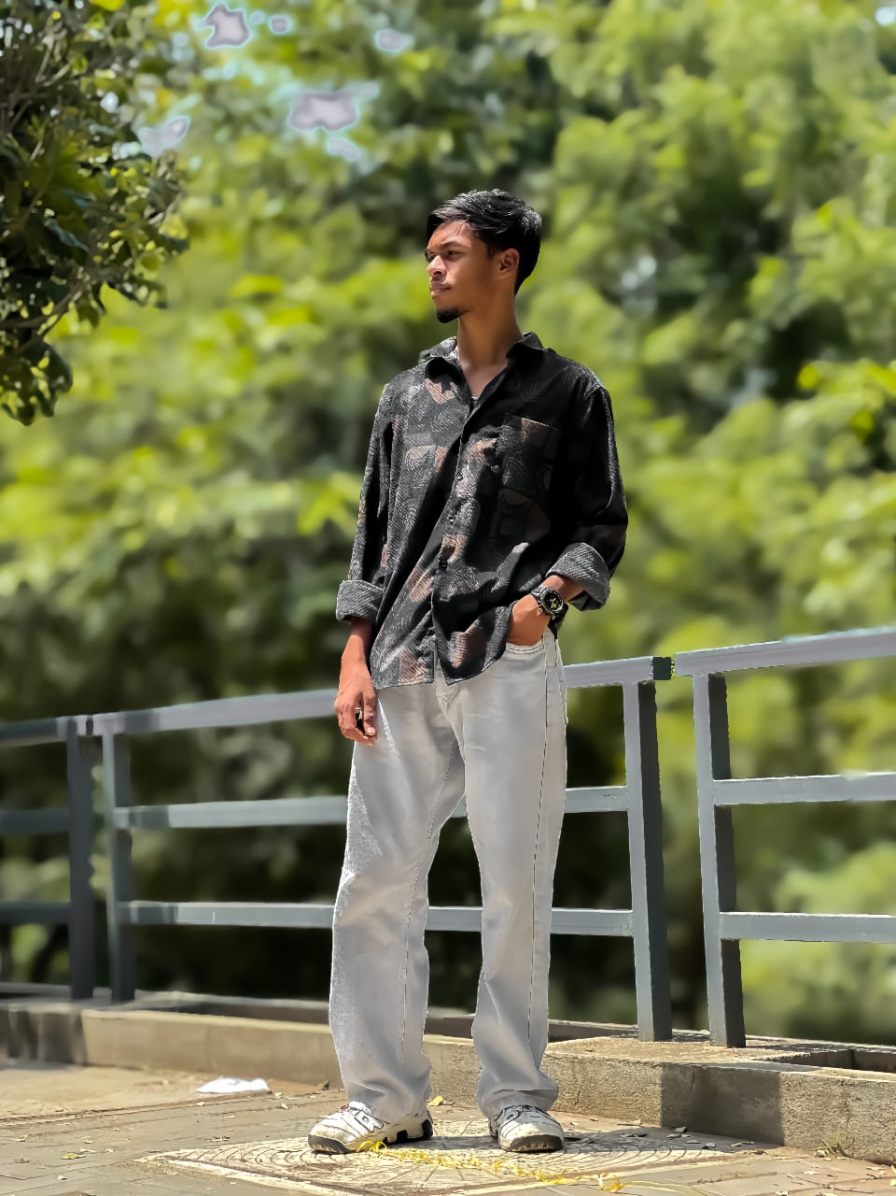
About Us
I am Niyamath ali.N I am studying in Bsc (IT) in SNMV college of arts and science its located by Malumichampatti, Coimbatore_641001.

Slide 2
Education
*Csi boys higher secondary school,Town hall,Coimbatore-641001
*My carrer was developed by a CSI boys higher secondary school in before march 2024.
*There is a lot of emotion In my studies period.
*Then my 10th,11th,12th,draduation are completed in 2024.

Slide 3
Skills
Debugger.
programmer.
Problem solver.
Easy to understand the programs.

