Slide 1
Sweet Guard: Precise Blood Glucose Regulation🩸
T
Recombinase polymerase amplification
TOC
Background
Description
Design
2nd Handshake Protocol
GAL4/UAS System
Brake Mechanism
Resources
CSU_CHINA 2021😺
Jing He 2/13/2023
From OUC_HAIDE🌊

Slide 2
# ​Background
I 型糖尿病主要由免疫介导胰岛B细胞破坏而导致🧫
目前的治疗主要包括药物治疗和手术移植👩‍⚕️
药物治疗需终身使用，多副作用💊
手术移植的资源稀缺性和免疫反应不容小觑😥
基于工程化细胞的可植入血糖精确调节系统💪

Slide 3
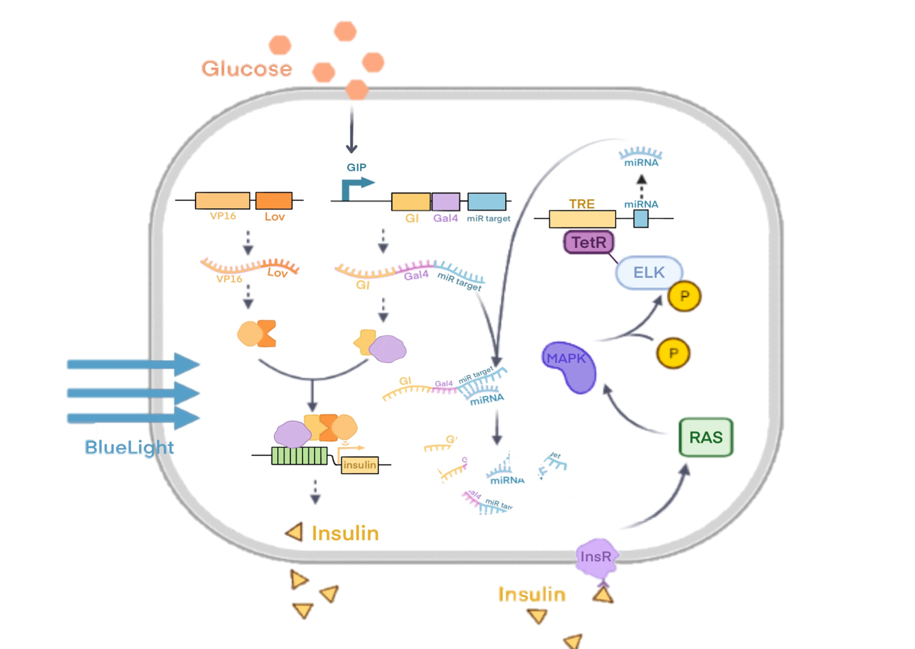
# ​Description
Domain
VP16 & GAL4: Yeast-hybrid system
Lov & GI: Photoreceptor genes that control plant phototropism
Framework
2nd Handshake🤝
[Glu]↑ + Blue light = [Insulin]↑
Negative feedback
Overloaded [Insulin] → Activate miRNA Brake Sys

Slide 4
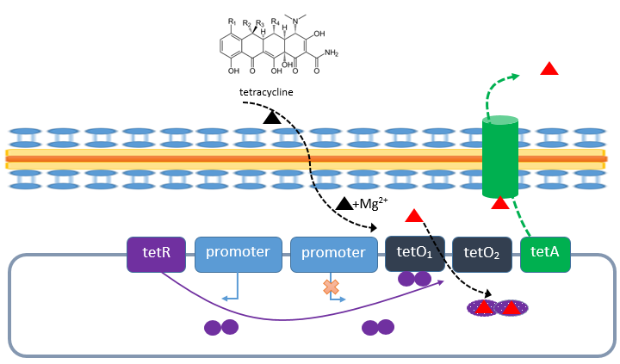
# ​Design
Tetracycline Regulation System 四环素调控系统
tetR: Tet repressor protein
tetO: Tet operator
tatA: Tet 外排转运蛋白

Slide 5
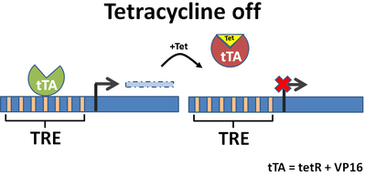
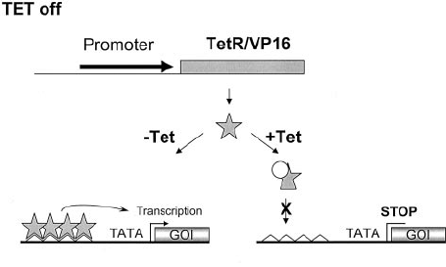
# ​Design
Tet-off System
tTA 反式激活蛋白
tTA = tetR + VP16
Ptet 依赖性启动子
Ptet = TRE + 下游 CMV 启动子
TRE：Tet 反应元件 (7*19nt TetO)
VP16 使 Ptet 激活并促使目的基因表达

Slide 6
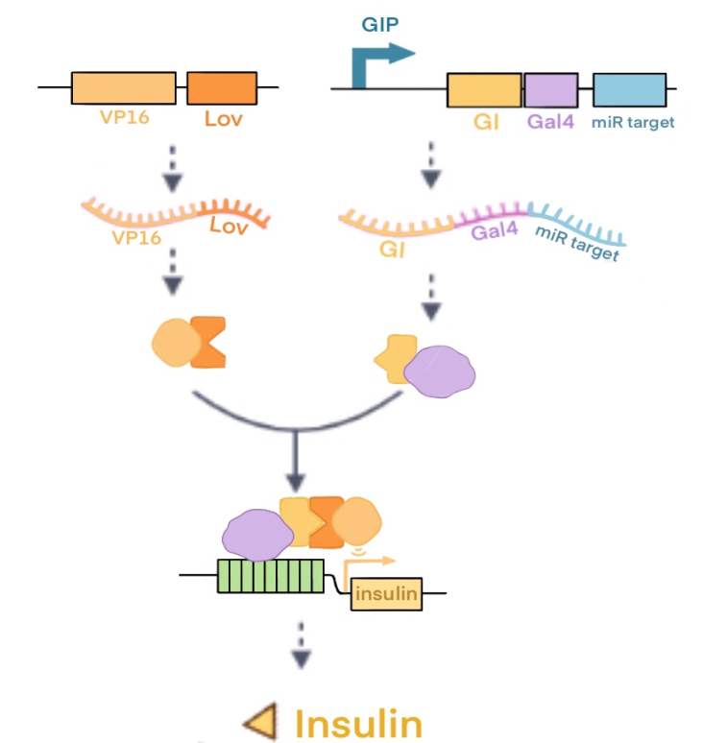
# ​Design
Bule light Control
Lov: Light-Oxygen-Voltage-sensing domain
GAL4 识别并结合 UAS
VP16 激活下游 Insulin 结构基因

Slide 7
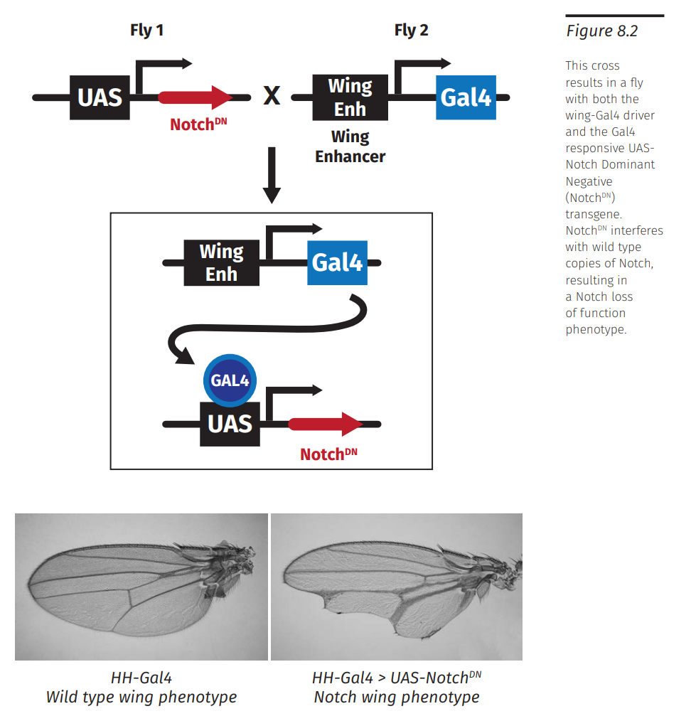
# ​Design
GAL4/UAS System
Gal4: A transcription factor that binds to an UAS
UAS: Upstream Activating Sequence

Slide 8
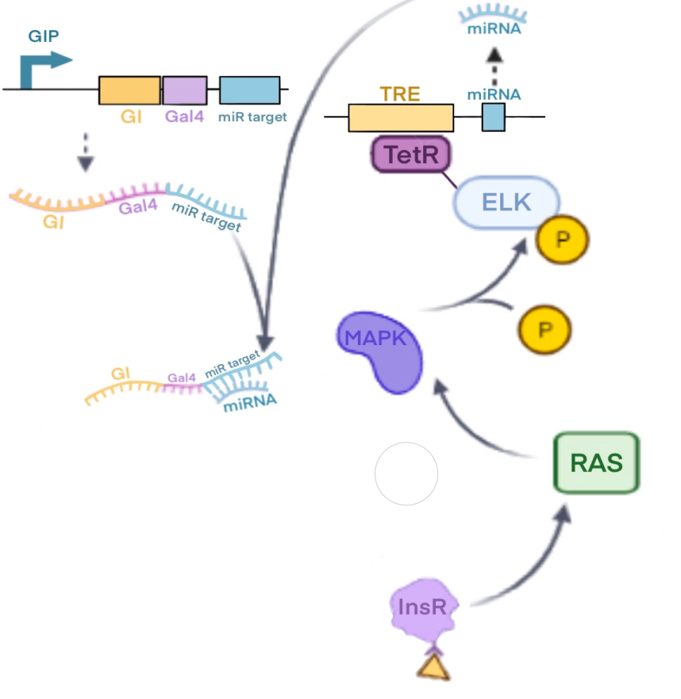
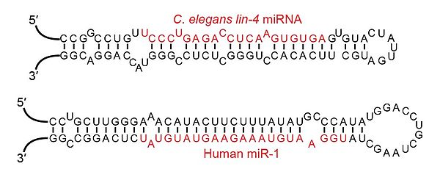
# ​Design
Brake Mechanism
miRNA(microRNA)
pre-miRNA → miRNA (21~23nt)
Involved in post-transcriptional regulation

Slide 9
# ​Resources
https://2021.igem.org/Team:CSU_CHINA
https://en.wikipedia.org/wiki/MicroRNA
https://en.wikipedia.org/wiki/Light-oxygen-voltage-sensing_domain#:~:text=A%20Light-oxygen-voltage-sensing%20domain%20%28LOV%20domain%29%20is%20a%20protein,microalgae%2C%20fungi%20and%20bacteria%20to%20sense%20environmental%20conditions.

Slide 10
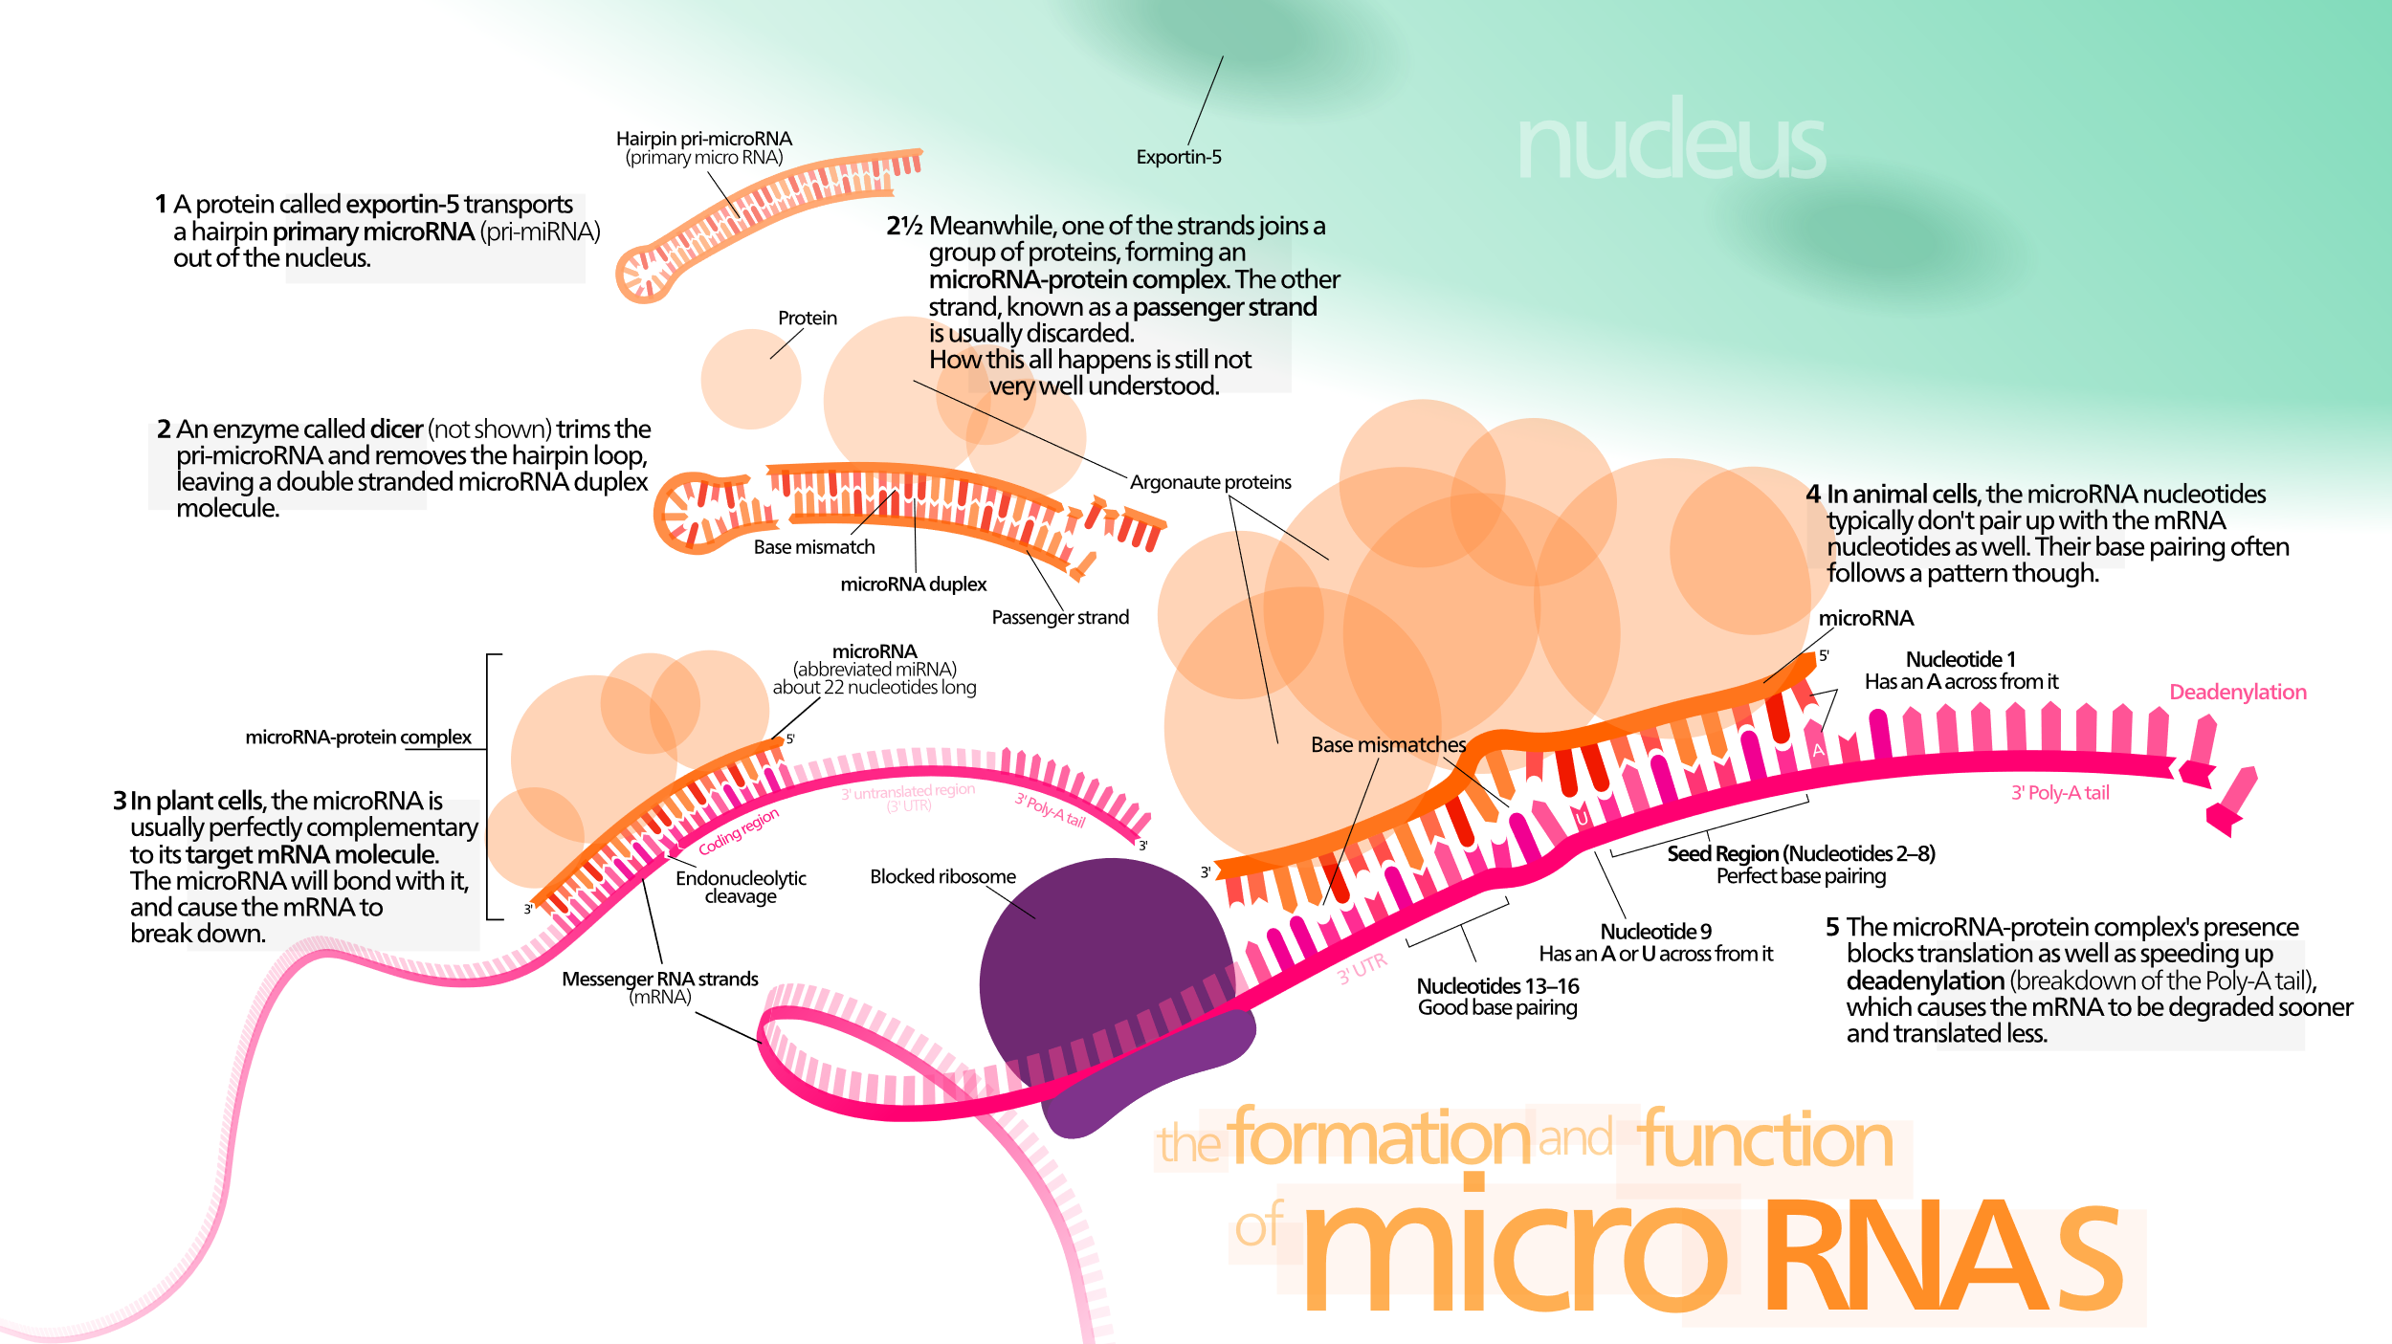

Slide 11


