Slide 1
COMP258 Neural Networks Project
Developing a predictive neural network model for HYPE dataset
-By Group 2
Vaishali, Niyanta, Shivam, Gagandeep, Rahul & Aritra

Slide 2
Agenda
Introduction
Data Analysis
Feature Engineering
Feature Selection
Pipeline
Training
Fine Tune
Hosting
Conclusion

Slide 3
Introduction
Feature | Description | # Of Categories
INTAKE COLLEGE EXPERIENCE | First time enrollment/Other enrollment status | 6
SCHOOL CODE | Code | 7
PROGRAM LONG NAME | Program name | 2
STUDENT LEVEL NAME | Diploma or secondary | 2
STUDENT TYPE NAME | New or returning | 1
STUDENT TYPE GROUP NAME | Student group | 2
TIME STATUS NAME | Fulltime or parttime student | 2
RESIDENCY STATUS NAME | Resident or non-resident | 2
FUNDING SOURCE NAME | Where did the funding come from | 5
MAILING CITY NAME | City name | 29
MAILING POSTAL CODE GROUP 3 | Postal code | 79
MAILING POSTAL CODE | Postal code | 335
MAILING PROVINCE NAME | Province name | 3
GENDER | Gender | 2
DISABILITY IND | Disability yes/no | 2
MAILING COUNTRY NAME | Country | 1
CURRENT STAY STATUS | Graduated/dropped out/studying | 10
ACADEMIC PERFORMANCE | Grade | 4
SUCCESS LEVEL | Successfully completed or not | 2
FIRST YEAR PERSISTENCE COUNT | Persisted first year | 2
HS AVERAGE GRADE | Grade | 9
AGE GROUP LONG NAME | Bucketed Age group | 7
FIRST GENERATION IND | First Generation or not | 2
APPL FIRST LANGUAGE DESC | First language | 3
APPL EDUC INST TYPE NAME | Education type | 1
APPLICANT CATEGORY NAME | High school or mature student | 5
APPLICANT TARGET SEGMENT NAME | Direct or international entry | 4
PREV EDU CRED LEVEL NAME | High school or post-secondary | 3
Format : xlsx
Shape : 668 X 39
Contains student records.
Target is SUCCESS LEVEL
Numeric Feature | Description
ID 2 | Student ID
RECORD COUNT
PRIMARY PROGRAM CODE
PROGRAM SEMESTERS
TOTAL PROGRAM SEMESTERS
EXPECTED GRAD TERM CODE | Year/Month format
HS AVERAGE MARKS | Marks
ENGLISH TEST SCORE | Score

Slide 4
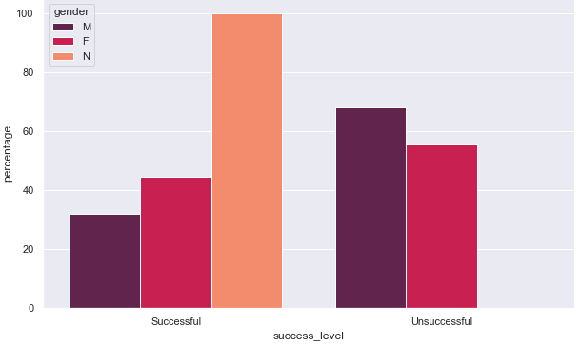
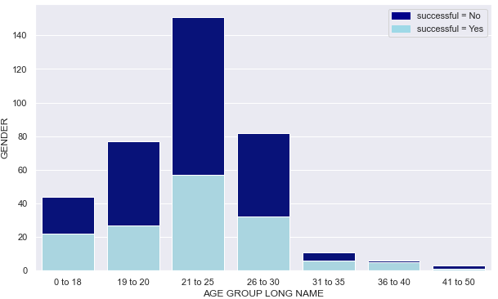
Data Analysis
Females counts(around 45% more) are more than males.
Males are often more unsuccessful (more 65% more) than females
Most of the students belong to 21 to 15 age group followed by 26 to 30.
most among 21-25 age group and 26-25 age group are most unsuccessful.

Slide 5
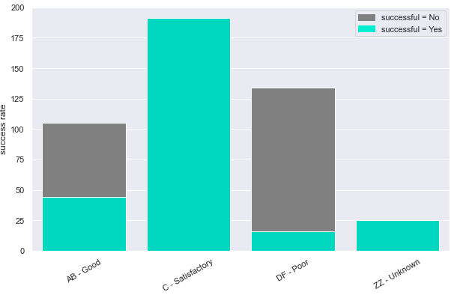
Data Analysis
Those who got A and B were half successful and half unsuccessful.
Those who got C are mostly successful
Those who got D and F are mostly unsuccessful.
Those who didn’t persist during the first year are likely to be unsuccessful.
Most of International Applicants are successful, only few of Non-Direct Entry candidates are unsuccessful.
Domestic high School students are noticeably unsuccessful.

Slide 6
Feature Engineering
We found that CURRENT STAY STATUS has 10 categories, reduce to 3
Using ADMIT TERM CODE keep the latest enrollment.
Convert FUTURE TERM ENROL into 10 encoded columns
Use ADMIT TERM CODE to create summer/fall/winter admissions

Slide 7
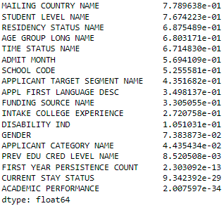
Feature Selection
Based on Chi2Test
drop

Slide 8
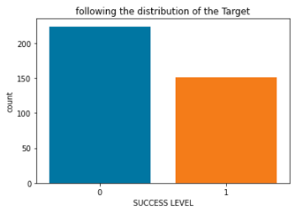
Pipeline
10% Test
Numeric Features - 'PROGRAM SEMESTERS', 'TOTAL PROGRAM SEMESTERS', 'FIRST YEAR PERSISTENCE COUNT', 'ENGLISH TEST SCORE', 'Term1', 'Term2', 'Term3','Term4', 'Term5', 'Term6','Term7', 'Term8', 'Term9', 'Term10’
Categorical Features - 'INTAKE COLLEGE EXPERIENCE', 'SCHOOL CODE', 'STUDENT LEVEL NAME', 'TIME STATUS NAME', 'RESIDENCY STATUS NAME', 'FUNDING SOURCE NAME', 'GENDER', 'DISABILITY IND', 'MAILING COUNTRY NAME', 'CURRENT STAY STATUS', 'ACADEMIC PERFORMANCE', 'AGE GROUP LONG NAME', 'APPLICANT CATEGORY NAME', 'APPLICANT TARGET SEGMENT NAME', 'PREV EDU CRED LEVEL NAME'
# of features after one-hot encode = 76

Slide 9
Modelling
Model | Input shape | Features used | Total params | Accuracy
1 Dense Layer of 32 Units, 1 DropOut 0.5 | (303, 70) | Removed 'APPL FIRST LANGUAGE DESC' | 2,305 | 0.85
1 Dense Layer of 32 Units, 1 DropOut 0.5 | (303, 76) | Included most of the features + Added Winter/Fall/Summer Sem feature | 2,497 | 0.95
1 Dense Layer of 32 Units, 1 DropOut 0.5 | (303, 68) | Dropped 3 categorical features with least p-value in Chi2Test 'FIRST YEAR PERSISTENCE COUNT’, 'CURRENT STAY STATUS’, ‘ACADEMIC PERFORMANCE', | 2,241 | 0.84

Slide 10
Fine Tune
tune for LR and # of Hidden Units.
Best param lr= 0.006, hidden units= 64
Accuracy on Train = 1 & Accuracy Unseen test = 1
Random Forest Classifier on this data, Accuracy of 1 on Unseen test Set

Slide 11
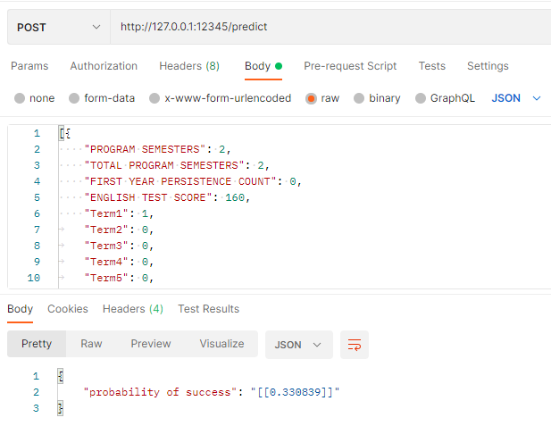
Hosting

Slide 12
Conclusion
In this project we have demonstrated,
exploratory data Analysis
Select features using Chi2Test & build a pipeline to transform the data
Model selection
Fine-tune using Keras Tuner library
Improvise the model’s Accuracy through by finetuning from 0.85 to 0.95.
Hosting a neural network model on flask.

Slide 13
Thank You

