Slide 1
Personality Prediction with Social Networks :
A Neural Network Approach
Akshay Kumar Niyas C | 10-CSS-06 10-CSS-44

Slide 2
Overview
Introduction
Working method
Experimental Setup
Experimental Results
Conclusion
Applications
References

Slide 3
Introduction
What is personality?
  “The combination of characteristics or qualities that form an individual's distinctive character” - google
  “Personality is the particular combination of emotional, attitudinal, and behavioral response patterns of an individual” - wikipedia
  Personality is usually broken into components called the Big Five, which are also known as personality traits. These components are generally stable over time and appear to be attributable to a person’s genetics rather than the effects of one’s environment.

Slide 4
Personality Traits
Neuroticism
  Related to emotional instability, represents the tendency to experience negative emotions and a lower tolerance to stress.
Extraversion
  An individual's preference for outgoing social experiences, while the opposite(introversion) is a desire for a lower level of social involvement.
Openness
  An individual's curiosity and appreciation for new experiences; the converse would be a greater respect for traditional and well-traveled experiences.
Agreeableness
  A tendency towards compassion and cooperation, while the opposite is a prevalence of suspicion and antagonism.
Conscientiousness
  Shows an individuals' self-discipline and devotion to duty; a lack of conscientiousness would be an increase in spontaneous and unplanned behavior.

Slide 5
Working method
Develop a questionnaire to decide the values actual personality traits of facebook users. This questionnaire also requests user to grant permission to access facebook profile/activities.
Extract possible features from facebook profile/activities of individuals.
Train a neural network using extracted features as input and actual values of personality traits as target outputs.
Perform necessary tests to evaluate the performance of system.
Now the system can be used to predict the personality trait values of previously unseen data.

Slide 6
Experimental Setup
Questionnaire used for data collection
  Gold Berg's 44 question BigFive inventory
  Answer of each question can be as follows
    Strongly Agree
    Agree
    Neither Agree Nor Disagree
    Disagree
    Strongly Disagree
  At the beginning of questionnaire, a request is made for granting the permissions required for accessing user's facebook profile/activities.

Slide 7
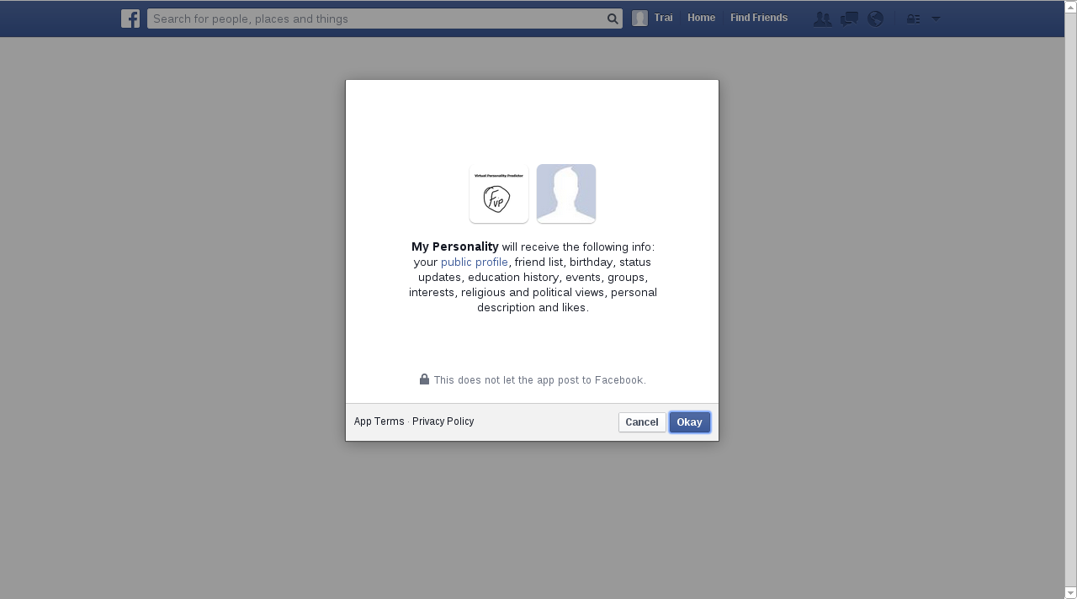
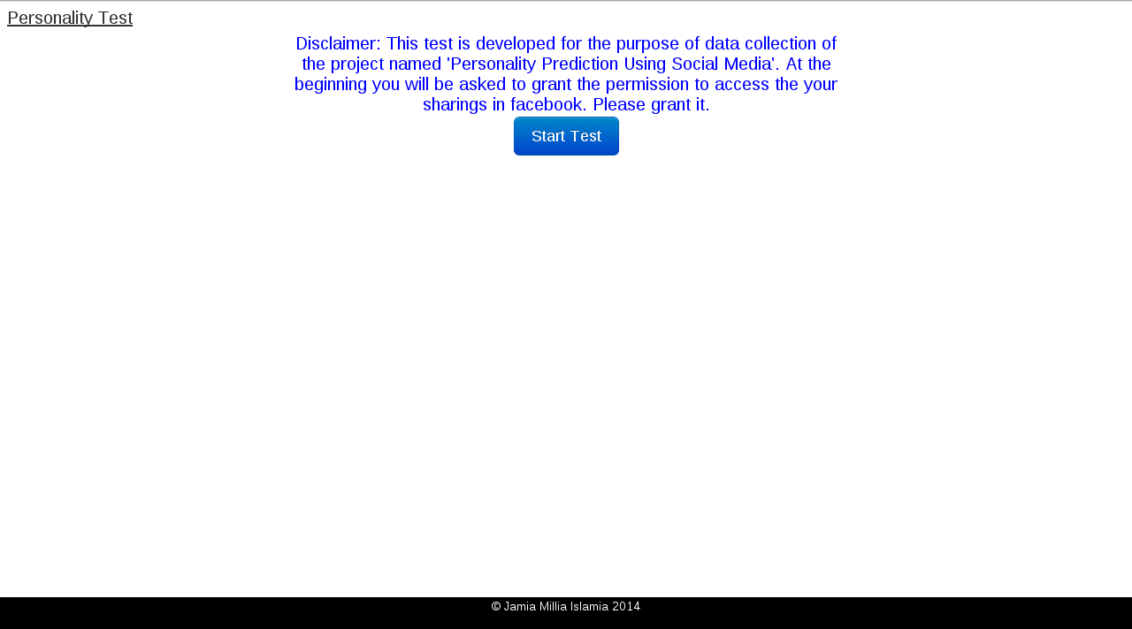
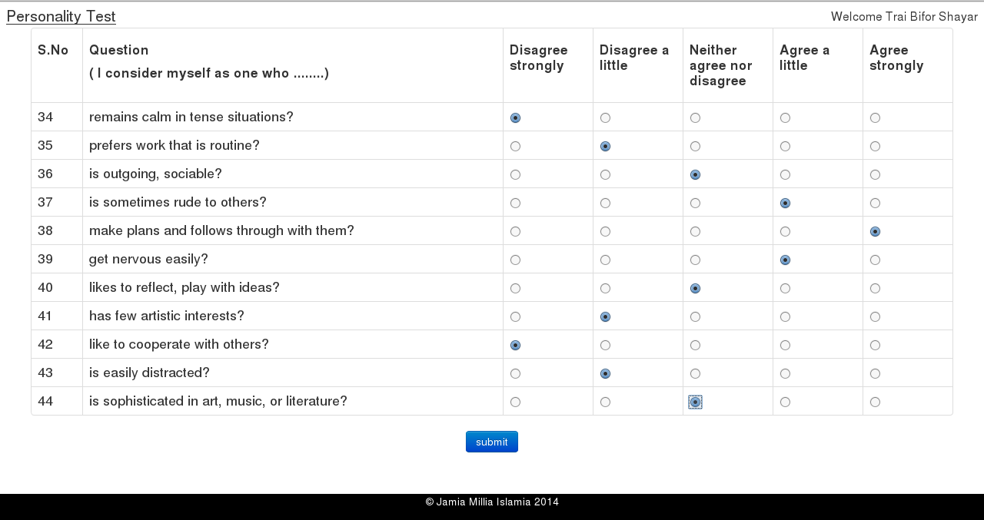
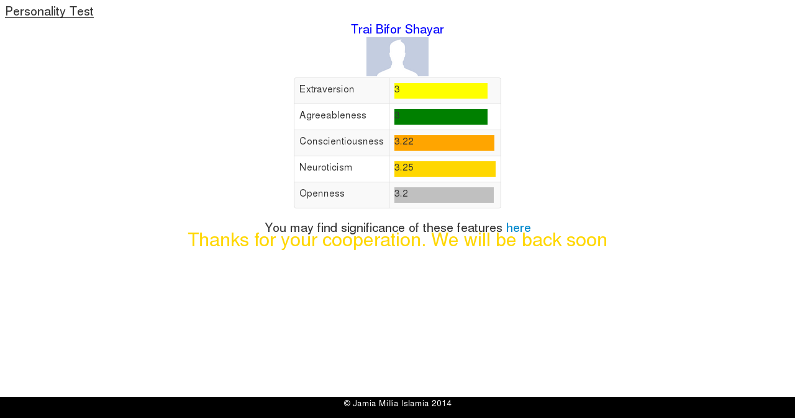
Few screen shots of questionnaire.

Slide 8
Feature Extraction
Following features were extracted.
  Basic statistical details. (Number of groups, Number of page likes ..etc) 8
  Category wise fraction of page likes 160
  Linguistic features 10
  Total 178

Slide 9
Construction and training of neural network
Python library named 'pybrain' is used for construction and training of neural network.
Neural network consists of 178 inputs, 5 outputs and 6 hidden layers.
Neural network was trained until error converges to a limit or a maximum of 1000 epochs.

Slide 10
Structure of Neural Network

Slide 11
Sample Experiment
Number of training tuples 16
Number of test tuples 4
Number of hidden layers 6

Slide 12

Sample Test Case 1
Shadab Khan
Traits | Predicted | Actual | Error
Extraversion | 3.03 | 3.50 | 11.74 %
Agreeableness | 3.57 | 3.67 | 2.43 %
Conscientiousness | 3.27 | 2.00 | 31.76 %
Neuroticism | 2.32 | 2.25 | 26.78 %
Openness. | 3.422 | 4.30 | 21.94 %
Maximum Error | 31.76 %
Average Error | 18.93 %

Slide 13

Sample Test Case 2
Yawar Siddiqui
Traits | Predicted | Actual | Error
Extraversion | 3.21 | 2.0 | 30.29 %
Agreeableness | 3.52 | 4.33 | 20.18 %
Conscientiousness | 2.78 | 2.67 | 2.84 %
Neuroticism | 3.32 | 3.0 | 8.04 %
Openness. | 3.29 | 3.3 | 0.33 %
Maximum Error | 30.29 %
Average Error | 12.34 %

Slide 14

Sample Test Case 3
Adil Ansar
Traits | Predicted | Actual | Error
Extraversion | 3.35 | 1.87 | 36.98 %
Agreeableness | 3.26 | 4.22 | 23.82 %
Conscientiousness | 2.55 | 3.0 | 11.16 %
Neuroticism | 2.62 | 4.12 | 37.42 %
Openness. | 3.06 | 3.3 | 6.04 %
Maximum Error | 37.42 %
Average Error | 23.08 %

Slide 15

Sample Test Case 4
Aashisha Chakraborty
Traits | Predicted | Actual | Error
Extraversion | 3.37 | 2.25 | 28.08 %
Agreeableness | 3.03 | 4.67 | 40.79 %
Conscientiousness | 3.08 | 3.55 | 11.94 %
Neuroticism | 2.50 | 3.37 | 21.76 %
Openness. | 3.79 | 3.8 | 0.04 %
Maximum Error | 40.79 %
Average Error | 20.522 %

Slide 16
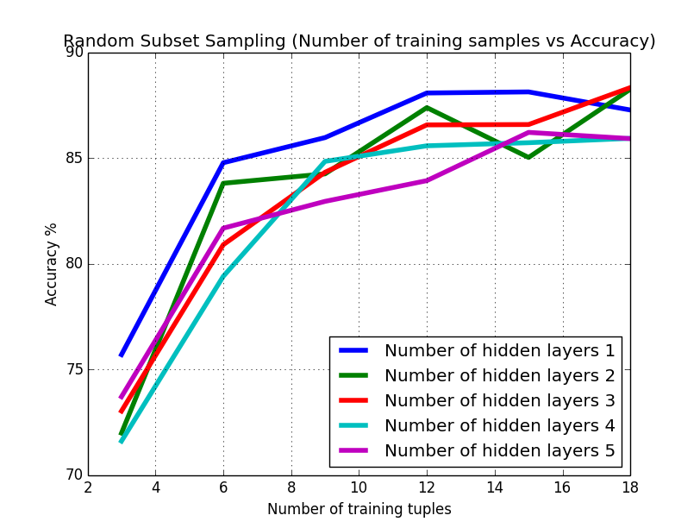
Test Result

Slide 17
Conclusion
It is possible to predict the values of personality traits of individuals using their facebook activities/profile with the help of a properly designed neural network with a certain amount of accuracy.

Slide 18
Applications
Online marketing system can recommend product in personalized way by analyzing individual's profile in Social Networking Sites.
Instant feedback: there are no questions at all and we get a score in a matter of seconds!
Real world validity: It look at individuals actual Facebook behavior rather than asking them about them real-world behaviour
Difficult to fake: in traditional testing, people often misrepresent who they really are (even if they do not mean to). By observing actual records of behaviour and choices individuals made in the past, the system largely circumvent the opportunity to 'cheat' the assessment

Slide 19
References
Personality Traits Recognition on Social Network – Facebook | Firoj Alam, Evgeny A.Stepanov, Giusepee Riccardi | 2013
http://en.wikipedia.org/wiki/Big_Five_personality_traits
Predicting Personality with social Media|Jennifer Golbeck, Cristina Robels, Karen Turner |“Extended Abstracts on Human Factors in Computing Systems ”-ACM | 2011
Predicting Personality with Social Behavior | Sibel Adalı,Jennifer Golbeck | IEEE/ACM International Conference on Advances in Social Networks Analysis and Mining | 2012
Predicting Personality from Twitter | Jennifer Golbeck, Cristina Robles , Michon Edmondson, Karen Turner | IEEE International Conference on Privacy, Security, Risk, and Trust, and IEEE International Conference on Social Computing | 2011
The Big-Five trait taxonomy: History, measurement, and theoretical perspectives. | John, O. P, Srivastava S | 1999
“Leveraging online social network data and external data sources to predict personality” Daniel Chapski
http://php-nlp-tools.com
http://mypersonality.org
http://pylab.org
http://pybrain.org

Slide 20
??

