Slide 1
WEB PAGE CLASSIFICATION
Akshay Kumar(10-CSS-06)
Niyas C

Slide 2
Overview
Abstract
Outline
Collection of dataset
Construction of classifier
Testing of classifier
Experimental Results

Slide 3
Abstract
World Wide Web is a large repository of information and it keeps on growing exponentially. The fact is that most of the information stored in it is in either unstructured or semi structured way. So it is not that much easy to get desired piece of information out of that large collection of unprocessed data. Several strategies has been employed to mine the data in World Wide Web for finding interesting information and to organize them in a meaningful way. Web data mining is a field of active research interest and computer scientists across the world is looking into development and improvement of web mining strategies. In this paper we will present a modified probabilistic model based on naive bayes theorem, which will help to classify webpages based on their textual content, in a better way than traditional naive bayes model.

Slide 4
The World Wide Web (WWW) has shown an exponential growth within last two decades in terms both technology involved and amount of information stored in it. It is observed that 90% of data in internet is generated within last two years[1]. According to google indexing, there are around 20 billion web pages on this very day[2].Now around 2.4 billion people are depending internet for finding information. Out of these people 70% use internet every day. And there was a rise in number of internet users by 566% percentage from 2000 onwards[3].subject directories to answer user queries. The database maintained by any crawler based search engine is quite large, and have considerably larger amount of data indexed in their databases as compared with subject directories[4].
The major method proposed for text classification includes decision tree method[5], rule based classification method[6], SVM(Space Vector Model) classification[7][8][9], Neural network classifiers[10][11][12], Bayesian classifiers[13][14], k-nearest neighbour approach[16] and also there are some other classifiers which do not belong to above categories[15]content or hierarchy of web page into consideration[17].Decision trees were developed using WEKA [18], (Waikato Environment for Knowledge Analysis) a collection of machine learning algorithms for data mining tasks. Shanks et. Al [19] have used the first fragment of each document to classify news articles.
This approach is based on the assumption that a summary is present at the beginning of each document, which is true only for news articles, this approach was later applied to hierarchical classification of web pages by Wibowo et.al [20]. Some approaches were also introduced on the basis of links present in the webpage and analyzing target pages[21]. Another variation of same was proposed in which only some of the target pages are taken into consideration[22].
We used the Python3 regular expression module and BeautifulSoup module to extract the information from web pages. Beautiful Soup is a Python library designed for easy and effective scraping of webpages and provides a few simple methods and Pythonic idioms for navigating, searching, and modifying a parse tree [24].
The standard Stop-Word list used in Bow [27] was used along with a comprehensive Stop-word list provided In the NLTK[28] (Natural language processing toolkit) library in python. Along this we used the Porter stemming[25] technique to reduce words to their least forms.
The posterior probability with Laplace’s correction was calculated using the formula[26][31]:
P (wk/C) = (n_{k}+1) / (n + |Vocabulary|) --(12)

Slide 5
Outline
Classification of web pages based on textual content
Make use of naive bayes classifier
Try to modify naive bayes model for improved classification
Achieve classification accuracy of 80%

Slide 6
Collection of dataset
Collect web pages belonging to 6 different categories namely Politics, Entertainments, Educational, Religion, Sports, Technology
Collect data samples from famous news portals like BBC, Reuters, Hindustan Times, CNET ... etc

Slide 7
Construction of classifier
Invloves two steps
Training the classifier
  Involves data pre processing and representation of important features obtained in a convenient form
Make use of a classification algorithm
  Apply a classification algorithm that will decide the
  category of a document using training data

Slide 8
Training of Classifier
Data preprocessing
  Each input file will be consisiting of html tags, javascript and css codes.
  Process input file and get rid of all html,css and javascript content
  Replace all non-ascii chars, special symbols and digits with space
  Split document into words
  Convert all words to lowercase

Slide 9
Training of Classifier[contd.]
Data Preprocessing[contd.]
  Remove all stop words in english language from list of words
  Convert all words into basic form using stemming algorithm
  Remove web page specific stop words Eg: home, copyright, rights, contact, email, login, reserved..etc
  Remove all words having length less than 3
  Convert word list to frequency list in which each word will be
  represented with number of occurances

Slide 10
Training of Classifier[contd.]
Data Representation
  A 2d hash function is used for representation of data
  Each item in first level stands for category and points to another hash function
  Hash function in second level will contain words belonging to that category with respective frequencies.

Slide 11
Training of Classifier[contd.]
Model data representation
{
'Politics':{ 'president':3, 'shutdown':4, 'federal':7},
'Educational':{'semster':4, 'exam':3,'course'7},
'Religion':{'belief':4,'holy':3,'divine':7,'tradition':3}
}

Slide 12
Classification algorithm
Algorithm based on naive bayes theorem was used for classification because of following reasons
  Easily scalable for large databases
  Can accomodate any number of attributes
  Less time complexity in comparison with other algorithms
  Comparable performance with other classification algorithms

Slide 13
Naive Bayes Model
According to Bayes theorem
Naive Bayes theorem assume class conditional independence which make calculation of P(X/H) more easy
According class conditional independence 'Effect of value an attribute a class is independent of values of other attributes'.
According to Naive Bayes Theorem

Slide 14
Classification Algorithm
INPUT freq-> word frequency list of test web page Database-> 2d hash table containing list of word frequencies in each category categories->List of available categories for classification OUTPUT category->category of given web page
naive_bayes(freq,database,categories): v=total_number_words_in_database pc={} for category in categories: attributes=database[category] n=total_number_of_words_in_category pc[category]=MAX_VAL for word in freq_list: if word not in attributes: pc[category]=pc[category]*(1.0/(n+v)) else: pc[category]=pc[category] * ((1+attributes[word])/(n+v)) Category=category for which pc[category] is maximum return Category

Slide 15
Testing of Classifier
Two types of testing were performed
K-fold cross validation
  Divide whole data set into k equal subsets. Perform k iteration, in iteration i reserve Di as test set and remaining sets as training sets. Accuracy will be sum of accuracy obtained in each iteration.
  Outputs produced : Graph between k and accuracy(2<=k<10), confusion matrix for k=5
Random sub set sampling
  Pick k number of documents as training documents and remaining docu-ments will be used for testing. And this procedure will be repeated n times. Overall accuracy will be average of accuracy values obtained each time.
  Outputs produced: Graph between number of documents vs accuracy

Slide 16
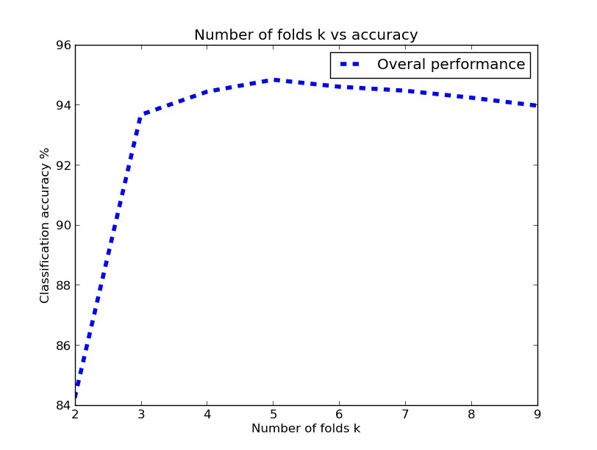
Experimental Results
K-Fold Cross Validation

Slide 17
Experimental Results[contd.]
->Predicted Actual | Politics | Entertainments | Sports | Educational | Religion | Technology
Politics | 470 | 5 | 10 | 0 | 14 | 1
Entertainments | 7 | 481 | 6 | 0 | 6 | 0
Sports | 11 | 3 | 485 | 0 | 1 | 0
Educational | 17 | 0 | 0 | 475 | 6 | 2
Religion | 1 | 0 | 0 | 0 | 499 | 0
Technology | 64 | 0 | 0 | 1 | 0 | 235

Slide 18
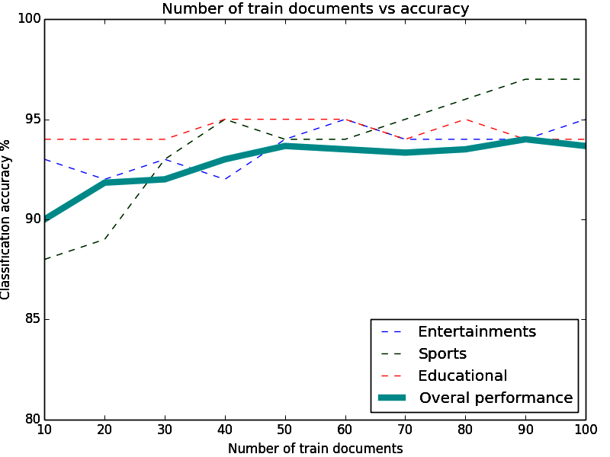
Experimental Results[contd.]
Random Sub Sampling

Slide 19
Conclusion
The proposed modification for traditional naive bayes web page classification gives better result than the traditional model. And also reduces computational cost and time by replacing floating point multiplication operations with cheaper floating point additions. We were able to get an accuracy of 84.36% for a complicated dataset like 20 newsgroup. It shows that it can perform better when we have broadly disitinct categories. This result is quite encouraging and it will help for improving the performance of web page classifiers. This approach can be utilized by the search engines and other online directory projects like DMOZ[32], Yahoo Directory for effective categorization of web pages to build a web directory with reduced human effort. This method can also be used in automatic crawlers for collecting web pages related to a particular category without human intervention.

Slide 20
References
[1] http://www.sciencedaily.com/releases/2013/05/130522085217.htm
[2] http://www.worldwidewebsize.com/
[3] http://www.thecultureist.com/2013/05/09/how-many-people-use-the-internet-more-than-2-billion-infographic/
[4] Automated Classification of Web Sites using Naive Bayesina Algorithm. Ajay S. Patil and B.V Pawar IMECS 2012.symbolic rule induction system for text categorization. DE. Johnson, FJ Oles, T Zhang, T Goets 2002
[5] Automated learning of decision rules for text categorization. Chidanand and Fred Damerau ACM 1994
[6] A statistical learning model of Text classification for Support Vector Machines. Thorsten Joachims ACM 2001
[7] Text categorization with support vector machines: Learning with many relevant features. Thorsten Joachims
[8] Support vector machines for text categorization. A. Basu, C. Watters, and M. Shepherd IEEE 2002
[9] Automated text classification using a dynamic artificial neural network model M. Ghiassi,M. Olschimke, B.Moon,P. Arnaudo Elsevier 2012
[10] Study a text classification method based on neural network model Jian Chen,Hailan Pan, Qinyum Ao Springer 2012
[11] Autmatic text classification using artificial neural network. Springer volume 172 2005
[12] Naive Bayes text classificaton - http://nlp.stanford.edu/IR-book/html/htmledition/naive-bayes-text-classification-1.html
[13] Naive Bayesian text classification - John Graham-cuming 2005
[14] A survey of text classification algorithms – Charu C Aggarwal, ChengXiang Zhai
[15] An improved K-nearest neighbour algorithm for text categorization. Li Baoli, Yu Shiven, Lu Qin ICCPOL 2003
[16] Recent research in web page classification-A review . Alamelu Mangai, Santhosh Kumar, Sugumaran IJCET 2010

Slide 21
[17] Data Mining: Practical machine learning tools and techniques, Ian H. Witten and Eibe Frank 2nd Edition, Morgan Kaufmann, San Francisco, 2005.
[18] Fast categorizations of large document collections Shanks, V. and H. E. Williams. SPIRE 2001
[19] Simple and accurate feature selection for hierarchical categorization. Wibowo, W. and H. E.Williams. ACM 2002[20] Computational Approaches to Analyzing Weblogs- Mihalcea, R. and H. Liu. A corpus-based approach to finding happiness. In N. Nicolov, F. Salvetti, M. Liberman, and J. H. Martin (Eds.) AAAI 2006
[21] Graph-based text classification: Learn from your neighbors Angelova, R. and G. Weikum SIGIR 2006
[22] S. Dumais and H. Chen, “Hierarchical classification of web content”, in Proc. of the 23rd annual Int. ACM SIGIR Conf. on Research and Development in Information Retrieval, Athens, Greece, 2000, pp. 256 - 263. [23] M.F. Porter, “An algorithm for suffix stripping”, Program, Vo.14, no. 3, pp. 130-137, Jul. 1980
[23]Python beautiful soup library.
[24] http://www.crummy.com/software/BeautifulSoup/
[25] http://tartarus.org/martin/PorterStemmer/index.html Porter Stemming algorithm, with various implementations.
[26] http://nlp.stanford.edu/IR-book/html/htmledition/naive-bayes-text-classification-1.html Stanford NLP , naïve bayes text classification
[27] The BOW or libbow C Library [Online].
[28] Available: http://www.cs.cmu.edu/~mccallum/bow/
[29] Bird, Steven, Edward Loper and Ewan Klein (2009). Natural Language Processing with Python. O’Reilly Media Inc. Python NLTK
[30] http://www.matplotlib.org/ Python based open source mathematical analysis toolkit.
[31] T. M Mitchell. (1997). Machine Learning McGraw-Hill Companies, Inc.
[32] Data Mining concepts and techniques Han Kamber Lee Morgan Kaufman publications. 3rd Edition 2012.
[33] DMOZ open directory project. [Online]. Available: http://dmoz.org/

Slide 24
END

