Slide 1
Website Classification
Akshay Kumar(10-CSS-06)
Niyas C(10-CSS-44)

Slide 2
Introduction
Website classification or website categorization is the process of assigning a website to one or more category labels. E.g. “News”, “Sport” , “Business”

Slide 3
Website classification can be divided into two categories
  Subject Classification: On the basis of subject or topic of website. Eg: “sports,politics,technology...etc”
  Functional Classification: The role that website play. Eg: “Personal website,Enrollment website ...etc”

Slide 4
Based on number of classes website classification can be divided into
  Binary classification : Two classes. For ex:
  “political and non-political”,”commercial and non-commercial”
  Multi class classification: Multiple classes
    Soft classification
    Hard classification

Slide 5
Based on the number of classes that can be assigned to an instance, classification can be divided into
  Single Label : One instance will be strictly assigned to one category only
  Multi Label : One instance can be classified into multiple categories

Slide 6
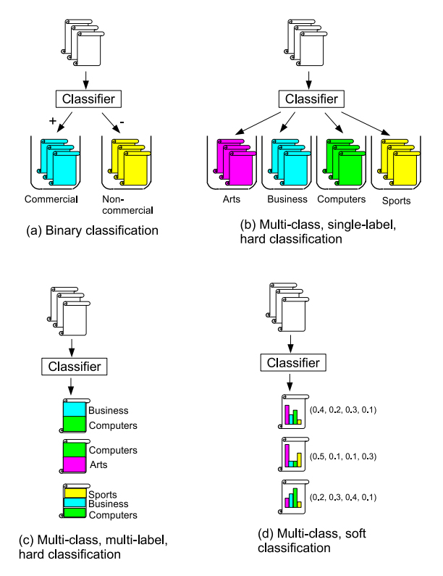
Overview of classification

Slide 7
Features used in website classification
Features can be classified into
  On page features
  Neighbors feature
    Required when features of website in consideration is not enough for classification purpose

Slide 8
Features used in website classification
URL
  “Fast webpage classification using URL features”
    Min-Yen Kan,Hoang Oanh Nguyen Thi
HyperLink
  Part inside <a>...</a> tag
Textual Content
Powerful html tags
Structure of website
Statistical information

Slide 9
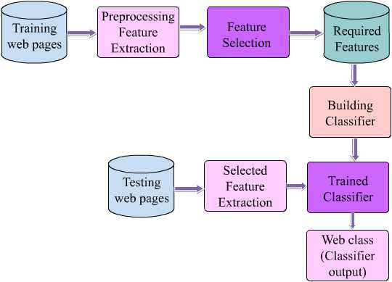
Structure website classifier

Slide 10
What we plan to do?
Desktop application using python for predicting category of input websites
Prepare training set and test set using sample database provided by open directory project.
Achieve a classification accuracy more than 80%
Demonstrate classification accuracy

Slide 11
How we do?
Based on Naive Bayes Classification method
Base research paper
  Automated Classification of Web Sites using Naive Bayesian Algorithm-2012
    Ajay S. Patil, B.V. Pawar
    IMECS March 2012,Honkong

Slide 12
Why Naïve Bayes Algorithm
A straightforward and frequently used method for supervised learning.
Provides a flexible way for dealing with any number of attributes or classes, based on probability theory of Bayes’s rule.
The asymptotically fastest learning algorithm that examines all its training input.
Performs surprisingly well in a very wide variety of problems in spite of the simplistic nature of the model.
Small amounts of “noise” do not perturb the results by much.

Slide 13
Applications
Assist web information gathering:
  Let to search websites belonging to particular category.
  Help to automate web directory projects

Slide 14
Applications
Content filtering
  Parent Control:
    Let parents to impart restriction on internet access of children by blocking non-desirable categories.
  Manage organization/institution network
    Let organization/institutions to block access to particular categories of websites to prevent students/employees from wasting their time and band width of institution.
    For example Jamia use cyberoam portal to control internet usage of staff/students and it contains a semi automated website classifier.

Slide 15
Limitations
There will be several websites that do not belongs to predefined categories
Multimedia contents in websites.

Slide 16
Thanks

