Slide 1
Website Classification
Akshay Kumar(10-CSS-04)
Niyas C(10-CSS-44)

Slide 2
Introduction
Website classification or website categorization is the process of assigning a website to one or more category labels. E.g. “News”, “Sport” , “Business”

Slide 3
Website classification can be divided into two categories
  Subject Classification: On the basis of subject or topic of website. Eg: “sports,politics,technology...etc”
  Functional Classification: The role that website play. Eg: “Personal website,Organization website ...etc”

Slide 4
Based on number of classes website classification can be divided into
  Binary classification : Two classes. For ex:
  “political and non-political”,”commercial and non-commercial”
  Multi class classification: Multiple classes

Slide 5
Based on the number of classes that can be assigned to an instance, classification can be divided into
  Single Label : One instance will be strictly assigned to one category only
  Multi Label : One instance can be classified into multiple categories

Slide 6
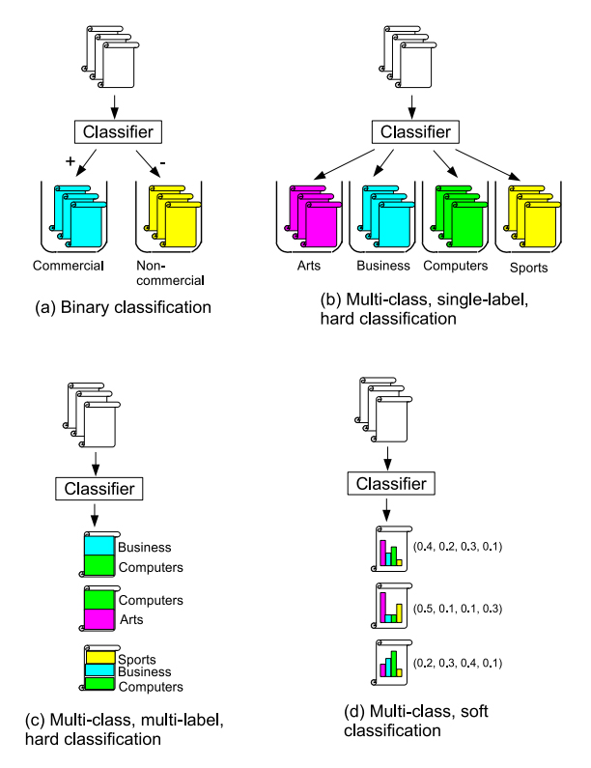
Overview of classification

Slide 7
Applications
Assist web information gathering:
  Let to search websites belonging to particular category.
  Help to automate web directory projects
Content Filtering:
  Optional blocking of website based on category

Slide 8
Web directory projects
They are directories in which websites are organized into different categories by human effort
Eg: open web directory, yahoo directory

Slide 9
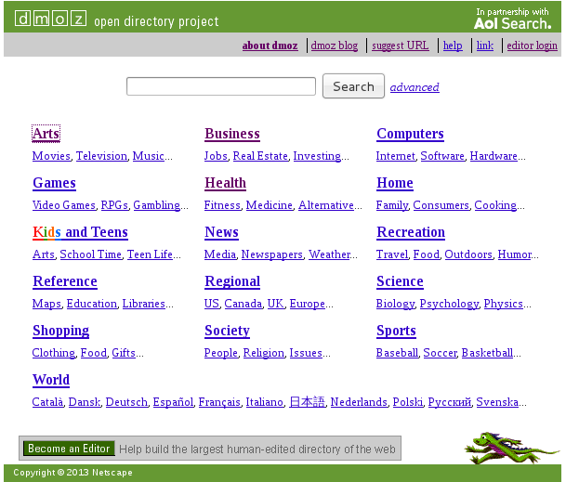

Slide 10
Content blocking application in
Parent Control:
  Let parents to impart restriction on internet access of children by blocking non-desirable categories.
Manage organization/institution network
  Let organization/institutions to block access to particular categories of websites to prevent students/employees from wasting their time and band width of institution.
  For example Jamia use cyberoam portal to control internet usage of staff/students and it contains a semi automated website classifier.

