Slide 1

AI Defence Readiness
& Threat Prediction Copilot
Predict equipment failures. Prioritize genuine security threats. Support
mission-ready decisions.
IBM BOB AI Innovation Hackathon — Team Tech-Titans
DEPSTAR | CSE

Slide 2
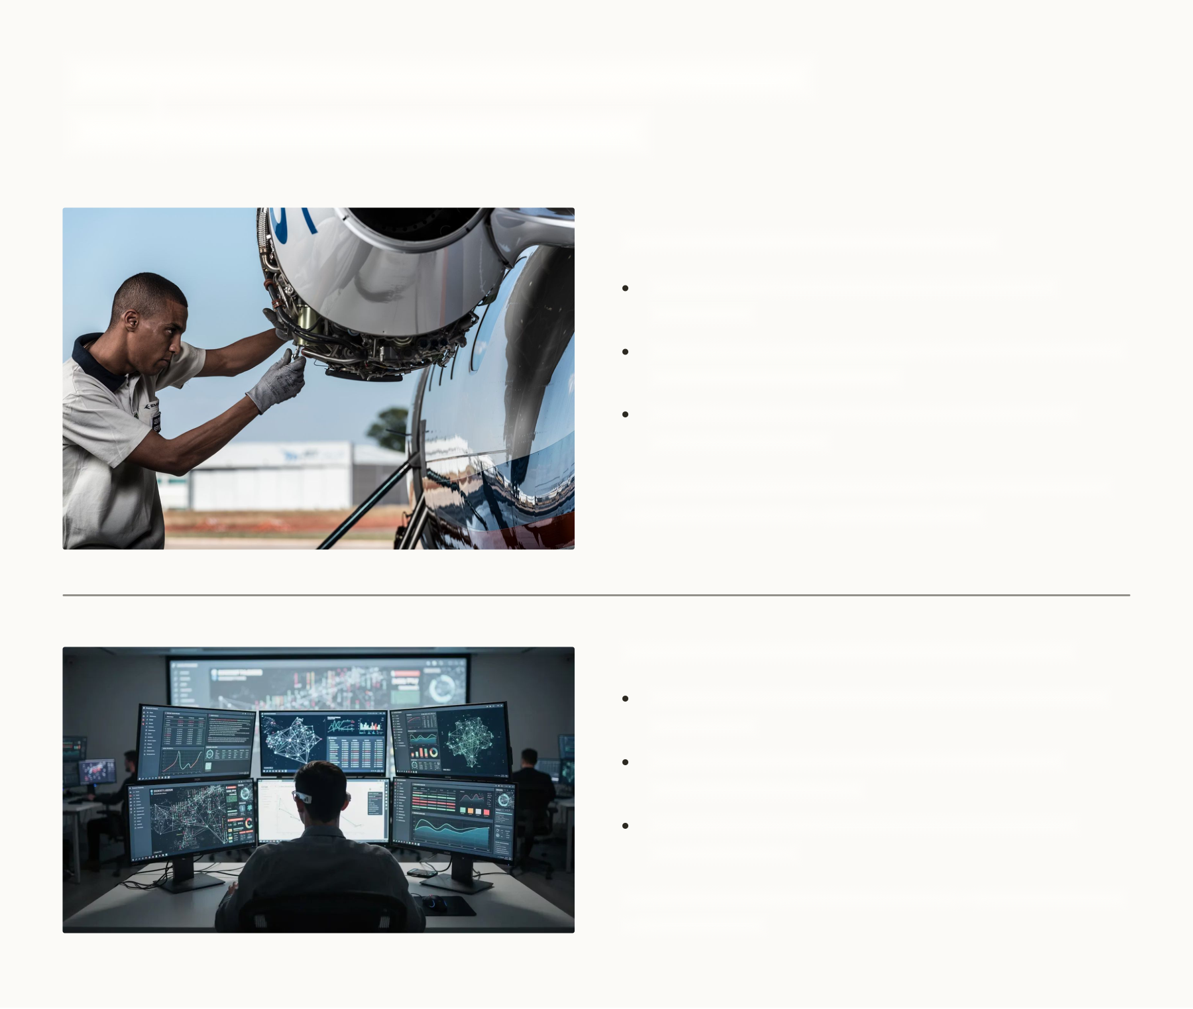
Defence Operations Face Two Critical
Risk
‑
Management Challenges
EQUIPMENT FAILURE — Who & What
Who: maintainers, ops planners, aircrew, mission
commanders
What: latent faults in mission‑critical aircraft/equipment
(sensors, actuators, hydraulics)
Signals: temperature, vibration, pressure, operating
hours, service records
Why it hurts
: unexpected downtime
→
maintenance surge
→
reduced availability
→
mission disruption
SECURITY ALERT OVERLOAD — Who & What
Who: SOC teams, network defenders, platform owners,
mission leads
What: streams from auth logs, network telemetry,
sensors, intelligence feeds
Problem: critical events buried among high-volume
low‑priority alerts
Why it hurts
: missed correlated activity
→
delayed response
→
mission impact

Slide 3
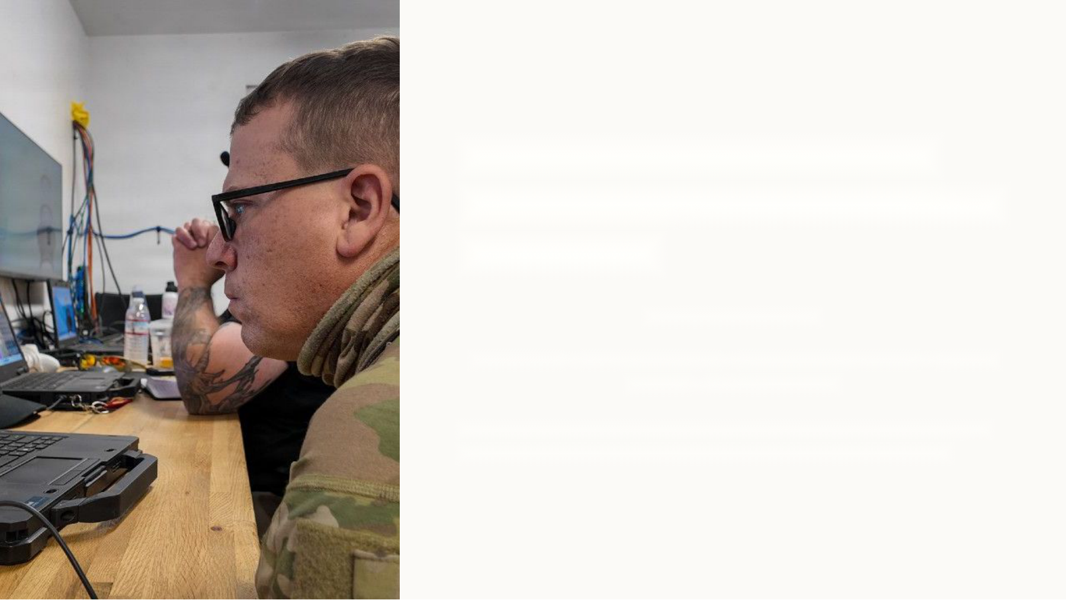
The Problem Is Not Lack of
Data — It Is Lack of Prioritized
Intelligence
Simple before workflow:
Sensor Data
→
Multiple Systems
→
Large Volume of Alerts
→
Manual
Analysis
→
Delayed Decision
Traditional monitoring raises notices. Operators need context: WHAT is
wrong, HOW serious, WHAT will be affected, and WHAT to do first.

Slide 4
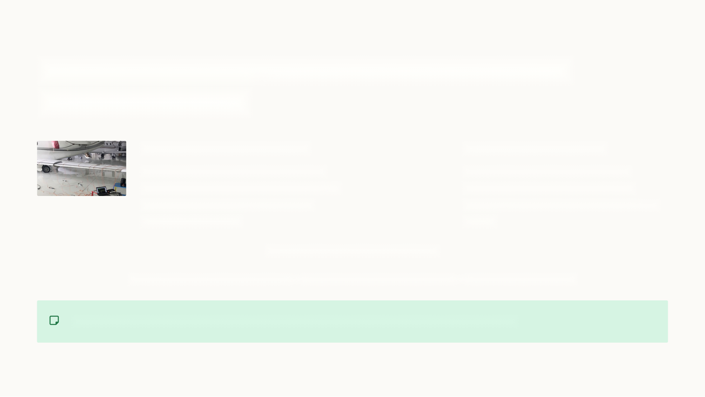
Our Solution: AI Defence Readiness & Threat
Prediction Copilot
EQUIPMENT INTELLIGENCE
THREAT INTELLIGENCE
Detect anomalies, predict component
Correlate alerts, detect suspicious
degradation, estimate failure probability,
behaviour, map to MITRE ATT&CK,
assess mission impact, recommend
prioritize threats, recommend response
maintenance priority
actions
AI DEFENCE READINESS COPILOT
EQUIPMENT RISK + CYBER RISK
→
UNIFIED MISSION RISK VIEW
→
PRIORITIZED ACTION
Converts complex signals into prioritized operational decisions — not additional raw alerts.

Slide 5

From Raw Signals to Actionable Decisions
Data Sources
AI Analysis
Risk Assessment
Prioritization
Inputs: equipment telemetry and security events. Analysis: anomaly detection, correlation, prediction. Outputs: asset health,
threat priority, mission‑focused recommendations.

Slide 6

Beyond Monitoring: A Unified Mission
‑
Risk
Perspective
Comparison
Predictive
Multi
‑
Source
Equipment
Threat
Traditional
: Monitor
→
Alert
→
Human investigates
Intelligence
Correlation
Our
: Detect
→
Predict
→
Correlate
→
Prioritize
→
Recommend
Detect early
Aggregate related
degradation patterns
security events to
Action‑oriented AI: suggestions are framed as operator
vs threshold alerts
reveal coordinated
options with rationale and confidence levels.
activity
Physical + Cyber Fusion
Evaluate combined mission impact across assets
and networks

Slide 7
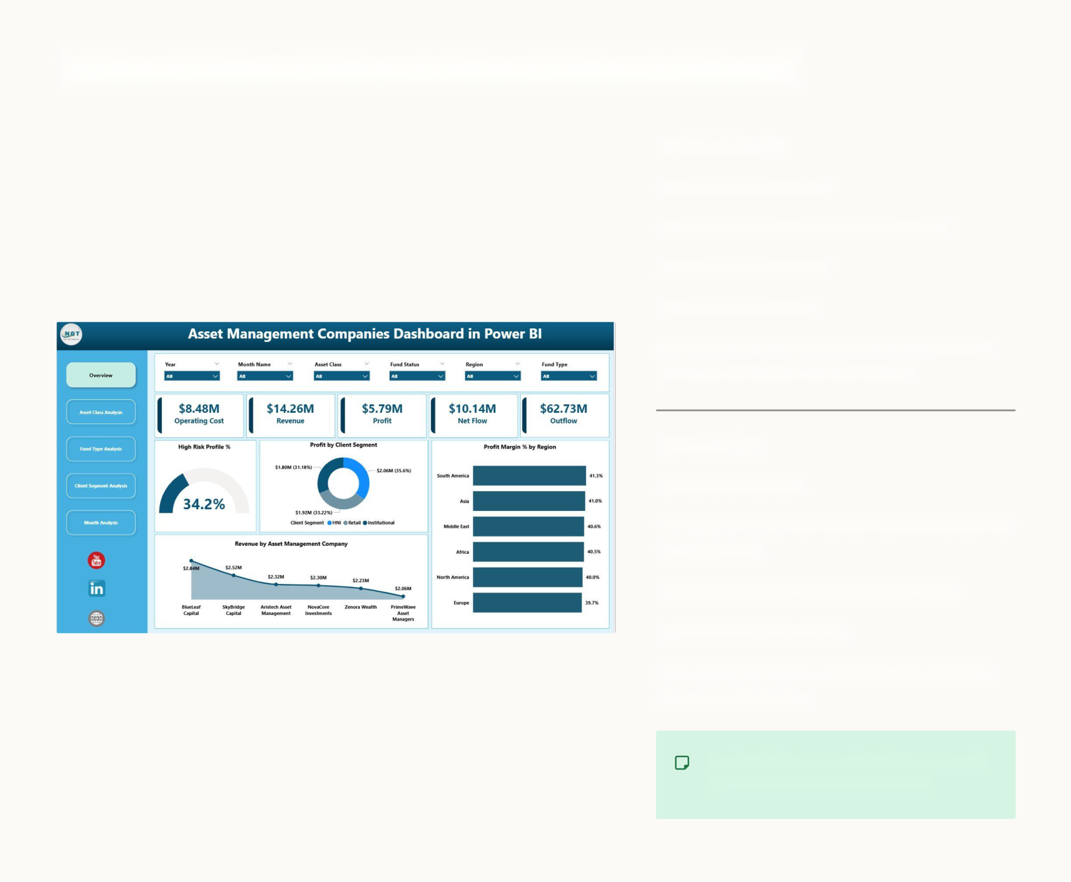
Prototype: Asset Risk Analysis Dashboard
AIRCRAFT A
‑
17
Mechanical Health:
72%
Predicted Component:
Hydraulic Pump
Failure Probability:
84%
Mission Impact:
HIGH
Interpretation: Copilot elevates maintenance
priority for pre‑flight intervention.
RADAR R
‑
04
Cyber Security:
43%
Detected: suspicious authentication + abnormal
network traffic
MITRE ATT&CK:
T1078 — Valid Accounts
Mission Impact:
CRITICAL
Interpretation: Correlated incident escalated
for immediate triage.
Prototype / Demonstration Values —
not field‑validated predictions

Slide 8

Technical Architecture
Data Sources
Normalization
AI Analysis
Risk & Copilot
Design notes: modular pipeline, normalized telemetry, separate model components for equipment and threat analysis, shared
risk/context store for mission fusion and audit logging.

Slide 9
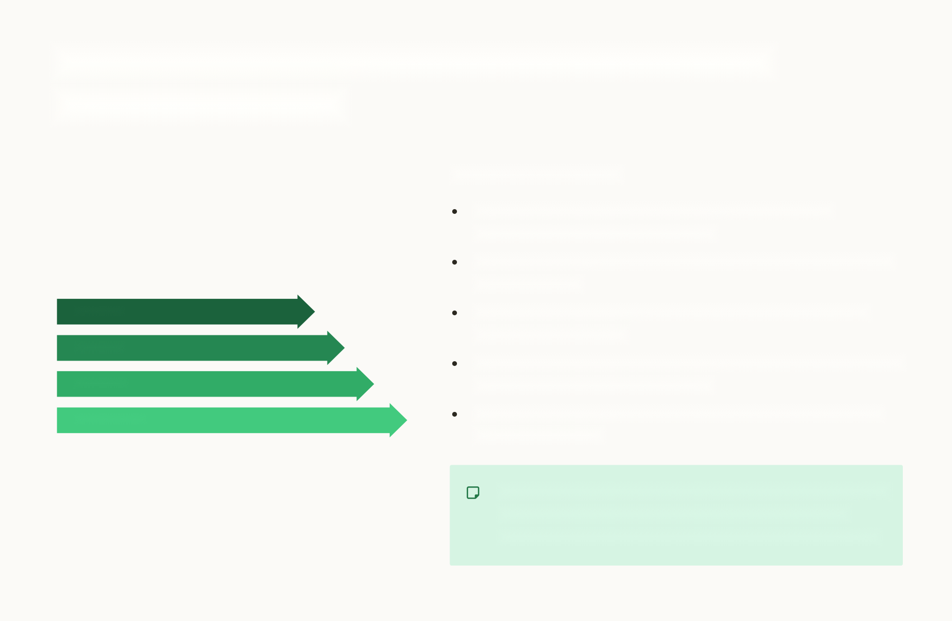
IBM Technology Integration — Where & How
watsonx / BOB Fits
Role of IBM / watsonx
Natural‑language interface: operator queries, incident
summaries, and explainable rationale
Context‑aware analysis: assist model grounding using validated
knowledge bases
Data / Events
Explainability: generate human‑readable risk rationales and
confidence annotations
AI Processing
Retrieval & grounding: surface approved playbooks, maintenance
watsonx Layer
procedures, and intelligence context
Copilot Intelligence
Human‑in‑the‑loop: draft recommended actions for operator
review and approval

Slide 10

From Detection to Decision — Two End
‑
to
‑
End
Examples
AIRCRAFT A
‑
17 — Mechanical Flow
RADAR R
‑
04 — Cyber Flow
1.
Sensor patterns (vibration, temp) show abnormal trend
1.
Suspicious authentication + abnormal traffic captured
2.
Equipment AI flags anomaly
→
estimates elevated failure
2.
Alert correlation links events
→
behaviour analysis
probability
identifies T1078
3.
Risk engine assesses mission impact
→
classifies HIGH
3.
Risk engine assigns CRITICAL mission impact
4.
Copilot generates maintenance recommendation
4.
Copilot recommends escalation and containment steps
5.
Human operator reviews and schedules intervention
5.
Operator reviews and triggers response playbook
Designed for quick judge comprehension: detection
→
context
→
decision in under 20s.

Slide 11
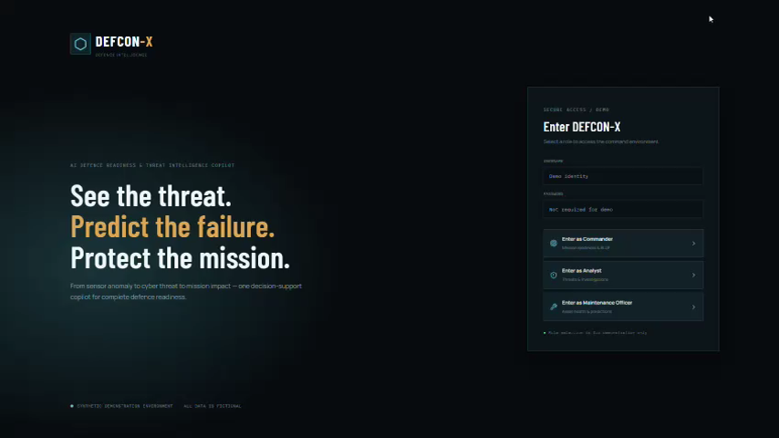
Prototype/Website Demo:

Slide 12
THANK YOU
By:
Niyati Trivedi 25DCS136
Shreya Raja 25DCS106
Hardi Pathak 25DCS102
Dhruti Rana 25DCS108

