Slide 1
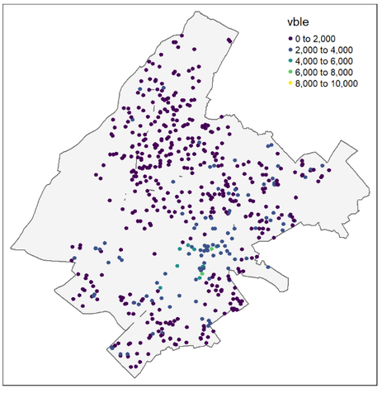
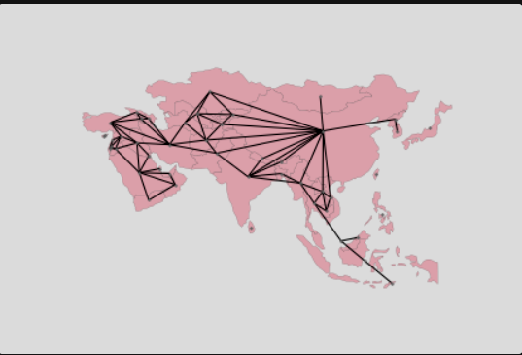
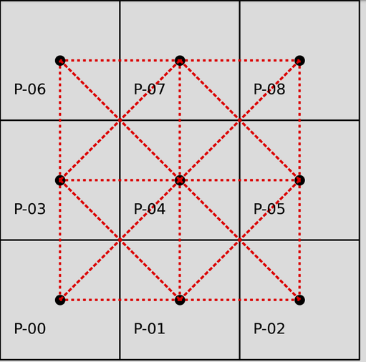
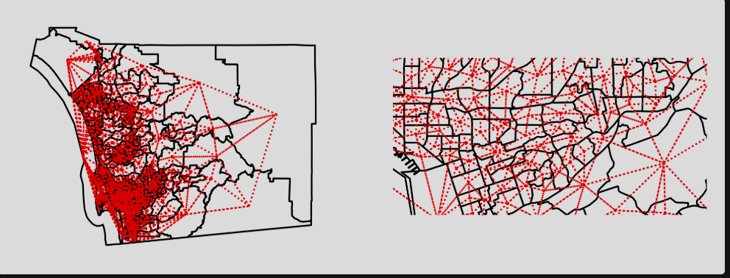
Spatio -Temporal Analysis of Aqi across Indian Cities
Presented by- Niyati Sharma,
M.Sc. Statistics
24MSSTAPY0029
DEPARTMENT OF STATISTICS,
PONDICHERRY UNIVERSITY

Slide 2
Contents
Objective of the study
Other spatial Statistics Used
Data Description
Predictive Modelling using some more ML models
Data Cleaning & Preprocessing
Result and interpretation
Exploratory Data Analysis
Future Prospect, References
Spatial Modelling
Moran’s I Statistics : Hypothesis and Significance, Results

Slide 3
Objective of the Study:
To analyze spatial pattern and temporal trends of air pollution
(PM 2.5, AQI) across Indian cities.
To detect pollution clusters (hotspots)
To measure spatial dependence.
To model how pollution spreads geographically (spatial regression)
To predict pollution in unmonitored areas
To understand whether pollution is random or spatially clustered.

Slide 4

Data Description
Pollution : Indian cities aqi 2015-2023
city | date | pm25| pm10 | no2 | so2 | co| o3| aqi| aqi_category
Coordinates data : Indian cities’ coordinates
latitude, longitude, population
Weather data : Climatography of indian cities
temperature_Celsius | temperature_Fahrenheit | ...air_quality_PM10| air_quality_us-epa-index| air_quality_gb-defra-indexs| unrise| sunset moonrise | moonset | moon_phase

Slide 5
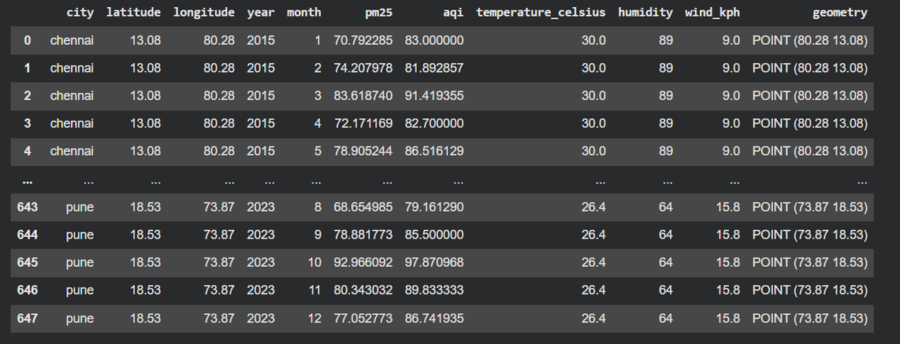
Data Cleaning & Preprocessing
Loaded and cleaned pollution and weather datasets. Standardized city names and converted date formats.
Aggregated pollution data to a monthly city level, enriching it with static weather features (latitude, longitude, temperature, humidity, wind speed) to create gdf (GeoDataFrame).

Slide 6
Exploratory Data Analysis (EDA)
Key Steps:
Generated summary statistics, city-wise statistics (mean, std, min, max for pm25, aqi), skewness, and kurtosis to understand data distribution.
Visualized key aspects: AQI distribution (histogram), city-wise AQI distribution (boxplot), correlation between pm25 and aqi (heatmap), and overall AQI trend over time.

Slide 7
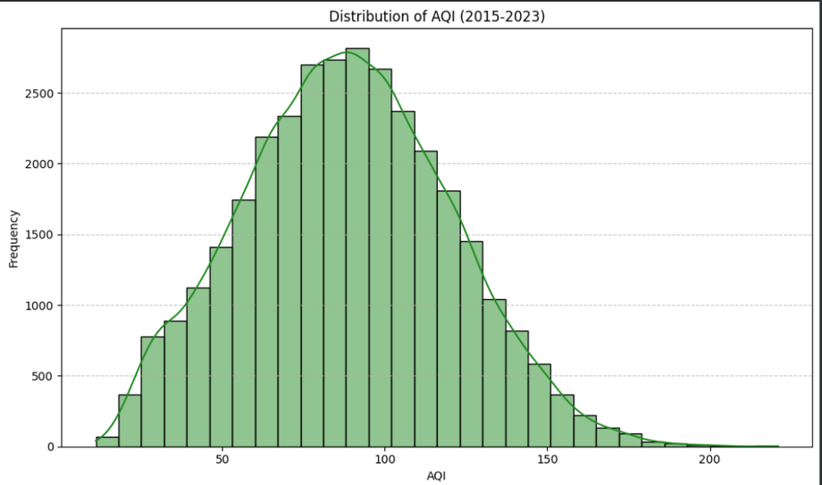
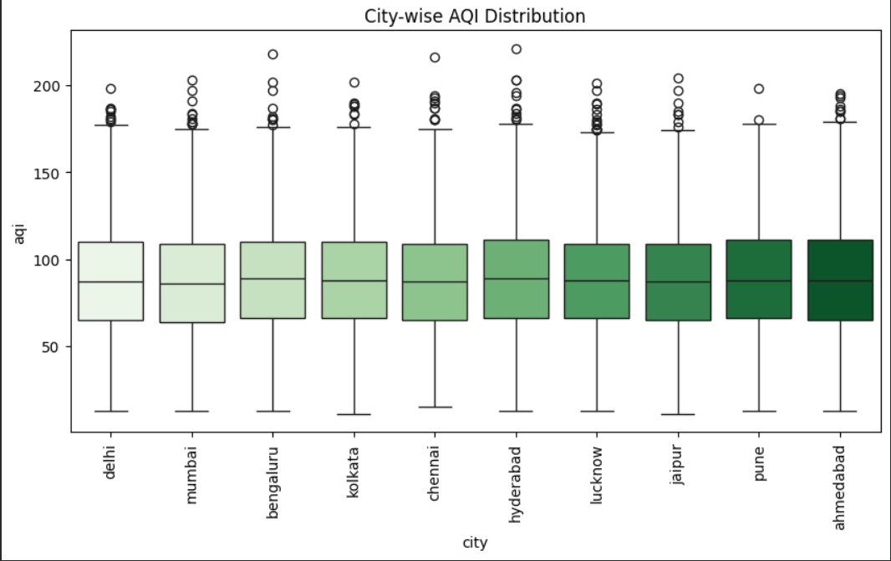
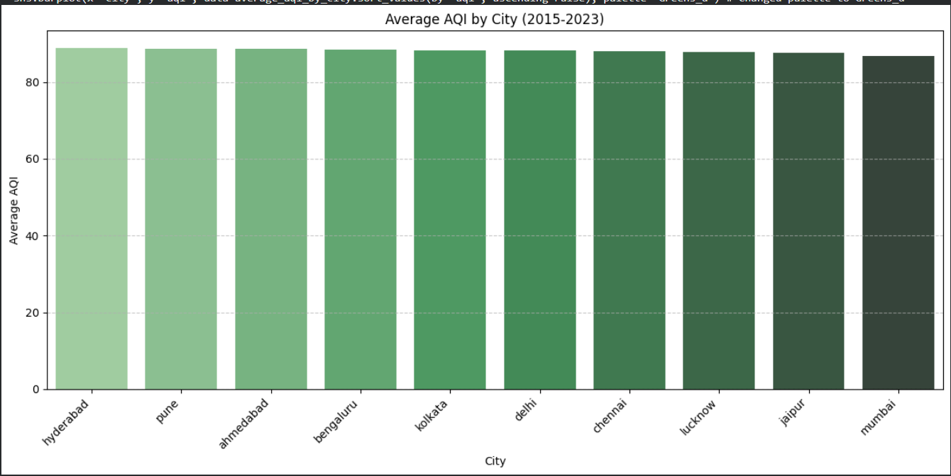
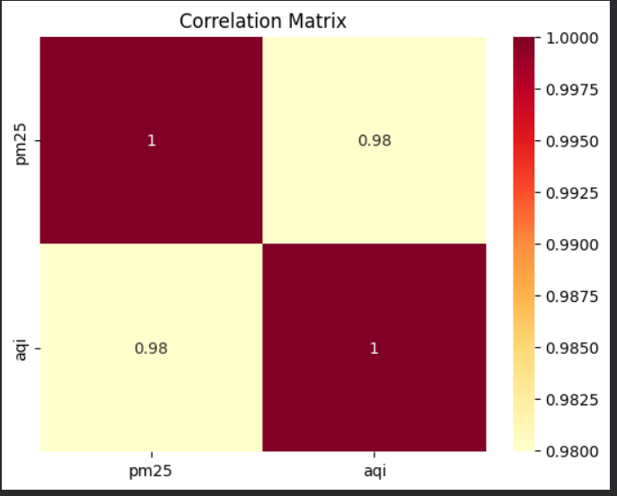
Exploratory Data Analysis (EDA)

Slide 8
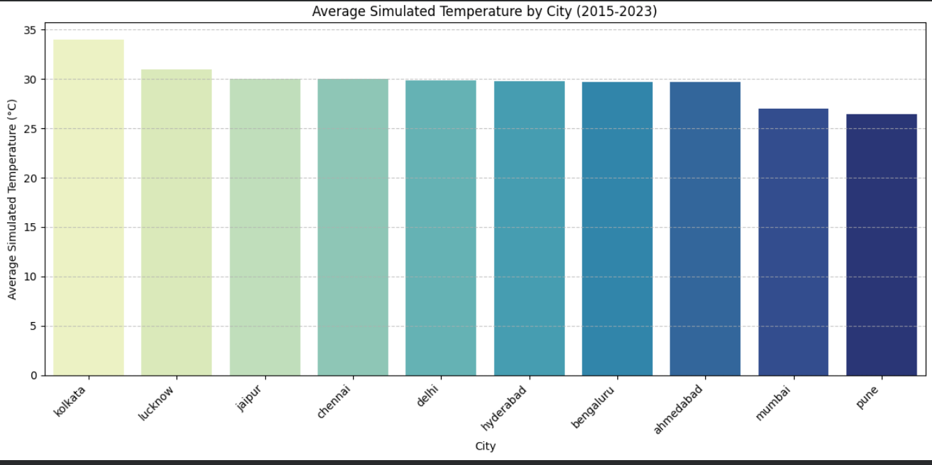
Exploratory Data Analysis (EDA)

Slide 9
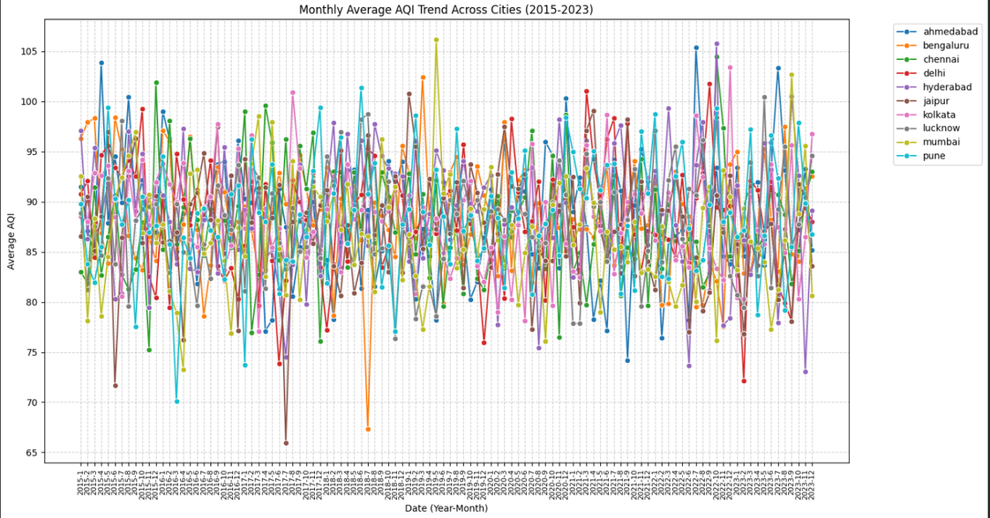
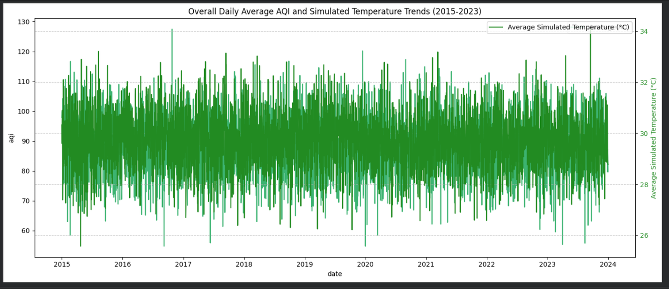
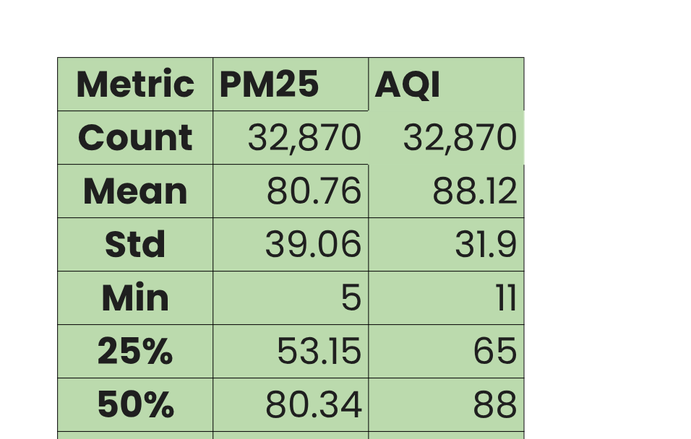
Exploratory Data Analysis (EDA)

Slide 10
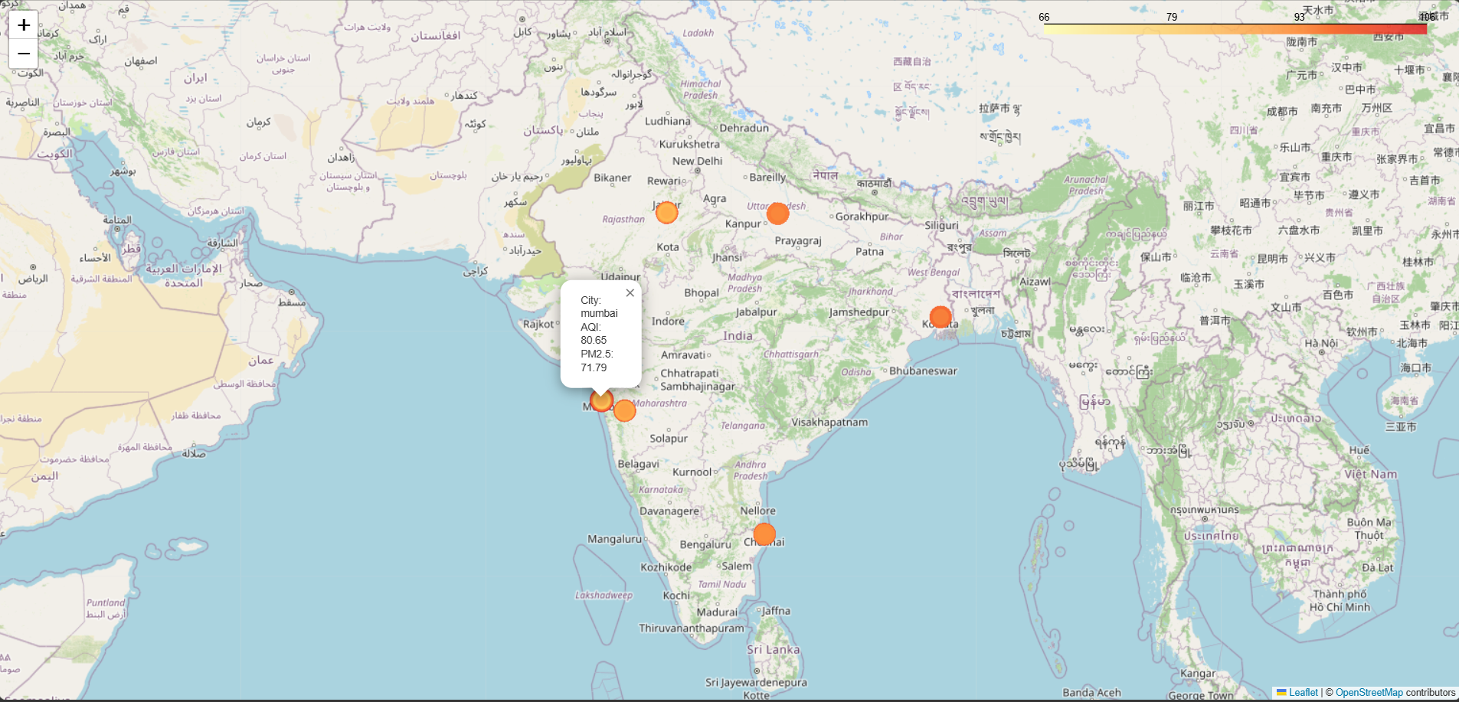
WHat is Spatial Data
Purpose
or geospatial data, is information that identifies the geographic location, shape, and characteristics of natural or constructed features on Earth. It links data to specific locations using coordinates (latitude/longitude), addresses, or postal codes, enabling visualization, analysis, and modeling in GIS (Geographic Information Systems)
Library used : geopandas

Slide 11
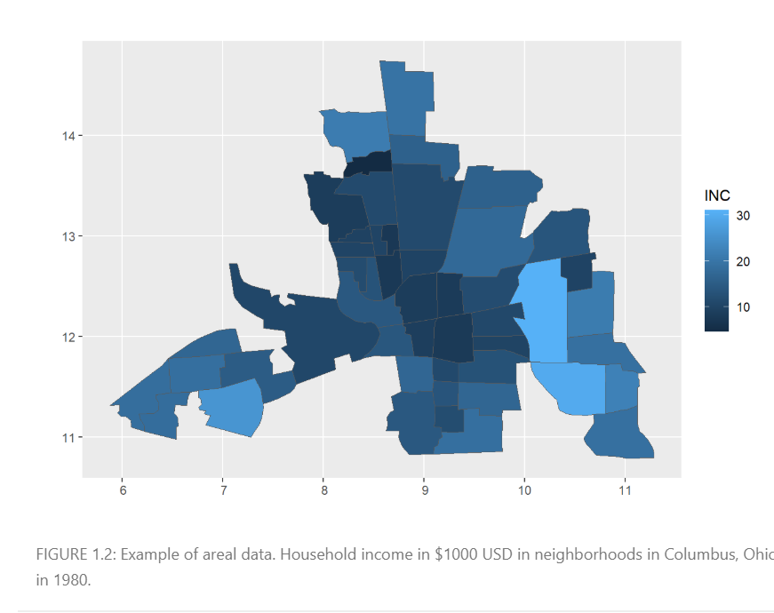
WHat is Spatial Data
Areal data
Areal data usually arise when the number of events corresponding to some variable of interest are aggregated in areas. For example, in spatial epidemiology, locations of individuals with a given disease are often aggregated in administrative areas. These data can be analyzed to understand geographic patterns and identify factors of disease risk, taking into account the neighborhood configuration and other factors known to affect disease risk (Moraga 2018a)

Slide 12
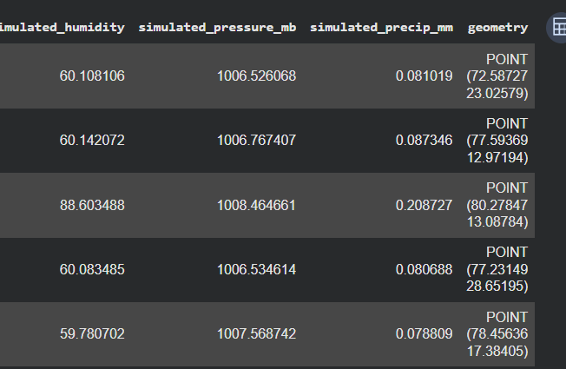
Prepared Cross-Sectional Data for Spatial Analysis
To perform spatial autocorrelation and regression, we often need a single snapshot or an aggregated view of the data.
This will represent the typical spatial patterns across cities.

Slide 13
Spatial Analysis:
Spatial Weights Matrix
Global Spatial Autocorrelation (Moran's I)
“everything is related to everything else, but near things are more related than distant things” (Tobler 1970).
from esda.moran import Moran
spatial weights connect objects in a geographic table to one another using the spatial relationships between them
from libpysal import weights
Hotspot Analysis (Getis-Ord G)
Local Spatial Autocorrelation (LISA)
G is the global version of a family of statistics of spatial autocorrelation based on distance. The class of statistics is conceived for points, hence the use of a distance , but it can also be applied to polygon data if a binary spatial weights matrix can be constructed.
min_threshold_distance method , DistanceBand , gao.G
Are designed to provide an indication of the extent of significant spatial clustering of similar values around each observation.

Slide 14
Spatial Analysis:
Kriging
Allow us to predict values of a spatially continuous variable at locations that are not sampled. These methods include closest observation, inverse distance weighting (IDW), and nearest neighbors.
Spatial Regression (ML_Lag)
Electronics showed the highest growth in Q2.
Top 3 regions contributed over 60% of total revenue

Slide 15
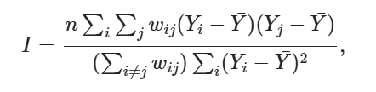
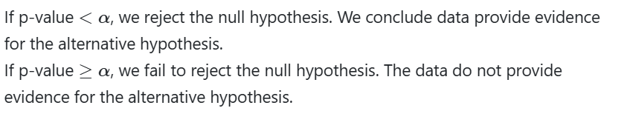

Moran’s I
Yi is the observed value of the variable of interest in region i, and ¯Y is the mean of all values. wij are spatial weights that denote the spatial proximity between regions i and j, with wii=0 and i,j=1,…,n
$$H_{1} : I !≠ E[I] (spatial autocorrelation)H_{0}: I = E[I] (no spatial autocorrelation)$$
Libraries and methods:
from splot.esda import plot_moran
import contextily
Results : Global Moran's I for AQI: -0.1713
P-value (two-sided): 0.4110
There is no statistically significant global spatial autocorrelation of AQI

Slide 16
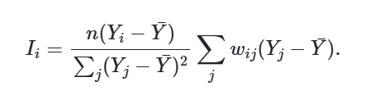
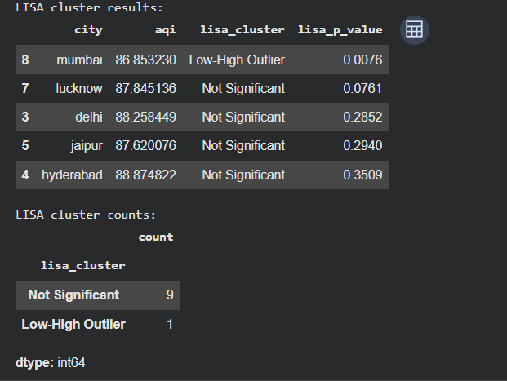
Local Spatial Autocorrelation (LISA)
The values of the LISAs are mapped to indicate the location of areas with comparatively high or low local association with neighboring areas
A high value for Ii suggests that the area is surrounded by areas with similar values. Such an area is part of a cluster of high observations, low observations, or moderate observations.
A low value for Ii indicates that the area is surrounded by areas with dissimilar values. Such an area is an outlier indicating that the observation of area i is different from most or all of the observations of its neighbors.
Local Indicators of Spatial Association (LISA) allow us to identify specific locations (cities) where significant spatial clustering occurs. These can be High-High (hot spots), Low-Low (cold spots), or spatial outliers (High-Low, Low-High). LISA helps pinpoint where the spatial patterns observed by Moran's I are concentrated.
Libraries : esda.moran: For global and local spatial autocorrelation analysis (Moran's I).

Slide 17
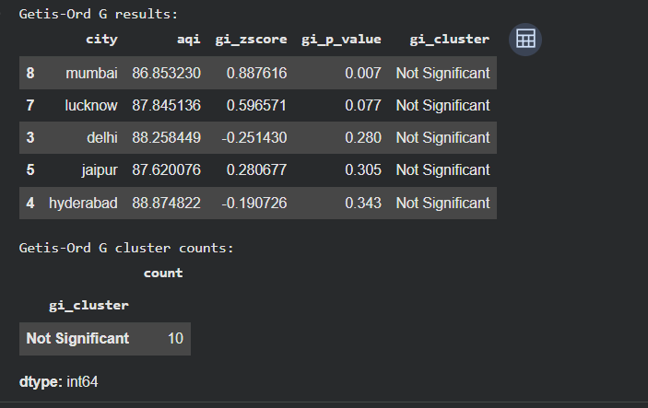
Hotspot Analysis (Getis-Ord G)
G is the global version of a family of statistics of spatial autocorrelation based on distance. The class of statistics is conceived for points, hence the use of a distance , but it can also be applied to polygon data if a binary spatial weights matrix can be constructed.
Getis-Ord G (or Gi*) identifies statistically significant hot spots and cold spots. A high positive Z-score and small p-value for a feature indicates a spatial clustering of high values (a hot spot). A low negative Z-score and small p-value indicates a spatial clustering of low values (a cold spot). I'll calculate this for AQI.
Lib : esda.getisord: For hotspot analysis (Getis-Ord G*).

Slide 18
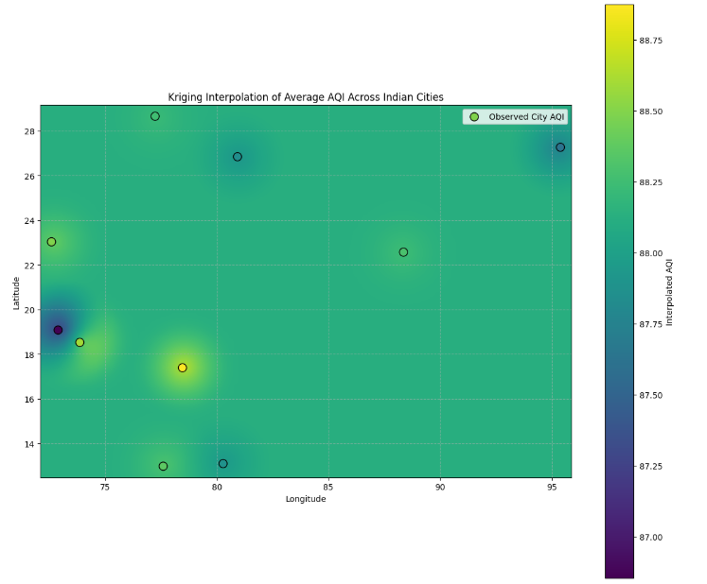
Kriging Results
Spatial interpolation method used to obtain predictions at unsampled locations based on observed geostatistical data.
Simple interpolation methods that allow us to predict values of a spatially continuous variable at locations that are not sampled.
Library:
pykrige: For Kriging interpolation.

Slide 19
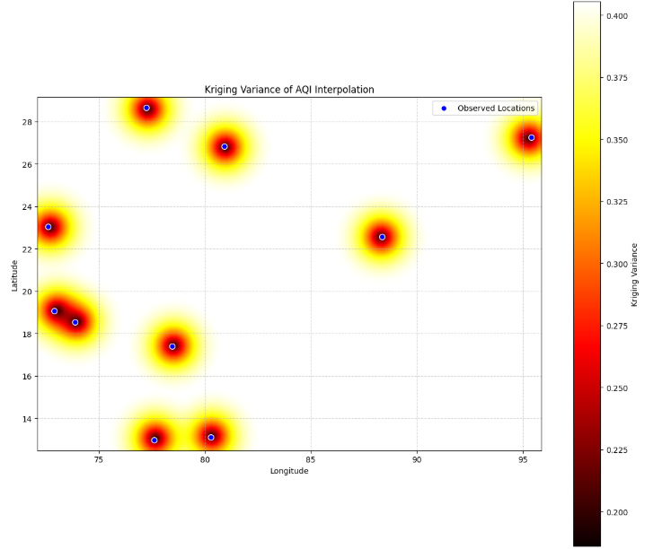
The variogram cloud shows half of all possible squared differences of data observation pairs against their separation distance h:

Slide 20
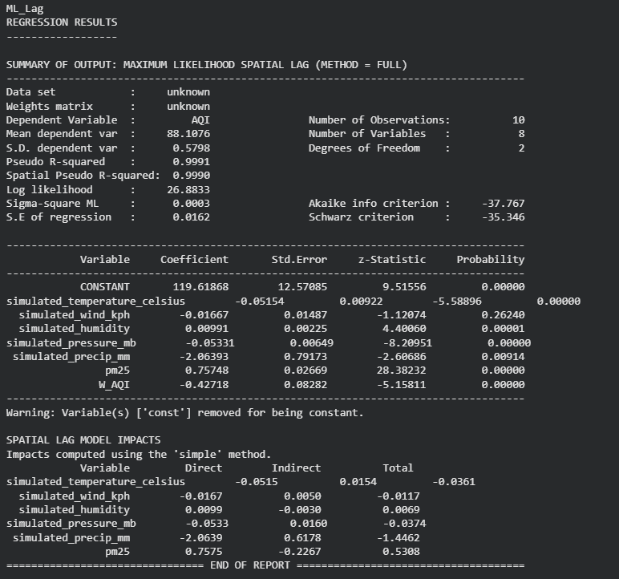
ML LAg
Spatial regression models explicitly account for spatial dependence. Here,we used a Spatial Lag Model (ML_Lag) where the dependent variable (AQI) in a given city is influenced by the dependent variable in neighboring cities. This model helps determine if there's a significant spatial spillover effect for AQI, considering other influencing factors.
spreg: For spatial regression models (e.g., Spatial Lag, Spatial Error).

Slide 21
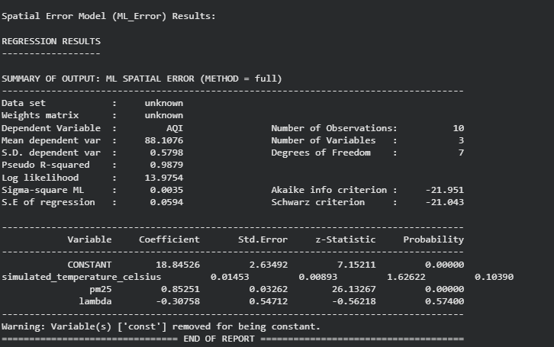
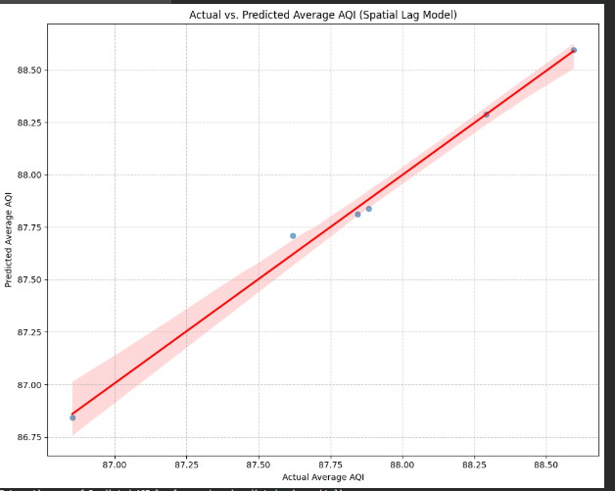
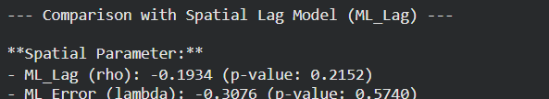
ML Error

Slide 22
Spatial Visualisations
Aqi and weather
LISA
Hotspot Clusters

Slide 23
OpenStreetMap

Slide 24
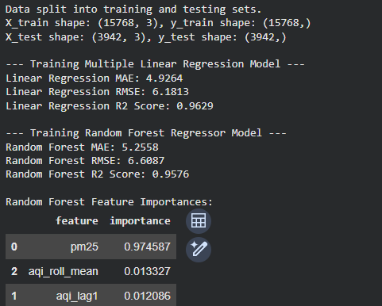
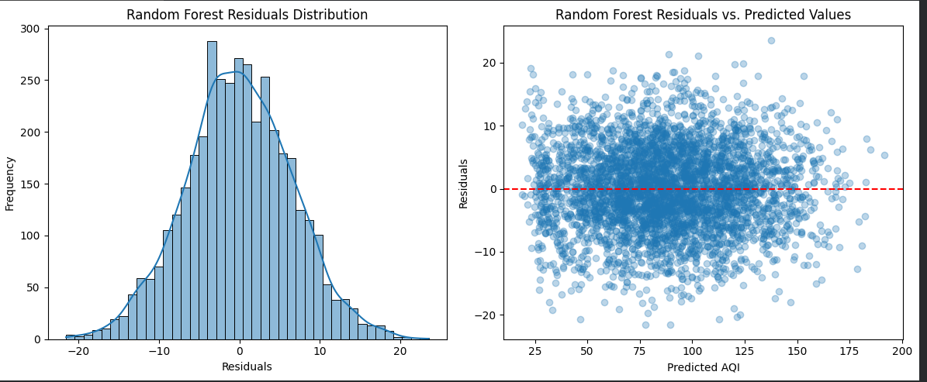
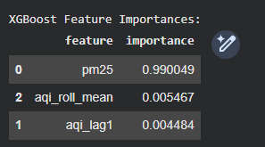
Predictive Modelling using some more ML models
--- Training XGBoost Regressor Model ---
XGBoost MAE: 5.1728
XGBoost RMSE: 6.4891
XGBoost R2 Score: 0.9591

Slide 25
Summary & Key Takeaways
Aggregated data to city-level averages to create a GeoDataFrame (city_gdf) for spatial analysis.
Constructed a K-Nearest Neighbors (KNN) spatial weights matrix (w).
Global Moran's I: Indicated statistically significant negative spatial autocorrelation (dispersion) of AQI.
LISA (Local Moran's I): Identified specific clusters (High-High, Low-Low, outliers) of AQI, visualized on an interactive map.
Hotspot Analysis (Getis-Ord G): Identified statistically significant hot spots and cold spots for AQI, visualized on an interactive map.
Kriging Interpolation: Performed Kriging to generate a continuous interpolated surface of average AQI, along with its variance, highlighting spatial distribution and potential areas of interest.
Spatial Regression (ML_Lag & ML_Error): Compared Spatial Lag and Spatial Error models using simulated_temperature_celsius and pm25 as predictors for AQI. Both spatial parameters (rho and lambda) were found to be not statistically significant for this dataset, with ML_Error showing slightly better fit metrics (AIC/BIC).

Slide 26
Future Goals
Applying LSTM
Time series analysis
Exploring more geospatial techniques

Slide 27
SOURCES
Central Pollution Control Board
OpenStreetMap
Kaggle.com
REFERENCES
The Analysis of Spatial Association by Use of Distance Statistics, Arthur Getis J. K. Ord
Moran (1950),
Regression analysis of spatial data , Colin M. Beale, Jack J. Lennon,1 Jon M. Yearsley,2,3 Mark J. Brewer4 and David A. Elston.
Spatial Statistics for Data Science: Theory and Practice with R has been published by Chapman & Hall/CRC Data Science Series
Spatial Data Science With Applications in R, Edzer Pebesma, Roger Bivand
Geographic Data Science with Python, Sergio J. Rey, Dani Arribas-Bel, Levi J. Wolf

Slide 28
Thank You
THANK YOU FOR YOUR ATTENTION
@reallygreatsite
hello@reallygreatsite.com
www.reallygreatsite.com

