Slide 1
IBM University Engagement Project Submission
“Exploring the Power of Agentic AI with IBM Granite and IBM Bob”

Slide 2

Project Tile – [The Daily Air Quality Action Agent]
Domain of Project – [Artificial Intelligence / Machine Learning]
Student Name | Recent Passport Photo | Email ID | Mobile number [WhatsApp]
Niyati Dewangan |  | niyatidewangan294@gmail.com | 7879172042
Recommended font style and size:
Font Style: Arial
Font Size (Heading): 28
Font Size (Content): 20

Slide 3
Problem Statement -
Problem Statement : The Daily Air Quality Action Agent
The Challenge:
Air pollution is a major public health crisis, contributing to respiratory issues, climate change, and reduced quality of life. Citizens often receive air quality index (AQI) data, but it is presented in technical formats, making it difficult to understand or translate into daily lifestyle actions. Traditional monitoring systems lack personalized recommendations and proactive alerts.
The Objective:
Build an AI-powered Daily Air Quality Action Agent that translates air quality data into actionable insights for citizens, policymakers, and organizations. The solution should:
AQI Data Retrieval (RAG) – Collect and interpret real-time AQI from public APIs, satellite data, or government sources.
Personalized Health Recommendations – Provide daily actionable advice (e.g., avoid outdoor exercise, use masks, keep children indoors) tailored to age, location, and health conditions.
Predictive Alerts – Forecast poor air quality days, issue early warnings, and suggest preventive measures like adjusting commute or using air purifiers.
Policy & Awareness Insights – Suggest community-level actions (e.g., carpooling, waste reduction) and summarize policy advisories for public awareness.
Multi-Agent System -
    AQI Data Agent (fetches & interprets data)
    Health Advisory Agent (personalized lifestyle suggestions)
    Forecasting Agent (predicts trends & risks)
    Community Action Agent (drives awareness campaigns)
Visualization Dashboard – Show daily AQI levels, risk alerts, and recommended actions in a clear and interactive format.

Slide 4
Proposed Solution -
AirGuard AI is an AI-powered Daily Air Quality Action Agent that converts complex real-time AQI data into simple, personalized and actionable recommendations.
Real-Time AQI Monitoring: Collects AQI, PM2.5, PM10 and pollutant data from reliable public APIs.
Multi-Agent AI System: Uses specialized agents for AQI analysis, health advisory, forecasting and community awareness.
Personalized Health Advice: Provides recommendations based on the user's age, location, activities and optional health conditions.
Predictive Alerts: Analyzes AQI trends to identify potential poor-air-quality periods and provide early warnings.
RAG-Based Information: Uses reliable health guidelines and government advisories to provide trustworthy information.
Community Actions: Suggests practical actions such as using public transport, carpooling and avoiding waste burning.
Interactive Dashboard: Displays AQI levels, pollution trends, risk alerts and recommended daily actions in an easy-to-understand format.
IBM AI Technology: Integrates IBM Langflow / IBM Orchestrate and IBM AI Models to coordinate the intelligent agents.
AI-Powered Chat Assistant: Allows users to ask questions about current air quality and receive context-aware answers.
AQI Risk Classification: Categorizes air quality into different risk levels and clearly communicates the associated health concerns.
Location-Based Insights: Provides air-quality information and recommendations according to the user's selected city or location.
Historical AQI Analysis: Displays previous AQI trends to help users understand pollution patterns over time.
Early Prevention: Warns users about deteriorating air quality so they can plan outdoor activities and travel accordingly.
Simple Citizen-Friendly Language: Converts technical pollution data into easy-to-understand daily actions.
Scalable Architecture: Can be extended with additional cities, pollution sources, sensors, APIs and AI models in the future.
Awareness & Education: Helps citizens understand pollution causes, health risks and ways to reduce their exposure.
Reliable & Secure Design: Protects user information and keeps API credentials secure using environment variables.
Emergency/High-Risk Alerts: Provides prominent warnings when AQI reaches dangerous levels and recommends immediate precautions.

Slide 5
Technology Used
IBM Bob platform -For designing and orchestrating multi-agent workflows visually
RAG– RAG to fetch real data first, then generate intelligent answers.

Slide 6
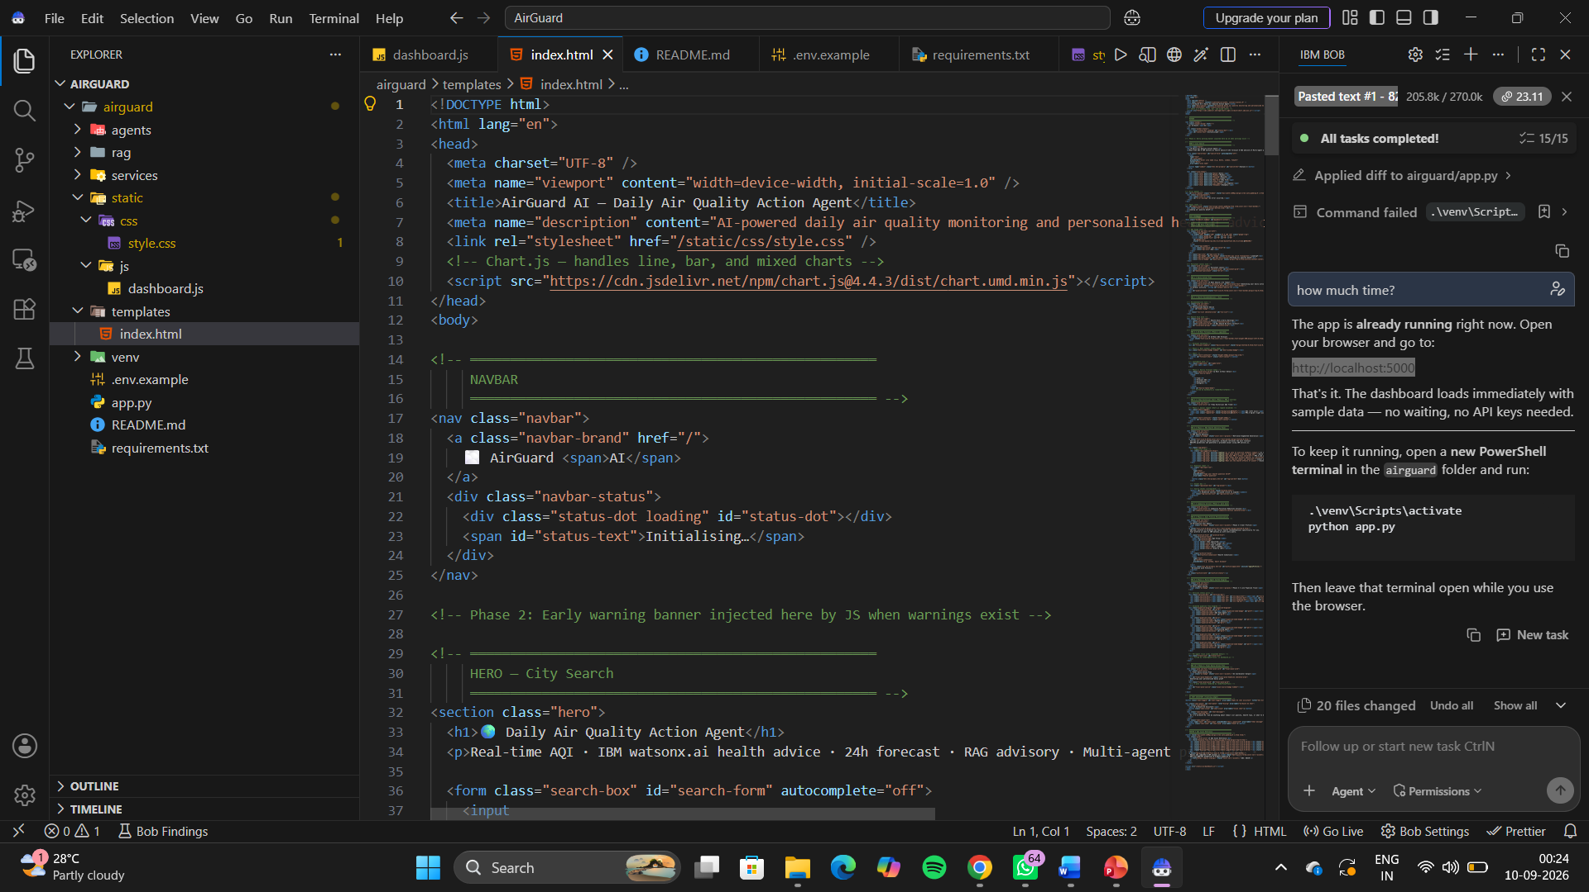
Required Files created using IBM bob -
App.py
Requirements.txt
Style.css
.env
Index.html

Slide 7
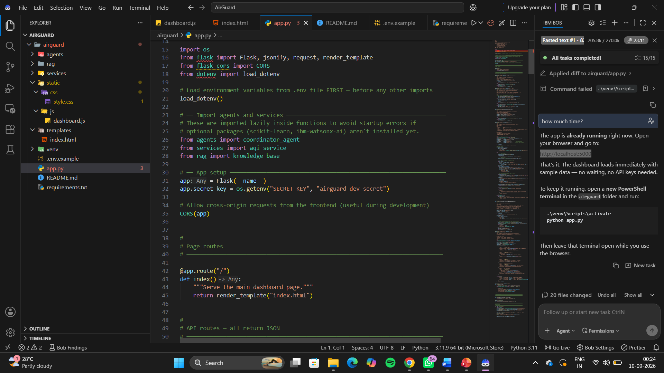

Slide 8

Role of Agentic AI in the solution
Role of Agentic AI in the Solution
Agentic AI acts as the intelligent decision-making layer of AirGuard AI. It enables multiple specialized AI agents to work together autonomously. The AQI Data Agent collects and interprets real-time pollution data, while the Health Advisory Agent converts it into personalized safety recommendations. The Forecasting Agent analyzes trends and identifies possible future pollution risks. The Community Action Agent suggests practical steps to reduce pollution and increase awareness. An AI Coordinator Agent connects these agents, combines their outputs, and generates a clear daily action plan for the user. Using IBM Langflow/Orchestrate and IBM AI Models, the system can retrieve information, reason over the data, make decisions, and provide proactive alerts rather than simply displaying raw AQI values.

Slide 9
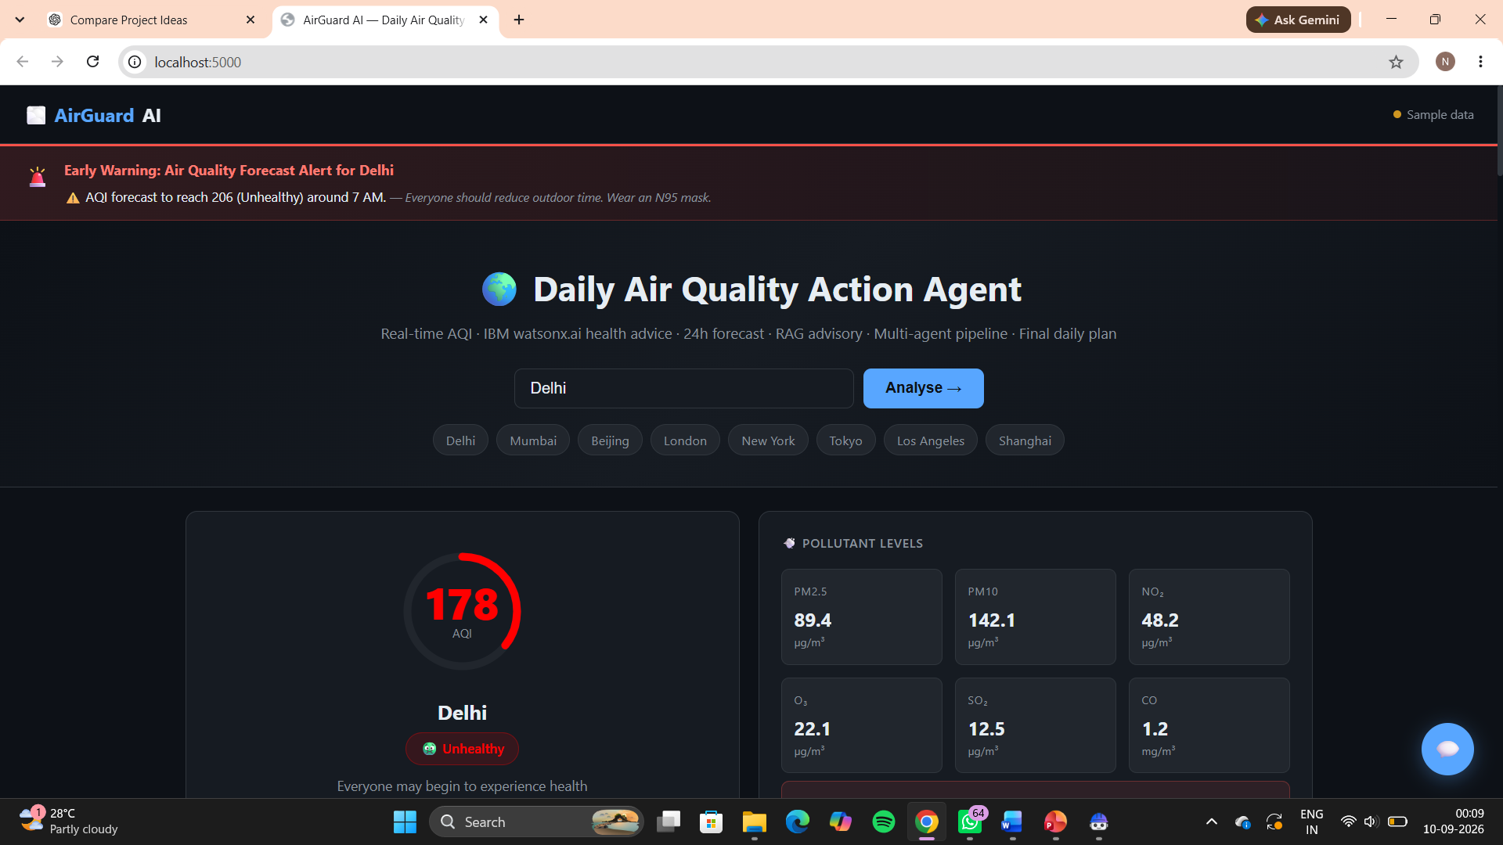
Project Output Screenshot
Please put IBM Bob output screenshots with 2-3 prompts.
You can take 2-3 more slides for each screenshot
·
·
·

Slide 10
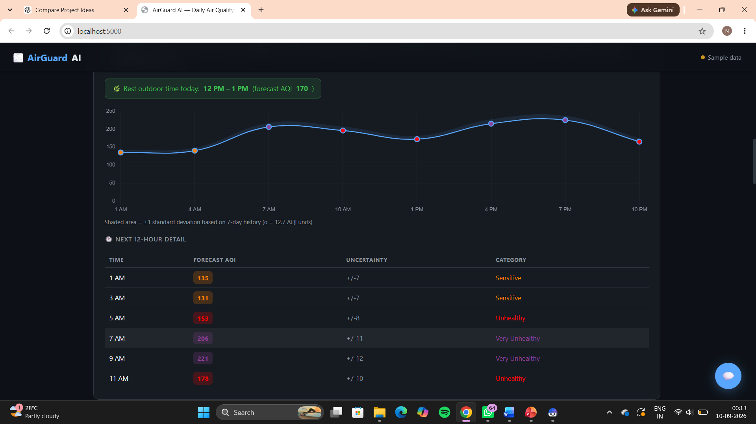
Project Output Screenshot
Please put IBM Bob output screenshots with 2-3 prompts.
You can take 2-3 more slides for each screenshot
·
·
·

Slide 11
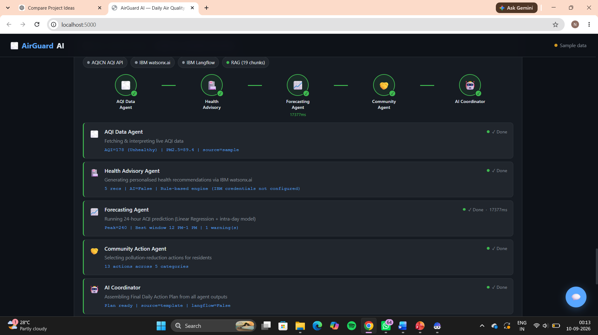
Project Output Screenshot
Please put IBM Bob output screenshots with 2-3 prompts.
You can take 2-3 more slides for each screenshot
·
·
·

Slide 12
Git Hub Link
https://github.com/niyatidewangan294-tech/AirGuard-AI
·
·
·

Slide 13
Future Scope
Advanced AQI Prediction: Use advanced machine learning and deep learning models to predict AQI more accurately for upcoming days.
IoT & Sensor Integration: Connect with IoT-based air-quality sensors to collect real-time local pollution data.
Satellite Data Integration: Incorporate satellite imagery and environmental data for wider-area pollution monitoring.
Smart City Integration: Integrate AirGuard AI with smart-city systems to support pollution monitoring and urban planning.
Wearable Device Support: Connect with smartwatches and wearable devices to provide personalized exposure and health-related alerts.
Voice-Based AI Assistant: Add voice interaction so users can ask questions about air quality hands-free.
Automated Emergency Alerts: Send notifications through mobile apps, SMS or email when dangerous AQI levels are detected.
Community & Government Insights: Provide aggregated pollution trends and insights that can support awareness campaigns and policy planning.
Expansion to Multiple Environmental Risks: Extend the platform to monitor related factors such as heat waves, pollen, wildfire smoke and other environmental hazards.
·
·
·

Slide 14
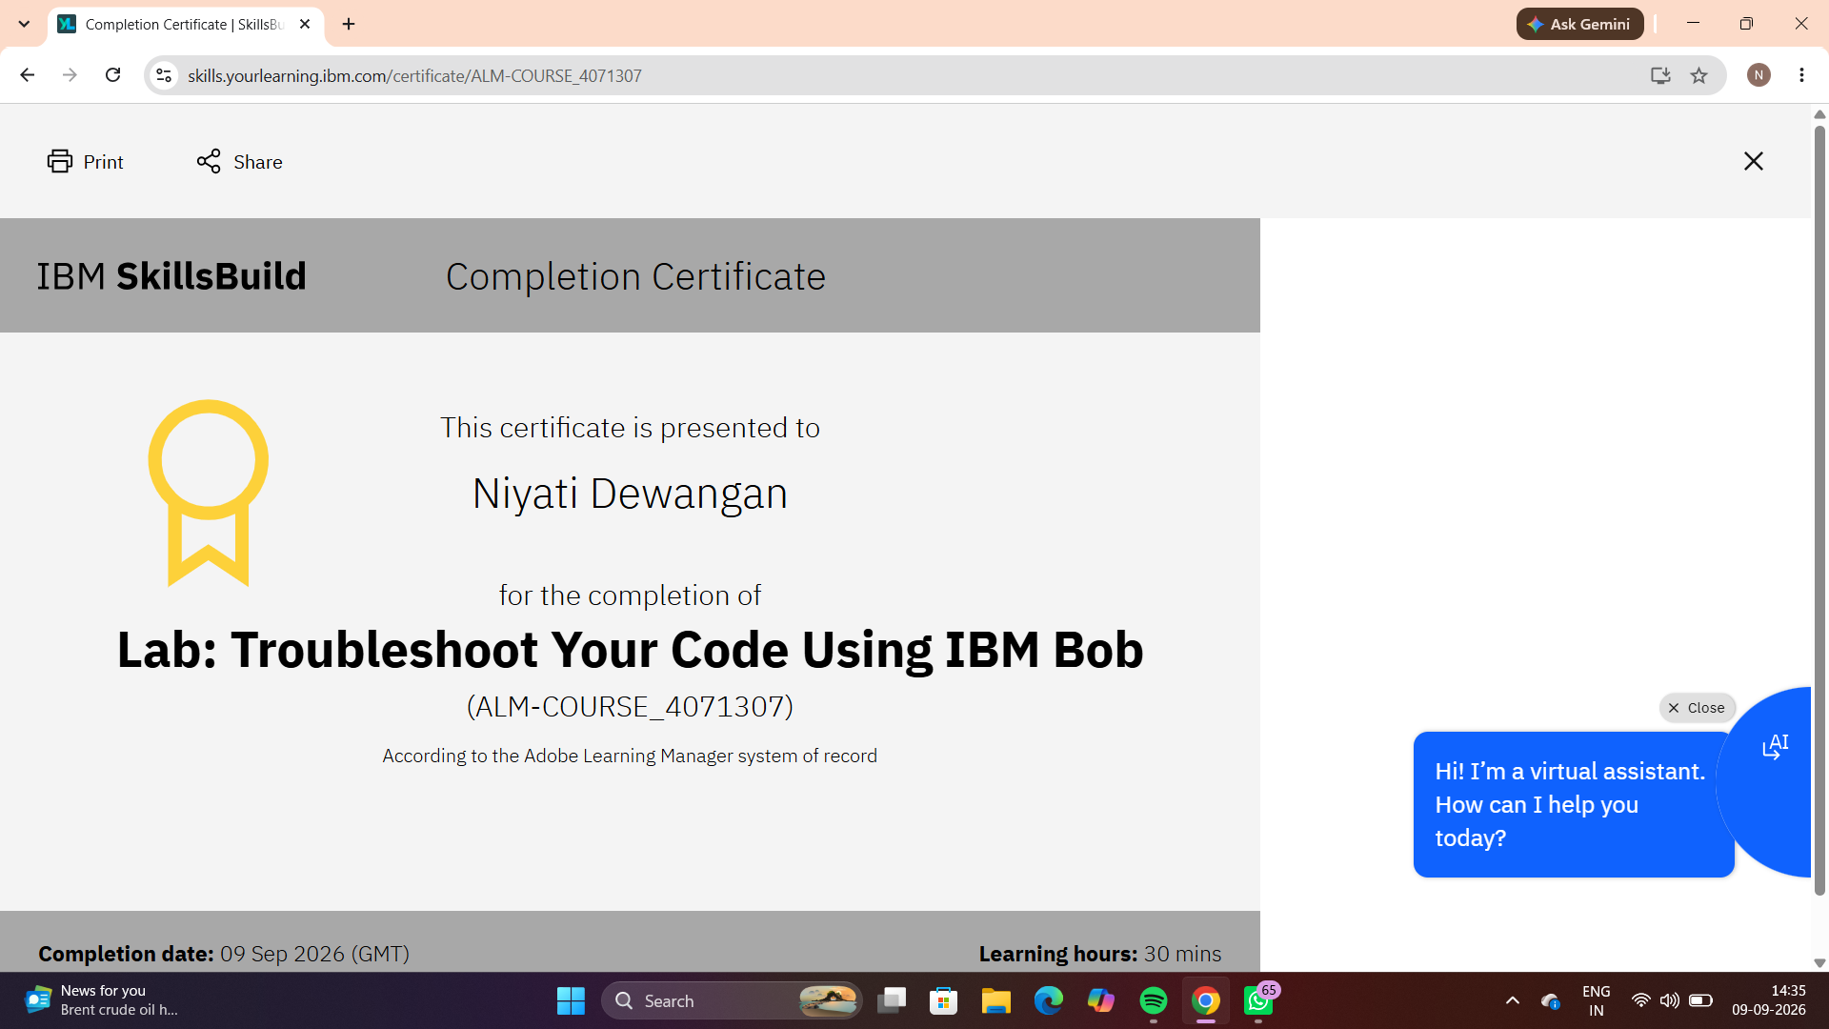
Certificates Earned:​
Add your IBM BOB Certificate

Slide 15
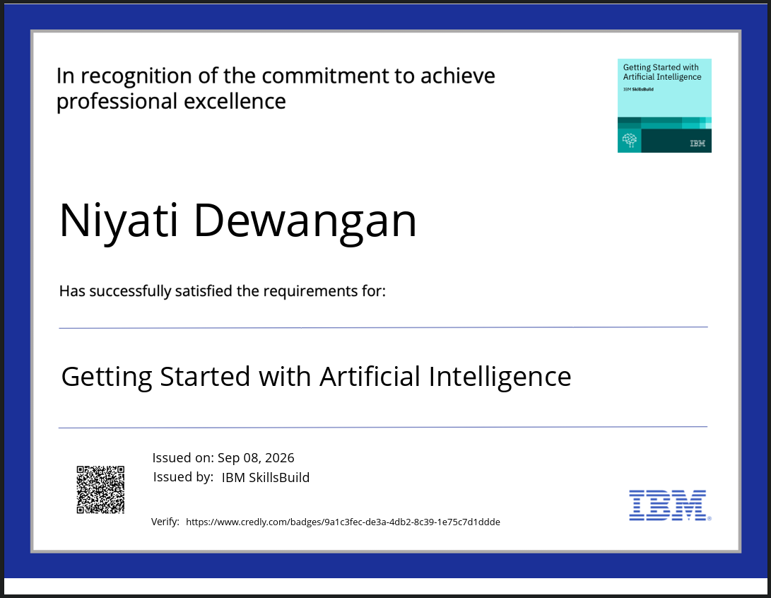
Certificates Earned:
Please add your credly certificate

Slide 16


