Slide 1

StockWise
ECE 568 Software Engineering for Web Applications
By Niyati Jain (nsj39)

Slide 2

Objective
The objective of the Django Web Application platform is to allow users to identify buy/sell trading signals based on their buy value and historical price predictions.
The objective of developing such a model is to assist traders in making informed decisions, potentially improving trading performance and profitability.

Slide 3
Web Application Services
Users would be able to input values such as their stock purchase value, date on which they bought and the date on which they plan to buy/sell.
The platform will then produce a visualization showing the predicted stock value prices till that date on which the user plans to trade.
3. It will then be able to give a buy/sell recommendation for the same.

Slide 4
About the Dataset
Yahoo Finance API: historical and real time data for a variety of financial markets, products and companies.
Targets technological sector stocks namely Apple, Google, Amazon, Microsoft and Meta: due to its prominence, widespread market interest, and historical significance within the technology and finance sectors.
Features: Open, High, Low, Close, Adjusted Close prices and Volume.
Period: 5 years

Slide 5

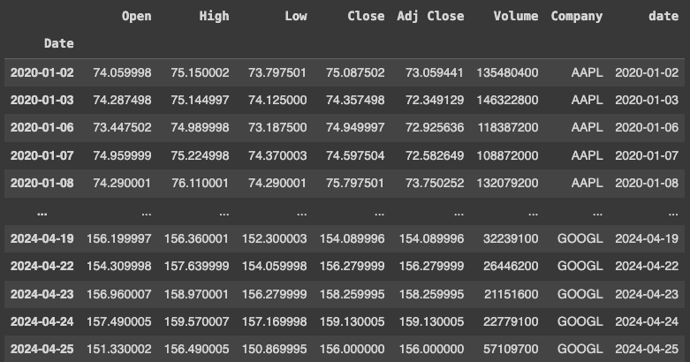
Data Pre-processing
The dataframe I created after importing the yfinance API data initially looked like this:
I checked for null values, removed the index column, checked for skewness and normalized the data as some data cleaning steps.

Slide 6
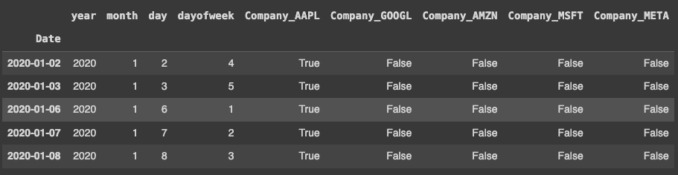
Feature Engineering
Using the ‘Date’ column, I created new columns called year, month, date and dayofweek using the Datetime object available in Python. These attributes would be crucial in my analysis as well as training the model since each of them individually could impact my final value to a huge extent.
To deal with the categorical values in the column ‘Company’, I used get_dummies and created new features representing each of the company.

Slide 7
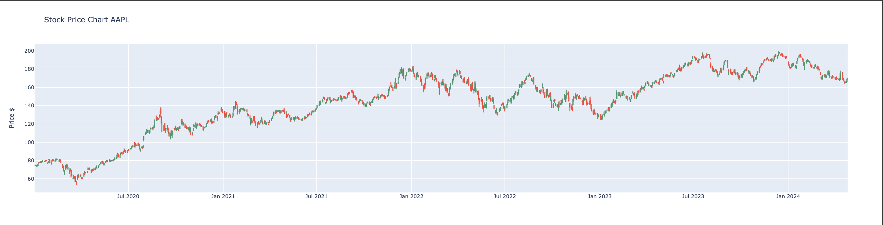
Data Analysis

Slide 8
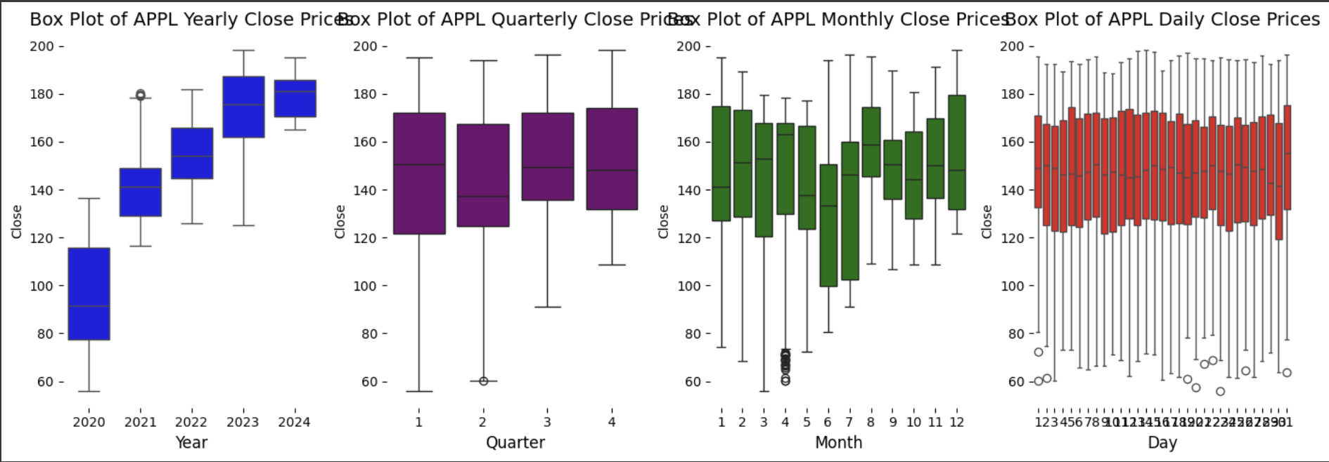
Data Analysis

Slide 9
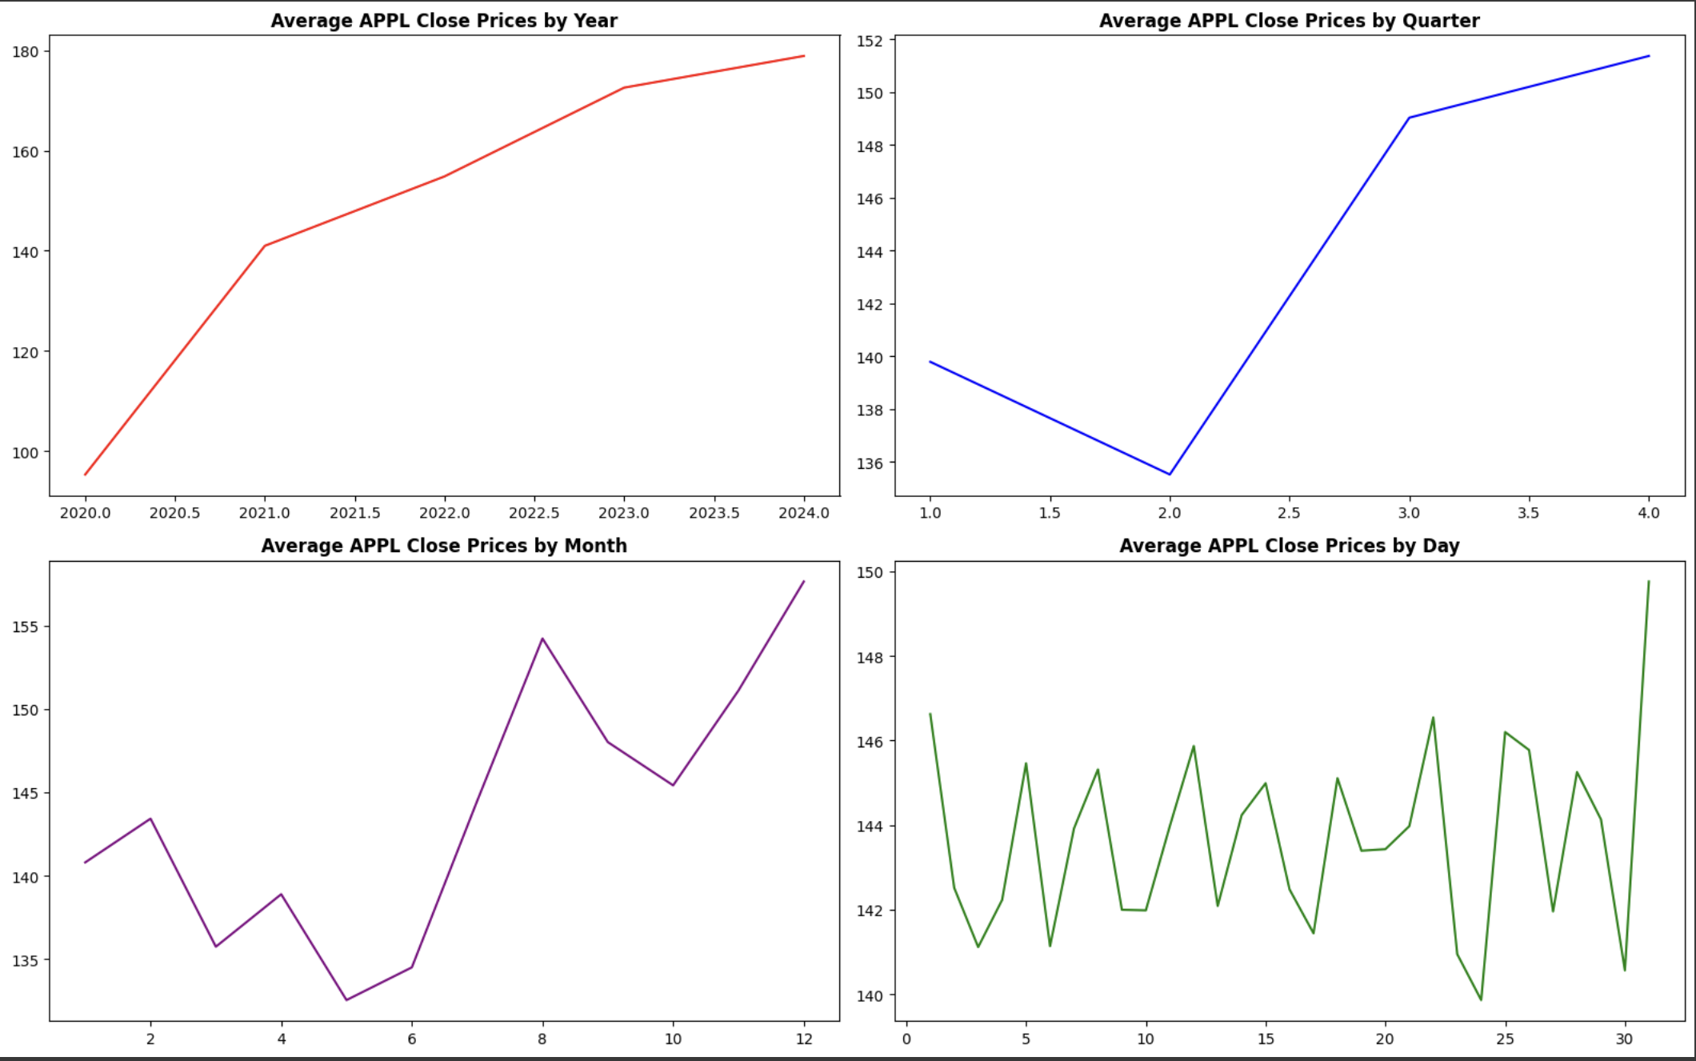
Data Analysis

Slide 10
Machine Learning Model
The machine learning model giving the best results for predicting the stock prices were Polynomial Regression, Random Forest Regressor, CatBoost and XGBoost.
The dataset was split into 80:20 training and testing set ratio. Then the model was trained on each of the selected machine learning models with the training data (date, Company) as input and the Close feature as output.
Optimize hyperparameters using techniques like Grid Search cross-validation to improve model performance.

Slide 11
Evaluation
The model was evaluated using:
RMSE
MSE
MAE

Slide 12
Demo ->

Slide 13
Thank you
By Niyati Jain (nsj39)

