Slide 1
Morse code lock
Niyati madaan

Slide 2
Idea and approach
Morse code is entered using the button by the user. By using time constraints the code entered is checked and matched. If the code matches completely the servo motor moves. The password can be changed by pressing the button for a longer period of time after entering the correct password. Also if the code is left for a certain amount of time, it would be wiped off.

Slide 3
features
Resets itself if the password is not continued.
Resets itself if the password is wrong.
Allows the user to change the password.
Checks the input and matches it after every entry.

Slide 4
Components required
Push button switch
Resistor
Wires
Arduino uno
Servo motor
Buzzer

Slide 5
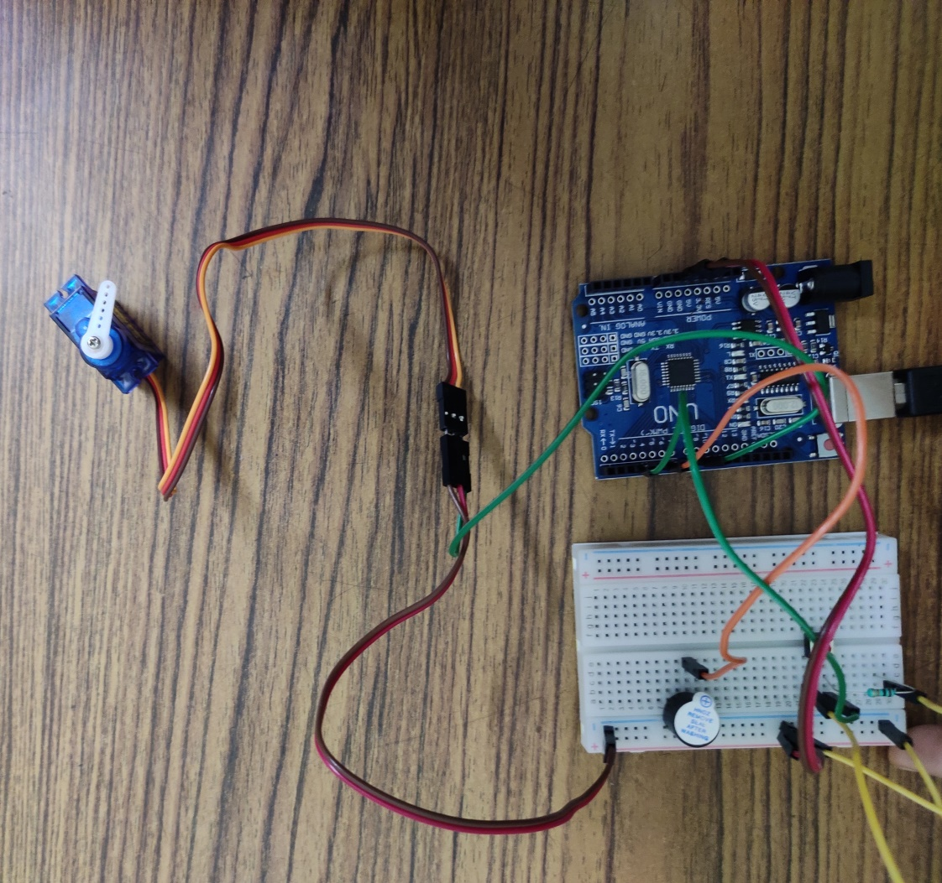
CONNECTIONS AND CIRCUIT DIAGRAM

Slide 6
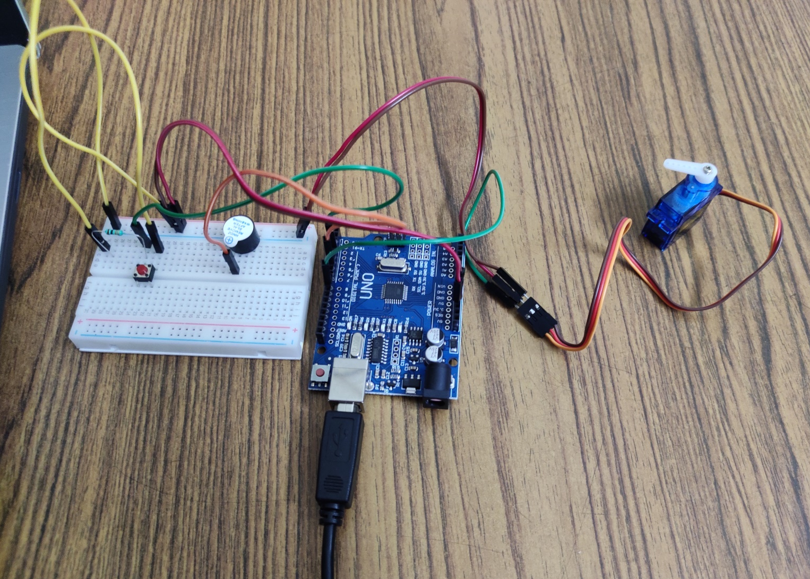
CONNECTIONS AND CIRCUIT DIAGRAM

Slide 7
code
The code is attached.

Slide 8
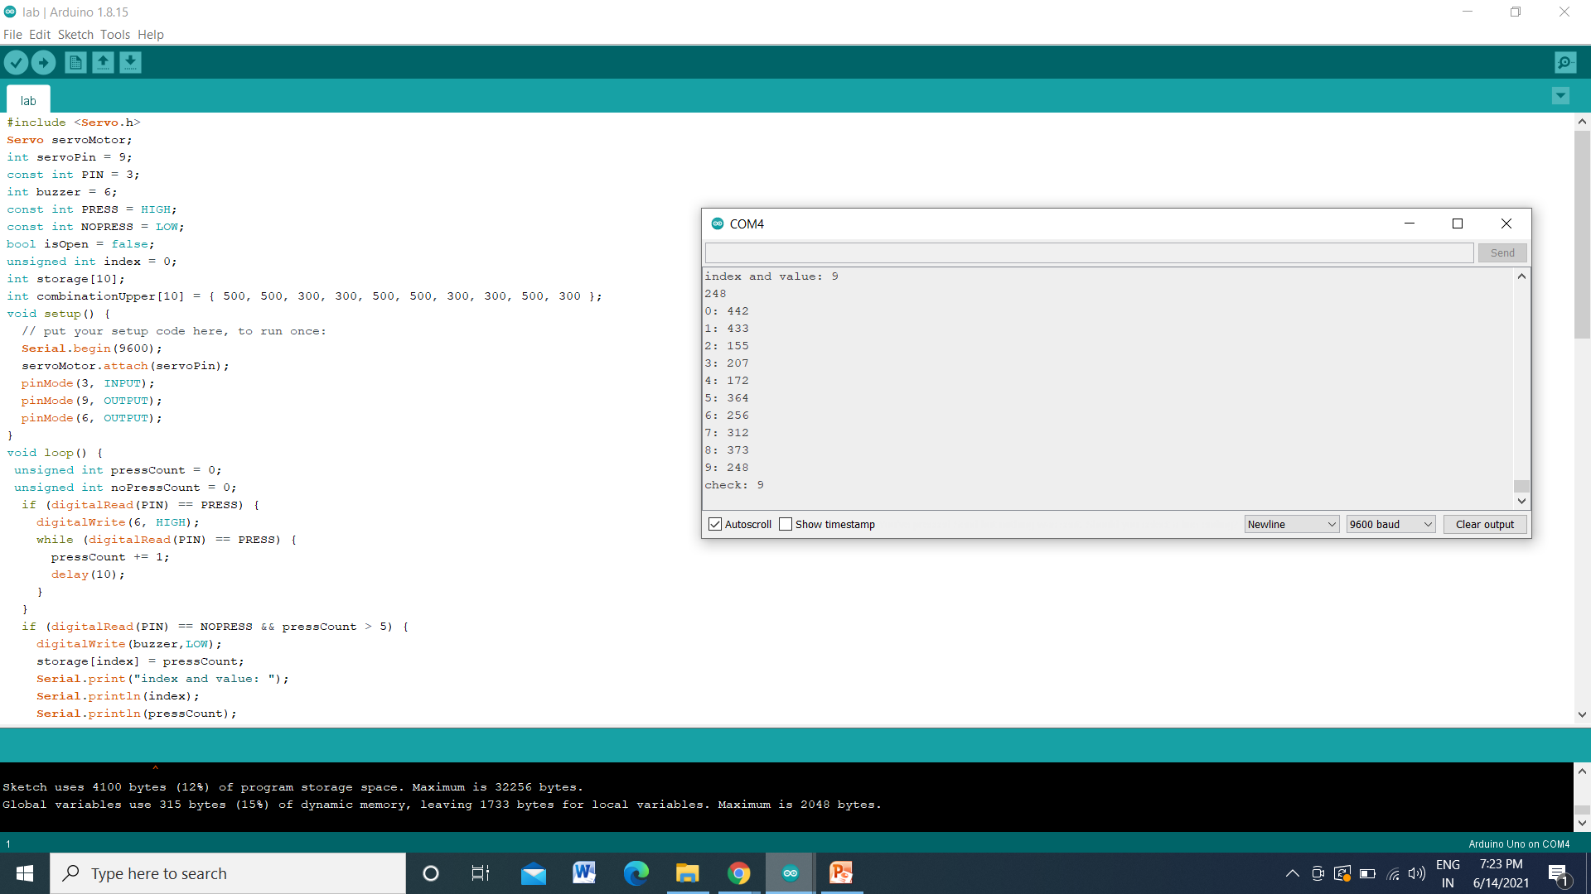
OUTPUT

Slide 9
Thank you

