Slide 1



Diasure
Preventing Diabetes Misdiagnosis through Data Accuracy
Ensuring Diagnosis for Better Lives
Founders: Niyati Parekh and Margvinatta Senesie

Slide 2
QUESTION
If you were diagnosed with diabetes today, how confident would you be that the diagnosis is 100% accurate?

Slide 3
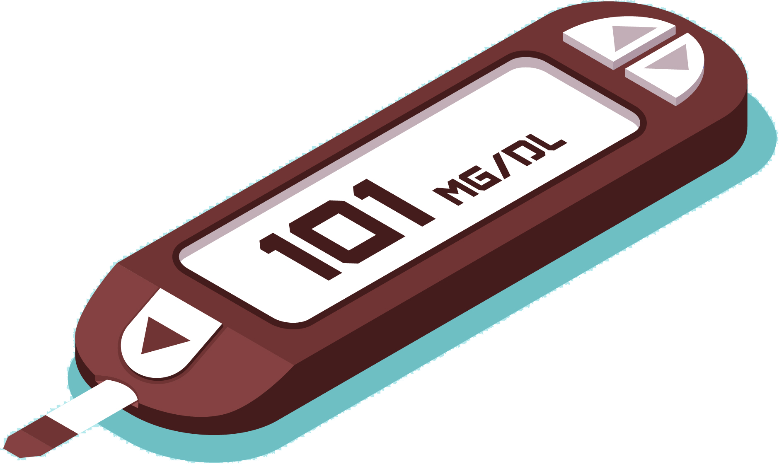
About 40% of type 1 diabetics have being misdiagnosed as type 2 (The Lancet Regional Health, 2023)
According to CDC, about 8.7 million U.S adults had undiagnosed diabetes in 2021
38.4 million are currently diagnosed with Diabetes (ADA)
8th leading cause of death in the US in 2021 (ADA)
The Problem

Slide 4

Introduction
Mission Statement: Empowering individuals with accessible, and reliable tools to correctly identify their type of diabetes, prevent misdiagnosis, and receive the right care.
About Us: Diasure was created to tackle the growing problem of diabetes misdiagnosis.
Notes:
About us: By combining digital tools, expert insights, and patient education, we help people confidently understand their diagnosis and take control of their health.

Slide 5
Diabetes
Diabetes is when the body can’t properly convert food into energy due to problems with insulin in the pancreas.
Either the body doesn’t produce enough insulin or can’t use it effectively, causing glucose to build up in the blood.
Symptoms are frequent urination , excessive thirst, weight loss, blurred vision, constant fatigue, numbness
3 types- Type 1, Type 2, and Gestational

Slide 6
Data
Partner with hospitals, clinics, insurance companies to gather real life data
Collect lab results, demographics, blood sugar levels, BMI, insulin, ketones, family history, diet, lifestyle
Check accuracy and quality of data through cross examination across all platforms
Cleaning measures- check duplicates, ensure format consistency, remove blank rows and columns
Clean before and after extraction
Sources
Hospitals
Staging
storage
Data analysis &
Presentation
Clean data :)
Cloud
Based
warehouse
Insurance comp

Slide 7
Indicators used
Diasure chart/Indicators:-
Fasting Glucose (mg/dL), OGTT (mg/dL), HbA1c (%), Random Glucose (mg/dL), Symptoms (Y/N), Diagnosis(scale), Gender, Systolic BP (mmHg), Diastolic BP (mm/Hg), BMI, Age, Exercise Level (scale) , Access to Healthy Food (Y/N/M), Pregnant (Y/N), Age at Onset, Family History (Y/N), Frequent Urination (Y/N), Very Thirsty (Y/N), Weight Loss (Y/N), Feeling Exhausted (Y/N), Diabetes Type
As recommended by CDC
Accurate and Proper Indicators = More accurate diagnosis
All measured data was randomly created for this project
https://docs.google.com/document/d/1kbnJGsanujm9D2g2GF8YkiKBRyWTIFjtUWASyiXru3A/edit?usp=sharing

Slide 8
Data Management & Pipeline
Data Gathering (Extract)
Source: Patient survey (via Diasure platform)
Collected:
Age, sex, gender, state, family history
Glucose, BMI
Lifestyle: activity, diet
Purpose: Self-check diabetes type using online diagnostic chart

Slide 9

Cont.
Data Cleaning & Processing (Transform)
ETL Flow (in R):
Extract: Shiny form input from CSV
Transform: Clean via dplyr, tidyr
Load: In R environment
Steps:
Drop nulls & duplicates
Standardize units/symptoms
Validate via diagnostic chart
Checks:
At entry & before prediction
Detect outliers, ensure completeness
Queries through SQL

Slide 10
Conclusions
Type 2 Diabetics was the most common type across all states
Age groups 20-39 had the highest prevalence
Age group 60+ have lowest prevalence
Georgia, Illinois and California has the most number of misdiagnosed diabetics
New York, Michigan, Illinois, and Georgia had the highest prevalence

Slide 11

Future Research & Resources
– Using a real-world healthcare dataset
- Advanced data querying using SQL and Jupiter notebook
- Include data for all 50 states
https://pmc.ncbi.nlm.nih.gov/articles/PMC10230615/
https://www.cdc.gov/diabetes/diabetes-testing/index.html
https://www.diabetes.org.uk/about-diabetes/types-of-diabetes
https://www.wesleymc.com/healthy-living/blog/how-many-types-of-diabetes-are-there
https://www.kaggle.com/datasets/alexteboul/diabetes-health-indicators-dataset
https://pmc.ncbi.nlm.nih.gov/articles/PMC6953756/#:~:text=Type%201%20diabetes%20is%20commonly,receive%20the%20required%20insulin4.
Diabetes in America: Prevalence, Statistics, and Economic Impact

Slide 12

Thanks!
Do you have any questions?

