Slide 1
Pharmacy management system
GROUP MEMBER
MD HASIBUZZAMAN 19-40495-1
MD NIYAZ MORSHED 19-40998-1
YOUSUF AL MAMUN 19-40552-1
ANIKA FERDOUS 19-40531-1

Slide 2
Introduction
In this project we create a admin panel where employee of pharmacy can log into the software. In this project we can check, add, update or delete medicine. Like the medicine we can also check employee information, add, update and delete the employee of a pharmacy. Then we can add, update or delete the information of medicine company. Lastly we can create billing of any customer medicine and print it for the customer.

Slide 3
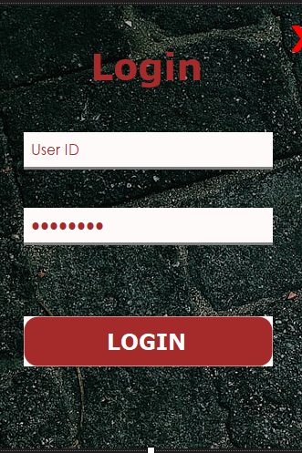
login
This is our Log in page. To run the project we need to give User Id and Password . If we enter the wrong User Id or password then the project won’t run . After giving correct information we can proceed to the next page.

Slide 4

Main Menu
After the log in the project we can see the Main Menu. In the main menu there are various kinds of options . 1. Medicine 2. Company 3.Employees
4.Billing 5. Log out

Slide 5
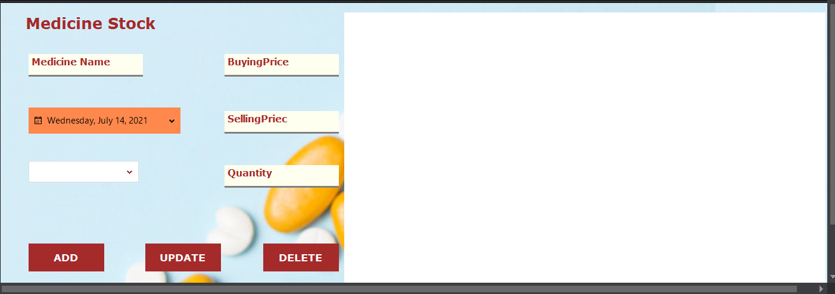
Medicine stock
In this interface we can see three buttons.
After give the Medicine Name , Buying Price , Selling Price Quantity , Expire Date and Press on the ADD/ UPDATE/DELETE it will ADD/ UPDATE/DELETE in the Database.

Slide 6
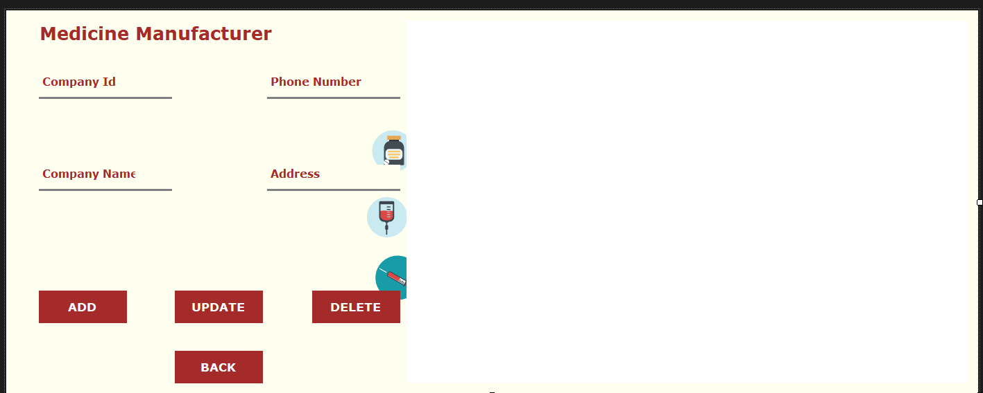
Medicine manufacturer
In this interface we can see there are four Options ADD,UPDATE,DELETE,BACK we have to give the necessary Information . Company ID , Phone NO. , Company Name , Address. Then we have press Add to add the information . If we want to delete then we have give the same Id , Phone No , Company Name and the Address then press the button delete . To update we have to do the same thing .

Slide 7
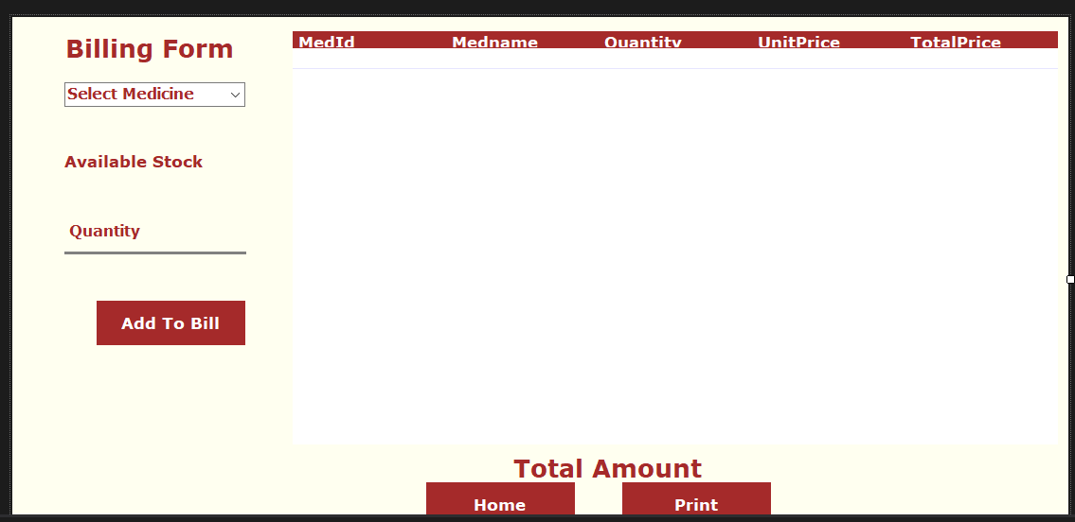
Billing form
In this page we can see there are three buttons . ADD TO BILL , HOME AND PRINT First we have to Select the Medicine Then give the Quantity and see the Available Stock. Then press The Add to Bill . The given information will add into the bill. Then after adding the bill we press the Print Button to Print The final Bill

Slide 8
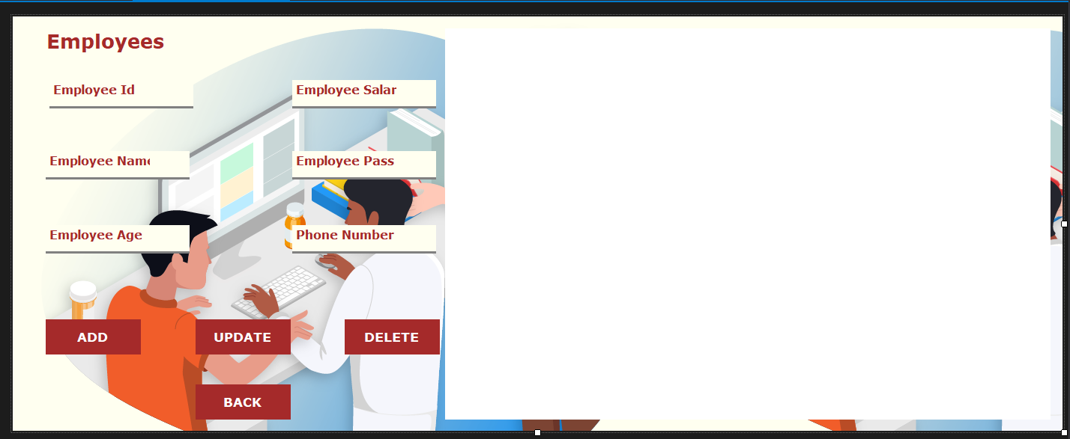
Employees
This is the Employees page . In this page there are four Buttons ADD, UPDATE , DELETE,BACK.
To add Employees We have to give Employee Id , Employee Salary , Employee Name , Employee Pass, Employee Age and Phone Number Then press the Button Add . The Employee will Add into the Data base. And to Delete or update we to go on the same process.

Slide 9
Conclution
In this project we tried to make our project human friendly. There might have some limitation, bug or error which we will be looking forward to solve it in the near future.

Slide 10


