Slide 1

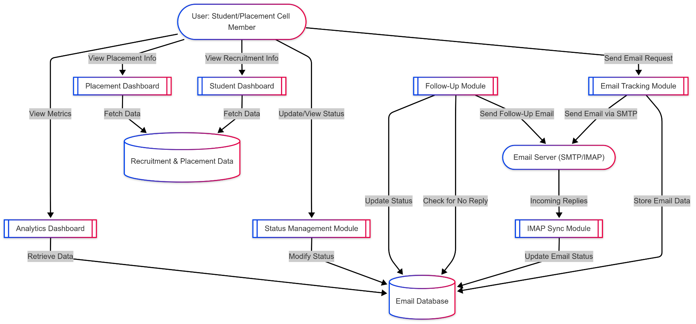
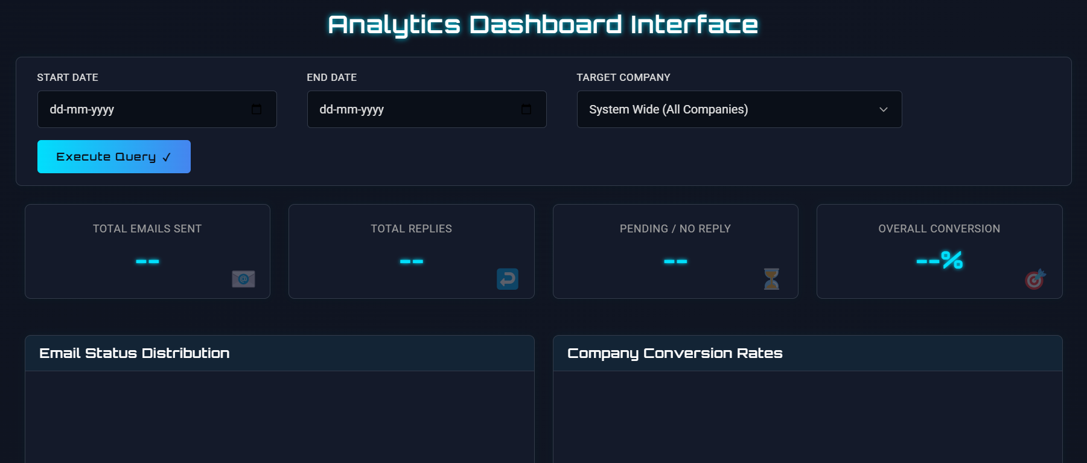
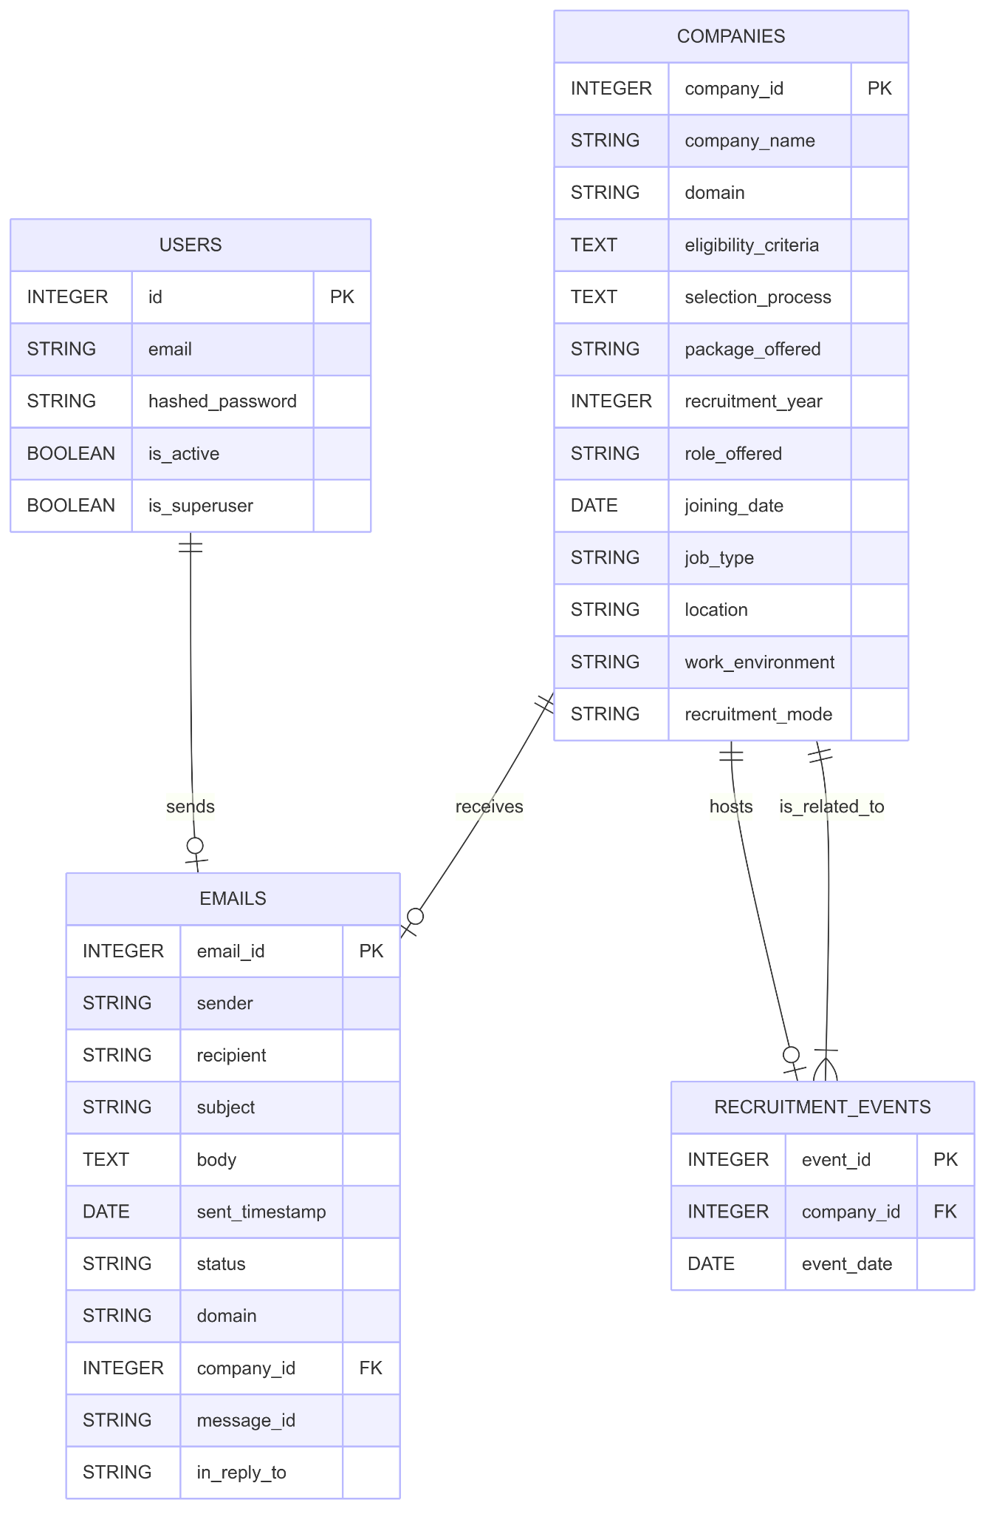
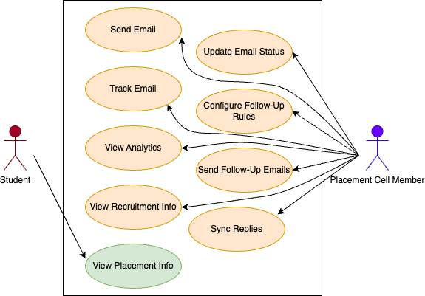
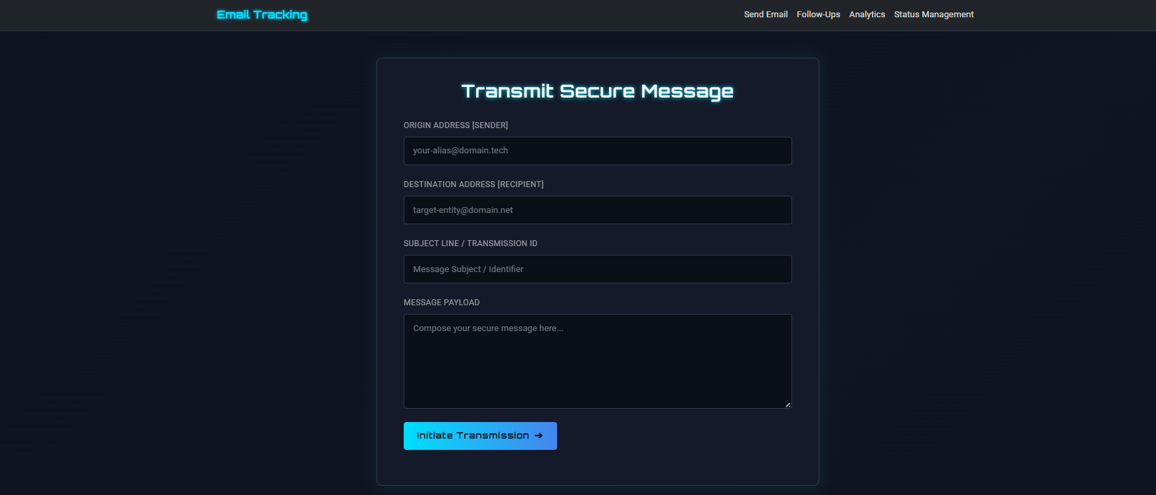
Email Tracking & Analytics System
Md Niyaz Asghar (2201124)
Summary
This project presents an Enhanced Email Tracking & Analytics System designed to streamline organizational email communication, automate follow-ups, and provide real-time analytics. It features modules for email tracking, IMAP syncing, follow-up automation, and status management. Dashboards for students and placement cell members track recruitment events and placements. Key results include improved response tracking, predictive insights on email timing, and a centralized platform for managing campus recruitment communications.
Objective
To develop an integrated Email Tracking & Analytics System that automates follow-ups, monitors email communication status, and provides actionable insights through dashboards for optimizing recruitment-related communications. The system aims to enhance engagement efficiency between students and the placement cell by tracking responses and visualizing placement and recruitment data. It also ensures timely follow-ups and data-driven decision-making through predictive analytics.
Approach
Designed modular backend using FastAPI with PostgreSQL for email tracking, status management, and analytics.
Implemented SMTP for sending emails and IMAP for syncing incoming replies.
Developed automated follow-up mechanism based on response time thresholds.
Built interactive dashboards for students and companies using HTML, CSS, JavaScript, and Jinja2.
Used Celery/BackgroundTasks for scheduling periodic email sync and follow-up tasks.
Integrated analytics endpoints to provide insights on email performance, response rates, and recruitment trends.
Implementation
The project utilizes FastAPI (Python) for building a high-performance backend API, integrated with PostgreSQL for reliable and structured data storage. For the frontend, it leverages HTML, CSS, and JavaScript with Jinja2 templating to deliver a dynamic and user-friendly interface. Additionally, Celery or BackgroundTasks is used for scheduling tasks like syncing email replies and sending automated follow-ups, while SMTP and IMAP protocols handle email communication.
Data Flow Diagram (Level 1)
Email Analytics Dashboard
Email Tracking Interface
Use Case Diagram
ER Diagram

