Slide 1
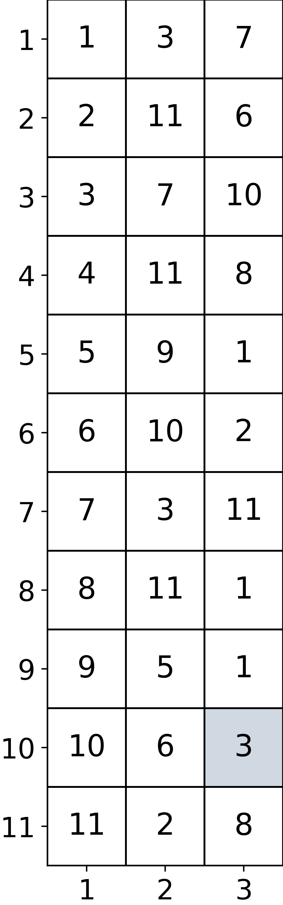
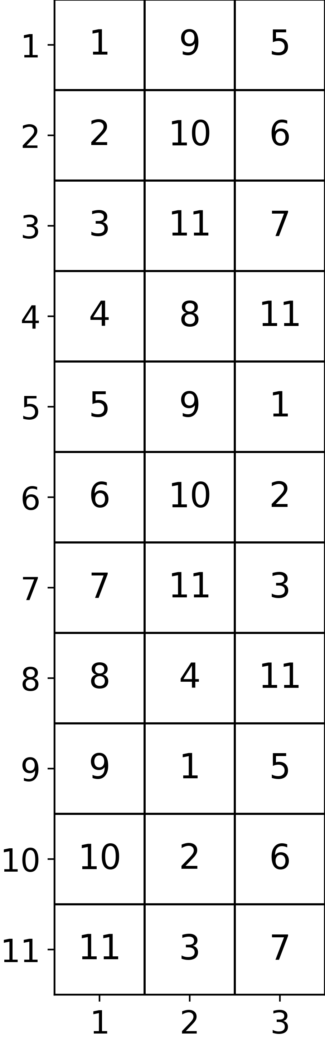
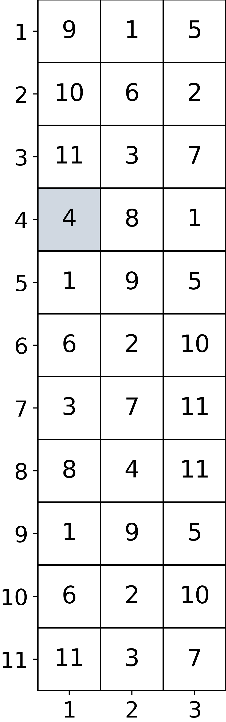
(k-1)-Nearest-Neighbors for All Subsequences and Dimensions
For the 4th subsequence in dimension 1, the 4th subsequence is also the core.
i
For the 10th subsequence in dimension 3, the 3th subsequence is the 2-NN.
dim ∈ [1,…, d]
k

Slide 2
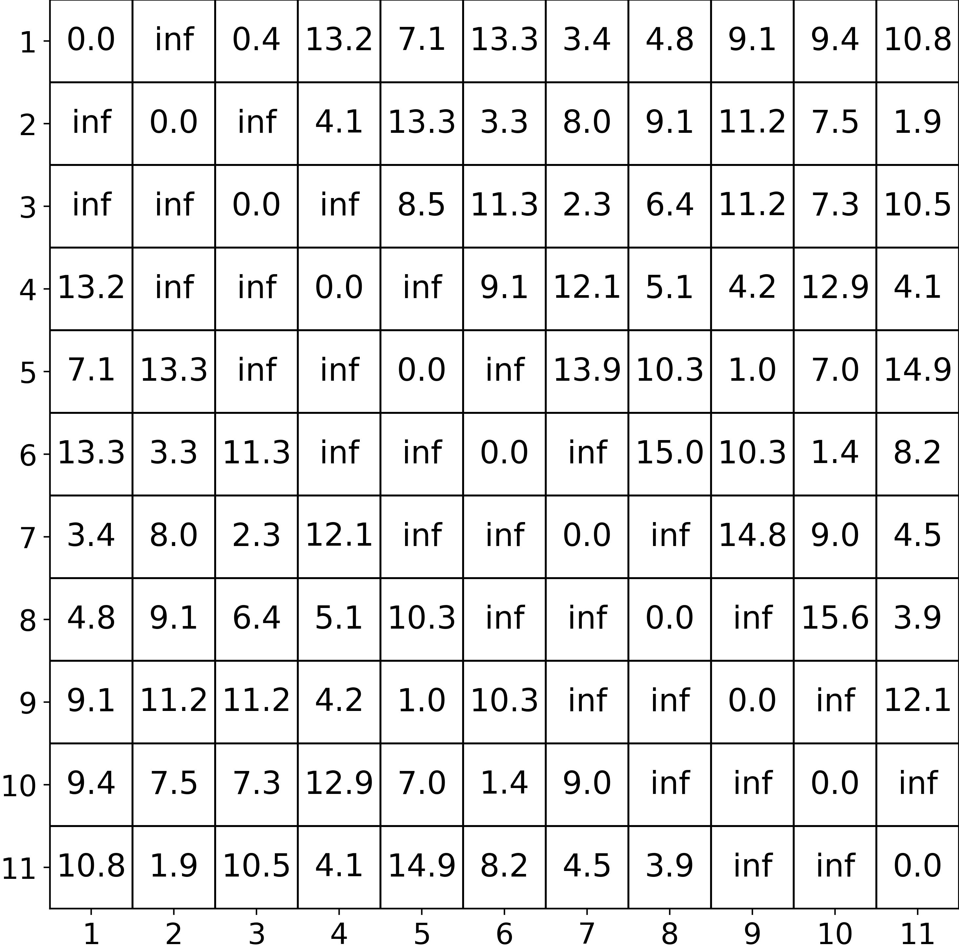
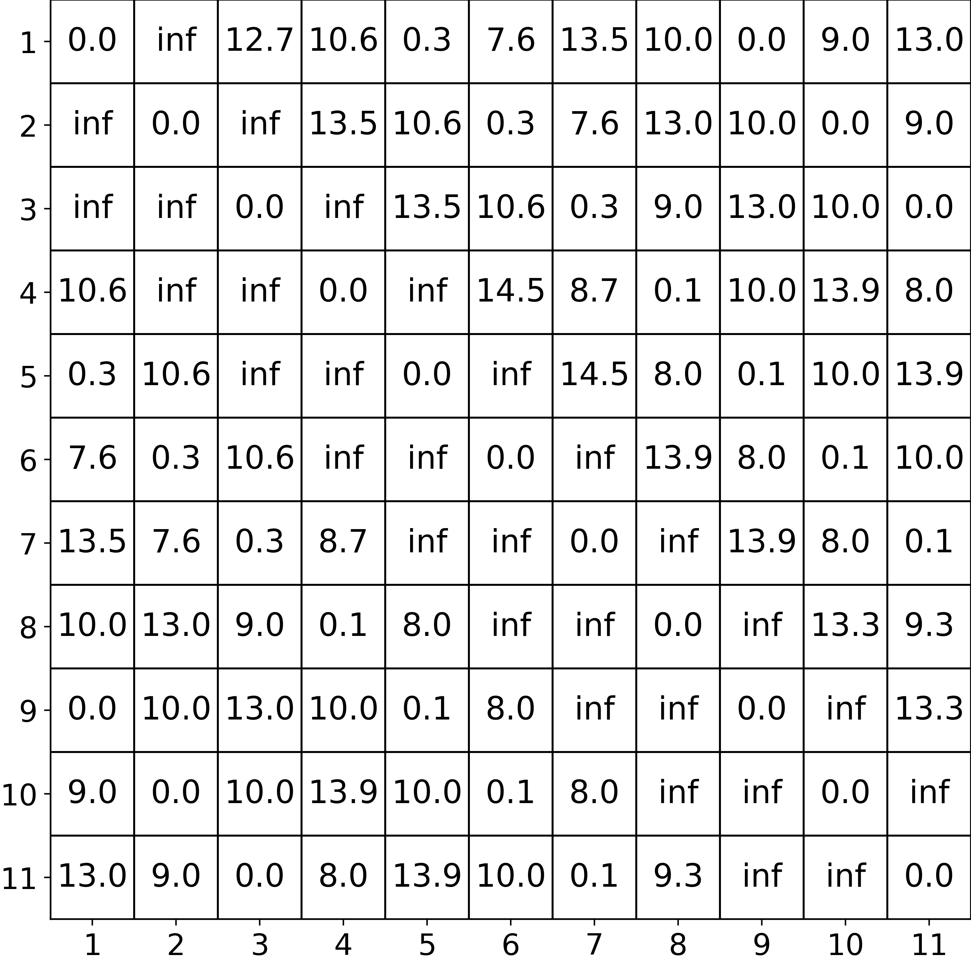
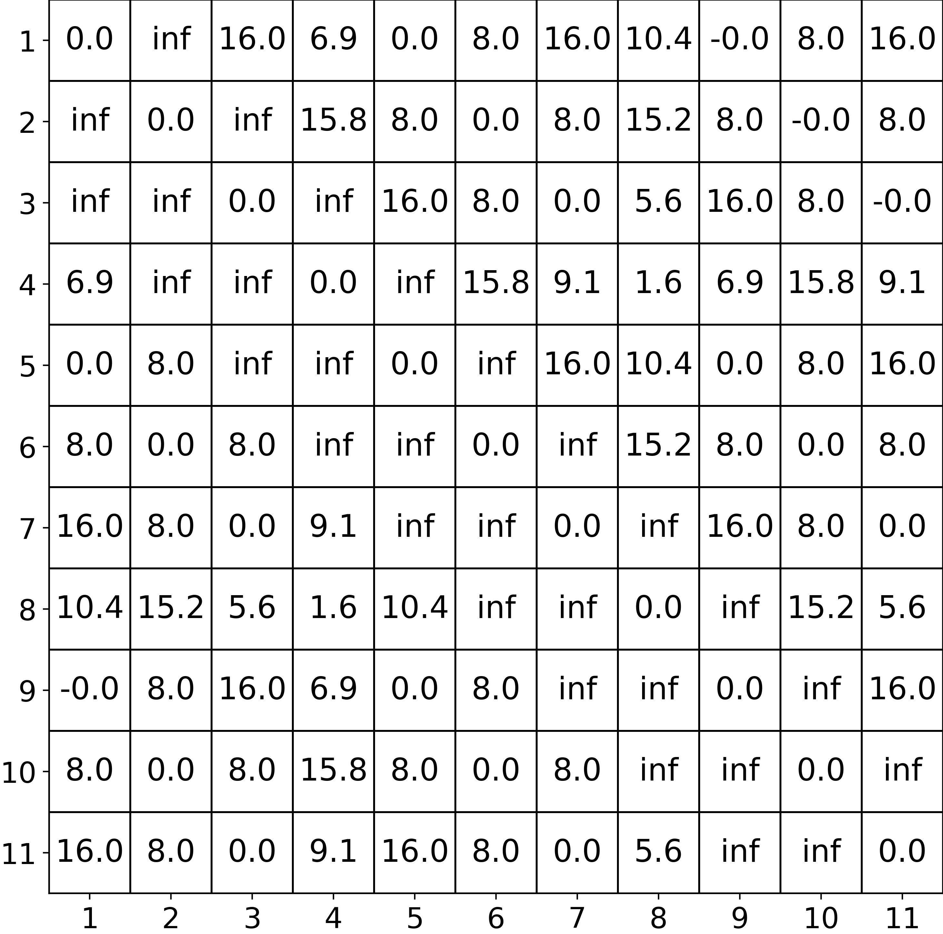
Multidimensional Distance Matrix
i
dim ∈ [1,…, d]
j

Slide 3
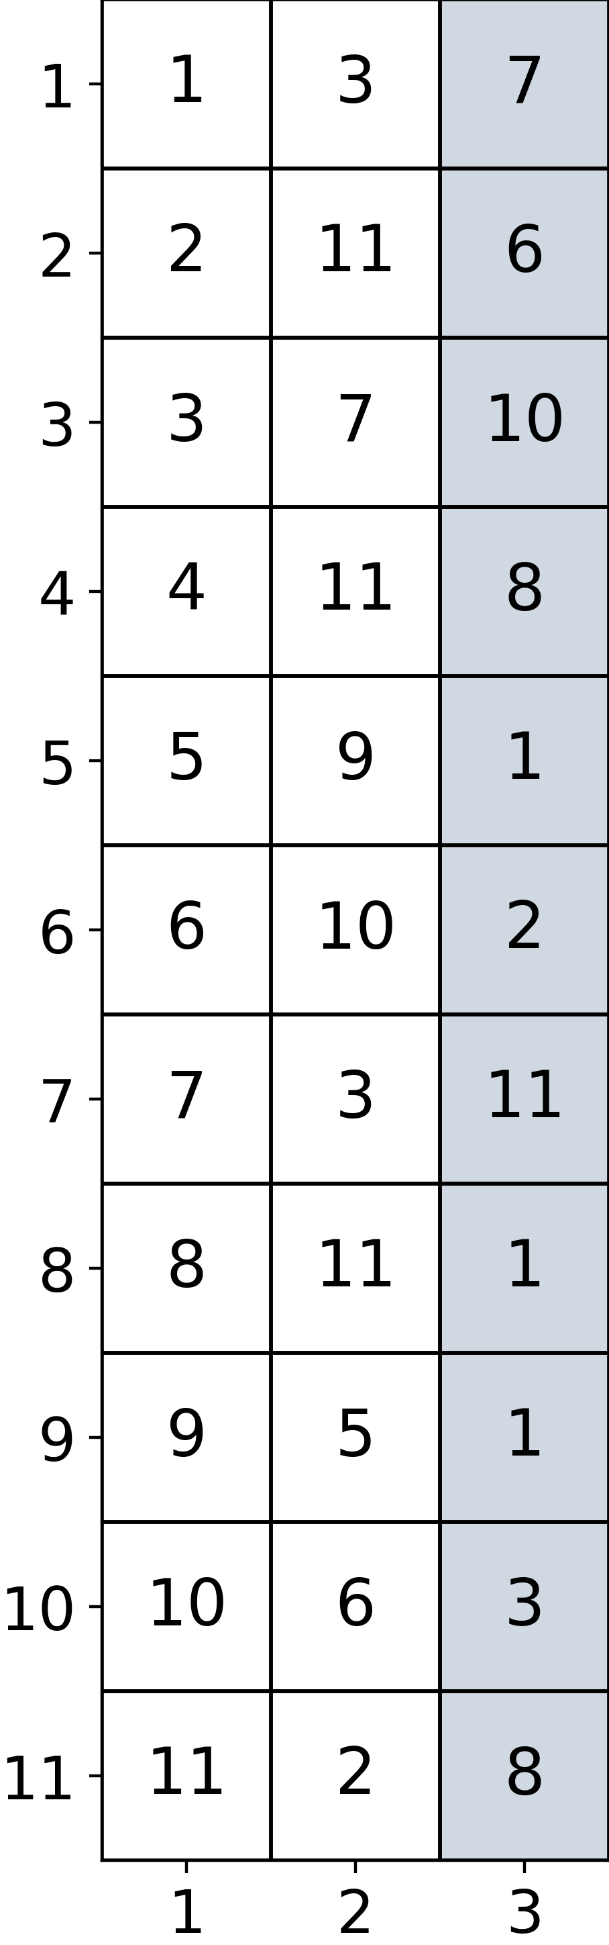
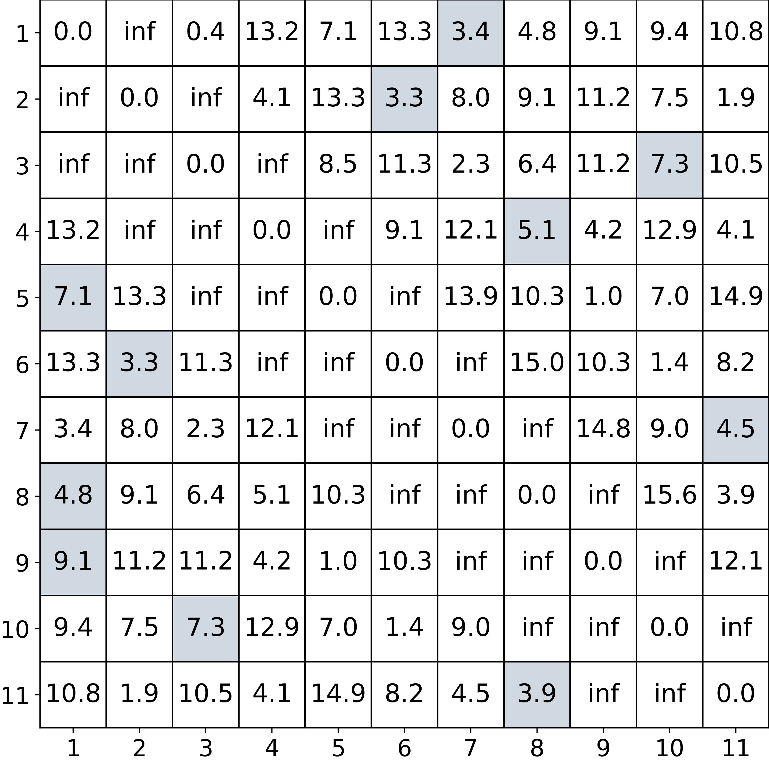
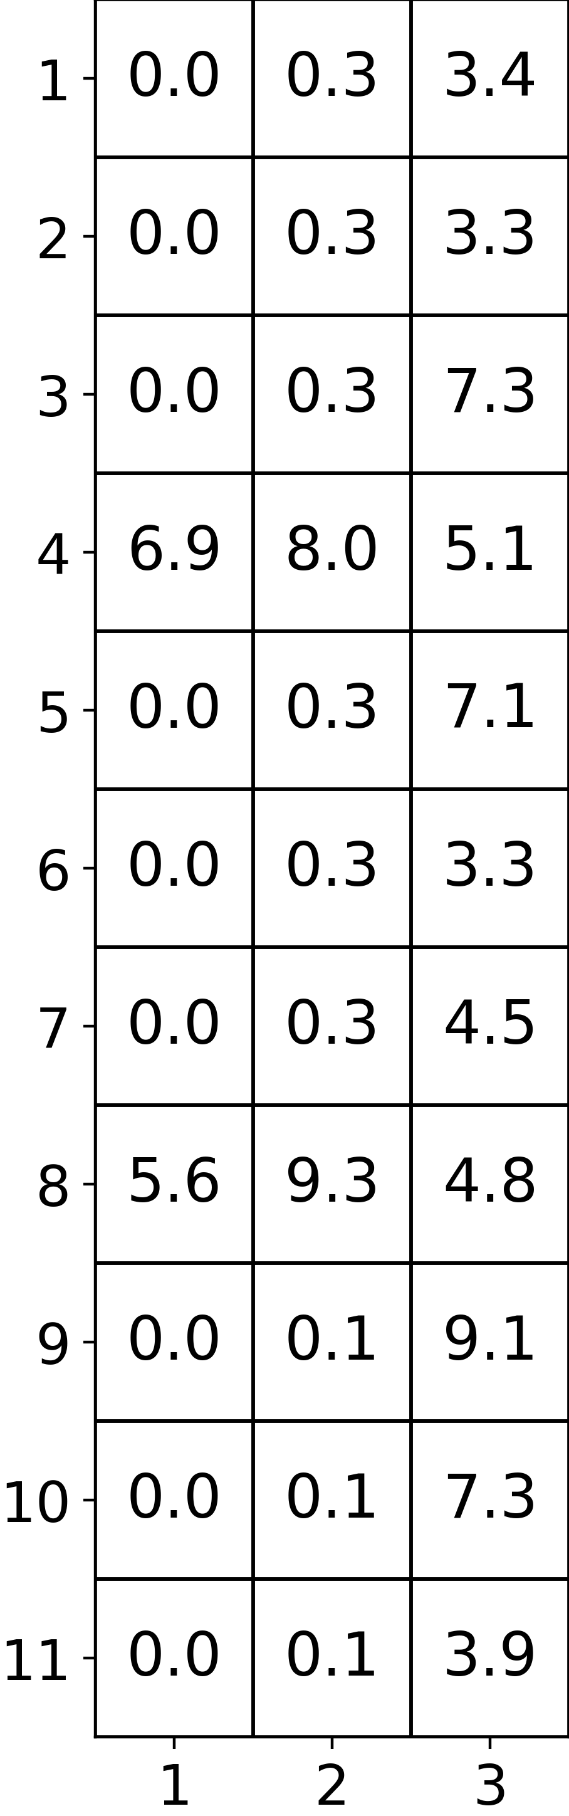
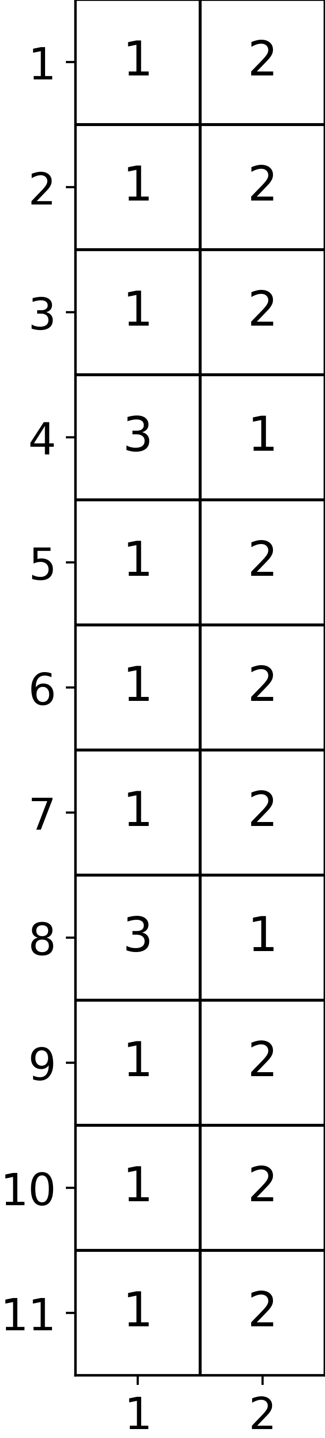
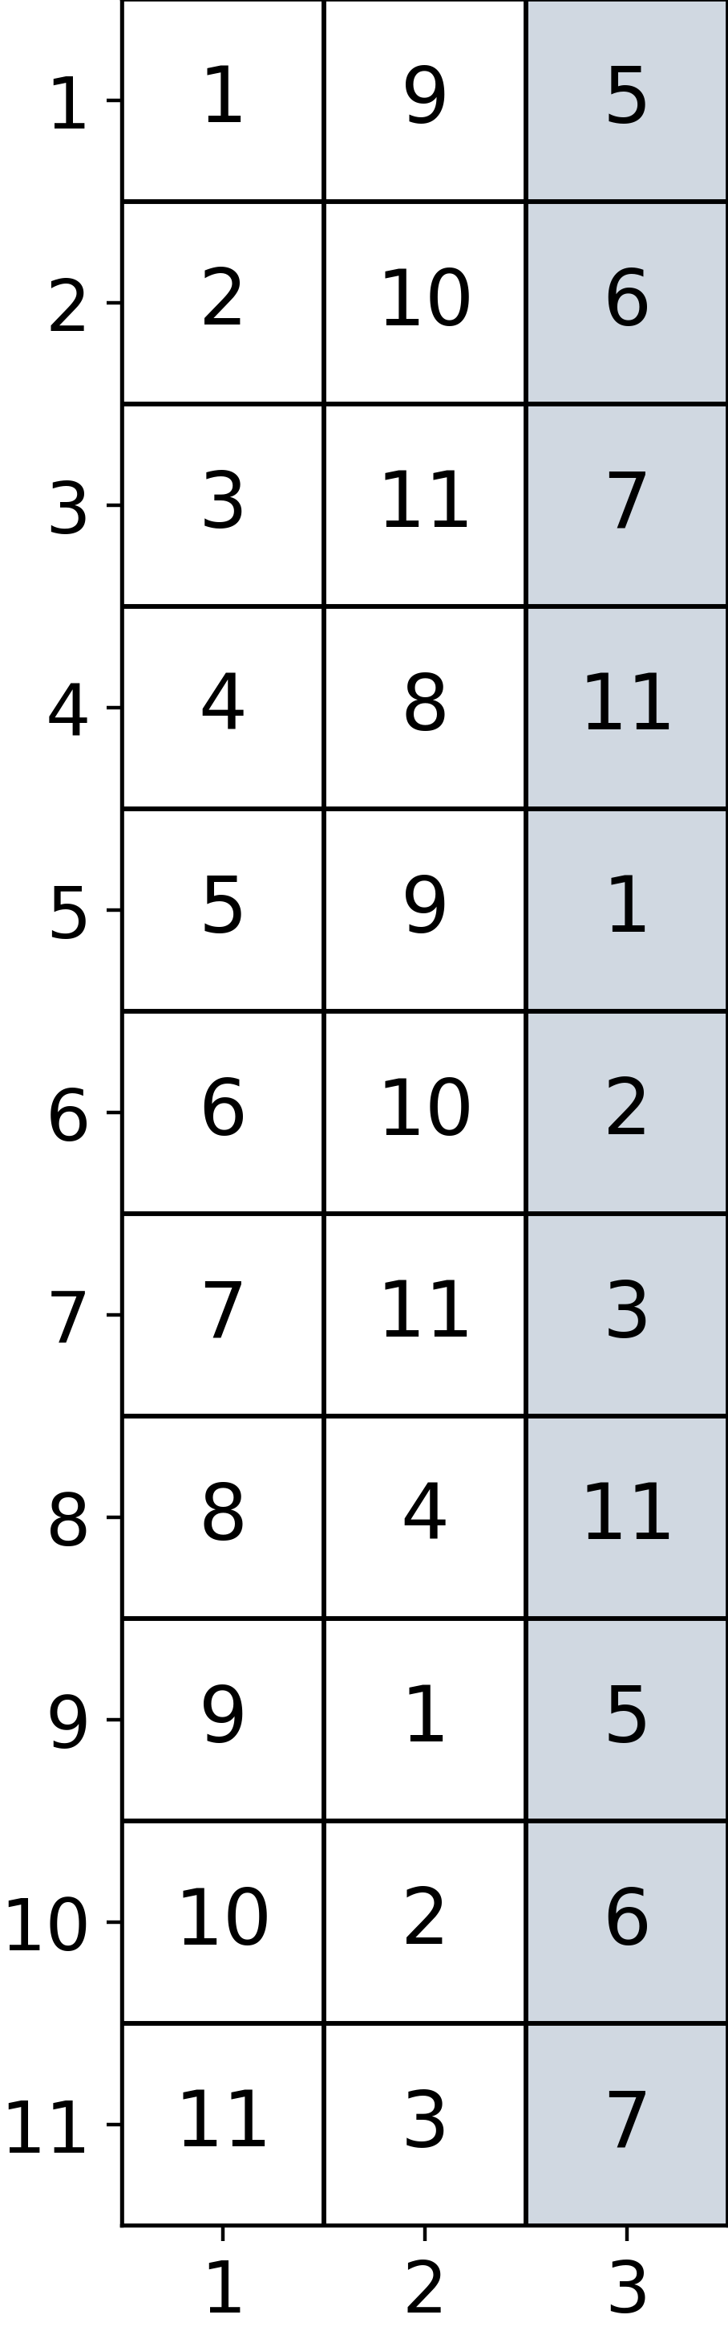
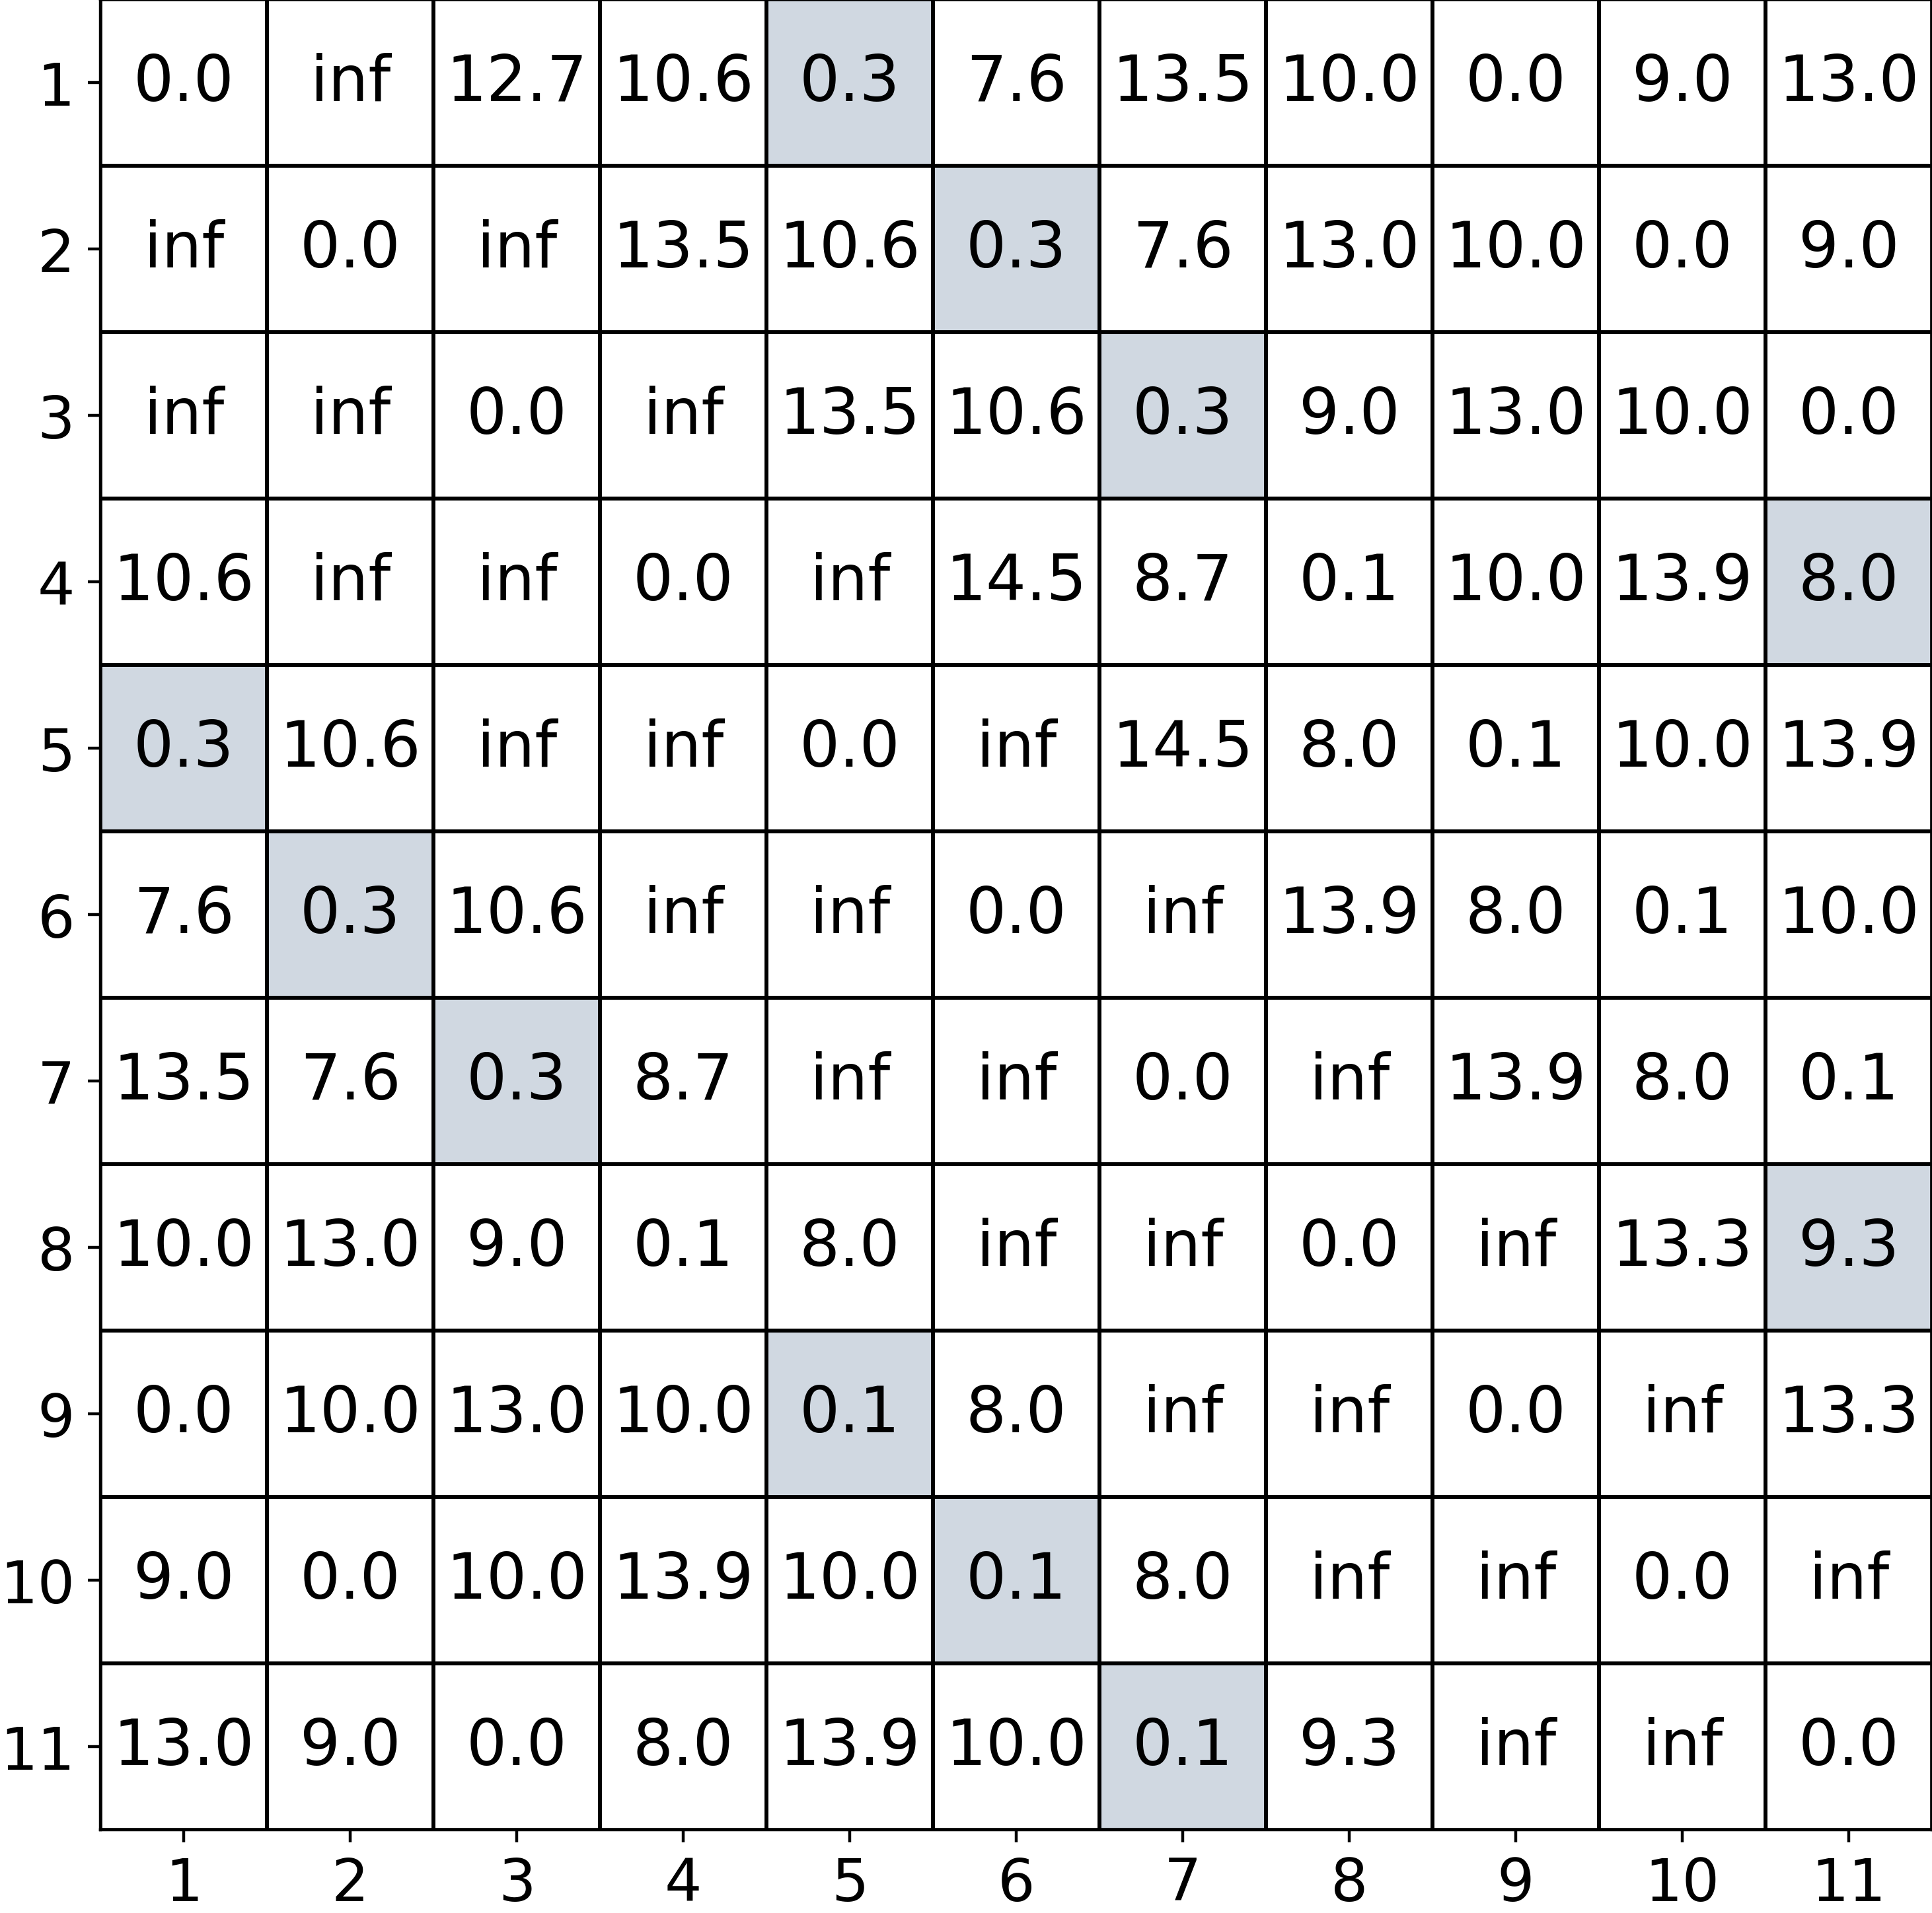
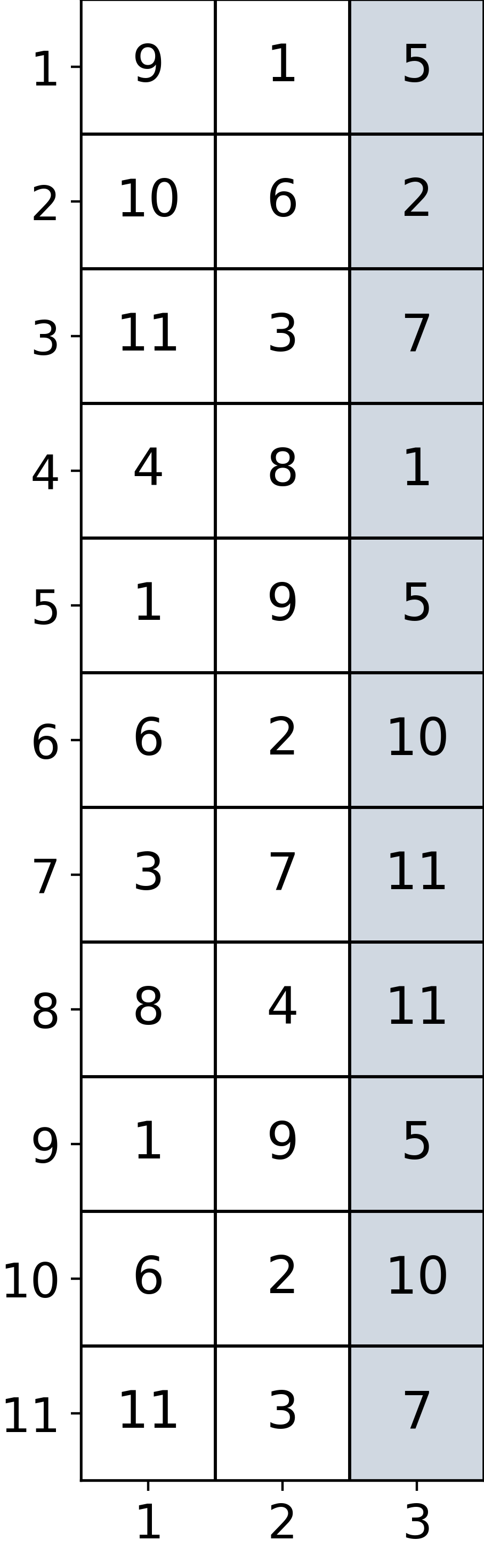
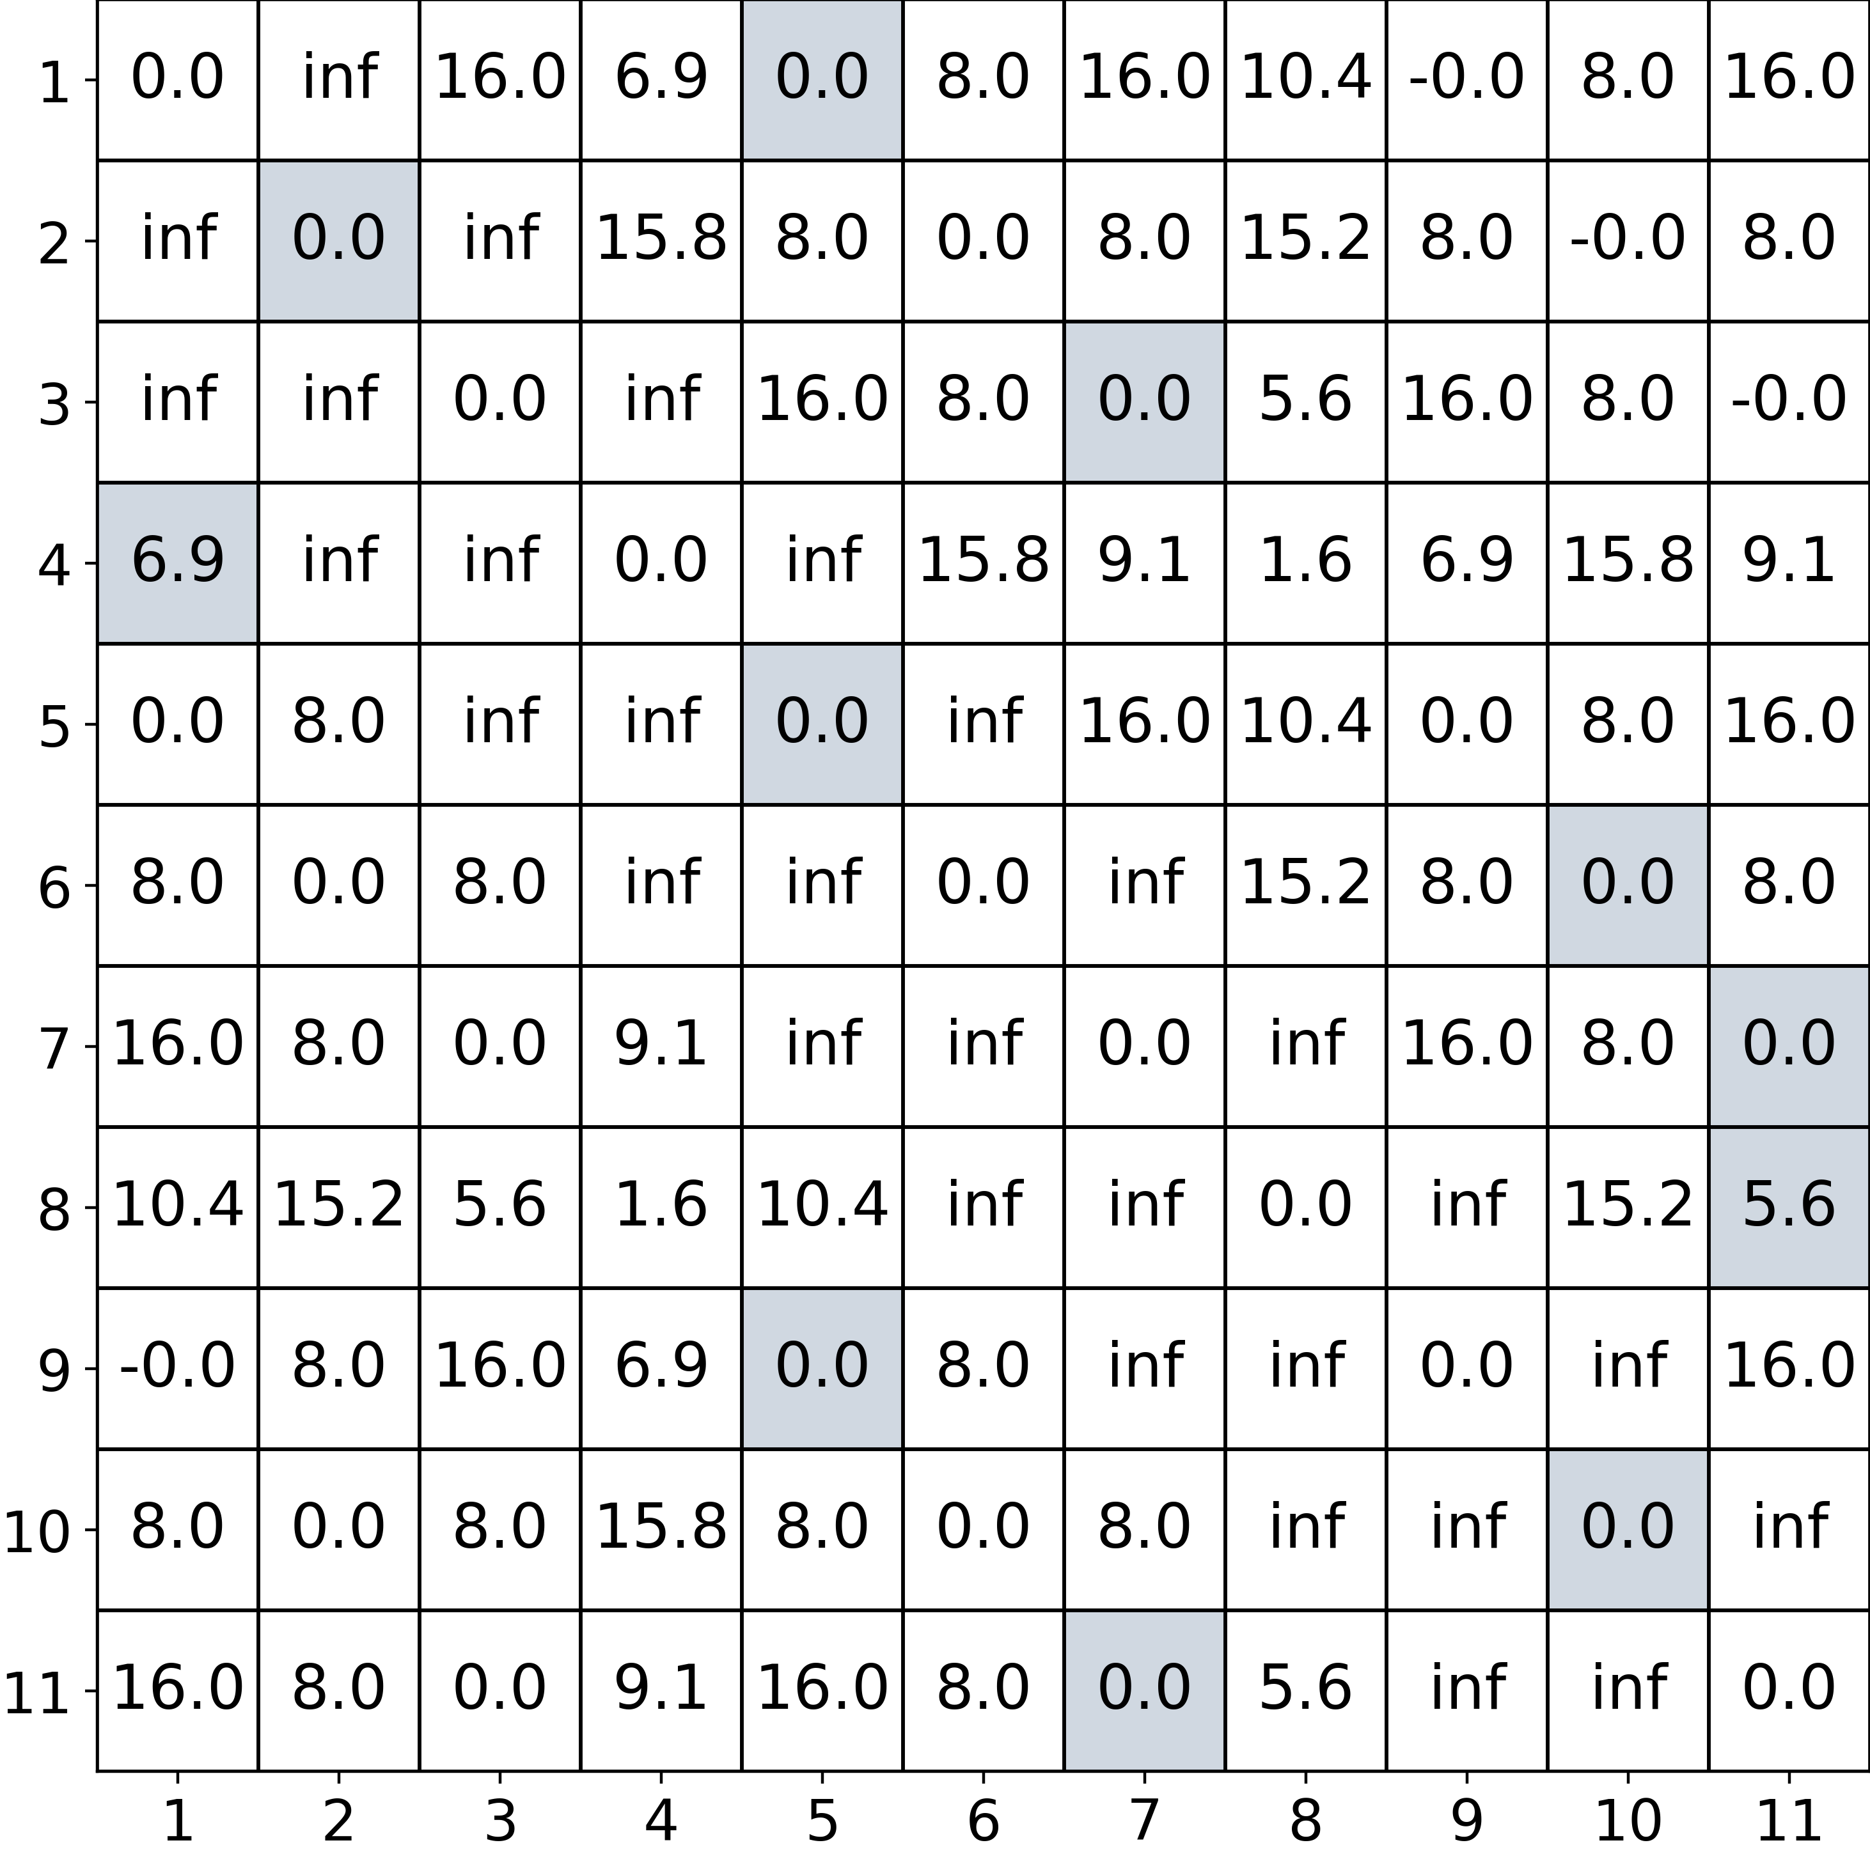
1. (k-1)-Nearest-Neighbors for All Subsequences and Dimensions
2. Multidimensional Distance Matrix
3. Selected
Distances
4. The m Most Relevant Dimensions
i
i
i
i
dim ∈ [1,…, d]
relevant_dim ∈ [1,…, m]
dim ∈ [1,…, d]
dim ∈ [1,…, d]
k
j

Slide 4



k=4
<r
<r
r
r
d
r
2r
d
r
<r
k=2
<r
<r
k=3
(a) (Top) Pair Motif
support=2
extent=d ∈
(b) K-Motifs
support depends on r
extent=d ∈
(c) Learning Motifs
support depends on r
extent=d ∈
(d) Valmod Motif Sets
support depends on D
extent=D • d ∈
(e) Range Motifs
support depends on r
extent=pairwise <2r ∈
(f) k-Motiflets
support=k ∈
extent depends on k

Slide 5
y
Exact 3-Motiflet
d = r + ϵ
r + ϵ
r
r
r
Found 3-Motiflet
d = 2r
x

