Slide 1
Bwenge for Schools
Marking, results, and insight

Slide 2
Why teachers like it
Marks against your rubric
Teacher stays in control
Results in minutes

Slide 3
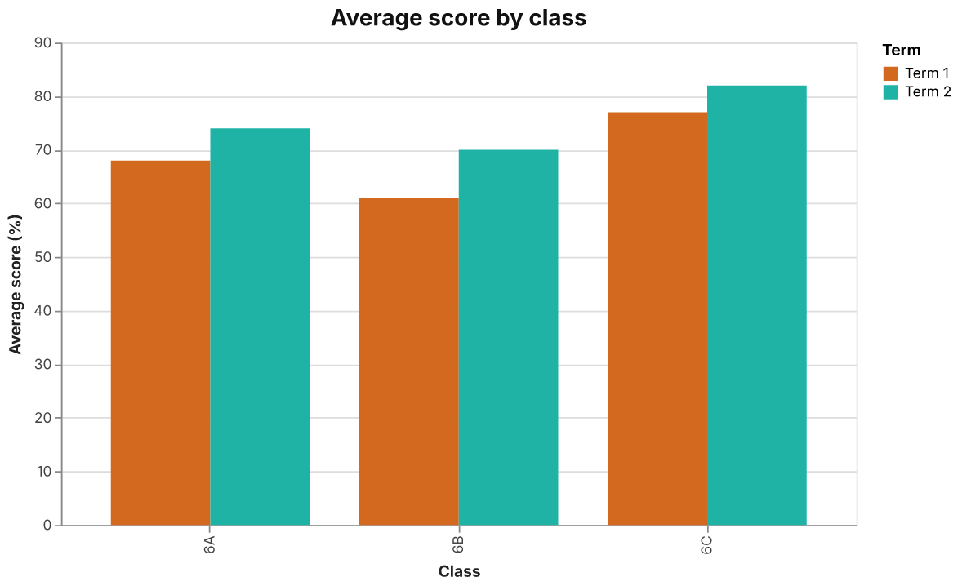
Class averages
Term 1 vs Term 2

Slide 4
“It gave me my weekends back.”
— A teacher

