Slide 1
CROP YIELD PREDICTION PROJECT
CROP YIELD PREDICTION – BIG DATA PROJECT PRESENTED BY: NIYONSHIMIRA JEANMARIE COURSE: INSY 8413 – INTRODUCTION TO BIG DATA ANALYTICS DATE: MONDAY, AUGUST 5, 2025

Slide 2
Problem Statement
Rwanda is an agricultural country.
Crop yield prediction helps in planning and food security.
The project aims to predict yield using Random Forest and real data.

Slide 3
Dataset Description
Source: FAO Rwanda Crop Production
Main Columns:
Country
Year
Item (crop name)
Production
Area_Harvested
Yield (target)

Slide 4
Data Cleaning
Removed duplicates
Forward-filled missing values
Checked data types using .info()

Slide 5

Feature Engineering
Encoded Item column using pd.get_dummies()
Scaled numerical features with StandardScaler
python

Slide 6
Train-Test Split
Split data: 80% training, 20% test
X: features, y: target (Yield)

Slide 7

Model Training
Used RandomForestRegressor with 100 trees.
Trained the model on training data.

Slide 8

Model Evaluation
Evaluated with:
R² Score: check how good the model is
RMSE

Slide 9
Problem Context & Data Insights
Problem: Inconsistent crop yields affecting smallholder farmers.
Dataset: Maize yield data from 2020–2023 (Rainfall, Temperature, Region, Area).
Key Insight: Yield varies significantly by region and climatic conditions.
Visualization Goals: Spot patterns, allow user filtering, and enable deeper analysis.

Slide 10
Conclusion
Machine learning helps predict crop yield effectively.
Supports agricultural decision-making.
Future improvement: add rainfall, soil quality, regional data.
This project demonstrated the use of Python for data cleaning and machine learning, paired with Power BI for insightful visualization, to analyze and predict maize production trends in Rwanda. The results provide actionable insights to support agricultural planning and decision-making.

Slide 11
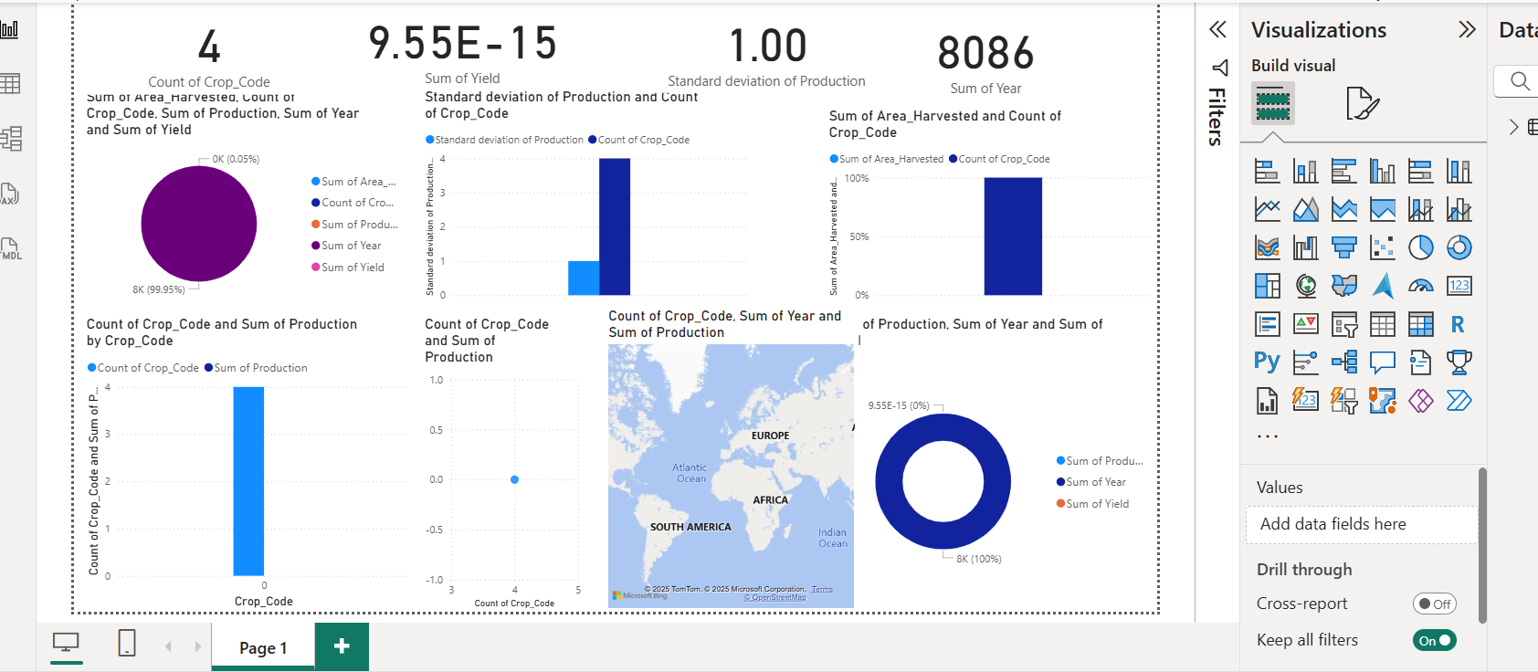
Power BI Dashboard Layout Plan

