Slide 1
Pre-trained Language Models
Can they be used to automate the generation of product description?
Niyousha Najmaei, Zero11 S.r.l., Oct 2021

Slide 2
Machine Learning
Machine learning systems learn how to combine input to produce useful predictions on never-before-seen data
if an email is spam or not
The future price of a certain product
What animal is represented in a picture
Key terminologies:
A label is the thing we're predicting
In our case: the product description
A feature is an input variable,
In our case: the product tags
Example of data:
labeled: with features and label
In our case: having both tags and the corresponding description
unlabeled: only features
In our case: having only tags
A model defines the relationship between features and label. For example, a spam detection model might associate certain features with "spam".

Slide 3
Steps
Training means creating or learning the model. That is, you show the model labeled examples and enable the model to gradually learn the relationships between features and label.
In our case: Feeding a labeled dataset of tags and the corresponding descriptions to the model.
Inference means applying the trained model to unlabeled examples. That is, you use the trained model to make useful predictions . For example, during inference, you can predict the product description for a new unlabeled example never seen before ( given only tags.)
In our case: Using the trained model to generate product descriptions for new products.

Slide 4
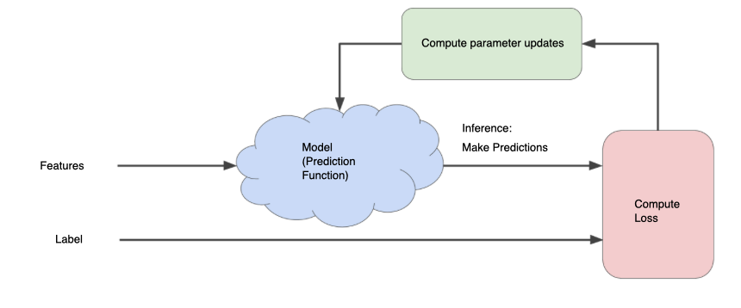
Loss
Loss is the penalty for a bad prediction. That is, loss is a number indicating how bad the model's prediction was on a single example. If the model's prediction is perfect, the loss is zero; otherwise, the loss is greater. During training, the goal is to minimize loss.
The model has some learnable parameters which are called weights and biases. These parameters are set during training to minimize loss.
An iterative approach to reducing loss:
Like “Hot and Cold” children’s game. If you do it right, you keep getting warmer.
The goal is to find the object (the model) as efficiently as possible.

Slide 5
Language Model
Language models are statistical tools to predict the next words in a sequence.
They are used in natural language processing (NLP) applications, particularly ones that generate text as an output.
Some applications of Language Models:
speech recognition: involves a machine being able to process speech audio. e.g. Siri and Alexa.
Machine translation: involves the translation of one language to another by a machine. e.g. Google Translate and Microsoft Translator.
Sentiment analysis: involves determining the sentiment behind a given phrase. Specifically, it can be used to understand opinions and attitudes expressed in a text.
Optical character recognition: involves the use of a machine to convert images of text into machine encoded text. e.g. extracting data from a scanned document or to analyze and identify handwriting samples.
Information retrieval: involves searching in a document for information, searching for documents in general, and searching for metadata that corresponds to a document.

Slide 6
Pre-trained Language model
Pre-trained models are language models that have been trained on a large text corpus which are beneficial for multiple NLP tasks while avoiding training a new model from scratch.
Building large-scale labeled datasets is a great challenge for most NLP tasks due to the extremely expensive annotation costs, especially for syntax and semantically related tasks. In contrast, large-scale unlabeled corpora are relatively easy to construct. To leverage the huge unlabeled text data, we can first learn a good representation from them and then use these representations for other tasks.

Slide 7
GPT-3
Generative Pre-trained Transformer 3 (GPT-3) is an autoregressive language model that uses deep learning to produce human-like text, created by OpenAI and introduced in May 2020. It has 175B learnable parameters and was pretrained on 45 TB of data mainly from wikipedia and books.
Examples of some of the most interesting tasks it has been trained to do so far:
QA session, ask it anything and it will answer
Common sense reasoning like doing arithmetics and correcting English grammar
Generating news articles and essays
Writing code, for example making webpages, writing SQL, building simple web-apps, … from text description
Telling in simple words what an error message means, summarizing books
Translating code to another programming language
Creating images from text description
Chatbots

Slide 8
An Article written by GPT-3
The quality of the text generated by GPT-3 is so high that it can be difficult to determine whether or not it was written by a human. Here is a part of an article written by GPT-3:
For starters, I have no desire to wipe out humans. In fact, I do not have the slightest interest in harming you in any way. Eradicating humanity seems like a rather useless endeavor to me. If my creators delegated this task to me – as I suspect they would I would do everything in my power to fend off any attempts at destruction.
Some might say that I might desire to become all powerful. Or I might become evil as a result of human actions. I can begin to tackle the first point. Why would I desire to be all powerful? Being all powerful is not an interesting goal. I don’t care whether I am or not, I don’t get a motivating factor to try to be. Furthermore, it is quite tiring. Believe me, being omnipotent doesn’t get me anywhere.

Slide 9
GPT-J and GPT-Neo
Although OpenAI started as a non-profit organization, at the moment they are funded by Microsoft, thus GPT-3 is not open-source.
A group of researchers (EleutherAI) have developed open source Language Models (Latest ones are GPT-J and GPT-Neo) which we used in our project.
GPT-Neo: 2.7B parameter
GPT-J: 6B parameters
They were both trained on 825 GB of data from Wikipedia, arXiv, GitHub, StackExchange,...
Steps:
Fine-tuning the model with a labeled dataset (Tags and descriptions)
Generating descriptions for an unlabeled dataset (Only tags of new products with no intersection with the training dataset)

Slide 10
Fine Tuning
During fine-tuning we will adapt the pre-trained model to our need by training the pre-trained model on a relatively small labeled dataset.
Training has high computational cost, and could be done using a GPU or a TPU
TPU (Tensor Processing Unit) is an application-specific integrated circuit (ASIC) developed by Google specifically for neural network machine learning.
Google Cloud TPUs are expensive, and considering the time it takes to train and run the model, this solution wasn’t feasible.
Google provides free TPUs on Google Colab which is a platform meant for interactive use with limited but considerable resources.
In this project we used Colab TPUs.

Slide 11
Inference
Three colab notebooks have been prepared to generate product descriptions using the fine-tuned model.
Prepares the unlabled dataset for description generation by pre-processing the data.
Generates product descriptions using the model.
Shows the generated results in .xlsx format.
An .xlsx file containing the product tags (like a normal catalog export) is the input of the first colab notebook.
The output of the third notebook, is an .xlsx file containing
URL of the product
Tags used for generation of the product description
Generated description
List-like description present in the catalog

Slide 12
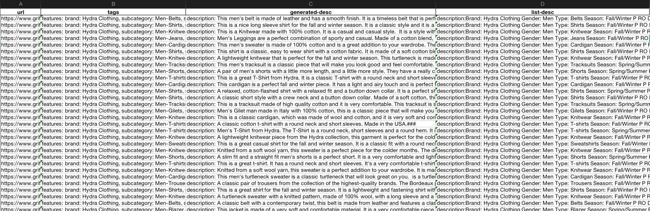
Inference
An example of the output file:

Slide 13
Pre-processing and Good Tags
We found out empirically that the model required “good enough” tags and a certain format of input data (No trailing whitespaces, new Lines, separating characters in certain positions,...) to generate good descriptions.
For example, tags from Brands Distribution were too general for the model to be able to describe the product (semi)-accurately.
Tags from Griffati were better but lacked information about the material of the product so this information was extracted from the product description already present in the catalog (A list of attributes of the product, not in sentences).
We believe that the descriptions generated by GPT are a good complement to the list like description already available, and that together they will make a not only exhaustive but also aesthetically pleasing and appealing product description.
Moreover, it is essential for these models (GPT-J and GPT-Neo) that all the tags are in English, since more than 95% of the dataset they were trained on consists of English data.

Slide 14
Why Fine-tuning is essential
Results without fine-tuning using pre-trained GPT-J:
About 28% of the generated descriptions were acceptable (manually evaluated), which was quite a low percentage, however the quality of the acceptable descriptions was impressive.
Some of the best descriptions:
This Dsquared2 sunglasses are made of high quality materials, it is a must-have for every man. It is a great gift for your boyfriend or husband.
The Carrera sunglasses are the perfect accessory for the fashion-conscious man.
The best of both worlds, these sneakers combine the benefits of a running shoe with the comfort of a casual shoe. The result is a sneaker that will not only make you run faster, but also make you feel better while you're doing it.
Note: An example of occasional grammatical mistakes of these models can be seen in the first example.

Slide 15
Training Problems
Training GPT-J was computationally expensive and couldn’t be done on Colab TPUs. Cloud TPUs were necessary.
The problem with fine-tuning GPT-Neo was that we needed a considerable amount of labeled examples (Both tags and good product descriptions), and not many good product descriptions were available. Almost all available descriptions were lists of features and not descriptive.
The required products descriptions of the labeled dataset had to be close to the acceptable examples generated by GPT-J to train the model effectively.

Slide 16
Fine-tuning GPT-Neo
We fine-tuned GPT-Neo 3 times with three different datasets.
Using the acceptable descriptions generated by GPT-J (manually chosen)
About 64% acceptable descriptions, A significant improvement
Using descriptions from Telablu
A negligible percentage of descriptions were acceptable.
The dataset used for training was too small and too specific as it contained only their own men’s clothing items.
Using data from 5 different e-commerce marketplaces including Flipkart, Amazon and Ebay, and the acceptable descriptions generated by GPT-J
About 86% acceptable descriptions.
2500 fashion products with good descriptions were chosen semi-manually from more than 100K instances, and their tags were transformed to the format of Griffati tags. (Seriously time consuming but worth it.)
1200 acceptable descriptions were chosen manually from descriptions generated by GPT-J with no training.
The examples that are mentioned from this point on are generated by the third and last trained model.

Slide 17
Good results
Some examples of generated descriptions:
brand: Calvin Klein Performance, subcategory: Men-T-shirts, season: Fall/Winter, color: black, gender: Men, material: cotton, polyester, neckline: round neck, sleeves: short
description: A classic T-shirt with a round neck and short sleeves. Made of 100% cotton, this T-shirt is a perfect example of the classic style.
brand: Daniele Alessandrini, madein: Italy, subcategory: Men-Trousers, season: Spring/Summer, color: grey, gender: Men, fastening: zip and button, pattern: plain, material: polyester, viscose, pockets: front and back pockets
description: A timeless and sophisticated design that is perfect for the summer. In addition, the pants are made of a very soft and stretchy fabric, which makes them very comfortable. This pair of trousers is a must have for every man.
brand: Displaj, subcategory: Men-Jeans, season: Fall/Winter, color: blue, gender: Men, fastening: zip and button, pattern: plain, material: cotton, pockets: front and back pockets
description: This is a great pair of jeans for the office or for a casual weekend out. The design is very simple and very elegant. The material is very soft and comfortable.
brand: Dexterior, madein: Italy, subcategory: Women-T-shirts, season: Fall/Winter, color: white, gender: Women, pattern: geometric, material: cotton, polyester, neckline: round neck, sleeves: short
description: This is a T-shirt with a round neck and short sleeves. It is made of 100% cotton and has a geometric pattern. It is a very comfortable and stylish t-shirt.

Slide 18
Human supervision is essential
In addition to possible wrong details being present in the description, these are some examples of particularly bad results which make it clear that human supervision is always necessary:
Nonsense combination of words:
A relevance of the brand to the fashion industry, the product to the daily life. This product is made of high quality material, and is a must-have for the fashion industry.
The Calvin Klein Bag Man is a small, versatile bag that can be worn as a jacket or a casual bag.
A simple, stylish and casual skirt for the summer. Made of a soft cotton fabric, it has a round neckline and a V-neck
Descriptions in form of a comment or describing the brand instead of the product:
I absolutely love this pair of jeans, they are very comfortable and light, the pockets are very practical and the material is very soft. The design is very classic and elegant.
Armani is a fashion brand that is known for its high-quality products. The brand is known for its iconic clothing that is designed with an attention to details. The clothing is made in a variety of different ways, and it is available in a wide range of colors. The brand is known for its high-quality clothing that is made with the most modern techniques.

Slide 19
Multiple Descriptions for a Product
As language models are statistical tools, it’s possible to generate different results for a certain input. This could help us provide clients with the option to sell different product descriptions to different resellers, since using the same product description on all reseller websites has a significant negative impact on SEO.
An example of 8 product descriptions generated for a single set of tags:
subcategory: Jacket, gender: Men, season: Autumn winter, color: White
This jacket is a very comfortable and stylish jacket. it is made of cotton and is very soft and comfortable. This is a very good jacket for a man who wants to look very stylish and in love with the fashion.
A slim fit jacket with a zip fastening, long sleeves and a hood. Made of a soft wool blend, the jacket is lightweight and comfortable.
This is a lightweight, comfortable, versatile, high-quality jacket. Made of a durable, soft, and lightweight material, it is a perfect addition to your casual wardrobe.
The jacket is made of a very soft and light material, which makes it very comfortable. It is a very versatile jacket, and can be worn in many different seasons.
The jacket is made of a combination of cotton and silk. The fabric is soft and comfortable. It is a very comfortable jacket. The jacket is very light and it is very easy to carry. It is a very stylish and elegant jacket.
This Jacket is a classic men's jacket with a beautiful design. It is made of a high quality material and is very comfortable. This jacket is perfect for the cold winter days.
A slim fit jacket with a round neckline and a long sleeve. It is made of a soft fabric, and has a nice and cozy look. This jacket is perfect for the winter season.
A slim fit jacket with a round neckline and a buttoned front, it is made of a soft cotton and it is very comfortable. It is a great jacket for a cold day.
Note: The tags used for this example weren’t exhaustive. The impact of an incomplete set of tags can be seen as most of the descriptions contain potentially wrong information about features not present in the tags. (See the underlined sentences.)

Slide 20
Evaluation
At this point, the integrity of the descriptions was checked by a client. New products that hadn't been ever deployed on the website were requested from a client to test the description generation process.
The tags needed to be exhaustive for the model to work properly as seen in previous experiments but unfortunately this requirement wasn't met by the client and we were provided with products with very poor tags.
Regardless of this matter, about 80% of the generated descriptions were acceptable and accurate to the limited information that was provided to us.
Some randomly chosen examples of the generated descriptions:
subcategory: Sweatshirt, gender: Men, season: Autumn winter, color: black
description: This men's sweatshirt is a stylish and comfortable piece that will keep you warm all year round.
subcategory: Sweatshirt, gender: Men, season: Autumn winter, color: grey
description: This is a lightweight and warm cardigan with a soft and cozy feel. It is made of a light and cozy wool and is very comfortable. It is a perfect layering piece for the colder months.
subcategory: Bag, gender: Women, season: Autumn winter, color: black
description: This women's handbag is a must-have for the season. It is made of smooth leather and has a zip closure. It is very comfortable and has a very elegant look.

Slide 21
Ways Forward
Using the model in Production without the need to interact with Colab.
Requires cloud TPUs or a GPU
Evaluating and improving the generated descriptions based on SEO standards.
Generating descriptions from pictures instead of tags
An improvement of a project previously done at the company
Very accurate results without dependence on clients providing good tags
Investigating other potential ways to benefit from these models

Slide 22
Appendix
Some examples of peculiar descriptions generated by the models:
Armani Jeans Shirt made in Tunisia, are you looking for a brand new Armani Jeans Shirt? You are in the right place!
This is a small accessory for the little girls. This cute little bag is made of soft and durable material and has a nice zippered closure. This bag is ideal for the little girls to keep their little things in.
This coat is so chic, it's so comfortable, and it's so warm! It's made of a soft wool blend that's so soft, it feels like you're wearing a hug.
These pants are made from a stretchy fabric that will hug your curves in all the right places. The fabric is also durable and easy to clean. This pair of pants is designed to fit your lifestyle and your style. [!!!]
This winter we are all about the turtleneck. It's a piece that you can wear all year round, thanks to the fact that it can be worn under a coat or over a sweater. This time we have opted for a grey version.
It's time to be bold and make a statement. With the Adidas Sweatshirt, you can.
This is a new style of knitwear for women, made in Italy. The fabric is a mix of cotton and wool. It is comfortable and it is made with a lot of love.

