Slide 1
11-Apr-23

Slide 2
Outline
One slide for outline of your presentation
Introduction and motivation (describe why this topic is interesting)
Materials and methods (dataset and methods that you planned to use in your project)
Evaluation (describe what do you expect from this research and which approach could you use to evaluate the outcomes?)

Slide 3
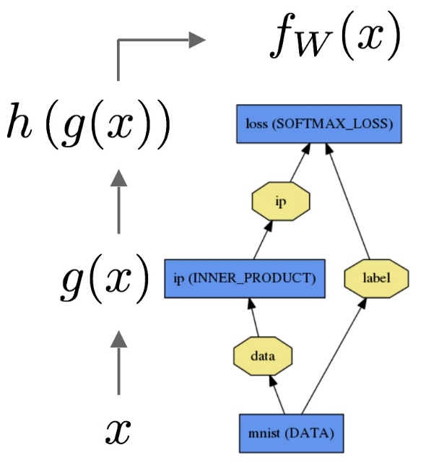
Some notes about figures and tables
Try to use high quality Figures
Put caption for each Figure/Table
Add reference (with hyperlink) to the Figures which you took from somewhere else
Put title for the axis (if any)
Put units for the variables (if applicable)
Forward pass of an ANN (Source: Caffe documentation)

Slide 4
Schedule
For your presentation you will have:
For Proposal presentation: 10 minutes + 5 minutes for possible questions
Please update the relevant folder in your repository and update the links in the associated README.md files.

