Slide 1
11-Apr-23

Slide 2
Outline
One slide for outline of your presentation

Slide 3
Introduction
You can have one or two slides for introduction
Bring the audience to the context of your topic
Introduce the topic

Slide 4
Main Topic (solutions of the problem)
This is the main body of your presentation
You can have many slides for this part (just consider the presentation time)
Attract the audience using nice visualization
Avoid putting a lot of text in one slide
Use equation editor for writing equations and define all variables of the equation
Use slides animations if necessary, but do not use it too much
If necessary, add sections to your presentation
Use consistent font and font size (view: slides master may help)

Slide 5
Main Topic (solutions of the problem)
Please organize your slides using the PowerPoint sections. For example for your Final Project Presentation, you can use the following sections as the body of your presentation:
Dataset
Exploratory Data Analysis (EDA)
Dataset information, acquisition details, image sizes, etc.
Model(s)
Description of the model(s) employed
Experimental Setup
Hyperparameters configuration (learning rate, epochs, optimizer, normalization, etc.)
Experimental protocol (train/val/test distribution, metrics, etc.)
Results
Quantitatively (metrics, training curves)
Qualitatively (model’s output, GradCAM (for classification))
Comparison between different methods (baseline, selected method(s), SOTA from other papers)
Summary
Summarize your findings
Discussion, limitations, future works

Slide 6
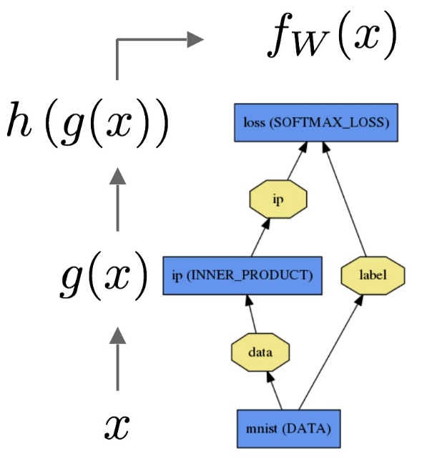
Some notes about figures and tables
Try to use high quality Figures
Put caption for each Figure/Table
Add reference (with hyperlink) to the Figures which you took from somewhere else
Put title for the axis (if any)
Put units for the variables (if applicable)
Forward pass of an ANN (Source: Caffe documentation)

Slide 7
Schedule
For your presentation you will have:
For Presentation01-Dataset: 15 minutes + 5 minutes for possible questions
For Presentation02-CNN Architectures: 30-45 minutes + 15 minutes for possible questions
For Presentation of the final project: 30-45 minutes + 15 minutes for possible questions
Please update the relevant folder in your repository and update the links in the associated README.md files.
We may use/share your presentation and related files later. Please let us know if you do not agree.

Slide 8
Summary
This last slide(s) summarizes your presentation
List the main parts of your presentation
Discussion
Advantages
Limitation
Future work and extensions (if applicable)

Slide 9
References
Add references which you used
Put a hyperlink for each reference
You can add some sources as further readings (more details which you did not cover them)

