Slide 1


ULTRASOUND NERVE SEGMENTATION USING DEEP LEARNING
Guide name : R. Anusha-Assistant professor- CSE, MLRIT
Presented by:
P. Harika Reddy - 17R21A05G3
Md Nizamuddin - 17R21A05F2
Md Abdul Mujeeb - 17R21A05F1

Slide 2
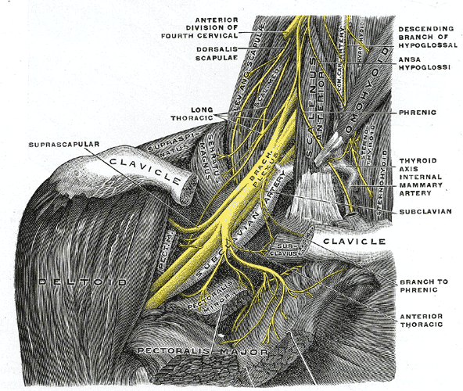
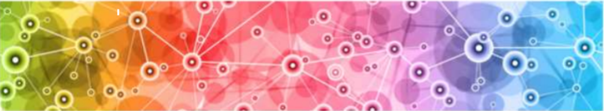
ABSTRACT
Today medical field has provided us enormous facilities that has been never thought before. There has been done many improvements in the field of surgery, medicine, X-Rays and many more. But some areas still want some improvements so that patients don’t need to face any type of difficulty or pain. We are trying to highlight the difficulties and in the treatments that are based on the ultrasound images. So in paper this our main focus is to improve the treatments based on ultrasound scans which is used widely in medical field due to vast area of application and cost effectiveness. These ultrasound scans are very important to detect any kind of injury of disease in human body because it used to scan the internal tissues of the body.

Slide 3
PROPOSED SYSTEM
The idea is to construct a Deep Neural Network for Biomedical Image Segmentation, in this case the ultrasound images of the nerves near the areas of the Neck.
To Train the Neural Network with not the raw ultrasound nerve images available but to pre-process the data with the aim to reduce noise in the image in order to make it clearer for the Deep Neural Network to understand the ultrasound nerve image.
To keep improving the Accuracy of the model by identifying potential parameters which are a bottleneck
To improve prediction time of the Neural Network by training efficient models that take significantly less time to predict when compared to conventional models.

Slide 4
ADVANTAGES
Clear Images prone to give High accuracy with significantly less data but more information due to clarity in dataset
Increase in Accuracy due to Image Noise reduction and pre-processing of the ultrasound images of nerves
Fast prediction due to availability of clear data for training the model for prediction

Slide 5



DIVISION OF MODULES
PREPROCESSING
MODEL TRAINING
PREDICTION

Slide 6
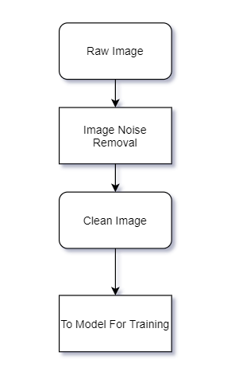
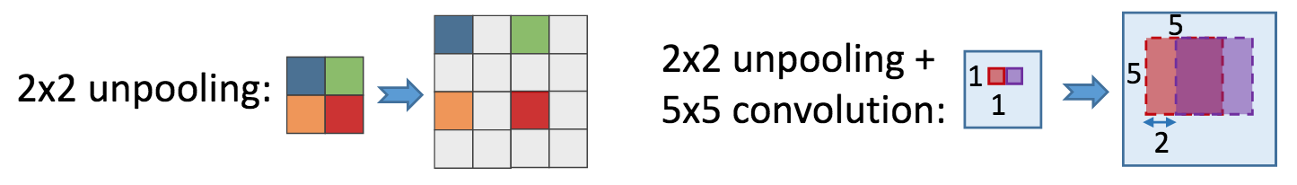
PREPROCESSING
Data is cleaned by removing irrelevant, duplicate ultrasound nerve Images
Data is properly up-sampled before sending as training data for model training purpose
Unpooling is used to stretch the low resolution Image
Convolution is used to up-sample the Image to a Higher resolution for more clarity

Slide 7
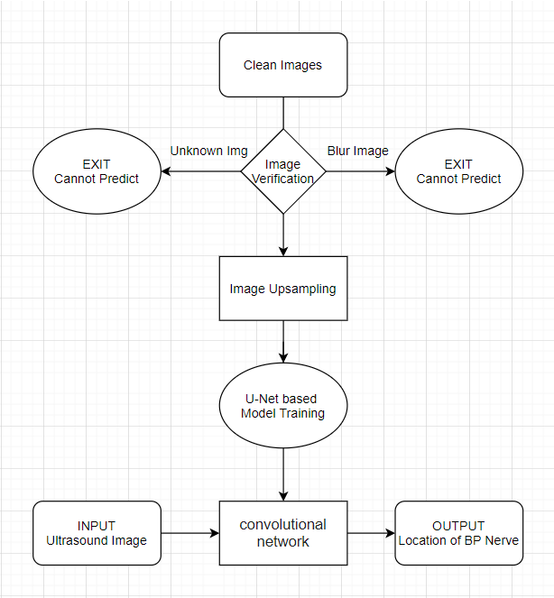
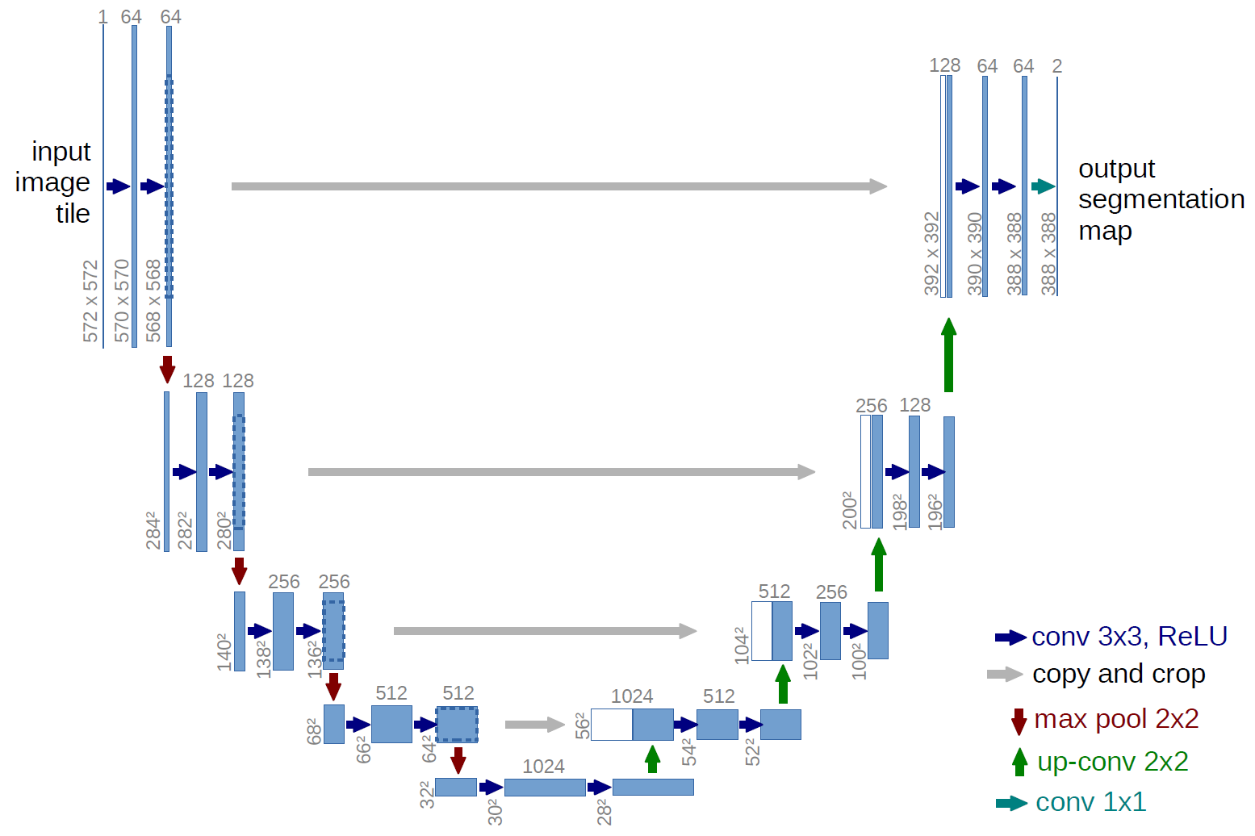
MODEL TRAINING
U-Net: Convolutional Networks for Biomedical Image Segmentation - Award winning Architecture
420x580 resolution
5635 training images with masks
5508 test; – ~120 images per 47 patients

Slide 8
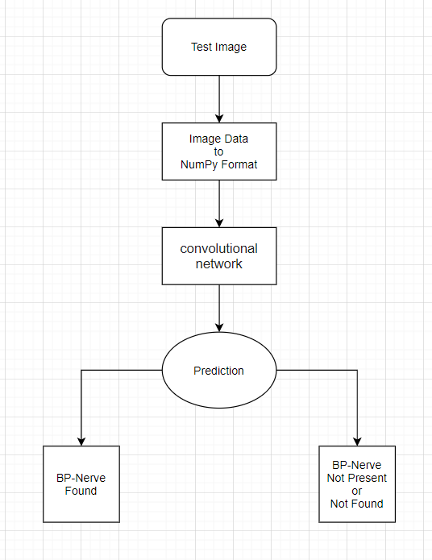
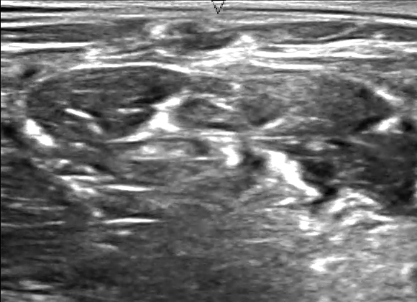


PREDICTION
Keras model is developed using core Tensorflow components
Model is supplied with test data, the kind of Images it hasn’t encountered before
Clear Images, if they contain BP Nerve, an White spot on Black Background is shown which depicts the position of the BP nerve in the Ultrasound Image

Slide 9
ALGORITHMS USED
Algorithm | Use-case
U-Net Convolutional Network | Architecture
Image Segmentation | Pre-processing
Run-Length Encoding | Image Format -> Readable Format
Convolutional 2D Layer Transpose | Training Deep Learning Model

Slide 10
TECHNOLOGIES USED
Technology | Purpose
Scikit-Image | Pre-Processing
Numpy | Data conversion from Image to RAW
Keras, TensorFlow | Deep Learning Model
Python 3 | Programming Language

Slide 11
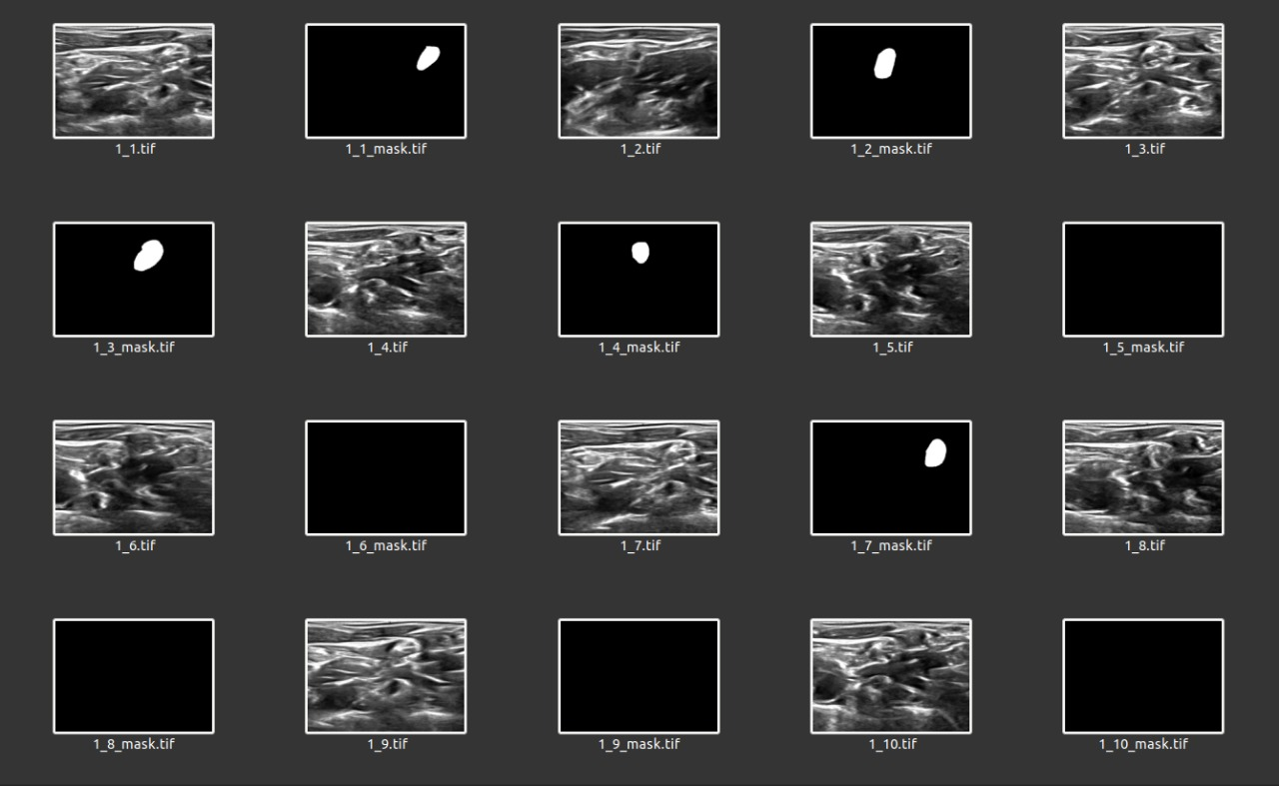
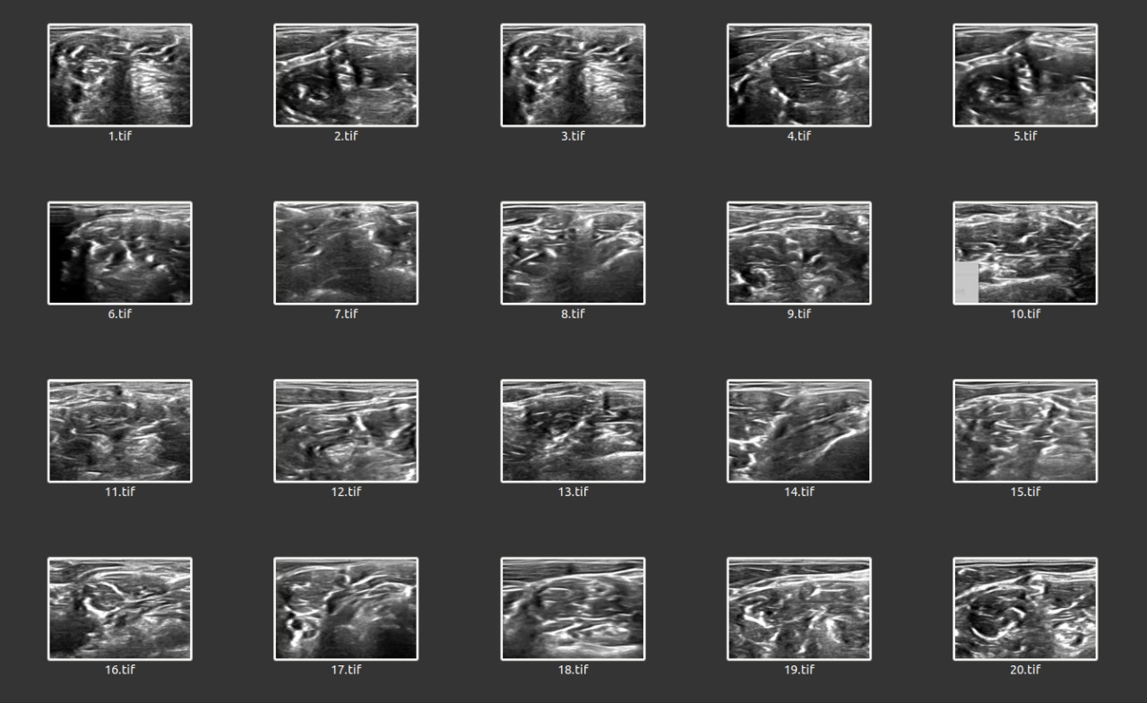
Dataset:
Training Data
Testing Data

Slide 12
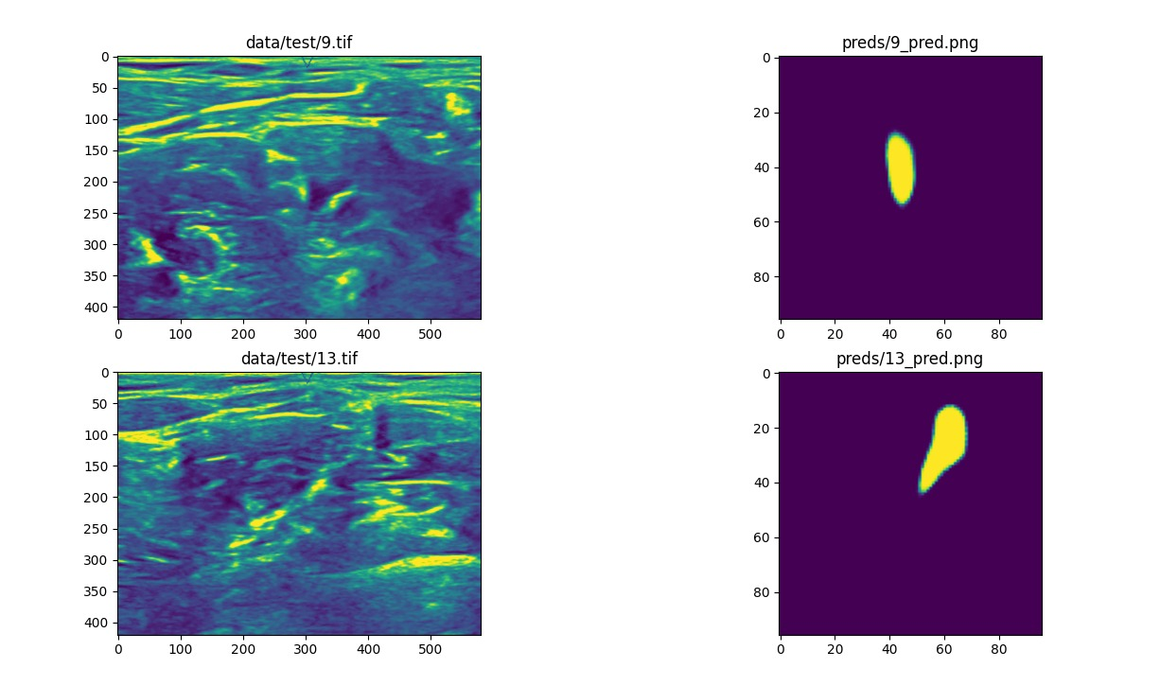
RESULT
We have successfully predicted the branchial plexus nerve around the part of neck in the human body.

Slide 13
CONCLUSION
One major disadvantage of these images is that they include huge amount of noise so doctors face difficulty in finding the exact location of the nerve where they have to inject the medicine to operate. These pictures are not clear enough to find the nerve at once so they have to inject needle very times. With this application they can find the nerve very easily because it includes the segmentation of these nerves in ultrasound images. This application is further extended to train the system with this data so that it can be used worldwide.

Slide 14
FUTURE WORKS
There are still some lack of facilities available in the area of medical field. The facilities should be improved with the latest technologies. The more are the facilities, the more will be the accuracy of the health of the patients.

Slide 15
REFERENCES
[1] https://data-flair.training/blogs/python-mini-project-speech-emotion-recognition/
[2] Efficient Detection of Brachial Plexus in Ultrasound Images using Machine Learning Algorithms Deepak Sharma, Lalit kumar
[3] P.A.Venktachalam, Ahmad Fadzil Mohd Hani, Umi Kalthun Nag Lim Eng Eng: “Processing of Abdominal Ultrasound Images Using Seed based Region Growing Method”, Proceedings of International Conference on Intelligent Sensing and Information Processing, IEEE, 2004.
[4] Olaf Ronneberger, Philipp Fischer, and Thomas Brox: “U-Net: Convolutional Networks for Biomedical Image Segmentation” MICCAI, 2015.
[5] https://en.wikipedia.org/wiki/Brachial_plexus
[6] https://medium.com/jun-devpblog/dl-12-unsampling-unpooling-and-transpose-convolution-831dc53687ce
[7] https://www.tutorialspoint.com/dip/concept_of_convolution.htm
[8] https://byjus.com/physics/accuracy-precision-measurement/
[9] https://medium.com/analytics-vidhya/precision-and-recall-in-machine-learning-c8a1b9638eeb
[10]TeemuKanstrén,https://towardsdatascience.com/a-look-at-precisionrecall-and-f1-score-36b5fd0d

Slide 16


