Slide 1
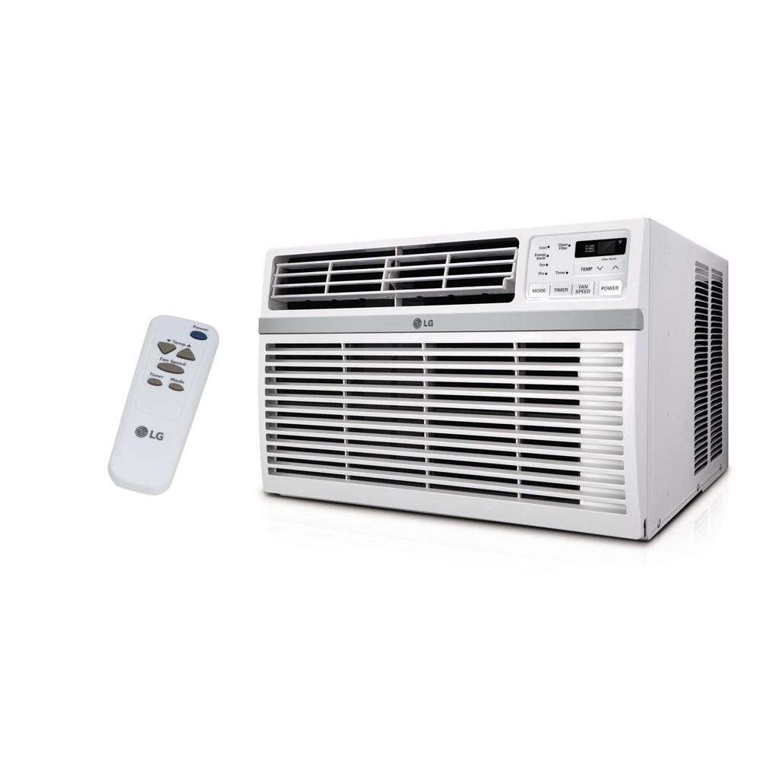
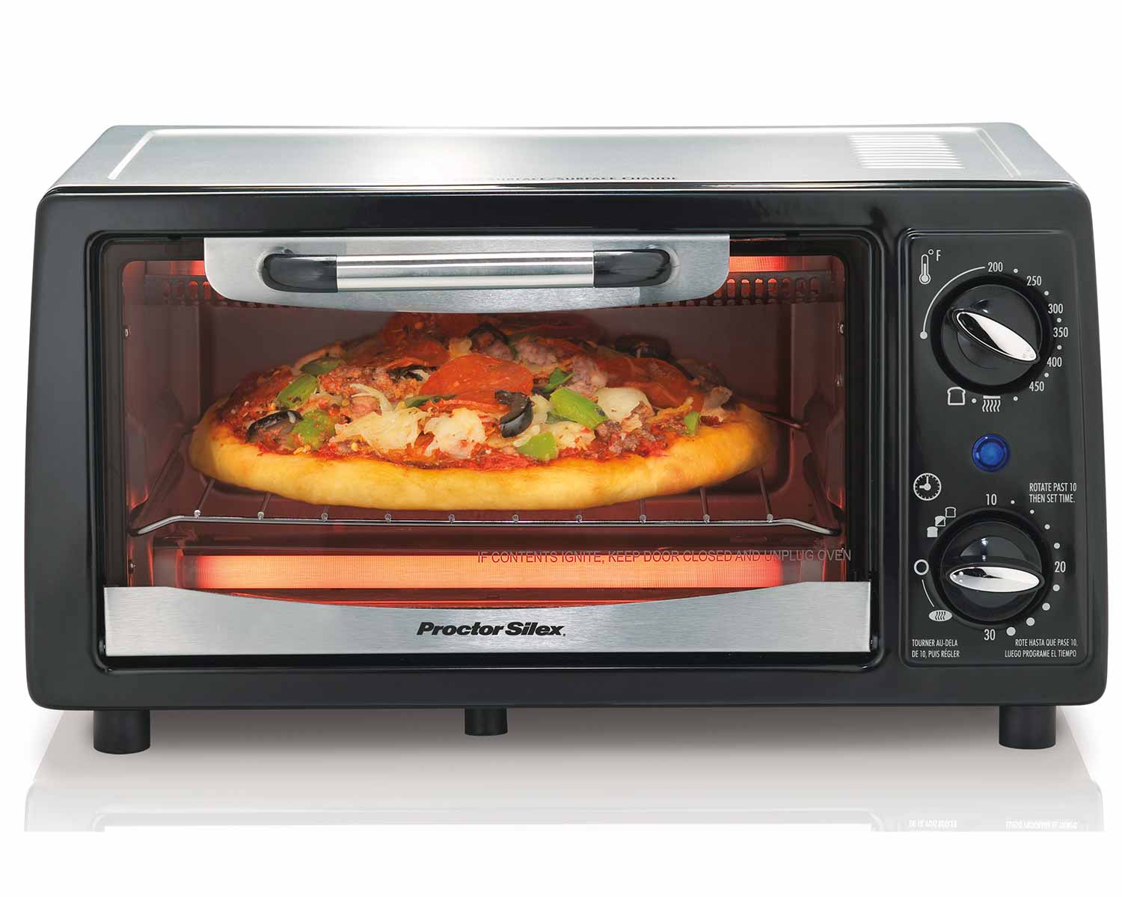
Looping / Iteration
Repeating a set of instruction for a peroid of time
Notes:
Title + Image + Text

Slide 2

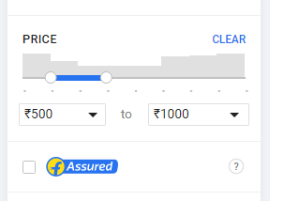

Looping / Iteration
How will you write this in programming?
Notes:
Title + Image + Text

Slide 3
Looping / Iteration
Repeat If
(Price >= 500 && Price <= 1000)
{
Display the bag;
}
while(Price >= 500 && Price <= 1000)
{
Display the bag;
}
Notes:
Title + Image + Text

Slide 4
Print 1 to N
Sample Input:
Sample Output:
10
1 2 3 4 5 6 7 8 9 10

Slide 5
Looping / Iteration
number = 1
Repeat If (number <= N)
{
Print number
number++
}

Slide 6
while Loop
Syntax:
while
(condition)
{
// Body of the loop
Increment / decrement;
}

Slide 7
Code
1
2
3
4
5
6
7
8
9
10
11
12
13
14
#include<stdio.h>
int main()
{
int N;
scanf(“%d”, &N);
How…??
int number = 1;
while(number <= N){
printf(“%d”, number);
number++;
}
return 0;
}

Slide 8
Demo

Slide 9
Looping / Iteration
number = 1
Repeat If (number <= N)
{
Print number
number++
}
for(number = 1; number <= N; number++)
{
Print number
}

Slide 10
for Loop
for(number = 1; number <= N ; number++)
{
Print number
}
Syntax:
1
2
4
for
(Initialization / Declaration;
Condition ;
Increment / Decrement )
{
// Body of the loop
3
}

Slide 11
Code
1
2
3
4
5
6
7
8
9
10
11
12
13
14
#include<stdio.h>
int main()
{
int N;
scanf(“%d”, &N);
for(int number = 1; number <= N; number++){
printf(“%d”, number);
}
return 0;
}

Slide 12
Demo

Slide 13
Count the number of digits
Sample Input:
Sample Output:
44
2

Slide 14
Pseudocode
Input: N
count = 0
Repeat If (N > 0)
{
count++
N = N / 10
}
Print count
Sample Input :
0
Output : ???
Notes:
Here the output is 0. But expected output is 1. Try to rewrite the code

Slide 15
Pseudocode
Input: N
count = 0;
If(N == 0){
Print “1”
}
Else{
Repeat If (N > 0)
{
count++
N = N / 10
}
Print count
}
Without “If” , how will you write this program?
Notes:
Here the output is 0. But expected output is 1. Try to rewrite the code

Slide 16
Pseudocode
Input: N
count = 0;
If(N == 0){
Print “1”
}
Else{
Repeat If (N > 0)
{
count++
N = N / 10
}
Print count
}
Input: N
do{
count++
N = N / 10
}while(N > 0)
Notes:
Here the output is 0. But expected output is 1. Try to rewrite the code

Slide 17
Pseudocode
Input: N
do{
count++
N = N / 10
}while(N > 0)
Syntax:
do{
// Statement
}while(condition);

Slide 18
Code
1
2
3
4
5
6
7
8
9
10
11
12
13
14
#include<stdio.h>
int main()
{
int N;
scanf(“%d”, &N);
int count = 0;
do{
count++;
N = N / 10;
}while(N > 0);
printf(“%d”, count);
}

Slide 19
Demo

Slide 20
Looping / Iteration
while
for
do - while
- Entry check loop
- The condition will be checked
first
- Exit check loop
- The statements will be
executed first

Slide 21
Looping / Iteration
Why we are using three loops?
Know the number of iteration - for
Don’t know the number of iteration - while
Statement to be executed atleast once – do - while

Slide 22
Jump Statements
break
continue
return
Notes:
We will see return in later lesson

Slide 23
break Statement
To terminate the loop
Syntax:
break;
Notes:
As soon as the break statement is encountered from within a loop, the loop iterations stops there and control returns from the loop immediately to the first statement after the loop.

Slide 24
// Program
Demo
1
2
3
4
5
6
7
8
9
10
11
12
13
14
#include <stdio.h>
int main() {
for(int i = 1; i <= 15; i++){
printf(“%d\n”, i);
if(i == 5){
break;
}
}
}

Slide 25
continue Statement
To execute the next iteration of the loop.
Syntax:
continue;

Slide 26
// Program
Demo
1
2
3
4
5
6
7
8
9
10
11
12
13
14
#include <stdio.h>
int main() {
for(int i = 1; i <= 10; i++){
if( i == 5){
continue;
}
printf(“%d\n, i);
}
}

Slide 27

THANK YOU
Notes:
Thank you slide

