Slide 1
Operators
An operator is a symbol that tells the compiler to perform certain
mathematical or logical manipulations.
Operators are used in program to manipulate data and variables.
a + b
a and b -> operands
+ -> operator
C Operators are classified into 7 categories.

Slide 2
7 Types of Operators
Arithmetic Operators
Relational Operators
Assignment Operators
Logical Operators
Bitwise Operators
Increment and Decrement Operators
Special Operators

Slide 3
Arithmetic Operators
An arithmetic operator performs mathematical operations such as addition, subtraction and multiplication on numerical values (constants and variables).
Operators | Example a = 10, b = 5
+ | a + b = 15
- | a – b = 5
* | a * b = 50
/ | a / b = 2
% | a % b = 0
Notes:
Title + Image + Text

Slide 4
If you have more than one arithmetic operator in an expression, which operator will execute first?
B O D M A S
%
*
+
-
order
Brackets ()

Slide 5
What is the difference between % and / operator?
/ -> Quotient
% -> Remainder

Slide 6
Relational Operators
A relational operator checks the relationship between two operands. If the relation is true, it returns 1; if the relation is false, it returns value 0.
Relational operators are used in decision making and loops.
It is used to form a condition
Notes:
Title + Image + Text

Slide 7
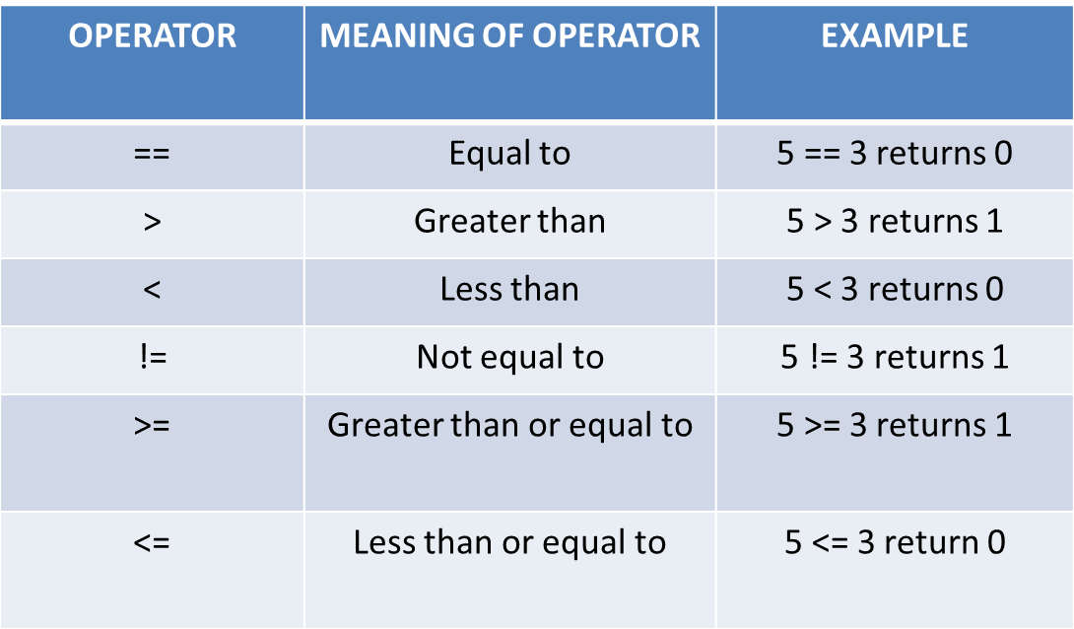
Relational Operators
Notes:
Title + Image + Text

Slide 8
Logical Operators
An expression containing logical operator returns either 0 or 1 depending upon whether expression results true or false
It is used to combine the conditions when you have more than one
Notes:
Title + Image + Text

Slide 9
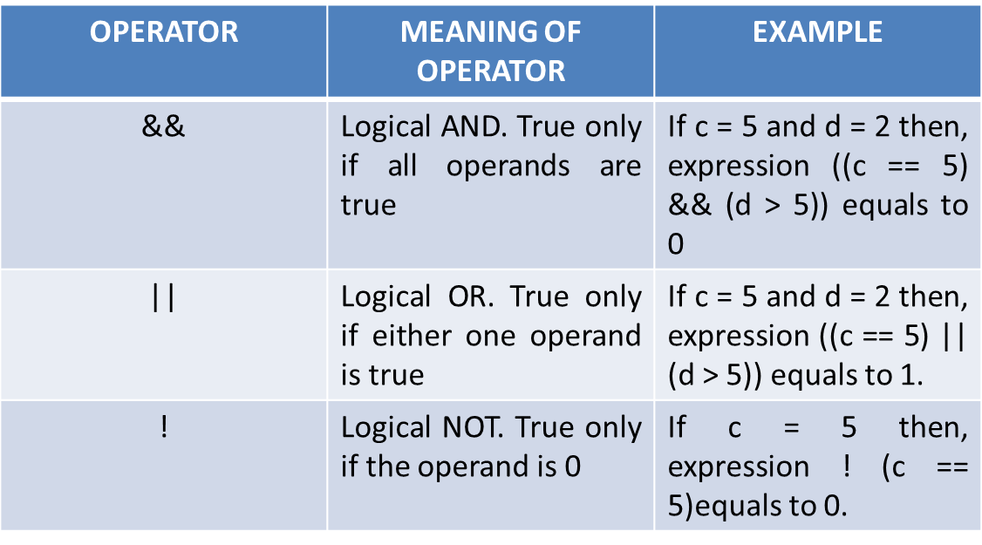
Logical Operators
Notes:
Title + Image + Text

Slide 10
Assignment Operators
Right side value will be assigned to the left side variable
Operator | Example | Meaning
= | a = b | a = b
+= | a += b | a = a+b
-= | a -= b | a = a-b
*= | a *= b | a = a*b
/= | a /= b | a = a/b
%= | a %= b | a = a%b
Notes:
Title + Image + Text

Slide 11
Bitwise Operators
To perform bit-level operations.
Uses:
Communication stack
Compressing(Audio, video, text, image..etc)
E.g: Zip file
Notes:
Title + Image + Text

Slide 12
Bitwise Operators
a | b | a & b | a | b | a ^ b
0 | 0 | 0 | 0 | 0
0 | 1 | 0 | 1 | 1
1 | 0 | 0 | 1 | 1
1 | 1 | 1 | 1 | 0
Notes:
Title + Image + Text

Slide 13
// Program
1
2
3
4
5
6
7
8
9
10
11
12
13
14
#include <stdio.h>
x = 1 0 1 1
y = 0 1 1 1
int main() {
x | y = 1 1 1 1
int x = 11;
int y = 7;
int a = 8;
int b = 1;
printf(“%d”, x | y);
printf(“%d”, x & y);
printf(“%d”, x ^ y);
printf(“%d”, a << b);
printf(“%d”, a >> b);
return 0;
}

Slide 14
// Program
1
2
3
4
5
6
7
8
9
10
11
12
13
14
#include <stdio.h>
x = 1 0 1 1
y = 0 1 1 1
int main() {
x & y = 0 0 1 1
int x = 11;
int y = 7;
int a = 8;
int b = 1;
printf(“%d”, x | y);
printf(“%d”, x & y);
printf(“%d”, x ^ y);
printf(“%d”, a << b);
printf(“%d”, a >> b);
return 0;
}

Slide 15
// Program
1
2
3
4
5
6
7
8
9
10
11
12
13
14
#include <stdio.h>
x = 1 0 1 1
y = 0 1 1 1
int main() {
x ^ y = 1 1 0 0
int x = 11;
int y = 7;
int a = 8;
int b = 1;
printf(“%d”, x | y);
printf(“%d”, x & y);
printf(“%d”, x ^ y);
printf(“%d”, a << b);
printf(“%d”, a >> b);
return 0;
}

Slide 16
// Program
1
2
3
4
5
6
7
8
9
10
11
12
13
14
#include <stdio.h>
Output:
16
int main() {
int x = 11;
int y = 7;
int a = 8;
How?
int b = 1;
printf(“%d”, x | y);
printf(“%d”, x & y);
printf(“%d”, x ^ y);
printf(“%d”, a << b);
printf(“%d”, a >> b);
return 0;
}

Slide 17
// Program
1
2
3
4
5
6
7
8
9
10
11
12
13
14
#include <stdio.h>
Output:
4
int main() {
int x = 11;
int y = 7;
int a = 8;
How?
int b = 1;
printf(“%d”, x | y);
printf(“%d”, x & y);
printf(“%d”, x ^ y);
printf(“%d”, a << b);
printf(“%d”, a >> b);
return 0;
}

Slide 18
Increment and Decrement Operators
++
Increment the value by 1.
--
Decrement the value by 1.
Notes:
Title + Image + Text

Slide 19
What is the difference between ++a and a++?
++a | a++
Pre - increment | Post - increment
First increment by 1 then, it returns the value | First return the original value then, it is incremented by 1.
Similarly, --a and a--

Slide 20
Special Operators
Sizeof()
&
*
Ternary( ? : )

Slide 21
Special Operators
sizeof() operator will returns the number of memory bytes allocated for the
data (constant, variables, array, structure etc).

Slide 22
// Program
1
2
3
4
5
6
7
8
9
10
11
12
13
14
#include <stdio.h>
int main() {
int a;
float b;
double c;
char d;
printf(“%d bytes”, sizeof(a));
printf(“%d bytes”, sizeof(b));
printf(“%d bytes”, sizeof(c));
printf(“%d byte”, sizeof(d));
return 0;
}

Slide 23
Special Operators
& is used to get the address of the variable
* is used to get the value of the variable pointed by the pointer

Slide 24
Special Operators
Ternary Operator is also known as conditional operator.
It works on three operands.
Syntax:
condition ? statement1 : statement2
E.g: 10 < 20 ? printf(" True ") : printf(" False ");

Slide 25
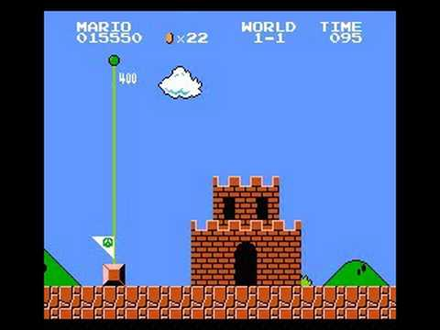
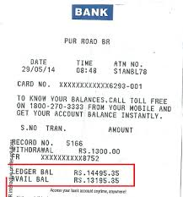

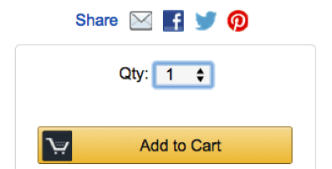
Operators Application

Slide 26

THANK YOU
Notes:
Thank you slide

