Slide 1

Recursion
Reduce unnecessary calling of function
To solve problems in easy way
To reduce the code size (E.g: Tower of hanoi)

Slide 2
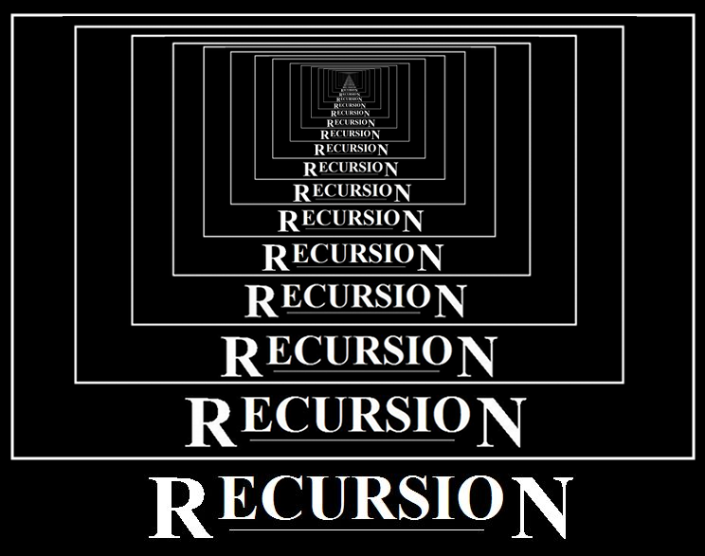
What is Recursion?
A function which calls a copy of itself
again and again
fun()
fun()
fun()
fun()

Slide 3
How memory was allocated to different function calls in recursion?
When any function is called from main, the memory is allocated to it on the stack.A recursive function calls itself, the memory for a function is allocated on the top of the memory allocation and different copy of the local variable is created for each and every function. Base is reached, function returns value to the function by whom it is called and the memory is deallocated and the process continuous.

Slide 4
Advantages
Provide clean and simple code
Iterate using stacks
Reduces unnecessary calling of functions
Reduce the code size

Slide 5
Recursion
Problem: finding out the number of layers in an onion.
Simple solution: As each layer is peeled off, layer-count is incremented by 1
Peeling the top layer reduces the problem to peeling (n-1) layers
onion_peel_count(n) = 1 + onion_peel_count(n-1)
= 1 + 1 + onion_peel_count(n-2)
= 1 + 1 + ... + onion_peel_count(0)
W.K.T onion_peel_count(0) = 0
onion_peel_count(n) = 1 + 1 + ...+ 1
This is recursion - repeatedly applying a procedure.
Applying the procedure again

Slide 6
Recursion
Peeling the top layer reduces the problem to peeling (n-1) layers
onion_peel_count(n) = 1 + onion_peel_count(n-1)
= 1 + 1 + onion_peel_count(n-2)
= 1 + 1 + ... + onion_peel_count(0)
W.K.T onion_peel_count(0) = 0
onion_peel_count(n) = 1 + 1 + ...+ 1
Mathematically
onion_peel_count(n) =
Problem reduction in each step
Base Condition
0 n = 0
1 + onion_peel_count(n-1) Otherwise

Slide 7
Recursion
first
Mathematically
onion_peel_count(n) =
Our logic notation
One that machine can understand
0 n = 0
1 + onion_peel_count(n-1) Otherwise
second
int onion_peel_count(int n) {
if(n == 0) {
return 0;
}
else {
return 1 + onion_peel_count(n-1)
}
}
How should you proceed ?
Notes:
Given a problem, how should you proceed ?
Writing first followed by second

Slide 8
Compute output
1 n <= 9
0 n == 0
dc(n) =
Intention of the Qn is ??
1 + dc(n/10) Otherwise
n | recursive_feeling_1 return value
98
784
47896
Mistake??
2
3
5

Slide 9
Print the sum of n numbers
#include<stdio.h> int sum(int n) {
if(n != 0)
return n + sum(n - 1);
else
return 0;
}
int main() {
int n,result;
scanf("%d",&n);
result=sum(n);
printf("%d",result);
return 0;
}

Slide 10
Code
#include<stdio.h>
int main(){
int num;
scanf("%d", &num);
printf("%d", dc(num));
return 0;
}
int dc(int n){
if(n <= 9){
return 1;
}
else{
return 1 + dc(n / 10);
}
}
Recursion in backend:

Slide 11
Print the digits from left to right using recursion.
Sample Input:
Sample Output:
428
4
2
8

Slide 12
Equation
print n
n <= 9
print_digits(n) =
print_digits(n/10) Otherwise
print (n % 10)

Slide 13
Code
#include<stdio.h>
int print_digits(int n);
int main(){
int num;
scanf("%d", &num);
print_digits(num);
return 0;
}
int print_digits(int n){
if(n <= 9){
printf("%d", n);
}
print_digits(n / 10);
printf("%d\n", n % 10);
}
Recursion in backend:
Sample Input:
456
Output:
40000000000000000000000000000000000..
Notes:
Answer: Infinite loop

Slide 14
Code
#include<stdio.h>
int print_digits(int n);
int main(){
int num;
scanf("%d", &num);
print_digits(num);
return 0;
}
int print_digits(int n){
if(n <= 9){
printf("%d", n);
return;
}
print_digits(n / 10);
printf("%d\n", n % 10);
}
Recursion in backend:
Notes:
Answer: Infinite loop

Slide 15
return (Jump statement)
To terminate the execution of the function and
returns the control to the calling function.
Syntax:
return;

Slide 16

THANK YOU
Notes:
Thank you slide

