Slide 1
Introduction to LangChain: Building Intelligent AI Applications

Slide 2
Course Objectives
Understand LangChain's architecture and how it enables AI workflows.
Build chains, prompts, memory-based applications and agents.
Learn how to integrate external tools and knowledge sources.
Explore Retrieval-Augmented Generation (RAG) and implement knowledge-backed applications.
Apply best practices for building secure, scalable and robust AI solutions.

Slide 3
What we will learn today?
Introduction to LangChain
Setting up the development environment
Chains in LangChain
Prompt Templates
Hands-on Exercises

Slide 4
1.1 LangChain
What is LangChain?
An open-source framework for developing applications powered by Large Language Models(LLMs)
Provides tools, components, and interfaces to simplify the creation of LLM-based applications.
Enables chaining together different components (LLMs, prompt templates, memory, agents, tools) to build complex workflows.
Addresses common challenges like managing context, interacting with external data, and orchestrating multi-step reasoning.
Why LangChain?
Modularity: Break down complex tasks into smaller, manageable components.
Integration: Seamlessly integrate with various LLMs (OpenAI, Hugging Face, Anthropic, etc.) and other data sources/APIs.
Abstraction: Simplifies interactions with LLMs and reduces boilerplate code.
Complex Workflows: Build applications that require memory, access to external tools, and multi-turn conversations.
Rapid Prototyping: Accelerate development of LLM applications.
LangChain acts as the bridge that connects them, giving AI the ability to reason, remember past information, and take meaningful actions. This is where real intelligence begins to take shape.

Slide 5
1.2 LangChain’s Core modules
Overview of main components:
Models: LLMs, Chat Models, Embeddings.
Prompts: Prompt Templates, Example Selectors, Output Parsers.
Chains: Combining LLMs with other components.
Retrieval: Indexing, Retrievers, Document Loaders.
Agents: Dynamic decision-making with LLMs and tools.
Memory: Persistent state for conversations.
Real‑World Applications:
You’ll see how LangChain is used to solve real problems — from intelligent customer service and automated writing to data analysis and research tools. Through hands-on examples, you’ll learn how to design and build similar solutions yourself.
Foundations – Getting Ready to Build AI
Python: Your AI Control Room Set up Python and all necessary tools for AI development.
Protect Your Keys Safely manage API keys to keep your AI access secure.
Install LangChain Step-by-step setup to get LangChain ready for smart AI projects.

Slide 6
Beyond Single Prompts: Why Chains Matter
Learn how LangChain “chains” connect different steps, so your AI can think through a complete process instead of just one question at a time.
The Flow of Thought: How Chains Work
See how chains work step-by-step—taking input, processing it and making decisions across multiple AI calls to solve complex problems.
Create Your First Smart AI
Build your first chain with us! Make useful AI apps like a text summarizer that shortens long documents or a Q&A system that understands the full context.

Slide 7
Foundations - Prompt Templates:
Precision in Communication: Structure, Variables & Placeholders: Learn the secret language of effective prompts. Understand how structured templates, dynamic variables, and smart placeholders empower you to consistently guide AI behavior, reducing ambiguity and boosting accuracy.
Navigate the Pitfalls: Avoiding Common Prompt Mistakes: We'll expose the subtle yet critical errors that lead to vague, unhelpful, or even biased AI responses. Master the art of clarity, conciseness, and contextual framing to unlock the AI's full potential.
Your Prompt Engineering Workshop: This isn't just theory! Dive into practical exercises where you'll design and refine prompt templates for diverse tasks – from creative writing to data extraction – becoming an architect of AI's understanding.

Slide 8
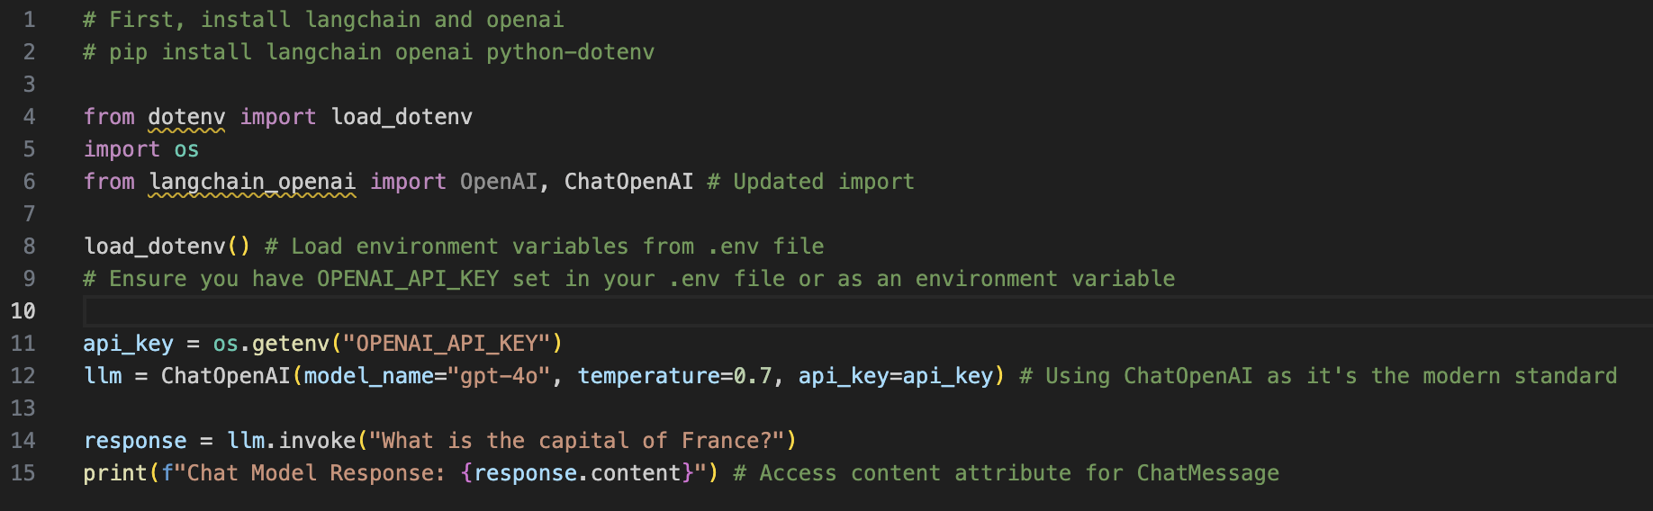
Models (LLMs, Chat Models)
Explanation: LangChain provides a standardized interface for interacting with different Large Language Models.
LLMs: For text completion
Chat Models: Optimized for conversational interfaces (messages, roles like system, human, AI).

Slide 9
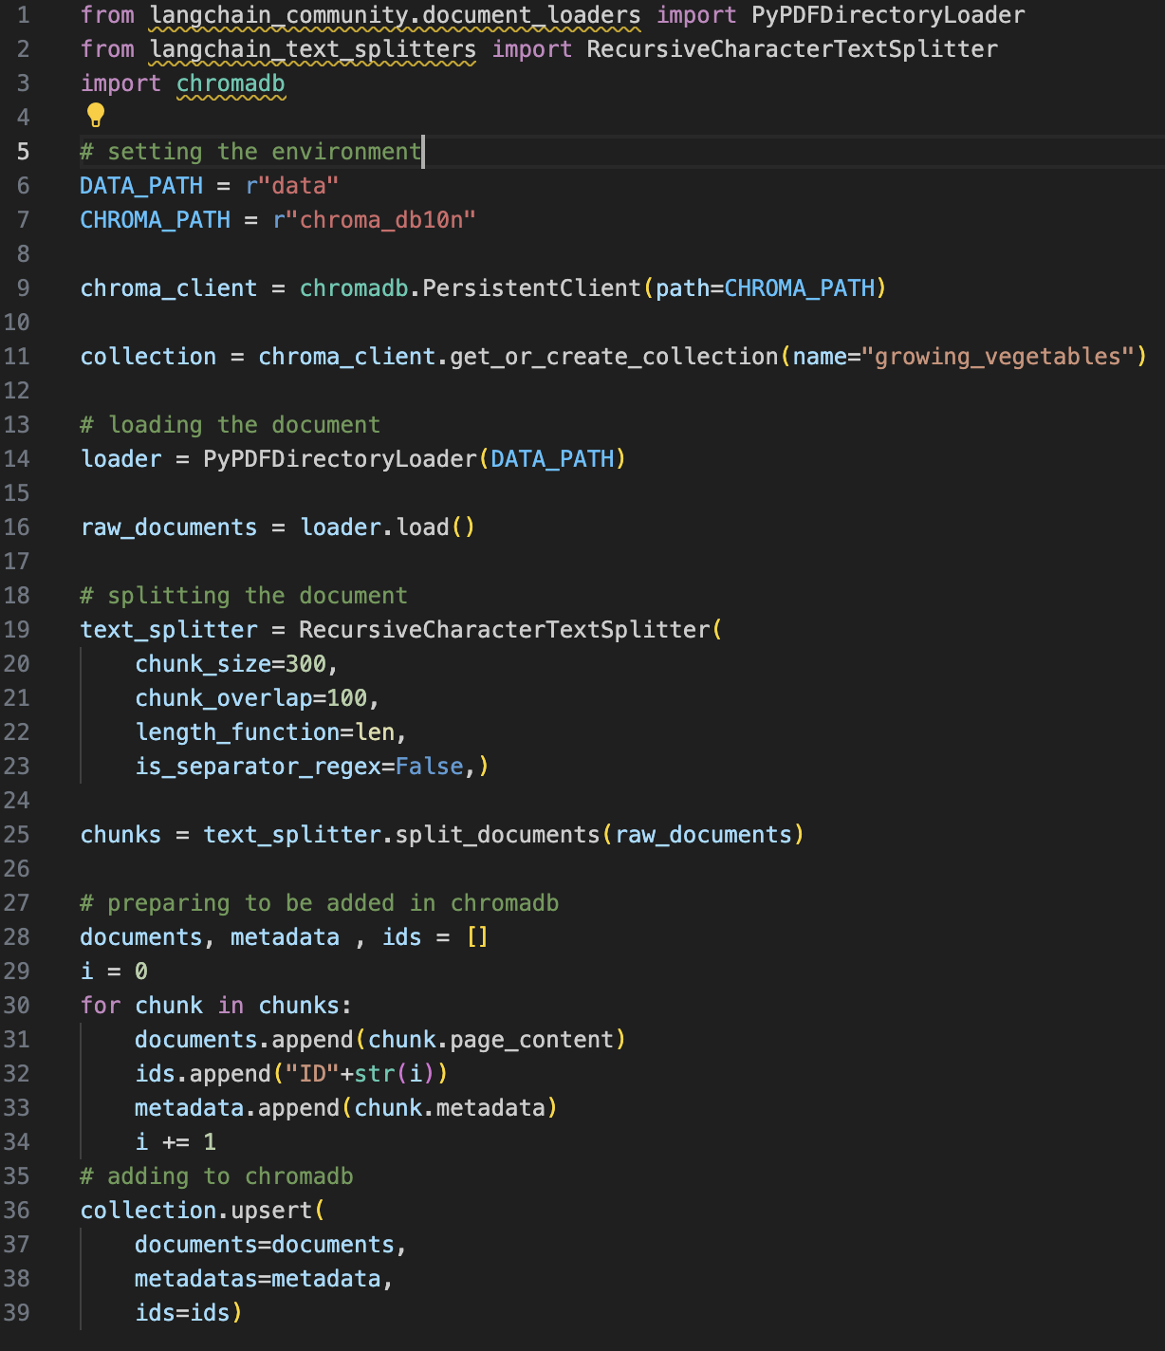
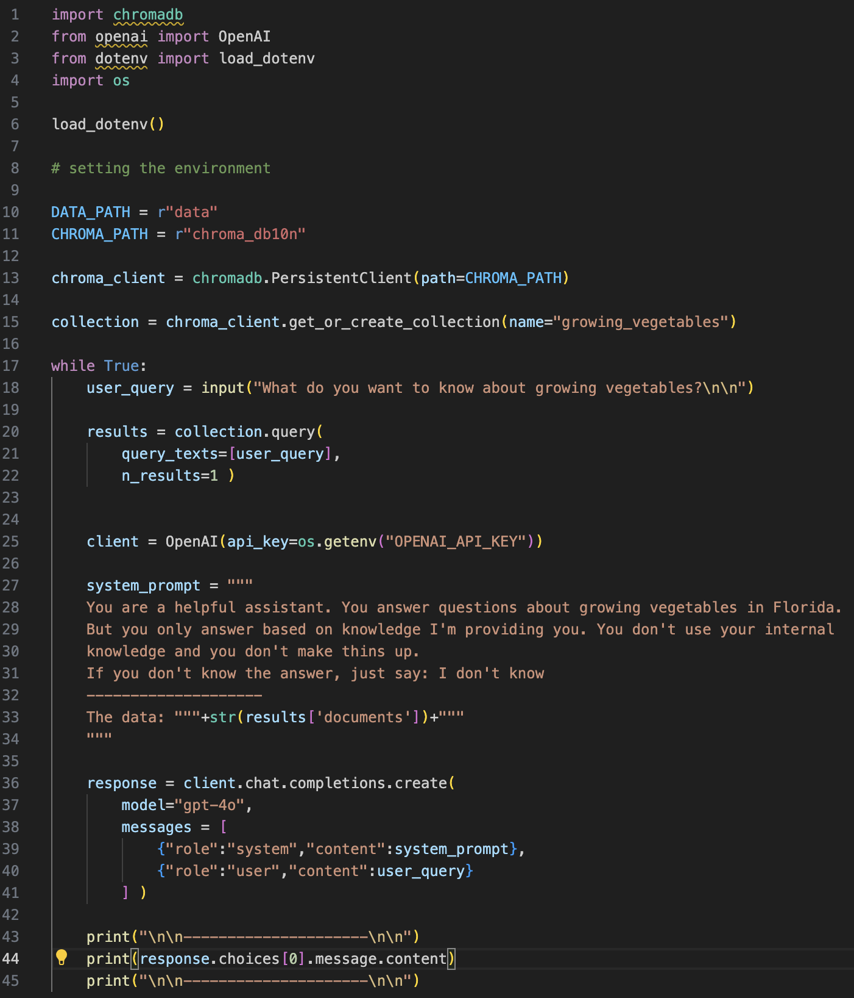
Embeddings
Numerical representations of text that capture semantic meaning.
Used for similarity search, clustering, retrieval-augmented generation (RAG).
LangChain provides interfaces for various embedding models.
Vector DB Dimensions:
Large outputs 3072‑dimensional vectors Small outputs 1536‑dimensional vectors. Higher dimensions can capture more nuance but cost more storage and compute

Slide 10
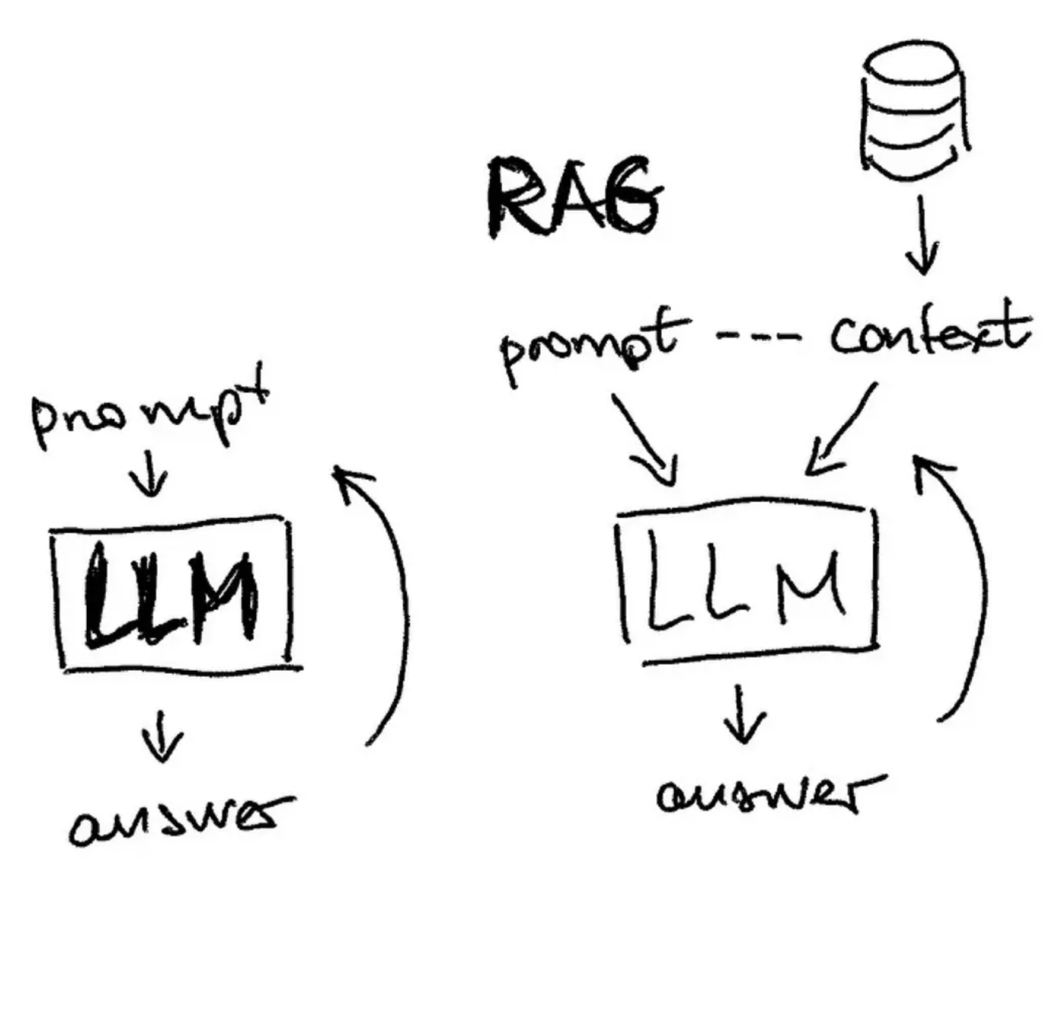
LLM/ RAG

Slide 11
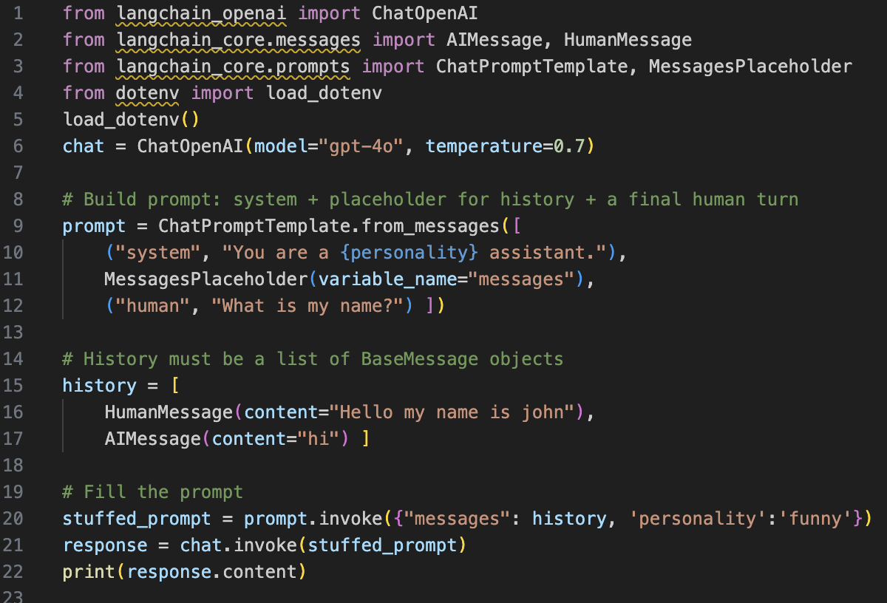
Prompts - Prompt Templates
Pre-defined, parameterized templates for generating prompts to LLMs.
Helps maintain consistency and structure in prompts.
Prevents boilerplate string formatting.

Slide 12
Output Parser
OutputParser in LangChain is like a translator that turns the model’s messy text into clean, predictable data you can use in code.
What it does
It tells the model “please answer in this exact format,” then reads the reply and converts it into Python types like string, list, dict, or a Pydantic model.
This avoids fragile string parsing and makes your app reliable even when models vary their wording.
When to use it
When you need structured output (like JSON or a typed object) but the model returns plain text.
When you want to safely consume model output in code (store in DB, render UI, call another tool).
Common types you’ll use
• StrOutputParser: get plain string from AIMessage.
• JSONOutputParser: get a Python dict/list from JSON text.
• PydanticOutputParser: validate and return a Pydantic model (typed fields).
How it fits in a chain
Prompt → Model → OutputParser → Your app logic.
You can “pipe” them so the parser runs automatically after the model.

Slide 13
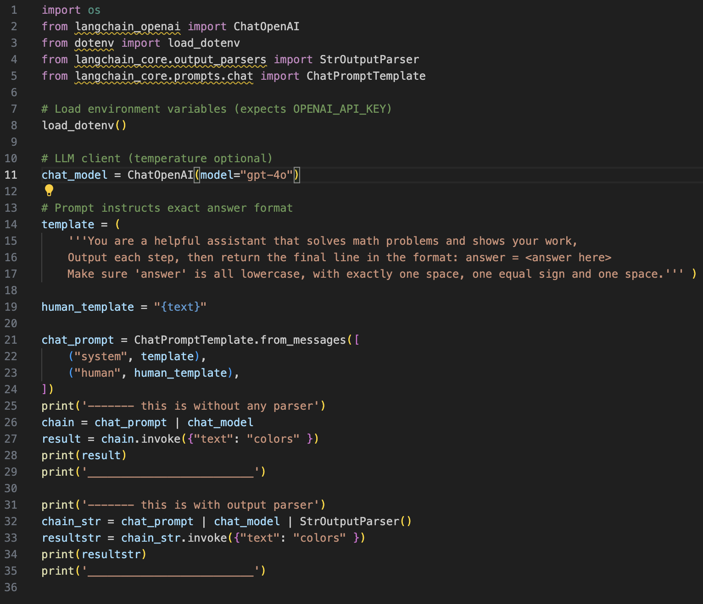
Output Parser demo

