Slide 1
Introduction to LangChain AI Agents for Building Intelligent AI Applications

Slide 2
Course Objectives
Understand LangChain's architecture and how it enables AI workflows.
Build chains, prompts, memory-based applications and agents.
Learn how to integrate external tools and knowledge sources.
Explore Retrieval-Augmented Generation (RAG) and implement knowledge-backed applications.
Apply best practices for building secure, scalable and robust AI solutions.

Slide 3
Installations and required setup to use langchain
Install LangChain and its integrations
Core framework:
pip install langchain
Integrations you’ll likely need:
pip install langchain-community
pip install langchain-openai
pip install langchain-core
install VS Code, python and pip on your machine
Create python virtual environment
(venv)
Set your API keys as environment variables pip install python-dotenv
py -m venv .venv
.venv\Scripts\Activate
Create .env in the working directory and enter your APIkey, OPENAI_API_KEY: “sk-…”
Refer this official documentation from langchain
https://python.langchain.com/docs/introduction/

Slide 4
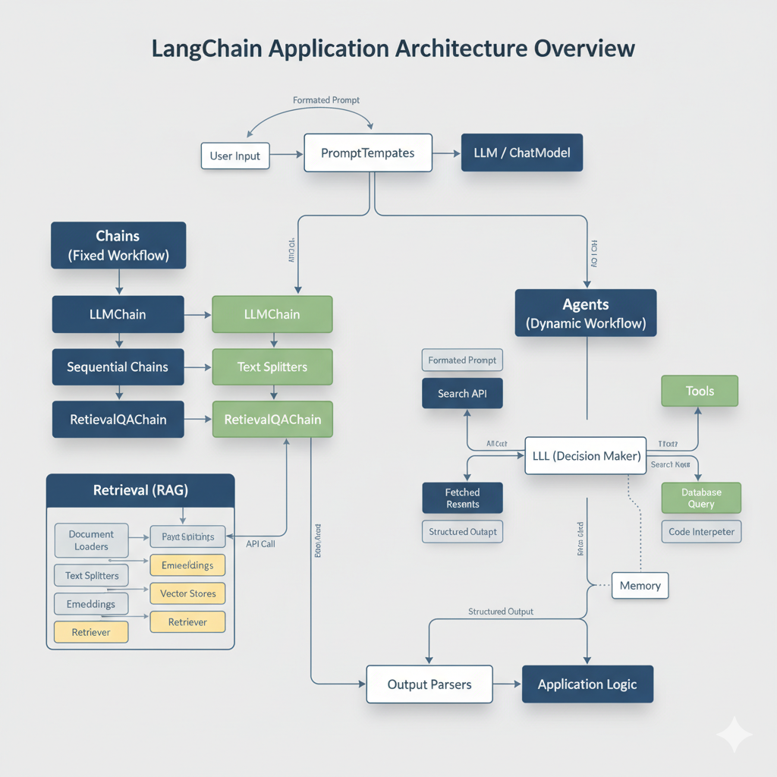
Architecture of langchain

Slide 5
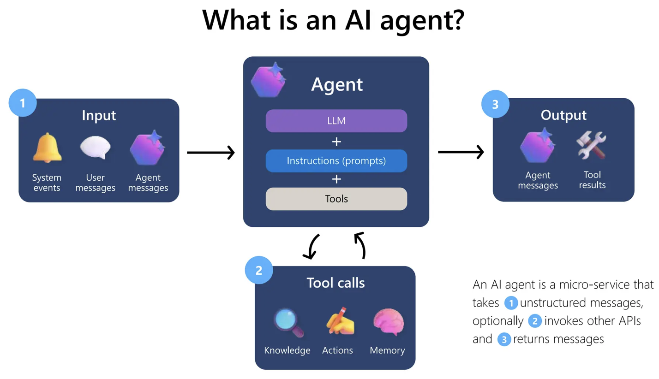

Slide 6
Agents
Agents are dynamic chains that use an LLM to decide which actions to take and in what order. Instead of a fixed sequence of steps, an agent observes its environment, reasons, acts and repeats until it achieves its goal.
Core Idea: An agent consists of an LLM, a set of tools, and a mechanism to reason about which tool to use.
Tools: Functions or APIs that an agent can call. These can be anything from searching the internet, looking up information in a database, calling a calculator, or even interacting with other APIs.
Example Tools: SerpAPIWrapper for internet search, PythonREPLTool for executing Python code.
AgentExecutor: The runtime that drives the agent, repeatedly calling the LLM for its next action and executing the chosen tool.
Agent Types: LangChain offers various pre-built agent types, such as zero-shot-react-description (which uses the ReAct framework for reasoning), OpenAIFunctions (for models that support function calling), etc.
Memory: Agents often need memory to remember previous interactions or conversation history, allowing for multi-turn conversations and more coherent decision-making.

Slide 7
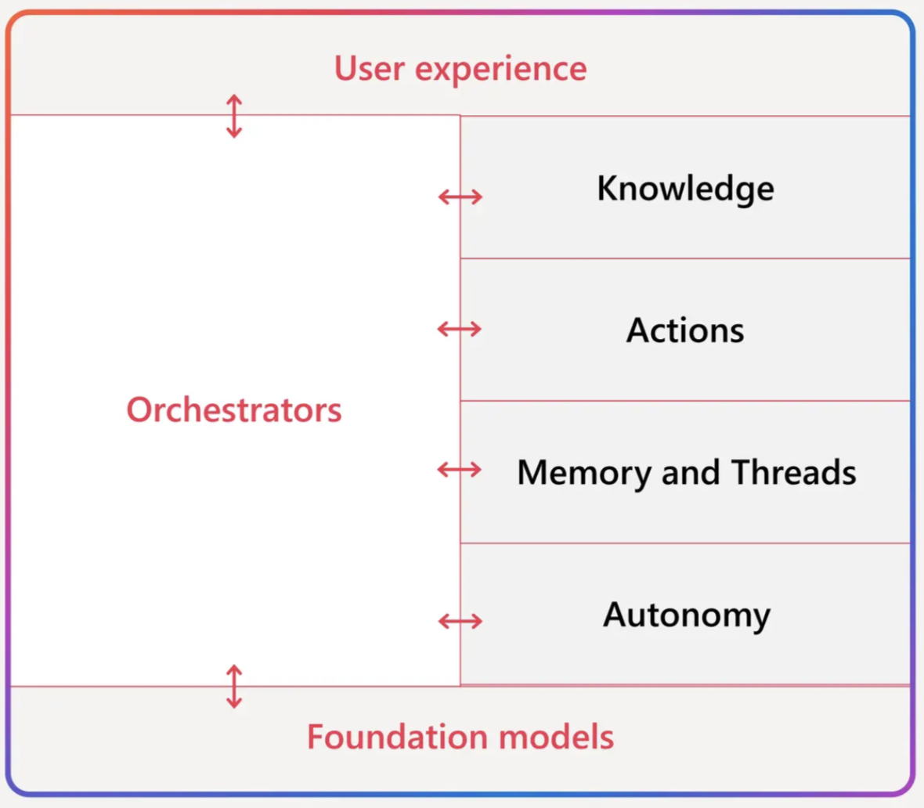
Components of Agents
﻿﻿﻿User Experience: The prompt that starts the whole process of the agent execution, as well as the agent interaction.
﻿﻿﻿Knowledge: Search and retrieve information from online sources or company knowledge base, to ground the models.
﻿﻿﻿Actions: Helps the agents perform certain actions (e.g. send an email, write a report) through connections to key applications.
﻿﻿﻿Memory and Threads: Captures and stores the past interactions for hyper-personalisation and increased human-like interactions
﻿﻿﻿Autonomy: Leaves the agents perform the tasks through an event-driven, trigger-based approach.
﻿﻿﻿Foundation Models: Enables Al Agents to think throughout the process, helping to plan and reflect.
﻿﻿﻿Orchestrators: Whether to be the client-side code or orchestrate across multiple agents across multiple cloud, orchestrators are key to bringing everything together.

Slide 8
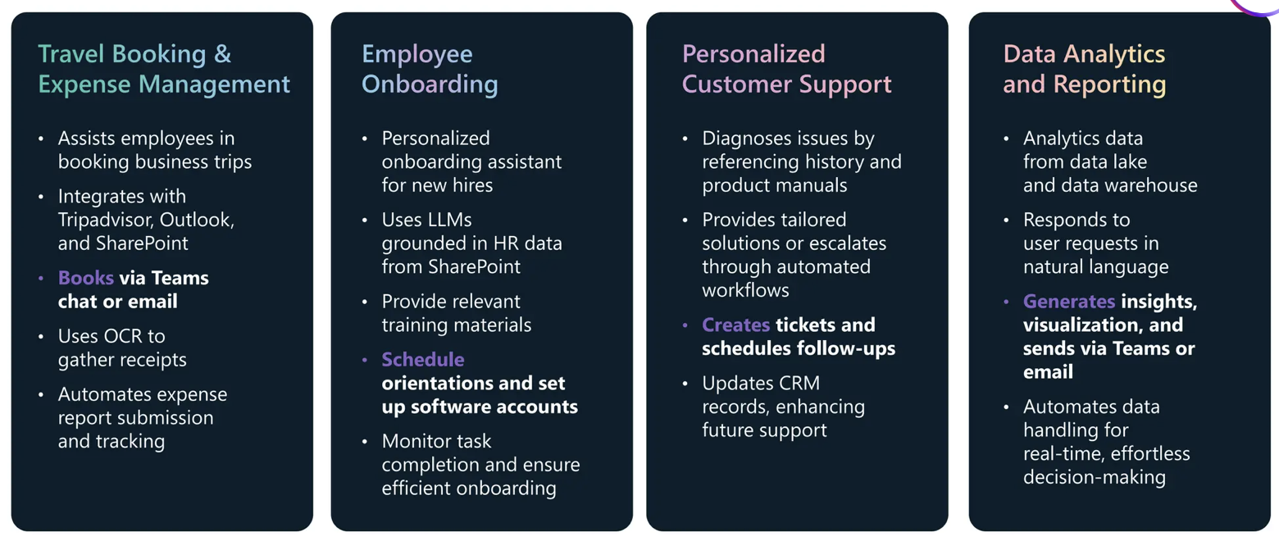
AI Agents use cases
Unlike previous tools, AI agents can reason, act and learn

Slide 9


Langchain
﻿﻿Framework for building LLM Applications
﻿﻿Focus on retrieving data and integrating with LLMs
Integrations with most Al popular tools
LangGraph by Langchain
﻿﻿Build Stateful apps with LLMs and Multi-Agents workflow
Cycles and Branching
﻿﻿Human-in-the-Loop
Persistence

Slide 10
Architecture User Input → Prompt → Agent → Tool Invocation → API Response → Output Parser → Final Response
Key components
Agent: Decides when and how to use tools
Tool: A wrapper around an external API (e.g., weather, news, database).
Runnable Chain: Composes prompt → model → parser.

Slide 11
Agents and Decision Making: The LLM as a Controller
Architectural Role: Agents elevate LLMs from mere text generators to intelligent controllers. Instead of a fixed sequence (Chain), an Agent uses an LLM to dynamically decide what to do next based on the input and available tools. This introduces dynamic routing and problem-solving.
How Agents Differ from Chains:
Chains: Pre-defined, deterministic sequence of steps. "Do A, then B, then C." Good for structured workflows (e.g., RAG: fetch docs, then answer).
Agents: Dynamic, non-deterministic decision-making. "What is the best next action given the goal and my tools?" Good for open-ended problems, requiring tool selection, observation, and iterative reasoning.
Routing, Tool Selection, and Fallback Logic:
Architecture:
Agent: Comprises an LLM (the "brain"), a set of Tools (the "actions"), and a AgentType (the reasoning loop, e.g., ReAct, OpenAI Functions).
AgentExecutor: The runtime that orchestrates the agent's cycle:
Thought: LLM decides what to do (e.g., "I need to search for this information").
Action: LLM specifies which Tool to use and its Tool Input.
Observation: Tool executes and returns its output.
Loop: The process repeats with the new observation until the LLM decides it has a Final Answer.
Routing: The LLM's primary role in an Agent is to route the query to the appropriate tool. Its prompt guides it to reason about tool descriptions.
Fallback Logic: Can be built into the agent's reasoning prompt (e.g., "If no tool is suitable, respond with 'I cannot help with that'"). Some agents or toolkits allow for explicit error handling within the executor.

Slide 12
Building an Agent
Example: Building a Bot Using Agent Architecture:
Scenario: A bot that can answer questions from a knowledge base (or) use a general search engine if the
knowledge base doesn't have the answer.
Architecture:
Tools: KnowledgeBaseQueryTool: Queries a vector store of FAQs.
SearchWebTool: Uses a search API (e.g., Google Search, SerpAPI).
Agent:
Configure an Agent with both KnowledgeBaseQueryTool and SearchWebTool.
The LLM in the agent's loop will decide:
If the query is clearly an FAQ, use KnowledgeBaseQueryTool.
If KnowledgeBaseQueryTool returns no answer or the query is clearly external, use SearchWebTool.
If both fail, provide a fallback message.
Benefit: Dynamic problem-solving and graceful handling of queries that go beyond the internal knowledge.

Slide 13
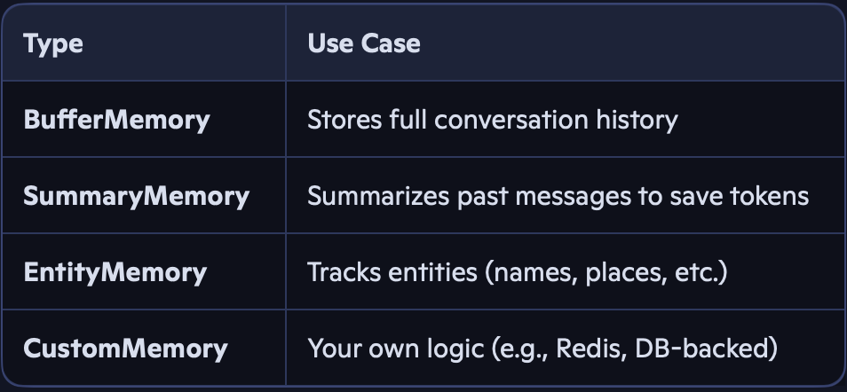
Memory in langchain
Memory gives an LLM application state and context across multiple turns of interaction, enabling coherent conversations, follow-up questions, and understanding of prior statements. Without memory, each interaction is stateless, like talking to someone who immediately forgets everything you said.
Implementing Context-Awareness in Apps:
Architecture:
A Memory object is initialized and passed into a Chain or Agent.
The Memory automatically manages adding new messages and retrieving past ones.
PromptTemplates are designed to include a chat_history variable that the Memory populates.

Slide 14
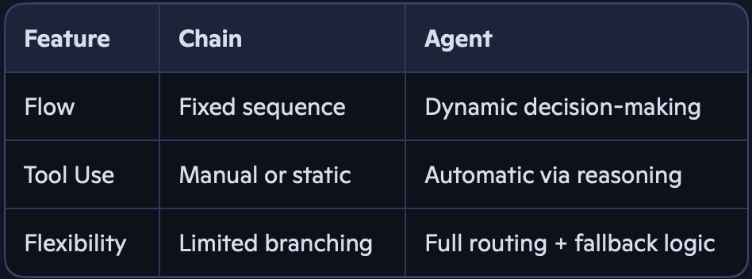
Difference between chain & Agents

Slide 15
Debugging and Error Handling
Architectural Role: Essential for building robust and reliable LLM applications, especially with complex chains and agents.
Monitoring Interactions:
Callbacks: LangChain provides a callback system (langchain.callbacks) that allows you to hook into various events (on_llm_start, on_tool_end, on_chain_error, etc.).
Logging: Using standard Python logging to record intermediate steps, inputs, outputs, and tool calls.
Tracing Tools: Integrations with tools like LangSmith (from LangChain itself) or Weights & Biases for visual tracing of complex chain/agent execution paths.
Benefit: Understanding the LLM's thought process, why an agent chose a specific tool, and where errors occur.
Handling Failures and Retries:
Tool-level Retries: Implement retry logic within your Tool's _run method for external API calls (e.g., using tenacity library).
Agent-level Fallbacks: Design the agent's prompt to guide the LLM on how to respond if a tool fails (e.g., "If the tool returns an error, state that you couldn't get the information and ask the user to rephrase").
Try/Except Blocks: Standard Python error handling around chain/agent execution.
Circuit Breakers: For critical tools, implement circuit breaker patterns to prevent repeated calls to a failing external service.
Benefit: Improved resilience and user experience, preventing crashes and providing informative error messages.

Slide 16
Hands on
Integrate api to chatbot
from langchain.tools import RequestsGetTool
tool = RequestsGetTool()
response = tool.run("https://api.weatherapi.com/v1/current.json?q=Hyderabad")
Add Memory to a Chatbot
memory = ConversationBufferMemory()
chain = prompt | llm | memory | parser
Create an Agent with Tool Selection
agent = initialize_agent([weather_tool, faq_tool], ChatOpenAI(), agent_type="zero-shot-react-description")
agent.run("Should I carry an umbrella today?")

