Slide 1
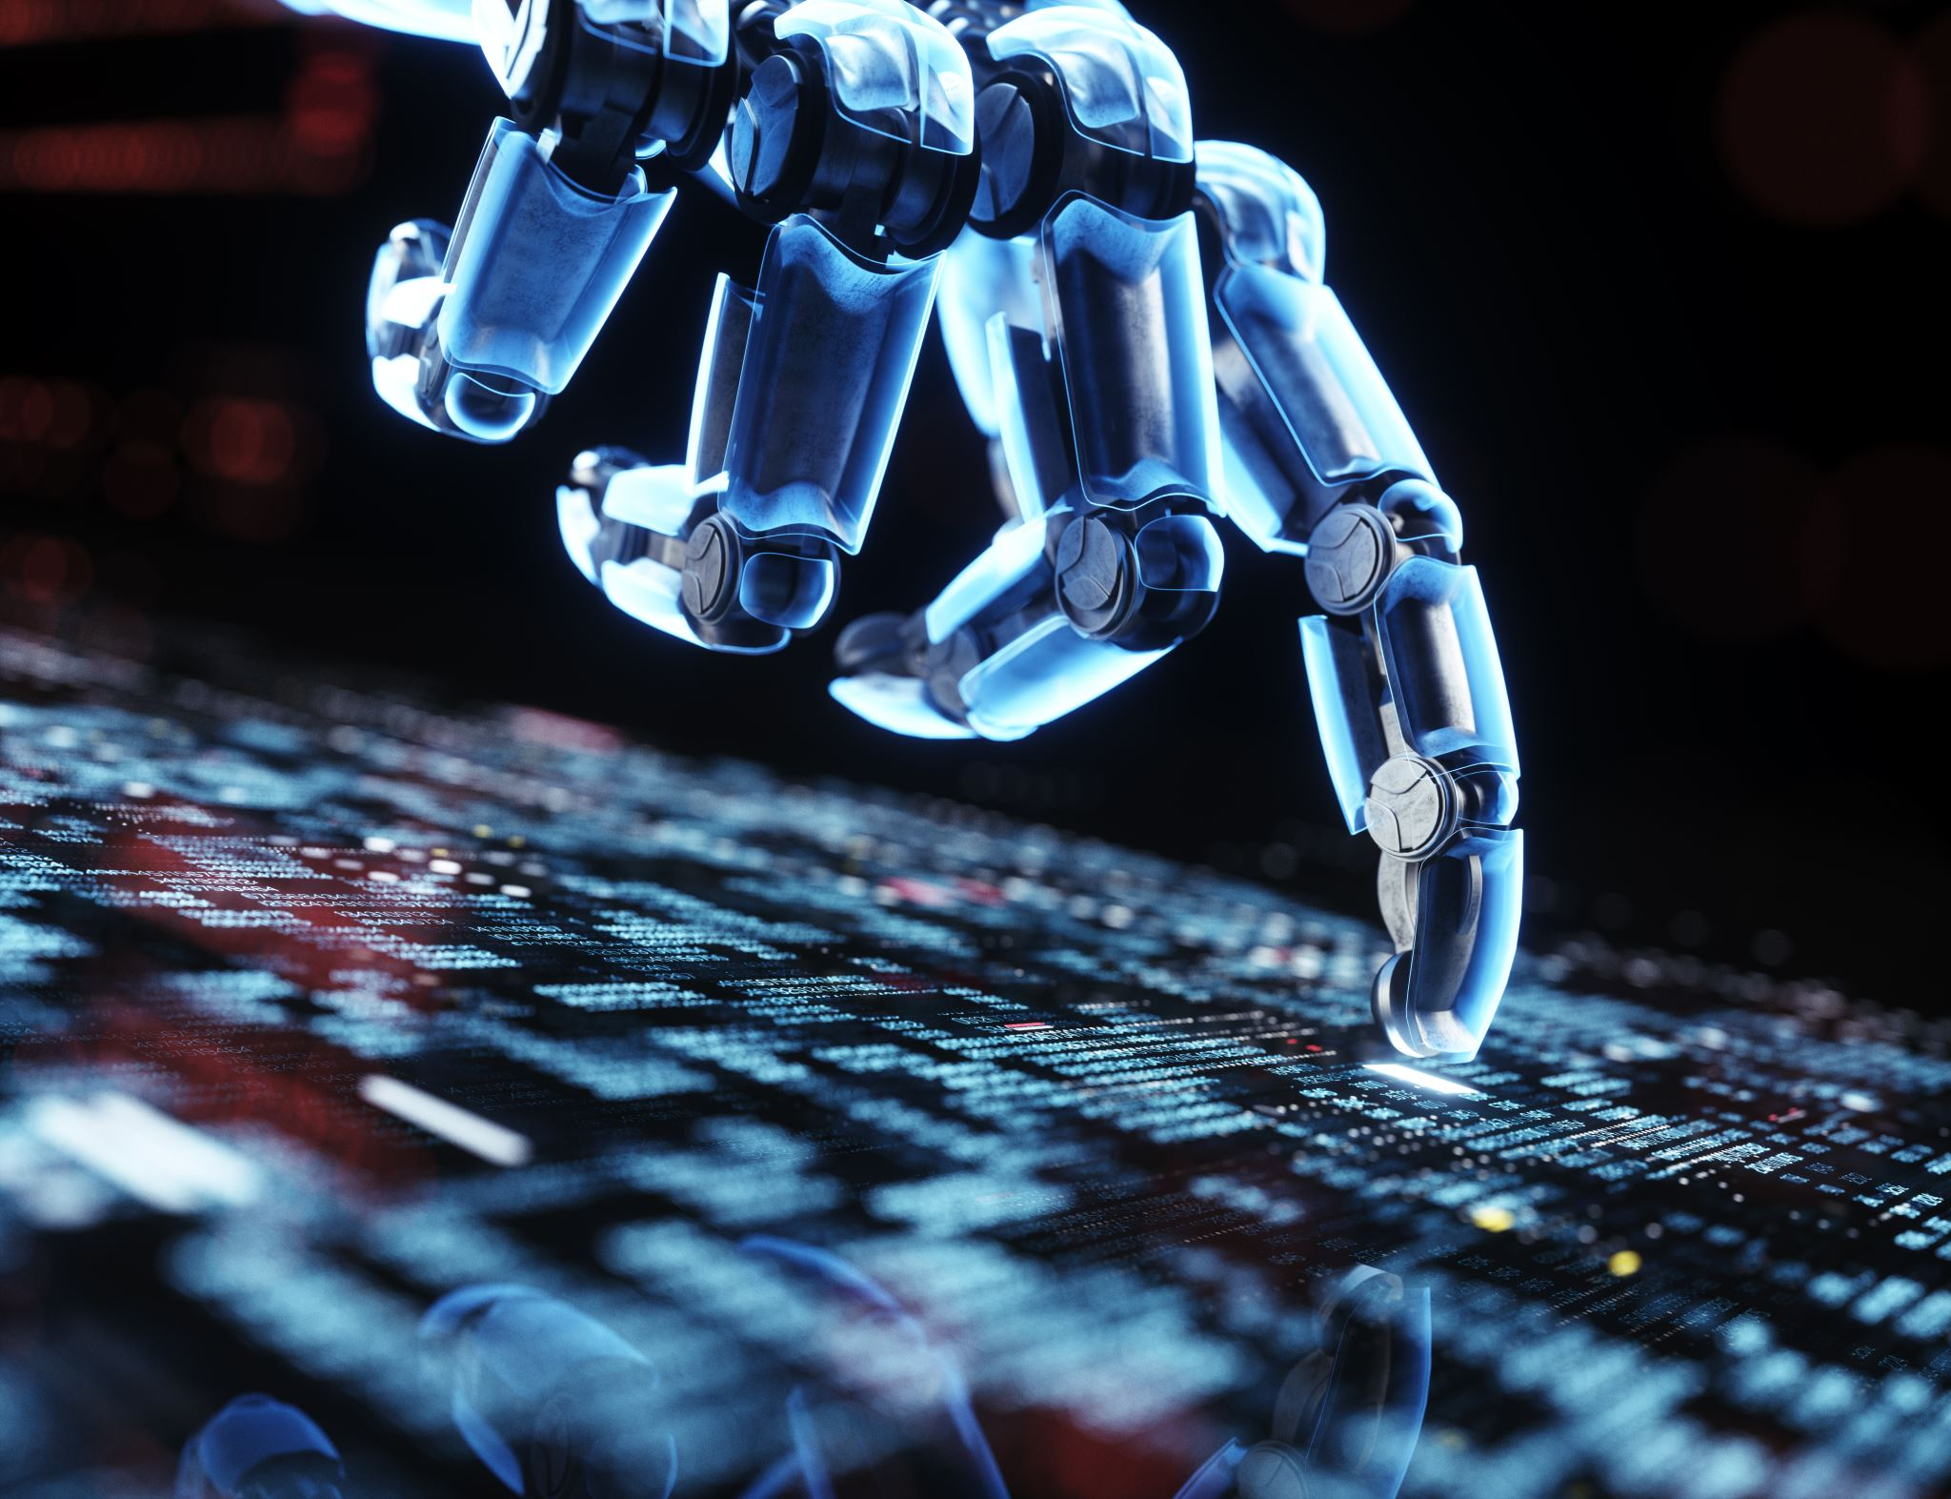
Core Topics in AI and Robotics

Slide 2
Robotics Fundamentals
Kinematics and dynamics of robotic systems
Actuation and sensor technologies
Control systems (PID, state-space models)
Robot operating systems (ROS)

Slide 3
Machine Learning Basics
Introduction to supervised, unsupervised, and reinforcement learning
Key algorithms (decision trees, SVM, k-nearest neighbors)
Data collection and preprocessing for robotics

Slide 4
Deep Learning for Robotics
Convolutional Neural Networks (CNNs) for visual perception
Recurrent Neural Networks (RNNs) and LSTMs for sequential data
Autoencoders and Generative Models (GANs) in robotics

Slide 5
Reinforcement Learning in Robotics
Q-learning, deep Q-networks (DQN)
Policy gradient methods (REINFORCE, A3C)
Application to robot control and decision-making in uncertain environments

Slide 6
Computer Vision in Robotics
Object detection and tracking
Visual SLAM (Simultaneous Localization and Mapping)
Scene understanding and semantic segmentation using AI

Slide 7
Natural Language Processing for Human-Robot Interaction
Voice recognition and NLP basics for robots
Integration of speech-to-text and text-to-speech in robotics
Conversational agents in robotics (voice assistants)

Slide 8
Robot Perception and Sensor Fusion
Combining data from multiple sensors (LIDAR, cameras, IMUs)
Kalman filters and Bayesian networks for sensor fusion
AI methods for sensor data interpretation

Slide 9
Motion Planning and Pathfinding Algorithms
Traditional algorithms: Dijkstra, A*, RRT (Rapidly Exploring Random Trees)
AI-driven pathfinding and optimization algorithms
Navigation in dynamic environments using AI

Slide 10
Autonomous Navigation and SLAM
Mapping and localization techniques
AI in autonomous vehicles and drones
SLAM using deep learning and neural networks

Slide 11
Human-Robot Interaction (HRI)
AI techniques for collaborative robots (cobots)
Gesture recognition and interactive robots
Ethical concerns in human-robot interaction

Slide 12
Robotics and AI Ethics
AI safety in robotics
Ethical challenges of autonomous systems (decision-making, bias)
Regulation and social implications of AI in robotics

Slide 13
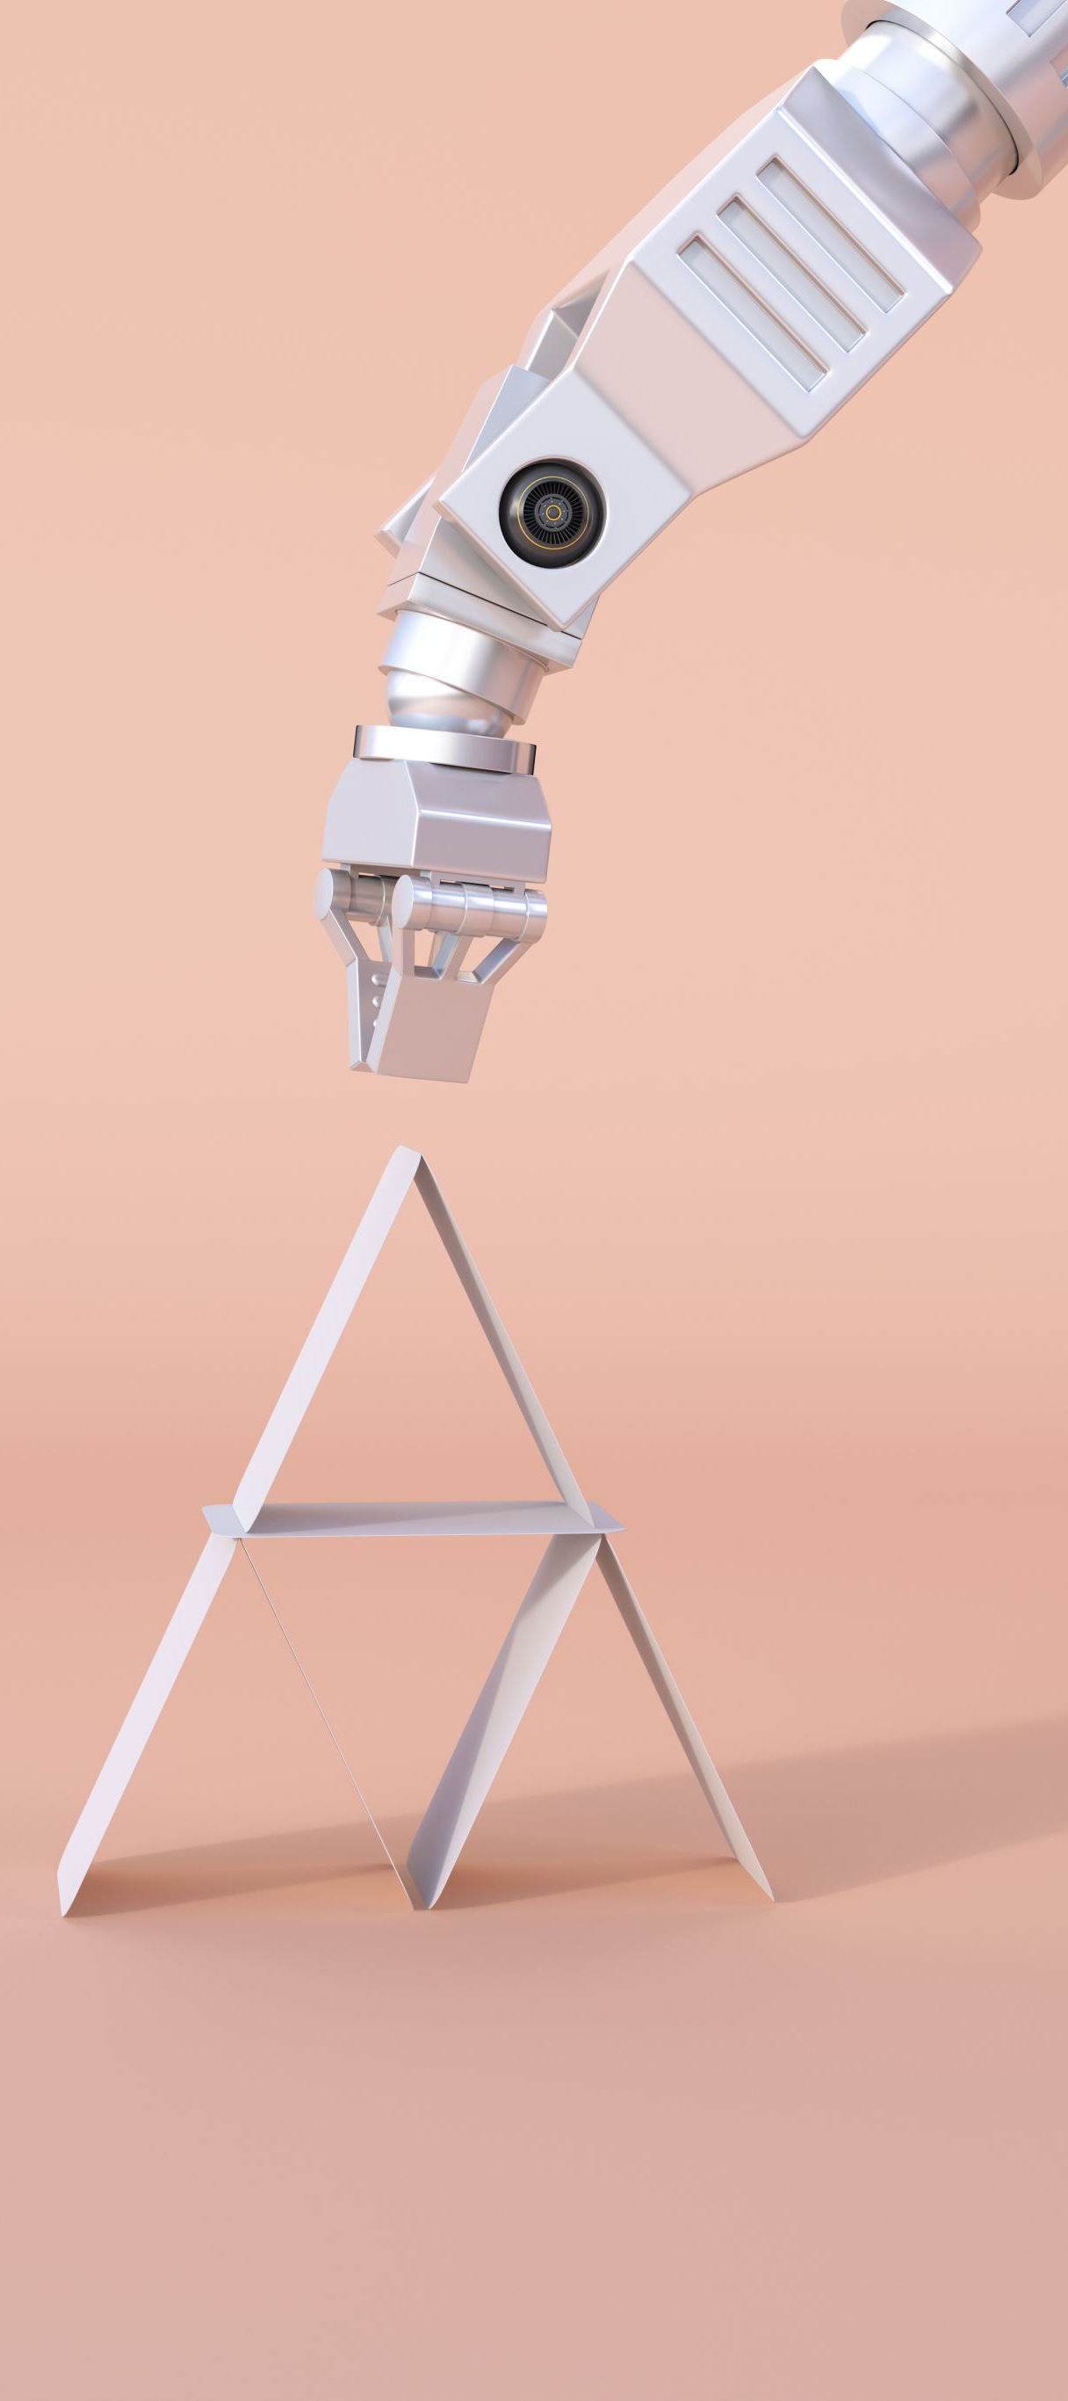
AI-Based Robot Learning and Adaptation
Learning from demonstration (imitation learning)
Adaptive control and behavior learning
Robot learning environments and simulators (Gazebo, PyBullet)

Slide 14
Swarm Robotics and Multi-Agent Systems
Basics of swarm intelligence and distributed AI
Coordination strategies for multiple robots using AI
Applications of multi-robot systems in industry and research

Slide 15
Robotic Manipulation and Grasping
AI-driven robotic hand-eye coordination
Learning-based approaches to manipulation and dexterity
Grasping objects in cluttered environments using AI

Slide 16
AI for Robotics in Industry 4.0
Integration of AI-driven robotics in smart factories
Predictive maintenance using AI for robotics systems
Role of AI in automating production lines and logistics

Slide 17
Simulation and Testing in Robotics
Role of simulation in AI-robotics integration
Robotics simulators and environments (Gazebo, V-REP)
Sim-to-real transfer learning for AI in robotics

Slide 18

Autonomous Systems and AI Safety
AI in autonomous vehicles, drones, and robots
Safety and reliability in AI-driven autonomous robots
Ethical and regulatory frameworks for autonomous systems

Slide 19

Thank You!

