Slide 1




Slide 2


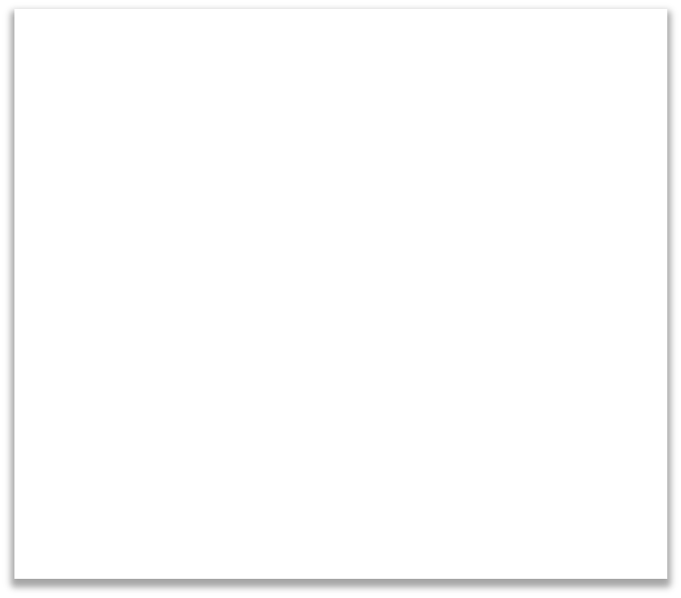


Output Label (Image class)
Input Image
CNN

Slide 3
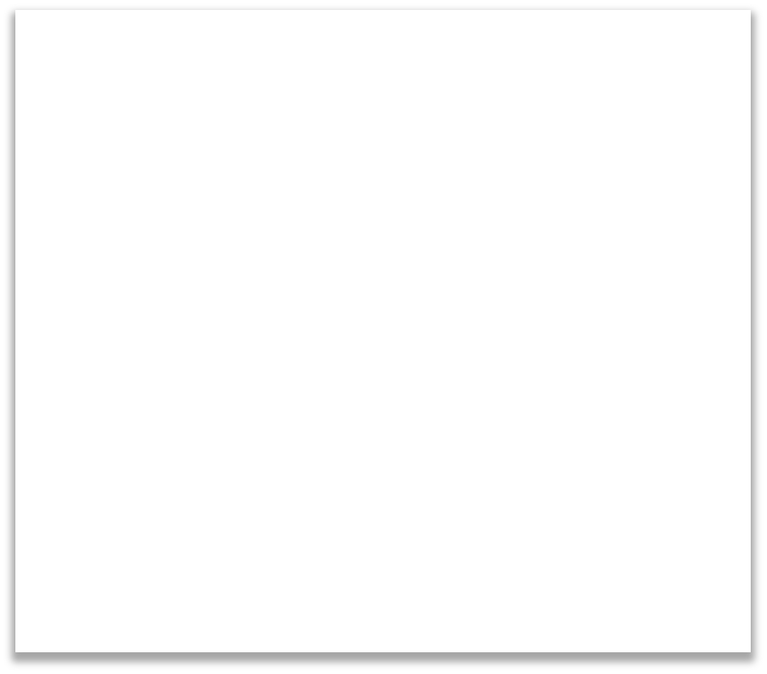










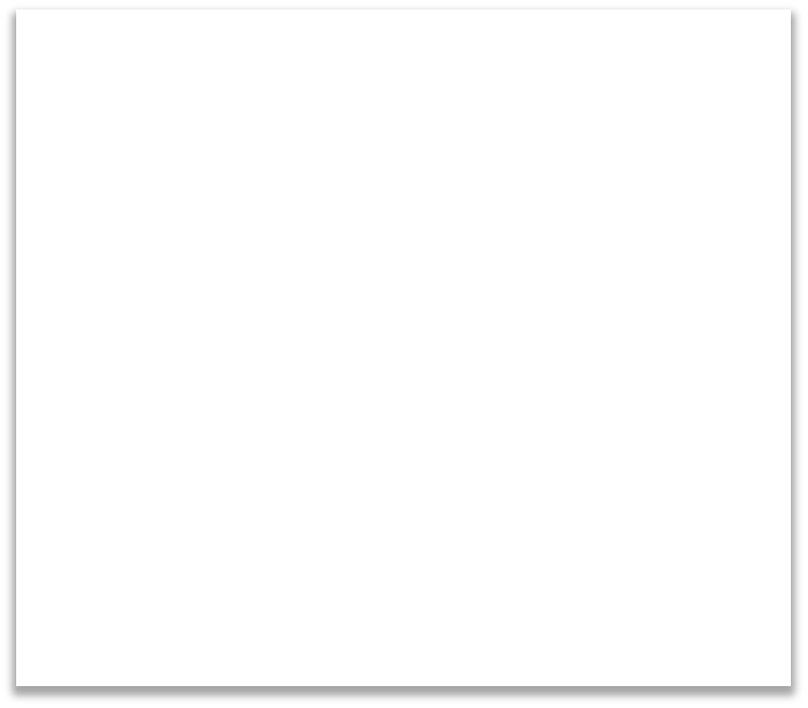









Happy
CNN
CNN
Sad

Slide 4
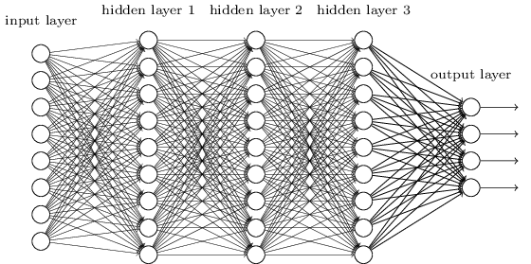
CNN
We know it is good to learn a small model.
From this fully connected model, do we really need all the edges?
Can some of these be shared?

Slide 5
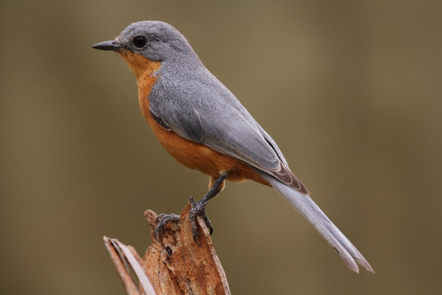
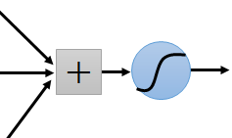
Consider learning an image:
Some patterns are much smaller than the whole image
Can represent a small region with fewer parameters
“beak” detector

Slide 6
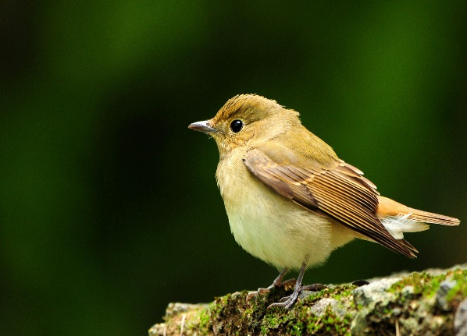
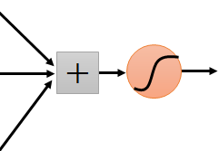
Same pattern appears in different places: They can be compressed! What about training a lot of such “small” detectors and each detector must “move around”.
“upper-left beak” detector
They can be compressed
to the same parameters.
“middle beak” detector

Slide 7



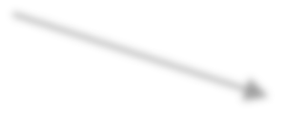

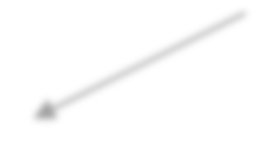




B / W Image 2x2px
Pixel 1
Pixel 2
Pixel 1
Pixel 2
2d array
Pixel 3
Pixel 4
Pixel 3
Pixel 4
Colored Image 2x2px
Red channel
Green channel
Pixel 1
Pixel 2
Colored Image
3d array
Pixel 1
Pixel 2
Colored Image
Pixel 3
Pixel 4
Pixel 3
Pixel 4
Blue channel

Slide 8
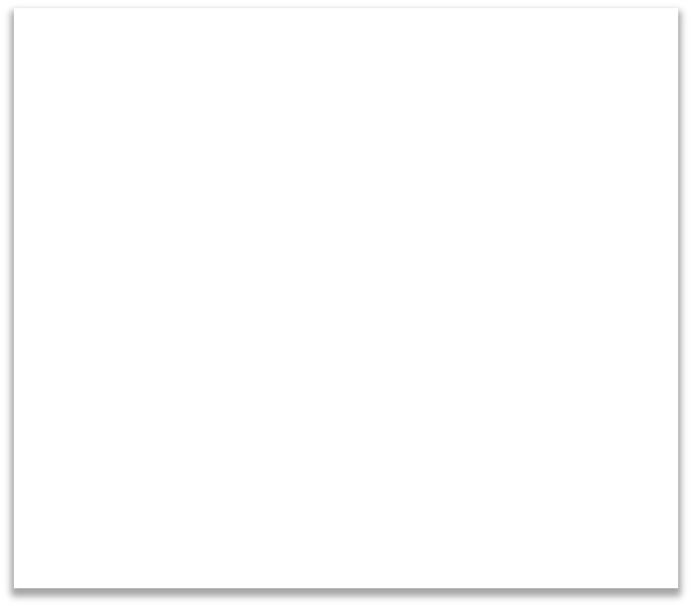




0 | 0 | 0 | 0 | 0 | 0 | 0
0 | 1 | 0 | 0 | 0 | 1 | 0
0 | 0 | 0 | 0 | 0 | 0 | 0
0 | 0 | 0 | 1 | 0 | 0 | 0
0 | 1 | 0 | 0 | 0 | 1 | 0
0 | 0 | 1 | 1 | 1 | 0 | 0
0 | 0 | 0 | 0 | 0 | 0 | 0

Slide 9
STEP 1: Convolution
STEP 2: Max Pooling STEP 3: Flattening STEP 4: Full Connection

Slide 10
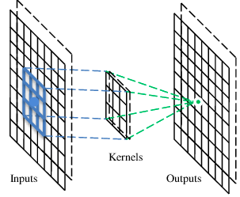
A convolutional layer
A CNN is a neural network with some convolutional layers
(and some other layers). A convolutional layer has a number
of filters that does convolutional operation.
Beak detector
A filter

Slide 11
Convolution
These are the network parameters to be learned.
1 | -1 | -1
-1 | 1 | -1
-1 | -1 | 1
1 | 0 | 0 | 0 | 0 | 1
0 | 1 | 0 | 0 | 1 | 0
0 | 0 | 1 | 1 | 0 | 0
1 | 0 | 0 | 0 | 1 | 0
0 | 1 | 0 | 0 | 1 | 0
0 | 0 | 1 | 0 | 1 | 0
Filter 1
-1 | 1 | -1
-1 | 1 | -1
-1 | 1 | -1
Filter 2
……
6 x 6 image
Each filter detects a small pattern (3 x 3).

Slide 12
Convolution
1 | -1 | -1
-1 | 1 | -1
-1 | -1 | 1
Filter 1
stride=1
1 | 0 | 0 | 0 | 0 | 1
0 | 1 | 0 | 0 | 1 | 0
0 | 0 | 1 | 1 | 0 | 0
1 | 0 | 0 | 0 | 1 | 0
0 | 1 | 0 | 0 | 1 | 0
0 | 0 | 1 | 0 | 1 | 0
Dot
product
3
-1
6 x 6 image

Slide 13
Convolution
1 | -1 | -1
-1 | 1 | -1
-1 | -1 | 1
Filter 1
If stride=2
1 | 0 | 0 | 0 | 0 | 1
0 | 1 | 0 | 0 | 1 | 0
0 | 0 | 1 | 1 | 0 | 0
1 | 0 | 0 | 0 | 1 | 0
0 | 1 | 0 | 0 | 1 | 0
0 | 0 | 1 | 0 | 1 | 0
3
-3
6 x 6 image

Slide 14
Convolution
1 | -1 | -1
-1 | 1 | -1
-1 | -1 | 1
Filter 1
stride=1
1 | 0 | 0 | 0 | 0 | 1
0 | 1 | 0 | 0 | 1 | 0
0 | 0 | 1 | 1 | 0 | 0
1 | 0 | 0 | 0 | 1 | 0
0 | 1 | 0 | 0 | 1 | 0
0 | 0 | 1 | 0 | 1 | 0
3
-1
-3
-1
-3
1
0
-3
-3
-3
0
1
3
-2
-2
-1
6 x 6 image

Slide 15
Convolution
-1 | 1 | -1
-1 | 1 | -1
-1 | 1 | -1
Filter 2
stride=1
Repeat this for each filter
1 | 0 | 0 | 0 | 0 | 1
0 | 1 | 0 | 0 | 1 | 0
0 | 0 | 1 | 1 | 0 | 0
1 | 0 | 0 | 0 | 1 | 0
0 | 1 | 0 | 0 | 1 | 0
0 | 0 | 1 | 0 | 1 | 0
3
-1
-3
-1
-1
-1
-1
-1
-3
1
0
-3
-1
-1
-2
1
Feature
Map
-3
-3
0
1
-1
-1
-2
1
3
-2
-2
-1
6 x 6 image
-1
0
-4
3
Two 4 x 4 images
Forming 2 x 4 x 4 matrix

Slide 16
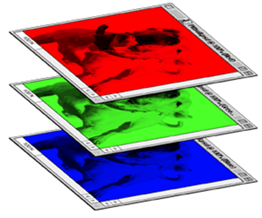
Color image: RGB 3 channels
1 | -1 | -1
-1 | 1 | -1
-1 | -1 | 1
-1 | 1 | -1
-1 | 1 | -1
-1 | 1 | -1
1 | -1 | -1
-1 | 1 | -1
-1 | -1 | 1
-1 | 1 | -1
-1 | 1 | -1
-1 | 1 | -1
1 | -1 | -1
-1 | 1 | -1
-1 | -1 | 1
-1 | 1 | -1
-1 | 1 | -1
-1 | 1 | -1
Filter 1
Filter 2
Color image
1 | 0 | 0 | 0 | 0 | 1
0 | 1 | 0 | 0 | 1 | 0
0 | 0 | 1 | 1 | 0 | 0
1 | 0 | 0 | 0 | 1 | 0
0 | 1 | 0 | 0 | 1 | 0
0 | 0 | 1 | 0 | 1 | 0
1 | 0 | 0 | 0 | 0 | 1
0 | 1 | 0 | 0 | 1 | 0
0 | 0 | 1 | 1 | 0 | 0
1 | 0 | 0 | 0 | 1 | 0
0 | 1 | 0 | 0 | 1 | 0
0 | 0 | 1 | 0 | 1 | 0
1 | 0 | 0 | 0 | 0 | 1
0 | 1 | 0 | 0 | 1 | 0
0 | 0 | 1 | 1 | 0 | 0
1 | 0 | 0 | 0 | 1 | 0
0 | 1 | 0 | 0 | 1 | 0
0 | 0 | 1 | 0 | 1 | 0

Slide 17
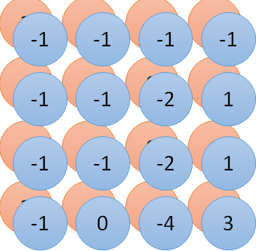
Convolution v.s. Fully Connected
1 | 0 | 0 | 0 | 0 | 1
0 | 1 | 0 | 0 | 1 | 0
0 | 0 | 1 | 1 | 0 | 0
1 | 0 | 0 | 0 | 1 | 0
0 | 1 | 0 | 0 | 1 | 0
0 | 0 | 1 | 0 | 1 | 0
1 | -1 | -1
-1 | 1 | -1
-1 | -1 | 1
-1 | 1 | -1
-1 | 1 | -1
-1 | 1 | -1
convolution
image
1 | 0 | 0 | 0 | 0 | 1
0 | 1 | 0 | 0 | 1 | 0
0 | 0 | 1 | 1 | 0 | 0
1 | 0 | 0 | 0 | 1 | 0
0 | 1 | 0 | 0 | 1 | 0
0 | 0 | 1 | 0 | 1 | 0
Fully-connected
……
……

Slide 18
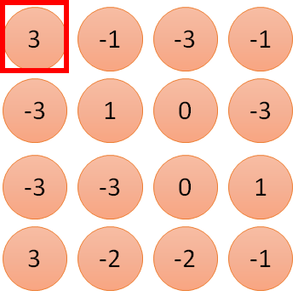
1 | -1 | -1
-1 | 1 | -1
-1 | -1 | 1
1
1
Filter 1
2
0
3
0
3
4:
0
1 | 0 | 0 | 0 | 0 | 1
0 | 1 | 0 | 0 | 1 | 0
0 | 0 | 1 | 1 | 0 | 0
1 | 0 | 0 | 0 | 1 | 0
0 | 1 | 0 | 0 | 1 | 0
0 | 0 | 1 | 0 | 1 | 0
…
0
8
1
9
0
10:
0
…
13
0
6 x 6 image
14
0
fewer parameters!
15
Only connect to 9 inputs, not fully connected
1
16
1
…

Slide 19
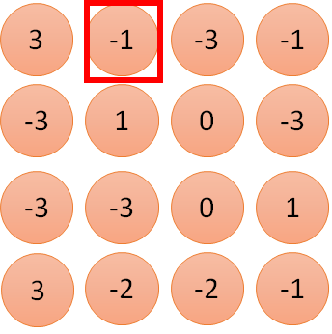
1 | -1 | -1
-1 | 1 | -1
-1 | -1 | 1
1:
1
Filter 1
2:
0
3:
0
3
4:
0
1 | 0 | 0 | 0 | 0 | 1
0 | 1 | 0 | 0 | 1 | 0
0 | 0 | 1 | 1 | 0 | 0
1 | 0 | 0 | 0 | 1 | 0
0 | 1 | 0 | 0 | 1 | 0
0 | 0 | 1 | 0 | 1 | 0
…
7:
0
8:
1
-1
9:
0
10:
0
…
13:
0
6 x 6 image
14:
0
Fewer parameters
15:
1
16:
1
Shared weights
Even fewer parameters
…

Slide 20
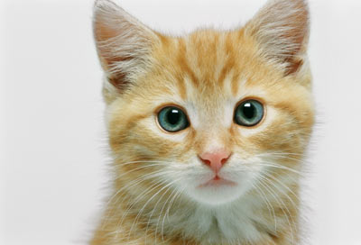
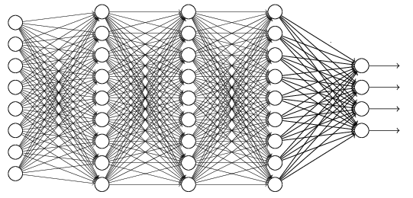
The whole CNN
cat dog ……
Convolution
Max Pooling
Can repeat many times
Fully Connected Feedforward network
Convolution
Max Pooling
Flattened

Slide 21
Max Pooling
1 | -1 | -1
-1 | 1 | -1
-1 | -1 | 1
-1 | 1 | -1
-1 | 1 | -1
-1 | 1 | -1
Filter 1
Filter 2
3
-1
-3
-1
-1
-1
-1
-1
-3
1
0
-3
-1
-1
-2
1
-3
-3
0
1
-1
-1
-2
1
3
-2
-2
-1
-1
0
-4
3

Slide 22
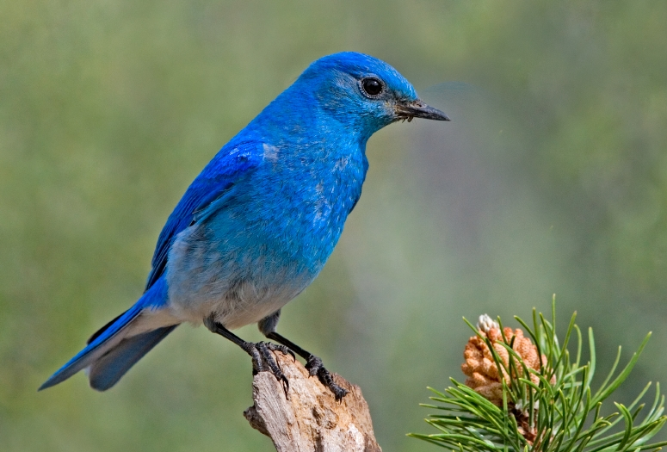

Why Pooling
Subsampling pixels will not change the object
bird
bird
Subsampling
We can subsample the pixels to make image smaller
fewer parameters to characterize the image

Slide 23
A CNN compresses a fully connected network in two ways:
Reducing number of connections
Shared weights on the edges
Max pooling further reduces the complexity

Slide 24
Max Pooling
New image
but smaller
1 | 0 | 0 | 0 | 0 | 1
0 | 1 | 0 | 0 | 1 | 0
0 | 0 | 1 | 1 | 0 | 0
1 | 0 | 0 | 0 | 1 | 0
0 | 1 | 0 | 0 | 1 | 0
0 | 0 | 1 | 0 | 1 | 0
Conv
3
0
-1
1
Max
Pooling
3
1
0
3
2 x 2 image
6 x 6 image
Each filter
is a channel

Slide 25
The whole CNN
3
0
-1
1
Convolution
3
1
0
3
Max Pooling
Can repeat many times
A new image
Convolution
Smaller than the original image
The number of channels is the number of filters
Max Pooling

Slide 26
The whole CNN
cat dog ……
Convolution
Max Pooling
Fully Connected Feedforward network
A new image
Convolution
Max Pooling
Flattened
A new image

Slide 27
Flattening
3
0
1
3
0
-1
1
3
3
1
-1
0
3
Flattened
1
Fully Connected Feedforward network
0
3

Slide 28


CNN in Keras
Only modified the network structure and input format (vector -> 3-D tensor)
input
Convolution
1 | -1 | -1
-1 | 1 | -1
-1 | -1 | 1
-1 | 1 | -1
-1 | 1 | -1
-1 | 1 | -1
There are 25 3x3 filters.
……
Max Pooling
Input_shape = ( 28 , 28 , 1)
28 x 28 pixels
1: black/white, 3: RGB
Convolution
3
-1
3
Max Pooling
-3
1

Slide 29
CNN in Keras
Only modified the network structure and input format (vector -> 3-D array)
Input
1 x 28 x 28
Convolution
How many parameters for each filter?
9
25 x 26 x 26
Max Pooling
25 x 13 x 13
Convolution
How many parameters
for each filter?
225=
25x9
50 x 11 x 11
Max Pooling
50 x 5 x 5

Slide 30
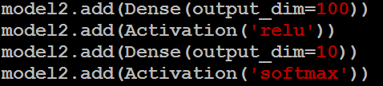
CNN in Keras
Only modified the network structure and input format (vector -> 3-D array)
Input
1 x 28 x 28
Output
Convolution
25 x 26 x 26
Fully connected feedforward network
Max Pooling
25 x 13 x 13
Convolution
50 x 11 x 11
Max Pooling
1250
50 x 5 x 5
Flattened

