Slide 1

OVERFITTING

Slide 2
OVERFITTING
UNDERFITTING OVERFITTING
Them model has not our training has trained too
Captured the underlying logic much on a particular data training Of the and missed the data

Slide 3
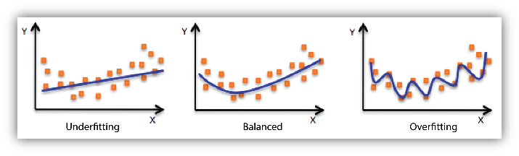
Underfitting vs overfitting

Slide 4
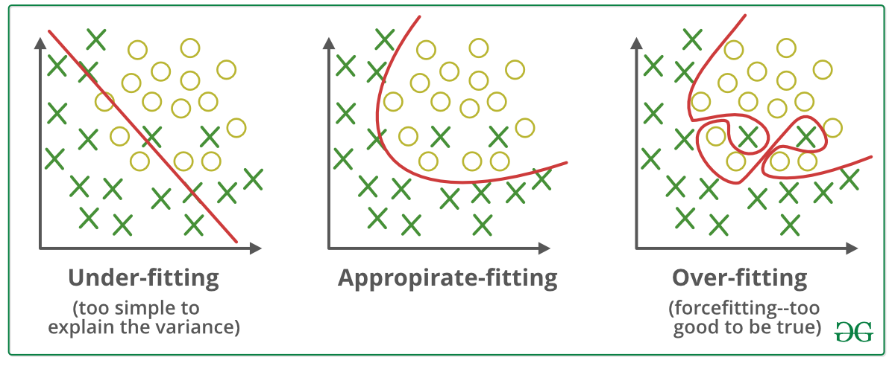
Underfitting and overfitting classification

Slide 5
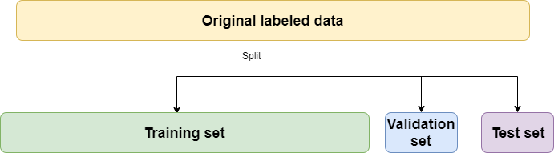
VALIDATION

Slide 6
Training Vs Validation
Calculate training loss
Will be decreasing (because of gradient descent)
Calculate validation
Validation could start increasing at some point
That is the red flag
It became overfitting
Stop training

Slide 7
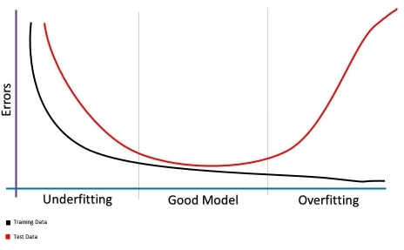
Over fitting

Slide 8
Training , Validation and test
Training – where the training happens
Validation – helps us overfitting
Testing – Measures the power of prediction
80 %10% 10%
70% 20% 10%

Slide 9
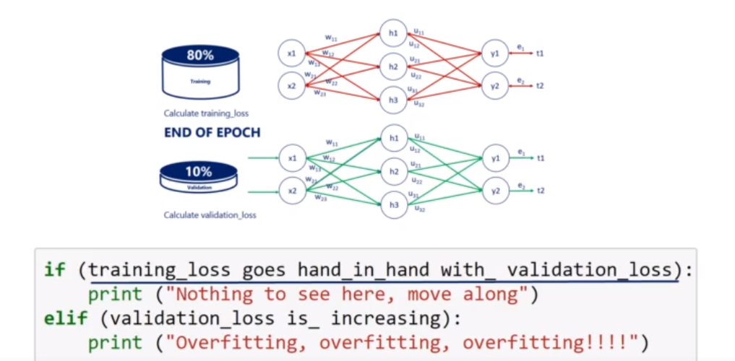
When to stop

Slide 10
N-FOLD VALIDATION
11000 DATASETS
9000+ 1000
1000 for training

Slide 11
Early Stopping
Preset number of epochs
Pros Cons
Solves the problem No guarantee minimum is reached
May not be minimized

Slide 12
Stop when updates too small
We can find minimum by trial and error
Each trail is better
Pros
Loss is minimized
Save computation

Slide 13
Validation set strategy
Training accuracy should be decreasing
Validation will start increasing after decreasing
Stop there

Slide 14
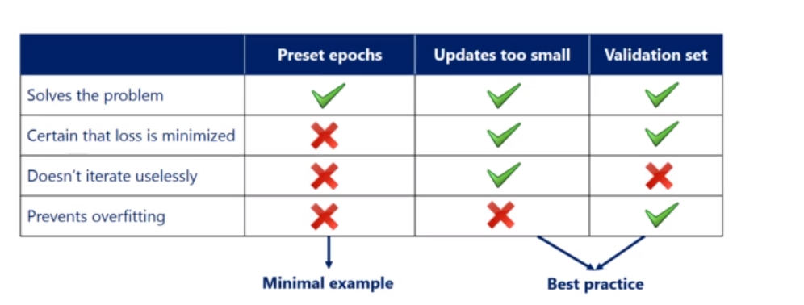
When to stop

Slide 15
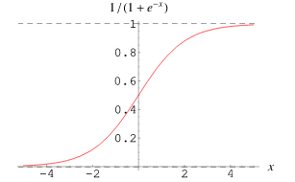
Initialization
Random
Normal Initializer ( 0- Mean distribution)

Slide 16
Xavier initialization
Uniform Xavier Initialization
In [-X,X] for x= sqrt (6/inputs +outputs)
Normal Xavier initialization
Draw each weight w from a normal distribution of mean 0 and standard deviation = sqrt(2/(inputs+outputs))

