Slide 1
RNN

Slide 2
RNN
Recurrent Neural Network(RNN) the output from the previous step is fed as input to the current step.
when it is required to predict the next word of a sentence, the previous words are required and hence there is a need to remember the previous words.
Thus RNN solved this issue with the help of a Hidden Layer.
The main and most important feature of RNN is its Hidden state, which remembers some information about a sequence.
The state is also referred to as Memory State since it remembers the previous input to the network.
It uses the same parameters for each input as it performs the same task on all the inputs or hidden layers to produce the output\

Slide 3
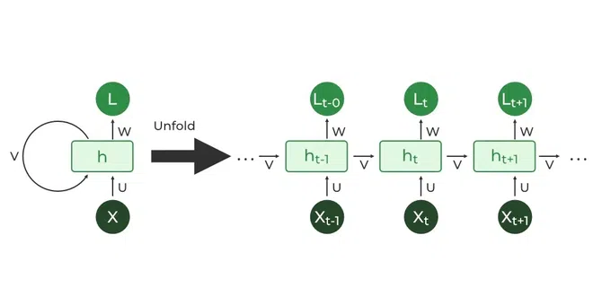

Slide 4
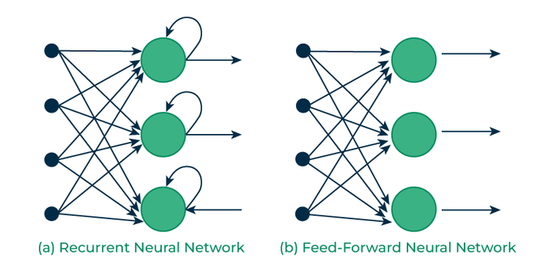

Slide 5
Recurrent Neuron and RNN Unfolding
The fundamental processing unit in a Recurrent Neural Network (RNN) is a Recurrent Unit
This unit has the unique ability to maintain a hidden state, allowing the network to capture sequential dependencies by remembering previous inputs while processing.

Slide 6
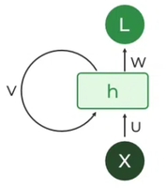
Recurrent Neuron

Slide 7
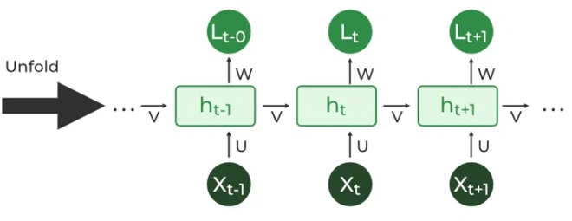

Slide 8
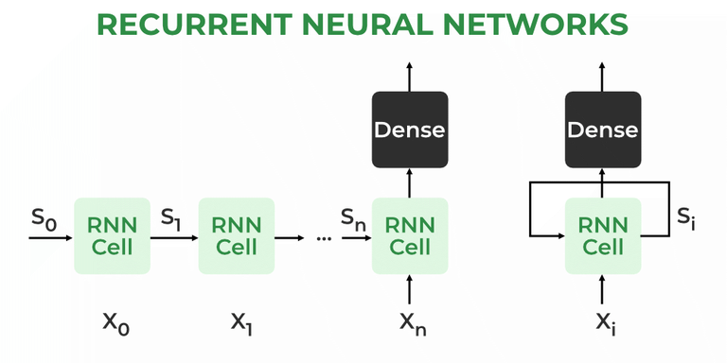

Slide 9
How does RNN work?
The Recurrent Neural Network consists of multiple fixed activation function units, one for each time step.
Each unit has an internal state which is called the hidden state of the unit.
This hidden state signifies the past knowledge that the network currently holds at a given time step.
This hidden state is updated at every time step to signify the change in the knowledge of the network about the past.

Slide 10

Thank you!

