Slide 1



React VS Angular VS vue.js
Background :
React was created by Jordan Walke in 2011 and Open sourced it in May 2013
Facebook and Instagram released React 16.0 on September 2017
The latest version React Fiber was released with React 16 in September 2017. React Fiber is an ongoing implementation of Reac'ts Core Algorithm.
AngularJS was released in 2010 by Google.
2.0 version which also called Angular 2 or just Angular was released in September 2016
4.0 version was released in March 2017
5.0 version was released in Nov 2017
Today there is
Mvc : Model-View-Controller

Slide 2
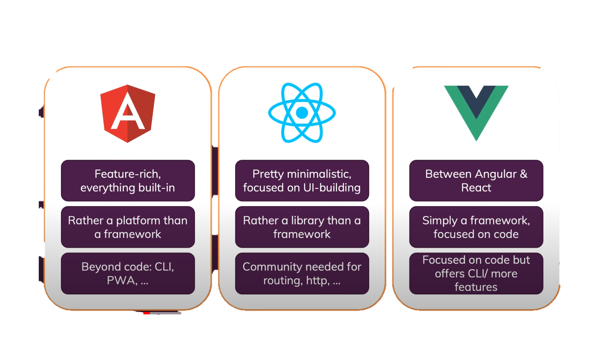
Philosophies

Slide 3
 | Angular | React
Code management
Dependancy injection
Mvc pattern compliancy | Angular JS is based on MVC (Model View Controller) | whereas React is based on Virtual DOM.
Enterprice solusions
Mainstream

Slide 4
React VS Angular VS vue.js
overview- | angular- google | react- facebook | veu- standalone, team of collaborates veu.js.org- huge team
philosophies- | * featurs-rich one stop shop, platform has tools like cli for managing and creating projects, easy to get support (almost )everithing has a solution | react- minimalistic and focused on UI-bulding librarty less featurs routers and more managment solutions you need to ise the community manage packages to add this featurs. the community is very wide and active so you probably find the solution -but you have to search it. | veu- between angular and react (more likr react) it is a framework focuse on core featurs that you need for writing a code like- routher, built-in-state management solution. form validation is a feature that manage in the community and not build in to veu Offets cli and more features then react
*syntax
writing code-
*easy of learning
popularity
*evolution
*performance

Slide 5
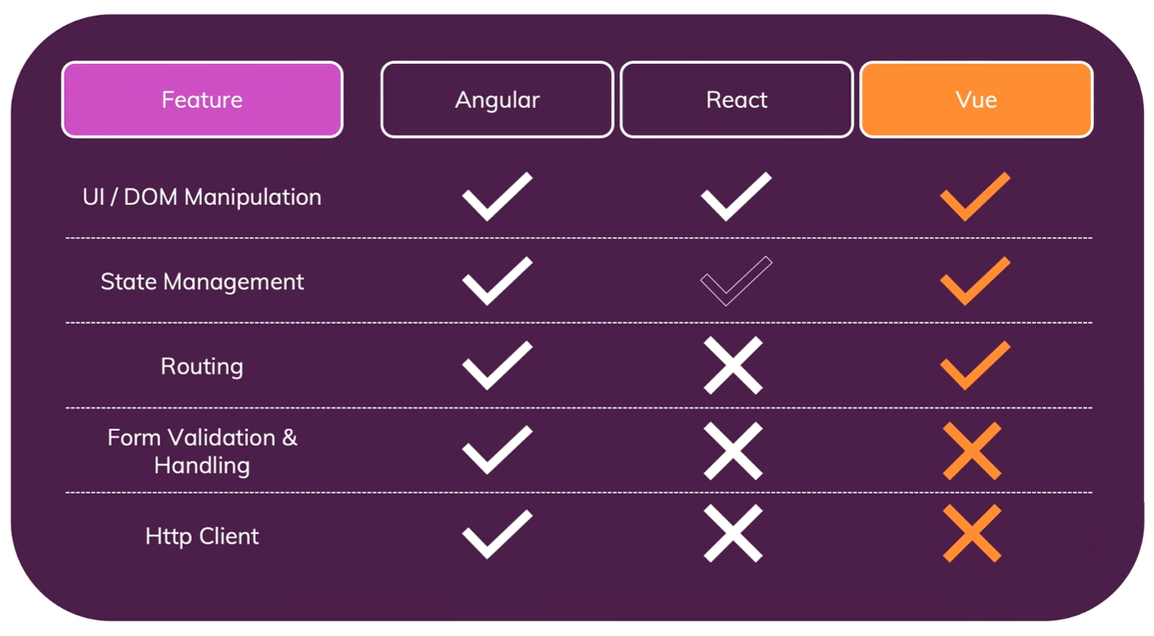

Slide 6
do i need/want to learn more then one ?

Slide 7
Angular-
Developed by google- Large community support
Written In Typescript, offers efficiency Structural framework
Built-in support for AJAX, HTTP, and Observables
Consistent with technology
Cleaner and crisp Coding
Enhanced support for error handling
Seamless updates using Angular CLI
Forms and validation
Shadow DOM / local CSS
UI and Business Logic Separation

Slide 8
react
developed by Facebook- Fully supported by Facebook
javaScript library
Allows you to use 3rd party libraries
Time-Saving
Simplicity and Composable
Better user experience and very fast performance.
Faster Development
Code Stability with One-directional data binding
React Component

Slide 9
reference
Angular vs React vs Vue. – Academind
https://pro.academind.com

Slide 10
flower
Get diagram
 |  |  |  |  |  |  |  | הטבלה של האשראי

Slide 11
flower
Edit diagram data

