Slide 1
THE QUANTUM COMPUTING
English Course : Presentation
ABAK-KALI Nizar
ROUSSEAU Sylvain
2014-2015

Slide 2
Introduction

Slide 3
Presentation Outline
The Qubits vs the bits
How a Qubit work ?
The States of a Qubit
Computation with Qubits
Quantum algorithms
Shor's algorithm
Quantum computers simulators
D-Wave Systems
Conclusion

Slide 4
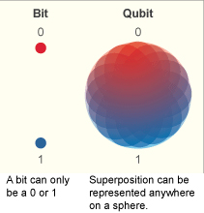
The Qubits vs the bits
A Photon, an electron, or a nucleus are often used as qubit.

Slide 5
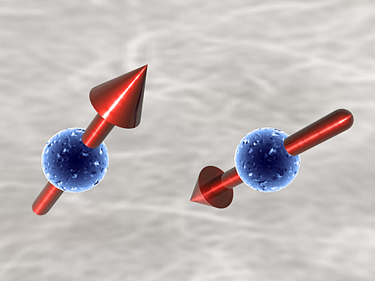
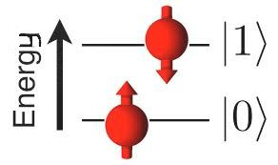
How a Qubit work ?
Energy states and spins

Slide 6
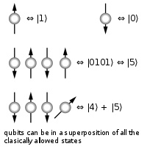
The States of a Qubit
A qubit has the possibility to be either 1 or 0 or both .
A qubit is a quantic particle, so his state is entangled to the state of another particle or a groupe of particles .
There is a quantic superposition .

Slide 7
Computation with Qubits
We don't know the state of a qubit until we mesure it .
N qubits are equivalent to 2^N bits of information.
300 qubits are equivalent to the number of particles in the universe .

Slide 8
Quantum algorithms
Shor's algorithm : integer factorization in O((log(n))³)
Grover's algorithm : searches an unordered list (or database) in O(√N)
Quantum Fourier Transform : O(n log(n))

Slide 9
Shor's algorithm
Let N be a composite number
1/ Pick a random number a < N
2/ If gcd(a, N) != 1 we found a factor
3/ Quantum part : find r sush as a^{x+r} mod N ≡ a^{x} mod N (period)
4/ If r is odd or a^{r/2} ≡ −1 (mod N), pick another a
5/ gcd(a^{r/2} ± 1, N) is a nontrivial factor of N

Slide 10
Quantum computers simulators
Online : http://www.quantumplayground.net/
C/C++ : CHP, Q++, QCLib, QuIDDPro, Shor's Algorithm Simulation
CaML : Q-gol

Slide 11

D-Wave Systems

Slide 12
Conclusion
Qubit will allow us to resolve problems unresolved before, very quickly .
At the same time, all form of security will be useless .

