Slide 1
Assignment Reports
Name : Mohamed Nizharudeen

Slide 2
CreditCard Fraud Analysis
Checked both the Train and Test csvs and concatenated into a single Dataframe
Analysed the dataframe observation and its characteristics by using df.head()
Out of 30 columns 1 column named “Class” was taken as a dependent variable which has 0 and 1.
The Class variable was a object later it is converted to numerical data by the use of LabelEncoder().fit_transform()
Then later on Prepared the data for the training by use of train_test_split function

Slide 3
CreditCard Fraud Analysis
The test size ration took for the train_test_split is 80:20 and the random state took was 30 as an assumption
Models Used:
Logistic Regression
KNeighbourClassifier
RandomForestClassifier
Metrics Used:
F1 Score

Slide 4
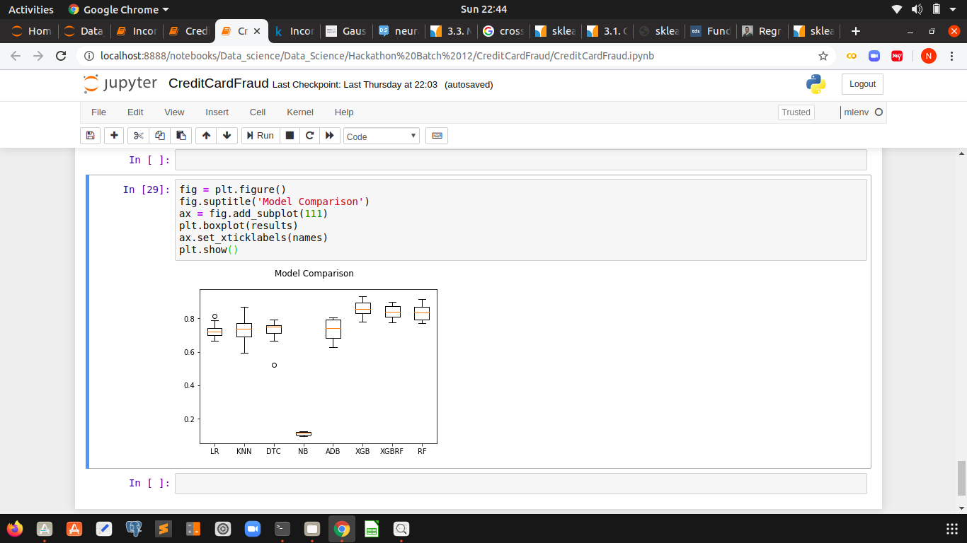
CreditCard Fraud Analysis

Slide 5
CreditCard Score
Checked both the Train and Test csvs and concatenated into a single Dataframe
Analysed the dataframe observation and its characteristics by using df.head()
Out of 305 columns 1 column named “y” was taken as a dependent variable.
The whole variable is a numerical data
Though the some Nan values were imputed by using just the mean for the particular column and its repeated for all the columns
Then later on Prepared the data for the training by use of train_test_split function

Slide 6
CreditCard Score
The test size ration took for the train_test_split is 70:20 and the random state took was 30 as an assumption
Models Used:
Linear Regression
Lasso
Ridge
ElasticNet
DecisionTree Regressor
RandomForest Regressor
Metrics Used:
Mean Absolute Error

Slide 7
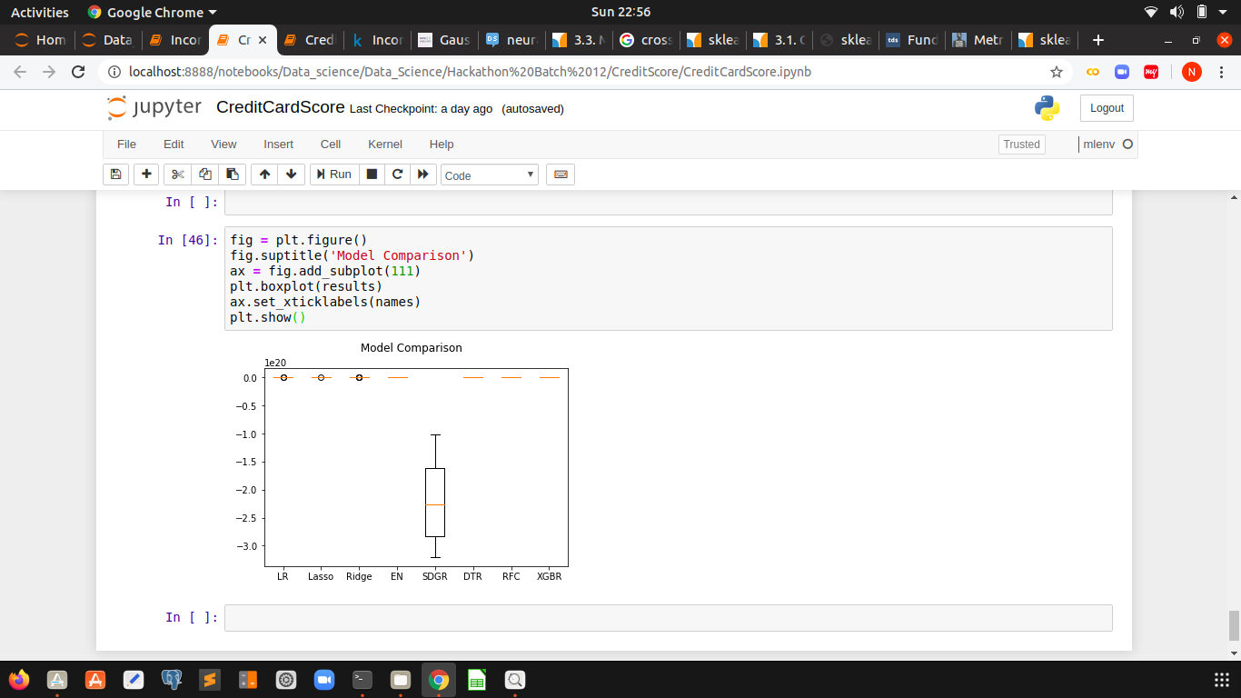
CreditCard Score

Slide 8
Income Prediction Report
Checked both the Train and Test csvs and concatenated into a single Dataframe
Analysed the dataframe observation and its characteristics by using df.head()
Out of 16 columns 1 column named as “income” was taken as a dependent variable.
The Sex variable was a object later it is converted to numerical data by the use of LabelEncoder().fit_transform()
The martial.status variable where divided into “married” and “single”, And later those variable are also converted into numerical data

Slide 9
Income Prediction Report
The education, occupation, relationship, race, workclass, native.country variable were removed because those were not related to our problem prediction
Then later on Prepared the data for the training by use of train_test_split function

Slide 10
Income Prediction Report
Models Used:
Logistic Regression
KNeighbourClassifier
RandomForestClassifier
AdaBoostClassifier
Metrics Used:
Accuracy

Slide 11
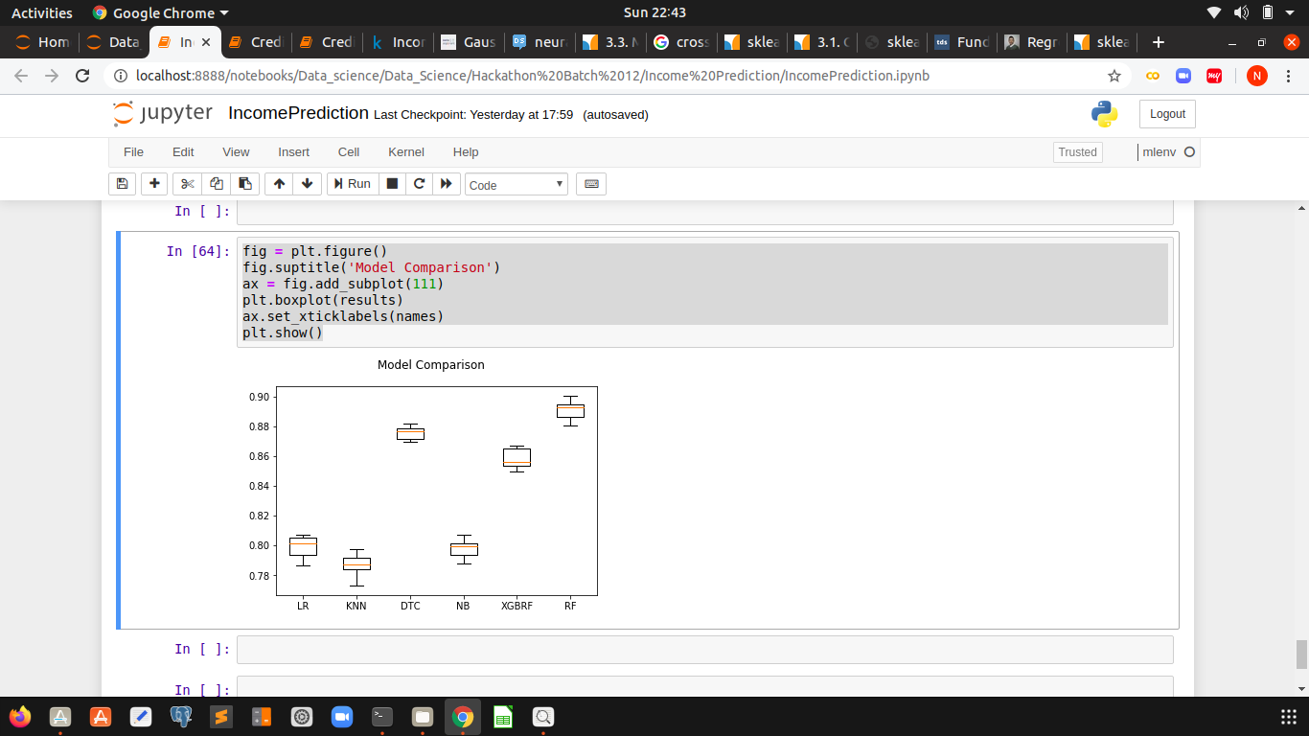
Income Prediction Report

