Slide 1

Introduction to BioSAILs
Nizar Drou
Core Bioinformatics Lead Developer
CGSB
NYU Abu Dhabi

Slide 2
Overview
What are Workflow Management systems
BioSAILs
Motivation
What is it?
Advantages of BioSAILs
The YAML format
The Biox command
The HPCrunner command
Executing workflows – guided tutorial
Workflow collections

Slide 3
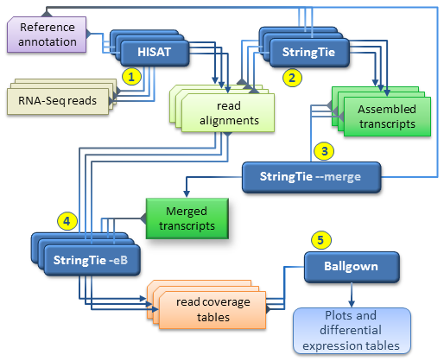
What are Workflow Management Systems
WMS are
A system that enables the automation and execution of a series of predefined tasks.
Capable of scaling and adapting as the tasks or the requirements change.
Can abstract the backend process from the user.
Uses an interface to define and execute the tasks.
In bioinformatics, WMS rely on some form of directed graph, where nodes usually are tasks, and edges represent data flow or dependencies.
Should also allow for monitoring and reporting of the executed workflows.
Ideally, should allow for an easy entry barrier to new and less experienced users.
Ideally, should be easily deployed on different architectures, and support multiple system setups.
There are a lot of WMS currently available and choosing the right one can be a challenge, but you should definitely pick one!
Differential expression analysis
http://ccb.jhu.edu/software/stringtie/index.shtml?t=manual

Slide 4
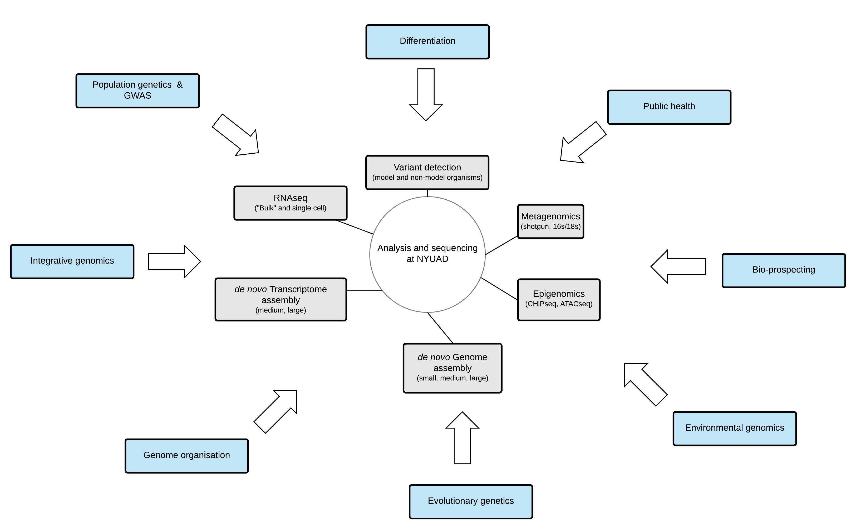
BioSAILs / Motivation
BioSAILs
Ability to support multiple research labs with various analysis needs.
Had to perform certain standardized processes for sequencing runs.
Quality Checking (QC).
Quality Trimming (QT).
Archiving.
Demultiplexing.
Nothing was around that fit our needs quite a few years ago.
Wanted to deploy Bioinformatics software rapidly on the HPC and avoid conflicts.
Be able to reproduce the analysis.
Be able to migrate to new setups easily.
Ability to fine-tune parameters to suit our HPC setup easily and optimize resources.
Easily adapt from paper to analysis.
Standardize Input/Output.
Wanted stuff in shell/bash!

Slide 5
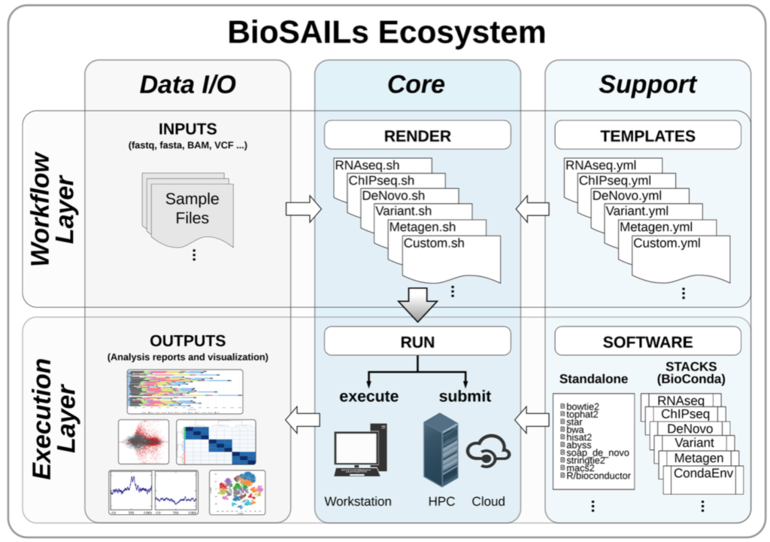
BioSAILs / What is it?
BioSAILs
Bioinformatics Standardized Analysis Information Layers
It comprises of 2 distinct layers,
Biox - Which is the analysis templating system.
HPCrunner - The workflow submission system.
Workflow are defined in YAML format.
Biox reads the YAML workflows and renders an executable shell script.
HPCrunner can then process the resulting shell script and submit it on a workstation, HPC, or cloud infrastructure.
The BioSAILs paper in BioRxiv at https://www.biorxiv.org/content/10.1101/509455v1

Slide 6
BioSAILs / Advantages
BioSAILs
Plain text based format for defining workflows makes it easier to understand and create.
Versatile in where it can be deployed, standalone machine, HPC cluster, or a cloud environment.
Easy to install through Conda/Bioconda.
Does not use a Domain Specific Language (DSL).
Extensibility through the use of plugins and APIs, and can consume both YAML and JSON.
Reproducibility, logging, and reporting.
Can be deployed with or without the software stacks (BioStacks and Gencore modules).
NYU researchers can benefit from in-house support for a WMS that has been running in production for the last 7 years.
Multiple production level workflows already exist to cover, QC/QT, RNAseq, WGS/WES, de novo Genome/transcriptome, Epigenetic analysis, Metagenomics and many more.
Notes:
- NextFlow and BigDataScript are each Domain Specific Languages (DSL). BioSAILs is more similar to SnakeMake and bcbio.
- The largest gain to reproducible research is having a clear and concise configuration template. And the whole analysis submission can be integrate in github for version control.
Logging is done per submission, per job, and per task with both a tabular terminal view and a programmatic JSON output. Exit codes, duration, stdout, stderr, and original commands are all logged.
BioX moves all the logic of finding files and organizing the workflow structure to the BioX libraries, giving the end user and any collaborators a format that is easy to read and parse.

Slide 7
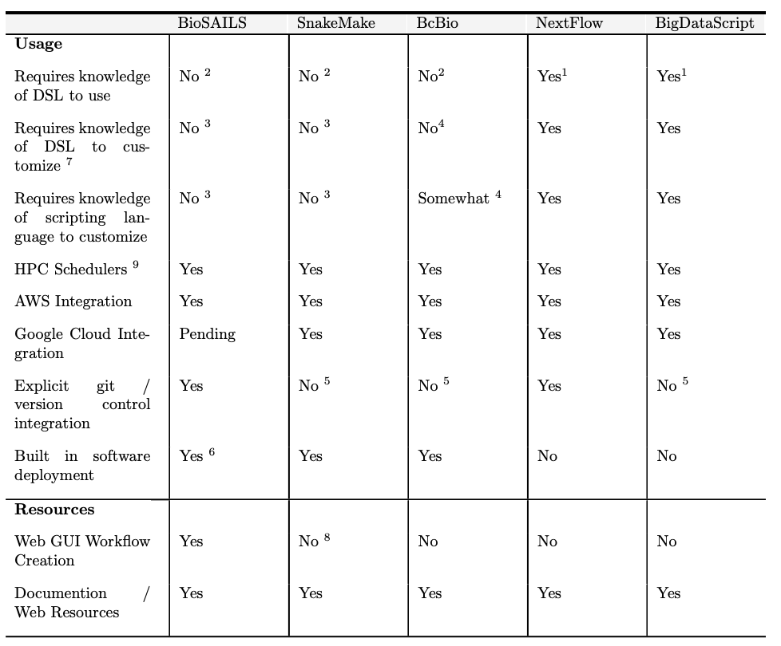
Bioinformatics WMS comparison
Notes:
The logic of your workflows remains the same whether processing 1 or 1000 samples. HPCRunner splits your workflow into efficient chunks, and lets the scheduler take care of the rest.
Executing hpcrunner with a SLURM, PBS, or SGE scheduler.

Slide 8
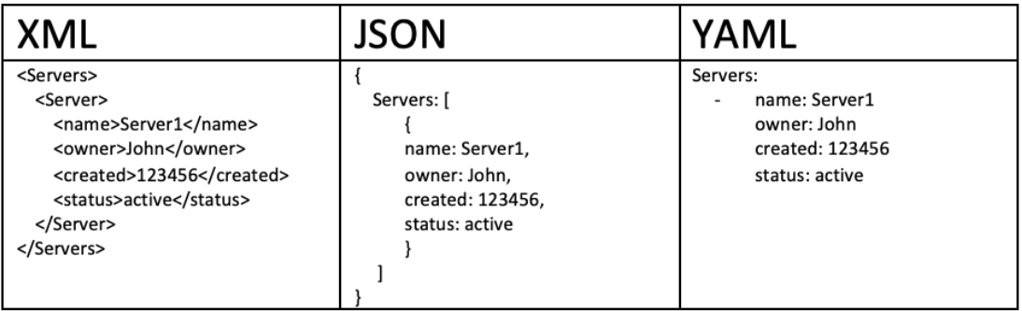
The YAML format
YAML
YAML is an acronym that stands for “YAML Ain't Markup Language”.
It is a serialization language that has steadily increased in popularity over the last few years.
It is easy to parse and generate similar to JSON and BSON (binary JSON).
It is a great way to describe bioinformatics workflows.
It is truly human readable plain text representation.
Unlike other formats, whitespace indentation is used to denote structure, no need for quotes or brackets (like JSON).
The YAML specification is a lot more expansive the JSON, which in turn allows for more data types and structures to be described. https://yaml.org/
Since YAML is a superset of JSON, it means you can parse JSON with a YAML parser.
Notes:
- serializing data is finding some sort of universal format that can be easily shared across different applications. A serialization language is a standard way of describing and organizing data objects to enable the serialization and deserialization of the data across multiple platforms/applications.

Slide 9
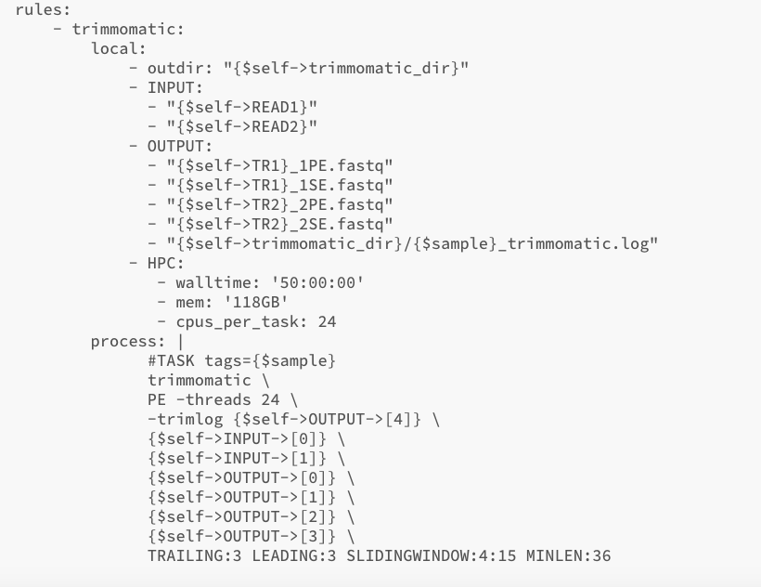
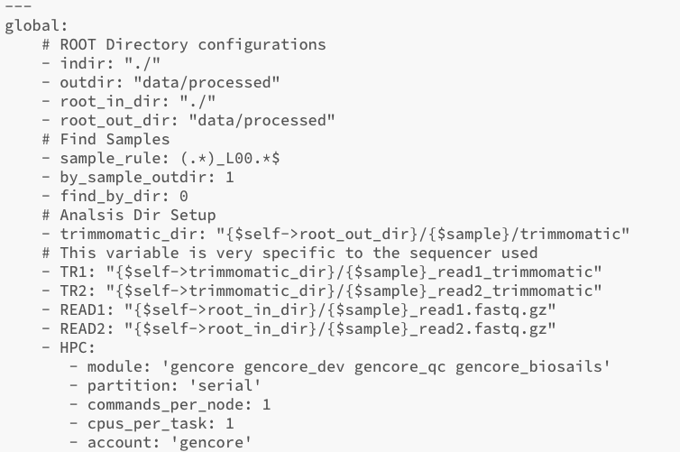
YAML // The main sections in a workflow
The GLOBAL variables
Global variables are defined at the top of your file can be accessed at any point in your workflow within any rule.
You can create your own global variables and reference them at any point in the workflow, and declaring them is easy.
There are some “special” variables such as indir, outdir, and the HPC directive that the command HPCrunner can interpret (among others).
The LOCAL variables
Local variables are declared per rule, and can only be accessed within their rule. A local variable can override a global variable, but will only override it in that rule.

Slide 10
Biox command
The Biox command consumes the YAML workflow, and will render an executable shell script.
It offer a rich Command Line Interface (CLI) with a lot of functionalities such as omit samples, select only specific samples, select specific rules etc.
It will also create the whole directory tree based on the configuration that the user provides.
It will also perform some checks on the YAML and attempt to highlight issues or conflicts in the YAML.
The directory structure will be based on the rule names.
Biox will iterate over the number of samples and create executable lines based on the rules.
Biox will also create the folder structure that captures all the logging and reporting for a particular analysis.

Slide 11
HPCrunner command
The HPCrunner command is a set of libraries for scaffolding data analysis projects, submitting and executing jobs on an HPC cluster or workstation, and logging results.
It does not rewrite any part of the workflow or shell executable.
It optimizes resource usage by taking advantage of HPC resources and splitting your jobs into smaller components and arrays.
Trouble shooting your jobs and getting support from your HPC admins becomes a straight forward task without the need to dig through a separate layer of logic.
Support for multiple HPC schedulers with mapped parameters such as nodes, CPUs, memory, partition etc.
There is an extensive CLI supplied with HPCrunner that allows you to change parameters on the fly rather than edit your workflow and rerun biox, everything from changing array size, to memory, cpus, partition, search paths, or even supply your own configuration file.
Supports git commits and version diffs to ensure reproducibility and accurate logging.
Notes:
The logic of your workflows remains the same whether processing 1 or 1000 samples. HPCRunner splits your workflow into efficient chunks, and lets the scheduler take care of the rest.
Executing hpcrunner with a SLURM, PBS, or SGE scheduler.

Slide 12
Running a simple workflow
By the end of this short guided tutorial, you should be able to:
Load the BioSAILs software modules on the HPC.
Run a multi-rule workflow with the test data through BioSAILs.
Modify and run a multi-rule workflow with the test data through BioSAILs.
Understand the INPUT structure and logic, as well as how to modify the ”sample search” parameter.
Understand the OUTPUT structure and how to change it from within a workflow.
Understand where BioSAILs stores the output logs and how to view them.
Create your own variables and using them within a workflow.
Create your workflow from scratch!
A GitHub repo that accompanies this workshop is here,
https://github.com/nizardrou/BioSAILs-WMS
To run any other workflow, it is as simple as,
biox run –w my_workflow.yml –o my_script.sh
hpcrunner.pl –i my_script.sh
Notes:
The logic of your workflows remains the same whether processing 1 or 1000 samples. HPCRunner splits your workflow into efficient chunks, and lets the scheduler take care of the rest.
Executing hpcrunner with a SLURM, PBS, or SGE scheduler.

Slide 13
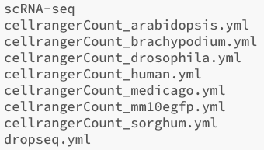
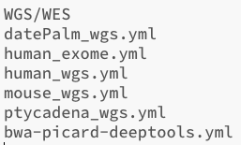
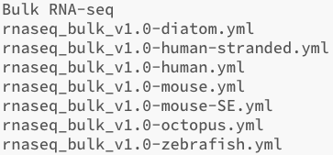

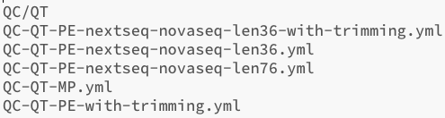

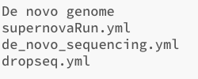

A whole collection of ready-made workflows
Over the years, we have compiled many workflows to perform various types of analysis. All of which are ready to use with minimal changes.
Notes:
The logic of your workflows remains the same whether processing 1 or 1000 samples. HPCRunner splits your workflow into efficient chunks, and lets the scheduler take care of the rest.
Executing hpcrunner with a SLURM, PBS, or SGE scheduler.

Slide 14
Acknowledgments
Jillian D Rowe – NYUAD*
Ayman Yusif – NYUAD*
Jayaram Radhakrishnan
Muhammed Arshad – NYUAD
Kristin C Gunsalus – NYUAD / NYUNY
The NYUAD HPC team
Notes:
The logic of your workflows remains the same whether processing 1 or 1000 samples. HPCRunner splits your workflow into efficient chunks, and lets the scheduler take care of the rest.
Executing hpcrunner with a SLURM, PBS, or SGE scheduler.

