Slide 1

Denovo Assembly Workshop
18-19 March 2024
By Neelu Begum

Slide 2
Quality Assessment
Alignment stats
BUSCO
Output visualisation (.bam, .bim and .fasta) on IGV
Other options:
rnaQUAST
E90N50 stats

Slide 3
So far…
A A A A
SMARTer IIA oligonucleotide (5’ leader sequence)
polyA tail
output
Denovo assembled transcript by Trinity (trinity.fa)
A A A A
Align back to original fastas to determine coverage
>80%

Slide 4
N50 & L50 related stats
Understand contiguity and completeness of our draft assembly
We assess the fragmentation of our sequence (contigs/reads) have been assembled into longer sequence (scaffold/chromosomes)
Computing L50 is to understand how many (contigs/scaffold are needed to cover 50% of the genome, indicating fragmentation of our assembly
Defined as at least x% of the assembled transcript nucleotides are found in contigs that are at least of Nx length.
Lower L50 value means lower gaps
Computing N50 means at least half of all assembled bases are in transcript contigs of at least the N50 length value, indicating completeness of assembly
Higher the number means larger number of the sequence has been assembled into larger continuous sequence = higher completeness

Slide 5
Alignment workflow
fasta
Sort BAM by position
(samtools sort)
Obtain original fasta
(choosen aligner)
BAM
Index BAM
(samtools index)
BAM & .bai output
Build aligner specific reference index
(binary index based on aligner)
Alignment metrics & QC
(samtools flagstat; samtools idxstats)
IGV
(Jubail)
Align trinity.fa to reference
(choosen aligner)
SAM
Choice of aligners based on your needs
convert SAM to bam
(samtools view)
BAM

Slide 6
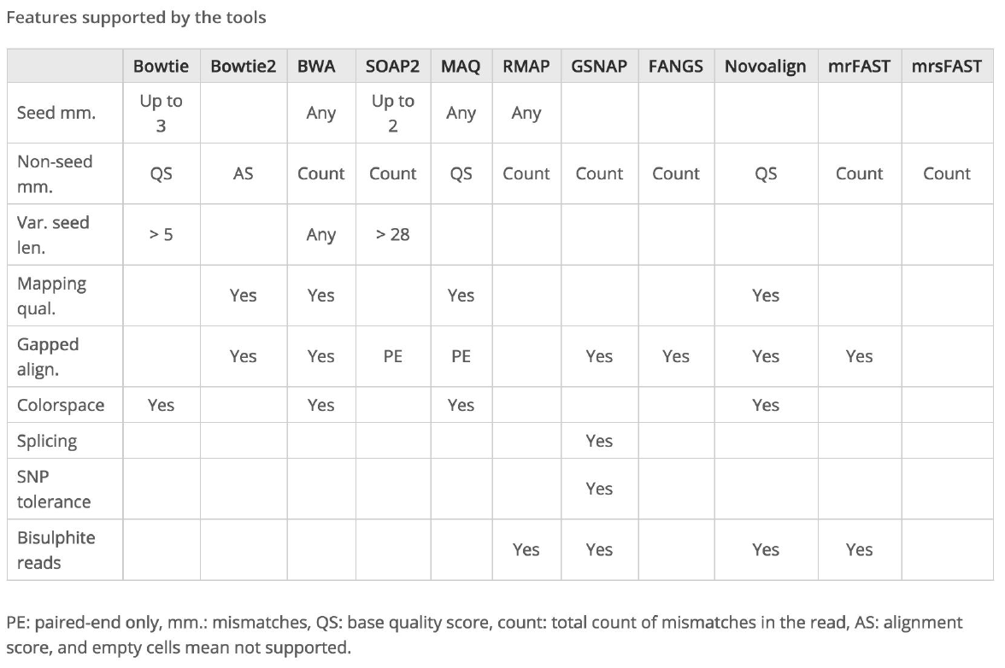
Alignment – index building
Low divergent mapping
BWA-backtrack (35bp;full length match)
BWA-SW (100bp)
Bowtie (<50bp)
Splice aware aligner
STAR
HISTAT2
Bowtie2 (>50bp;--local; --very-sensitive-local)
BWA-MEM (>500bp; faster)
TopHat2 (fusion mode)

Slide 7
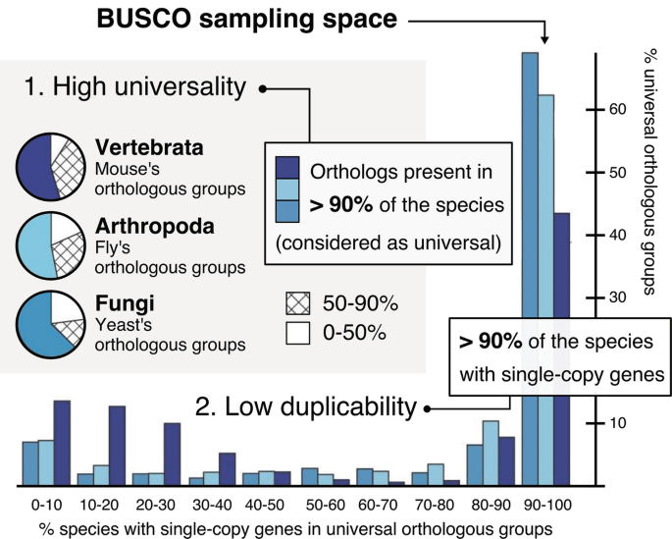
BUSCO
(Benchmarking Unviersal Single-Copy Orthologs)
Seppey, M., Manni, M. and Zdobnov, E.M., 2019. BUSCO: assessing genome assembly and annotation completeness. Gene prediction: methods and protocols, pp.227-245.

Slide 8
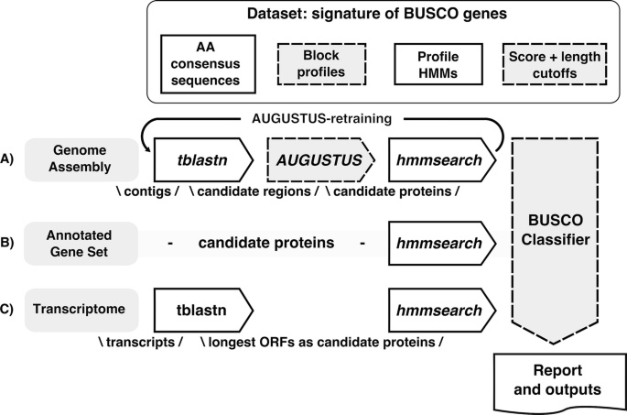
BUSCO selecting orthologs
1. Selection of Single copy orthologs
2. Model building using (HMM-build) from each BUSCO group
3. Prune sequences by searching trinity.fa against HMM profiles
4. Optimised parameters using “expected-score” and “expected-length” classification cut-offs
5. Consensus sequence of BUSCO & position-specific matrices for each BUSCO created
Seppey, M., Manni, M. and Zdobnov, E.M., 2019. BUSCO: assessing genome assembly and annotation completeness. Gene prediction: methods and protocols, pp.227-245.

Slide 9
BUSCO outputs
BUSCO transcriptome run output folder contains a short_summary_OUTPUT_NAME.txt
protein fasta files
Final BUSCO score:
--short_summary_OUTPUT_NAME.txt:
# The lineage dataset is: NAME_OF_LINEAGE
# BUSCO was run in mode: genome C:80.0%
[S:80.0%,D:0.0%],F:0.0%,M:20.0%,n:10
8 Complete BUSCOs (C)
8 Complete and single-copy BUSCOs (S)
0 Complete and duplicated BUSCOs (D)
0 Fragmented BUSCOs (F)
2 Missing BUSCOs (M)
10 Total BUSCO groups searched
C:complete [S:single-copy, D:duplicated], F:fragmented, and M:missing.

Slide 10
BUSCO…with a pinch of salt
Contamination of DNA
RNA extraction efficiency dependent
Core genes in species highly susceptible to mutations
Consider source material of transcriptome e.g. time, organ, life stage it can affect completeness score
Organism may even be too complicated for the assembler
This all means you use the BUSCO tool as good metric how well you have assembled and assess how much you can improve assembly possibly with other aligners but it wont always be 90%

Slide 11
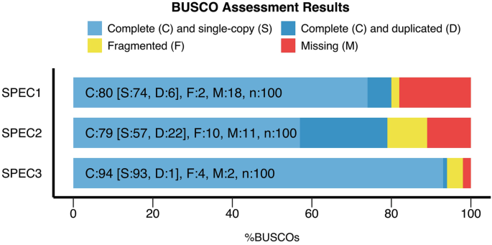
BUSCO
Output metric:
Assembly 1
Assembly 2
Assembly 3
Seppey, M., Manni, M. and Zdobnov, E.M., 2019. BUSCO: assessing genome assembly and annotation completeness. Gene prediction: methods and protocols, pp.227-245.

Slide 12
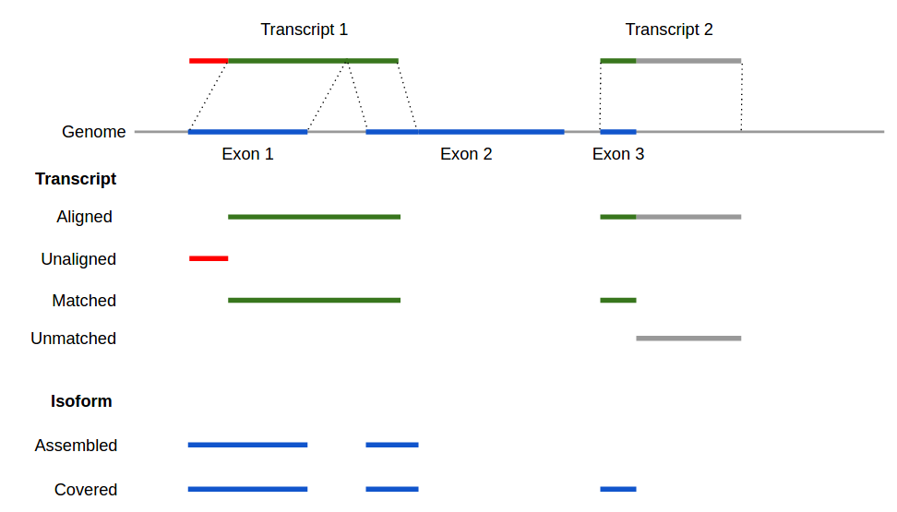
Quast
Tool for evaluating assemblies, especially de novo assembly quality assessment
Works with and without reference genome
Includes BUSCO so don’t need to independently run
GeneMark predict genes
Trinity.fa
Sequence from gene database (in our case the predicted genes from GeneMarkS-T
No. of protein encoded genes
No. of protein coding isoforms
Total no. of exons/introns/isoforms
Average length intro/exon/isoforms (bp)
Max. no. of exon per isoform

Slide 13
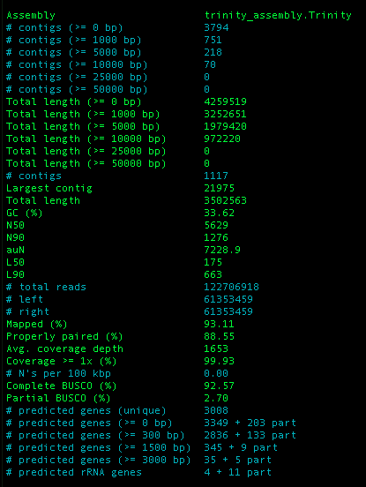
Quast - metrics
report.txt
No of contigs
Length of contigs
N50 (length of all contigs that cover at least 50% of the assembly)
No. of predicted genes
GeneMark (prokaryotes)
Glimmer (for eukaroytes)
MetaGeneMark (for metagenomes)
Other info includes: reads_stats.txt, busco stats

Slide 14
GeneMarkS-T
Predicts gene and intergenic regions (sequences > 50 Kb)
GeneMarkS-T algorithm divides the whole set of transcripts into several sets (clusters) more homogeneous in G + C composition and derives several cluster-specific models of protein-coding regions.
Prokaryotes genome annotation pipelines:
QUAST/rnaQUAST: assessment of genome assembly quality - uses GeneMarkS
MetAMOS: a tool for metagenome assembly and analysis - uses MetaGeneMark
Eukaryotic genome annotation pipelines:
MAKER2: uses GeneMark-ES along with SNAP and AUGUSTUS.
BRAKER1: integrates RNA-Seq reads -- uses GeneMark-ET and AUGUSTUS
BRAKER3: integrates RNA-seq reads and known proteins -- uses GeneMark-EP+ and AUGUSTUS

Slide 15
Ab inito gene predictor
Ab initio methods use statistical models with two types of sensors:
1) Signal sensors exploit specific sites and patterns (splicing sites, promotor and terminator sequences etc.)
2) Content sensors exploit the coding versus non-coding sequence features (exon or intron lengths or nucleotide composition)
Gene predictors
GlimmerHMM
SNAP
AUGUSTUS
GeneID
Genscan
GeneMark-ES

Slide 16
Unknown species: R. ferriguenus
ourRNA seq.fasta
Saudi_ref.fa
Dovetail_Khalid.fa
Selected 5 similar species based on latest study on phylogeny
(fasta)
Assembled genome based on public dovetail_UAEU
(Histat2)
Gene predication ran
(augustus)
Gene predication ran
(augustus)
Convert from GFF to GTF
(agat)
Only 50% recovery. Absent transcripts as exons not aligned and don’t know landscape of dovetail_UAEU
(Trinotate retrieved ORF and homology similarity testing performed)
Build Hmm model
(augustus; seqping)
Indexing of each reference
(HiStat2)
Convert from GFF to GTF
(agat)
ourRNA seq.fasta
(trinotate)
Indexing of each references
(HiStat2)
OurProteinModel
Trinity workflow
(trinotate)
RNAseq DGE
RSEM + Visualise on trinotate web

Slide 17
Further reading
Manchanda, N., Portwood, J.L., Woodhouse, M.R., Seetharam, A.S., Lawrence-Dill, C.J., Andorf, C.M. and Hufford, M.B., 2020. GenomeQC: a quality assessment tool for genome assemblies and gene structure annotations. BMC genomics, 21, pp.1-9.
Seppey, M., Manni, M. and Zdobnov, E.M., 2019. BUSCO: assessing genome assembly and annotation completeness. Gene prediction: methods and protocols, pp.227-245.
https://ucdavis-bioinformatics-training.github.io/2020-Genome_Assembly_Workshop/busco/busco#:~:text=Benchmarking%20Universal%20Single%2DCopy%20Orthologs,completeness%20using%20single%20copy%20orthologs.
https://github.com/ablab/quast
Huang Y, Chen S-Y, Deng F. Well-characterized sequence features of eukaryote genomes and implications for ab initio gene prediction. Comput Struct Biotechnol J. 2016;14:298–303.
http://exon.gatech.edu/GeneMark/
https://github.com/trinityrnaseq/trinityrnaseq

