Slide 1
Variant detection and Annotation workshop
26th-27th Feb 2024
Nizar Drou & Manikandan Vinu

Slide 2
What we will learn
By the end of this 2-day workshop, you will be able to:
Understand quality checking and quality filtering when it comes to sequencing data.
Be able to align sequenced data back to a reference genome.
Be able to post process the alignments in accordance with established best practice guides.
Be able to call variants (short Indels and SNPs).
Filter the variants and annotate them.
Be able to interpret and understand the effects of the variants.

Slide 3
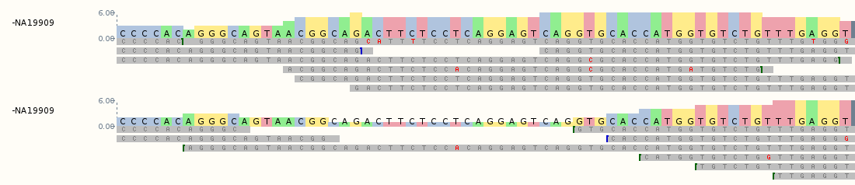
What is Variant detection?
Describes the bioinformatics processes of detecting variants (or mutations) in DNA/RNA data and associating them with traits or disease, either in a single sample or a population.
Somatic variants – these are variants that are not inherited and they can occur after conception in a given cell/tissue. They are not shared by every cell in the body, and they are not present in germline cells (eggs/sperm), and thus cannot be passed on to offspring.
Germline variants – These are variants that are present in germline cells, and can be passed on to future generations. They can also be called “constitutional” variants and they are present in every cell in the body.
The bioinformatic processes involved in calling germline vs somatic variants can differ, but the initial steps involving alignment and alignment post processing are the same.
https://www.ebi.ac.uk/training/online/courses/human-genetic-variation-introduction/wp-content/uploads/sites/76/2020/05/fig11.png

Slide 4
Linking Genotype and Phenotype is complex
Let’s not over-simplify things, explaining disease can be more complex!
Genetic Variation
DNA Sequence
DNA Epigenome
eQTL
Gene Expression
RNA Sequence
RNA Epigenome
QTL
pQTL
Proteome
mQTL
Metabolome
Phenotypes
Endophenotype = G + E + GxG + GxE
Idaghdour and Awadalla, 2012
Notes:
Quantitative trait loci (QTL) are genetic regions that influence phenotypic variation of a complex trait, often through genetic interactions with each other and the environment. These are commonly identified through a statistical genetic analysis known as QTL mapping.

Slide 5
Basics of Sequencing

Slide 6
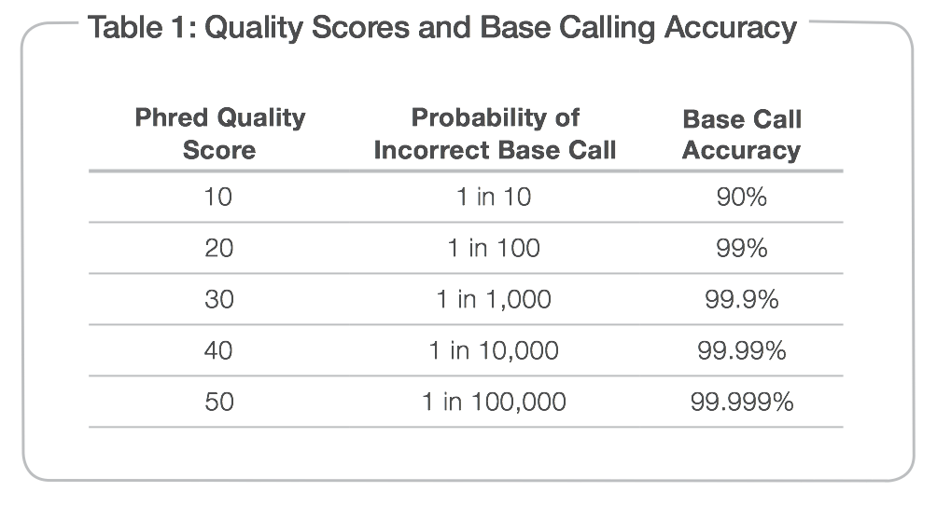
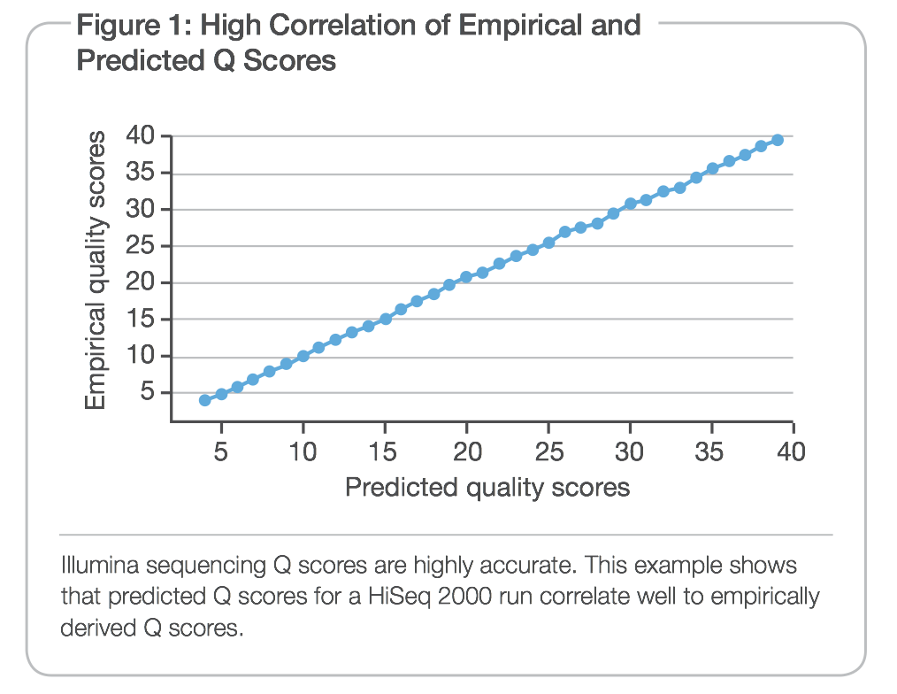
Quality scores
Measured by Phred quality scores (Q scores).
Originally implemented for Sanger sequencing accuracy,
Peak resolution and shape
Confirmation of sequencing through large multivariate table lookups.
Highly accurate across chemistries and instruments
It is the standard quality metric for sequencing.
Process of generating and using lookup tables in Illumina is similar to the Sanger sequencing algorithm

Slide 7
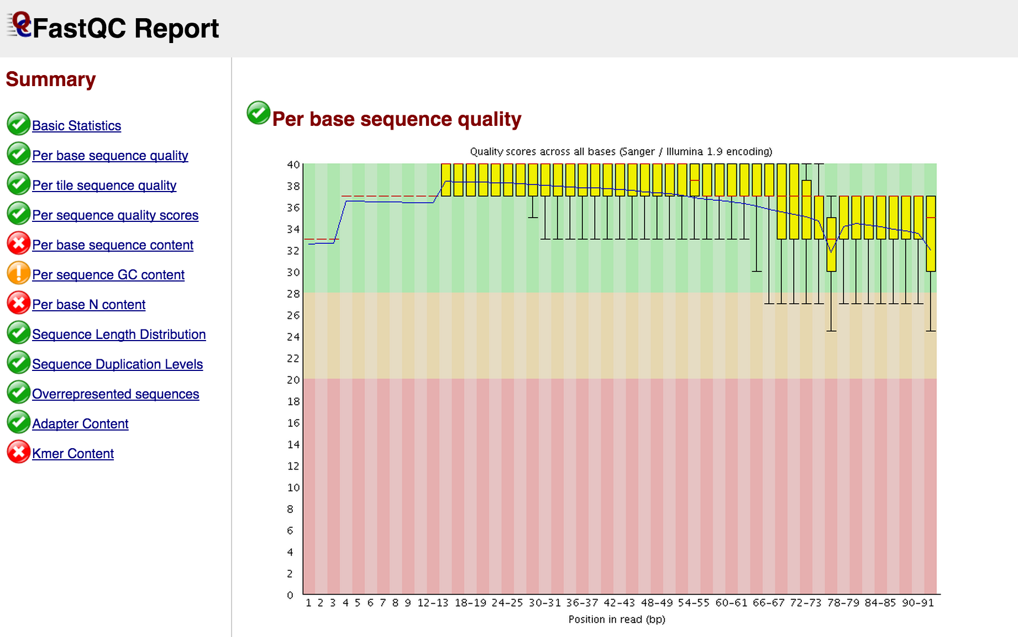
Quality scores

Slide 8
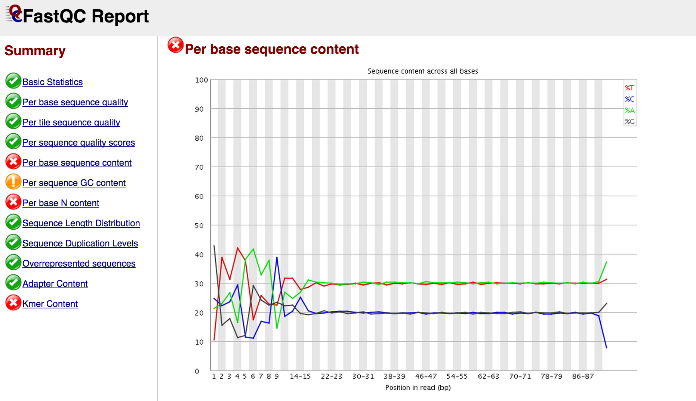
Quality scores

Slide 9
Quality trimming (QT)
Many tools are available (FastP, Trimmomatics, FastX toolkit, Seqtk, Sickle).
Raw FASTQs
Adapter Clipping
Min length 36bp
Clipping trailing bases with Q<3, and PolyG trimming
4bp sliding window with average Q>=15
Quality Trimmed FASTQs
FASTQC
Amount of data lost
Balanced filtering
Uniformity across samples
Changes in base representation
Duplication level change
Potential unclipped adapters

Slide 10
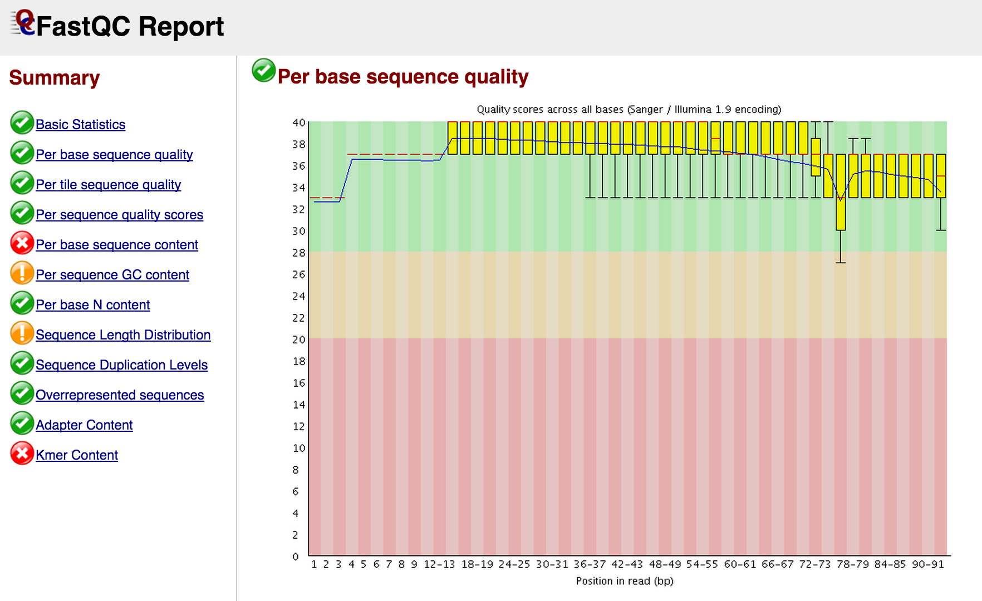
Quality scores

Slide 11
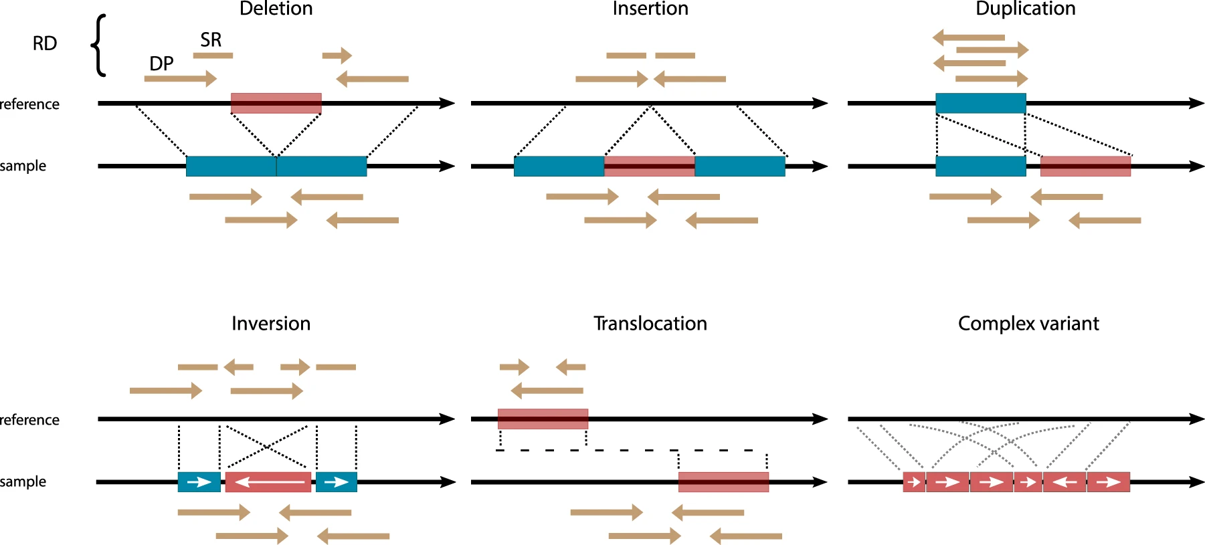
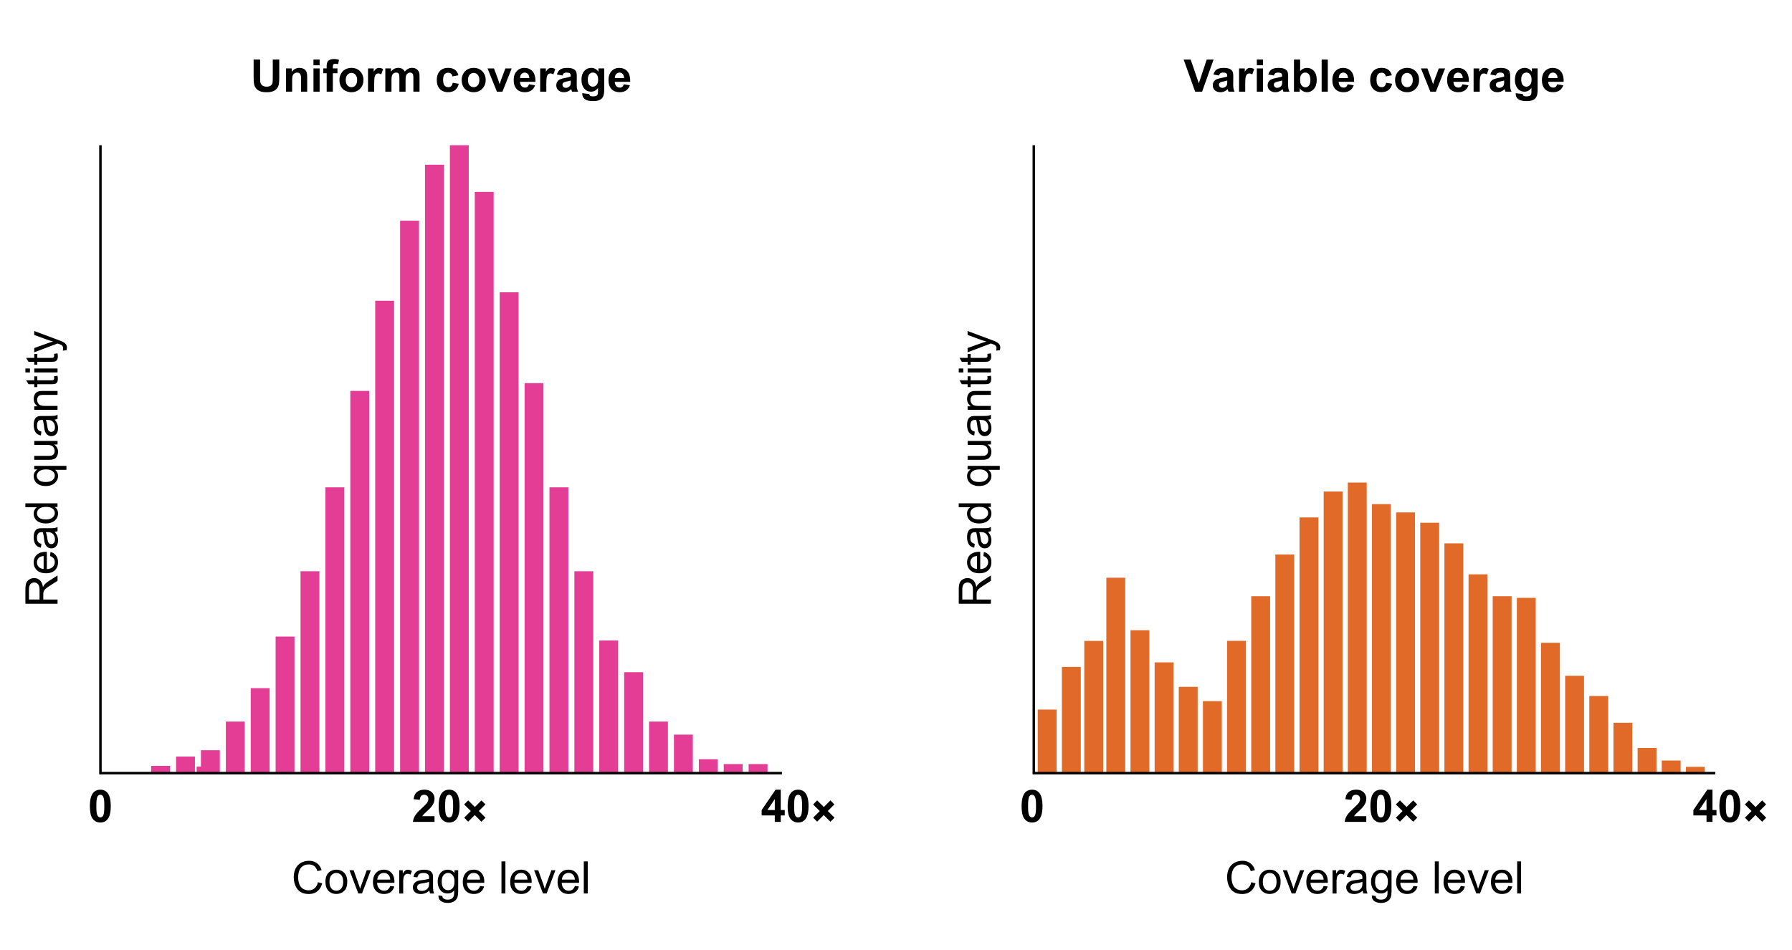
Challenges for variant calling
Biological, technology based, and computational challenges.
Sequencing coverage (depth).
Many different types of variants (SNPs, short Indels, large Indels, CNVs, Segmental duplications etc).
Some areas of the genome are difficult to capture.
Hyper variable regions.
Algorithms can introduce computational bias.
Sequencing technology artefacts.
van Belzen, I.A.E.M., Schönhuth, A., Kemmeren, P. et al.
Structural variant detection in cancer genomes: computational
challenges and perspectives for precision oncology. npj Precis. Onc. 5, 15 (2021).
https://doi.org/10.1038/s41698-021-00155-6
https://www.pacb.com/wp-content/uploads/Figure-2_Coverage-graphs.svg

Slide 12
Reference Genomes
A representation of a species genome, but individuals vary.
In almost all cases, it is stored as a FASTA file (text based).
Can be a draft (contigs/scaffolds), or complete (arranged into chromosomes).
Model reference genomes are maintained, updated and released by GRC (Genome Reference Consortiums).
Annotations are available to “label” the genomes, and they take the form of GTF/GFF files.

Slide 13
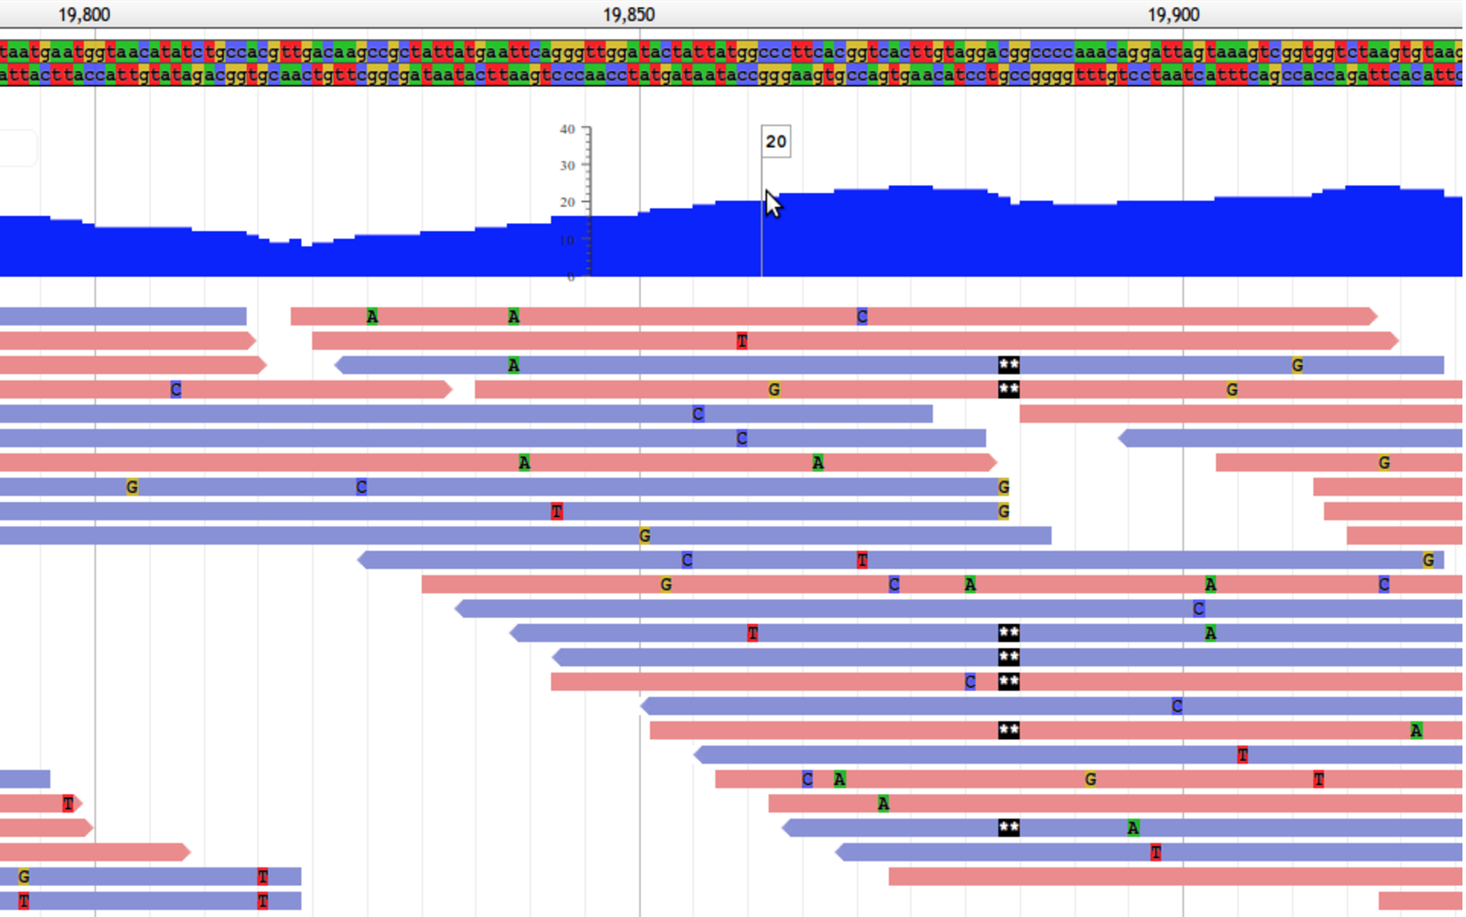
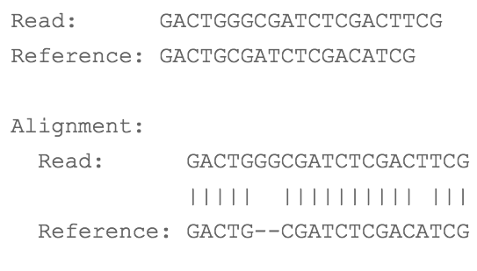
Alignment process overview
Alignment of millions of reads
Applicable
Considerations
DGE analysis
Variation
Epigenetic analysis
Evolution/divergence
Assembly
Quality assessment
Speed
Sensitivity & accuracy
Scalability & performance
Application (Genomic/RNA/repeats)
Documentation and support
Unix/Linux based? No? …….NOT INTERESTED!
But you can try it ………… if you must.

Slide 14
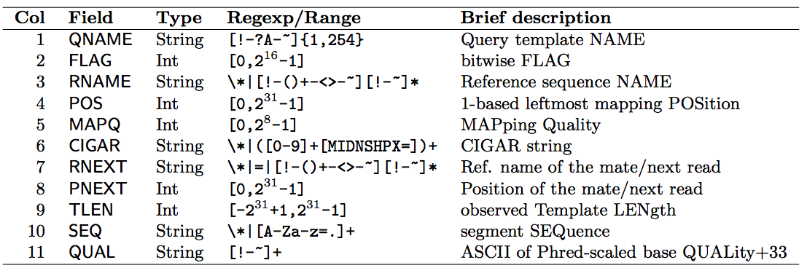
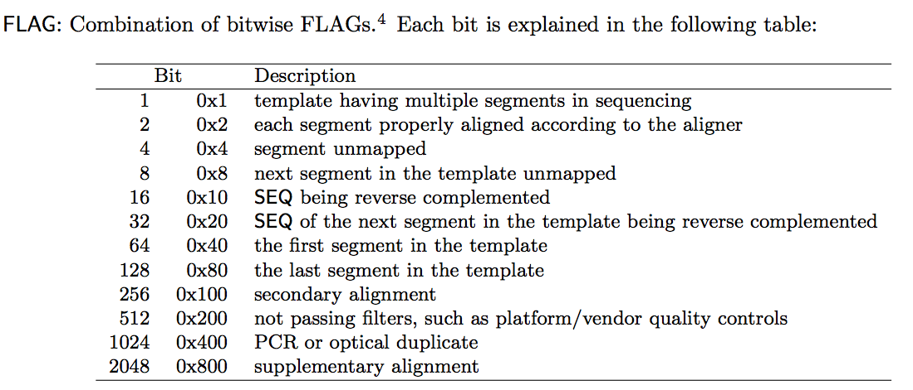
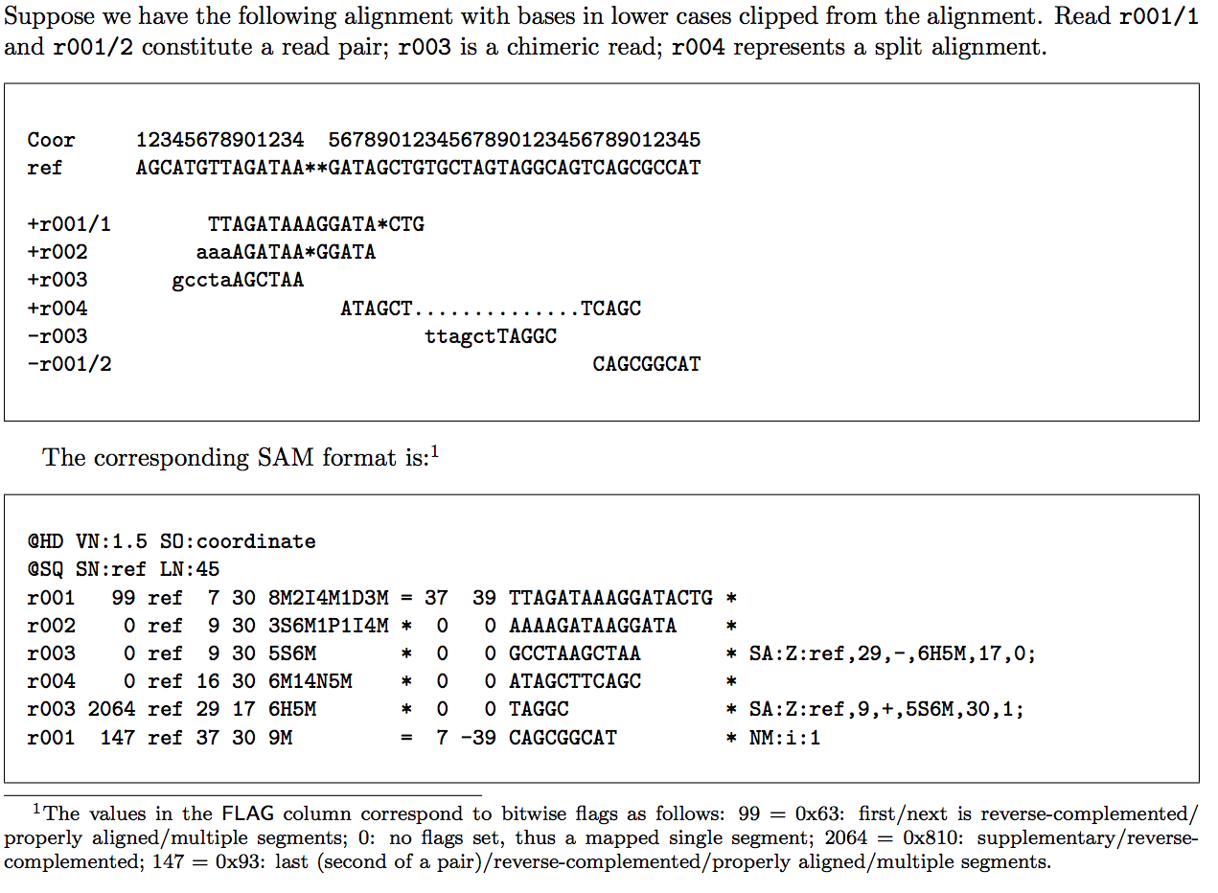
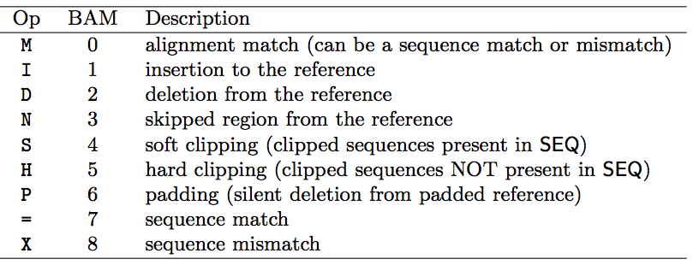
SAM file format
Storing sequence data (alignments) in tab-delimited text file.
Standard alignment format.
Header section (optional) & alignment section.
11 mandatory alignment fields.

Slide 15
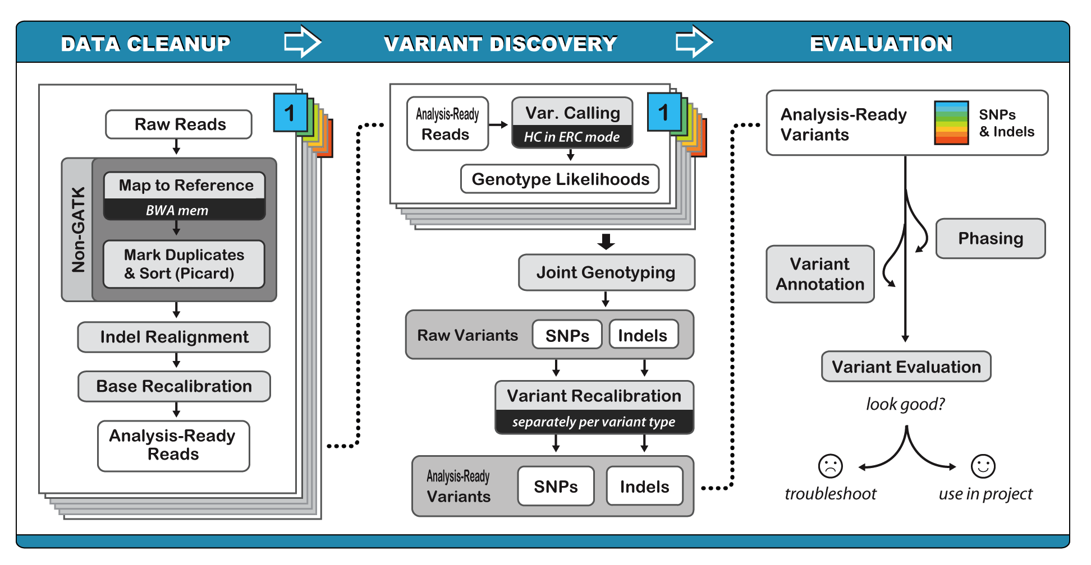
The Broad Institute Best Practice guide (GATK/PICAR)

Slide 16
General overview of our exercises (Steps, Tools, File formats)
Tools involved
Steps
File Formats
Evaluate raw QC
FastQC, FastP
Quality filter the reads
FASTQ, Text, CSV, HTML
Evaluate filtered quality
Align vs reference human genome
BWA mem, SAMtools
FASTQ, FASTA, SAM, BAM
File format conversion and indexing
PICARD, GATK
Post process alignment
BAM
Qualimap bamqc
Evaluate alignment quality
CSV, HTML, PDF, Text
GATK HaploTypeCaller, SnpEff, SnpSift
Variant calling, annotation and filtration
VCF, HTML, CSV
IGV
Visualization
BAM, FASTA, GTF
Interpretation

Slide 17
Some background on the data for this workshop
The data is publicly available.
Single sample datasets (no population data).
Standard germline variant detection (not somatic or tumor detection).
The dataset has been reduced from its original size (otherwise it would take us quite a long time).
There are 3 datasets that have been randomly assigned to you, p1, p2, and p3.
Your task is to call variants and figure out, which dataset you have (some information will be given).
We will provide you links to the complete datasets should you wish to run the analysis again on the data.
You will need an active HPC account to participate in the training, but you can recreate this analysis on your own setups.
So let’s head over to the Github page and start!
https://github.com/nizardrou/Variant-Detection-and-Annotation-workshop

