Slide 1
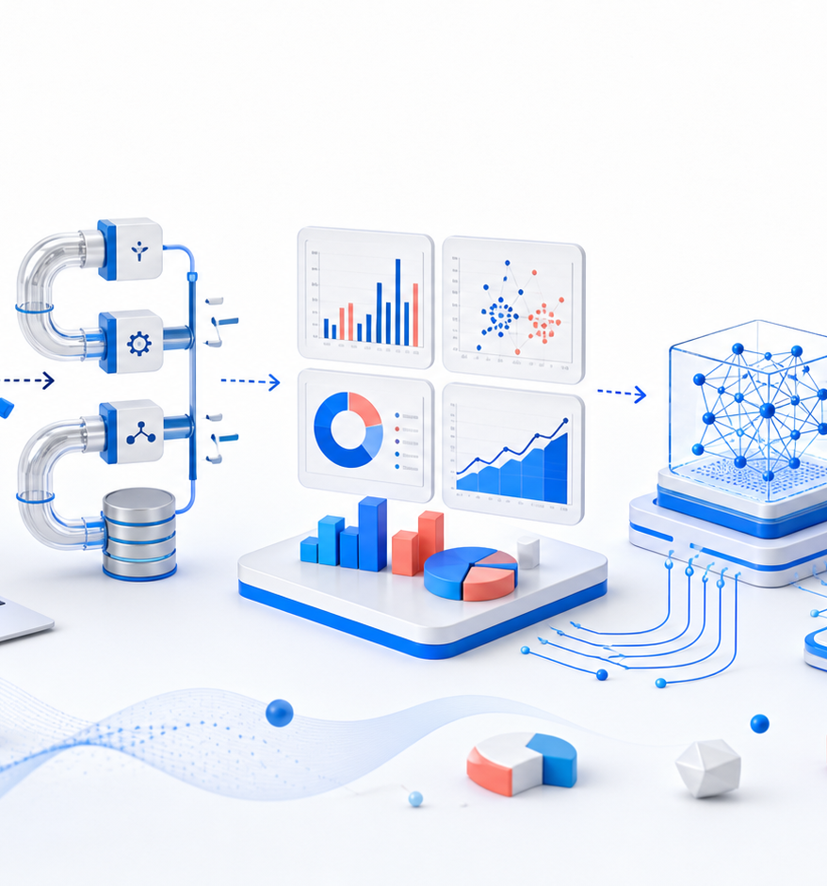

WEEK 10 · SESSION 1
SQL and Analytical Data Modelling
Transform analytical data from relational storage to distributed pipelines.
Notes:
Reliable SQL begins with grain: what one row represents. We define keys before joining and test whether joins duplicate or discard business events.
[Sources]
- DS Academy curriculum manifest: Week 10, session 1: SQL and Analytical Data Modelling
[/Sources]

Slide 2
WEEK 10 / SESSION 01
DS ACADEMY
Learning outcomes
01
Write joins, aggregations, windows, and CTEs.
02
Choose grain and keys before metrics.
03
Test queries for duplication and missingness.
End-to-End Data Science & AI
02
Notes:
By the end of this session, learners should be able to Write joins, aggregations, windows, and CTEs. Choose grain and keys before metrics. Test queries for duplication and missingness.
[Sources]
- DS Academy curriculum manifest: Learning outcomes for SQL and Analytical Data Modelling
[/Sources]

Slide 3
WEEK 10 / SESSION 01
DS ACADEMY
The concept system
01
02
joins
window functions
03
04
grain
dimensional modelling
End-to-End Data Science & AI
03
Notes:
Use these four concepts as a system rather than isolated vocabulary: joins, window functions, grain, dimensional modelling.
[Sources]
- DS Academy curriculum manifest: Core concepts for SQL and Analytical Data Modelling
[/Sources]

Slide 4
FROM QUESTION TO EVIDENCE
A repeatable reasoning loop
01
02
03
04
→
→
→
Define
Transform
Validate
Communicate
Model orders and customers, then compute retention and revenue.
DS ACADEMY · PRACTICAL REASONING
Notes:
Apply the session content through a four-stage reasoning loop: define the question, transform deliberately, validate assumptions, and communicate the evidence.
[Sources]
- DS Academy curriculum manifest: DS Academy teaching framework applied to SQL and Analytical Data Modelling
[/Sources]

Slide 5
WEEK 10 / SESSION 01
DS ACADEMY
Guided lab
01
Frame
LAB BRIEF
Define inputs, outputs, and success criteria.
Model orders and customers, then compute retention and revenue.
02
Build
Implement the smallest correct workflow.
03
Verify
Test normal, boundary, and failure cases.
04
Explain
workbook / tests / evidence
Record the evidence and remaining limits.
End-to-End Data Science & AI
05
Notes:
Guide learners through the lab without completing the reasoning for them. Ask for an explicit frame, a minimal implementation, boundary tests, and an evidence note.
[Sources]
- DS Academy curriculum manifest: Guided lab for SQL and Analytical Data Modelling
[/Sources]

Slide 6
WEEK 10 / SESSION 01
DS ACADEMY
Portfolio deliverable
A documented SQL model with data tests.
WEEKLY ASSESSMENT
Analytical Pipeline at Two Scales
QUALITY GATE
Reproducible
Data model 25%, SQL 25%, Spark 25%, tests 15%, documentation 10%.
Tested
Decision-relevant
End-to-End Data Science & AI
06
Notes:
The deliverable is A documented SQL model with data tests. Use the weekly assessment rubric as a quality gate, not as an after-the-fact scoring checklist.
[Sources]
- DS Academy curriculum manifest: Portfolio deliverable and assessment rubric for week 10
[/Sources]

Slide 7
SESSION CHECKPOINT
What should remain after the lesson?
CONCEPT
joins + window functions
PRACTICE
Model orders and customers, then compute retention and revenue.
EVIDENCE
A documented SQL model with data tests.
Narration available in English and
සිංහල
DS ACADEMY
Notes:
Reliable SQL begins with grain: what one row represents. We define keys before joining and test whether joins duplicate or discard business events.
[Sources]
- DS Academy curriculum manifest: Session summary for SQL and Analytical Data Modelling
[/Sources]

