Slide 1


FINAL PRESENTATION
COD 7001 Project
IIT DELHI
User-Level Resource-Aware Runtime System
Presented by Nizaul Rahman (2025MCS2099) & Aslam Malik (2025MCS2012)
This project focuses on building a user-level runtime system that can monitor system resources and adapt scheduling decisions dynamically.

Slide 2
Problem Definition
Design a runtime that provides:
Visibility → real-time resource monitoring
Control → user-level scheduling
Adaptability → dynamic behavior under stress
01
The key goal is to shift control from the OS into a user-space runtime that can actively respond to system conditions.

Slide 3
Modern systems face:
CPU contention
Memory pressure
Co-located workloads
01.
Motivation
02.
OS hides resource dynamics
Why This Matters...
02
Applications typically rely on the OS scheduler, which hides real-time resource conditions. This limits control and can lead to poor performance under stress.
03.
Leads to:
Inefficient scheduling
System instability

Slide 4
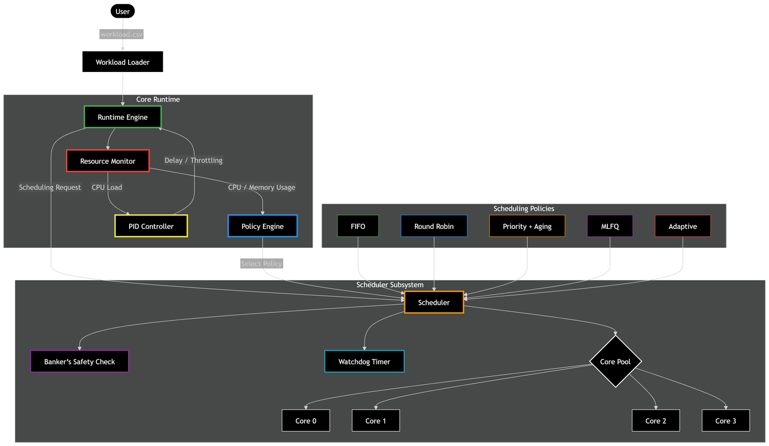
System Overview
System Architecture
User-level runtime (no kernel changes)
Components:
Task Manager
Scheduler
Policy Engine
Resource Monitor
03
The system is modular. The Policy Engine decides behavior, while the Scheduler executes it based on runtime conditions.

Slide 5
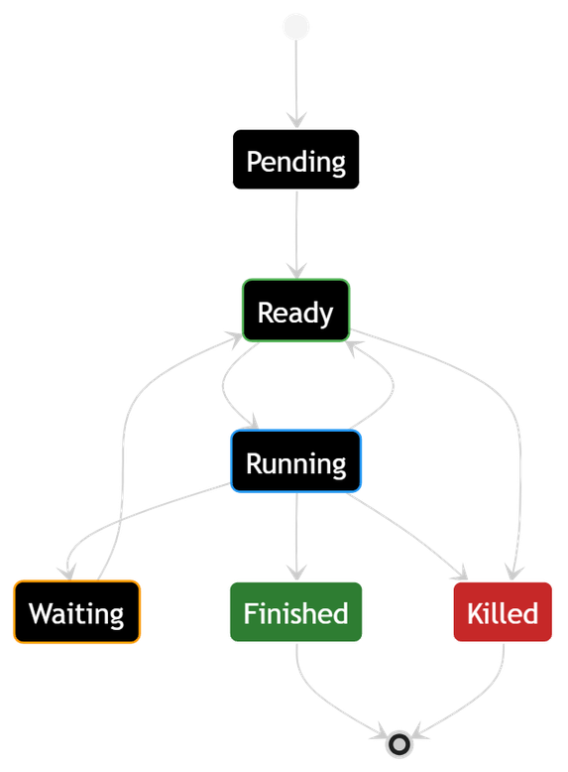
04
Each task has:
ID, priority
Type: CPU / Memory / Mixed
Execution modeled as:
Task Model
CPU bursts
I/O bursts
Tasks are cooperative and explicitly yield control, since we do not rely on kernel preemption.
Task Abstraction

Slide 6

initialize(csv)
setPriority()
Runtime API
addTask()
setCoreCount()
API Design
06
runtime_yield()

Slide 7
FIFO
Priority + Aging
Scheduling Policies
Adaptive (dynamic switching)
Round-Robin (q = 2)
Scheduling Strategies
07
MLFQ
Multiple policies allow us to compare behavior and enable adaptive decision-making.

Slide 8
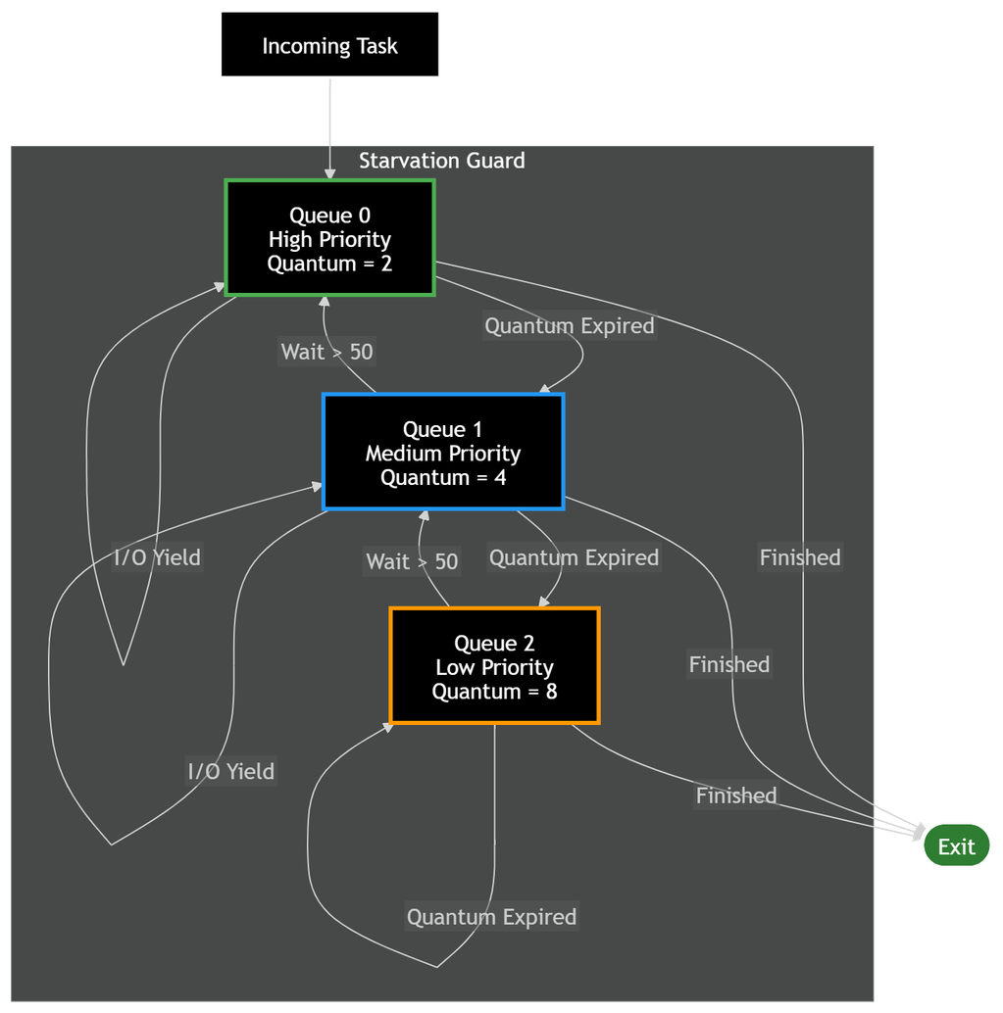
MLFQ Design
Multi-Level Feedback Queue
Q0: q = 2
Q1: q = 4
Q2: q = 8
Demotion: CPU-heavy tasks
Promotion: starvation prevention
[Insert MLFQ diagram]
08
MLFQ balances fairness and responsiveness by adapting priorities dynamically.

Slide 9
Resource Monitoring
Resource Awareness
CPU via /proc/stat
Memory via /proc/self/status
Adaptive sampling:
Stable → reduce sampling
Volatile → increase sampling
09
Monitoring is lightweight and adaptive to avoid introducing overhead.

Slide 10
Adaptive Control
PID-Based Throttling
Target CPU = 70%
Uses PID controller:
Proportional
Integral
Derivative
Applies delay to regulate load
10
Instead of aggressive scheduling, we regulate execution smoothly using control theory.

Slide 11
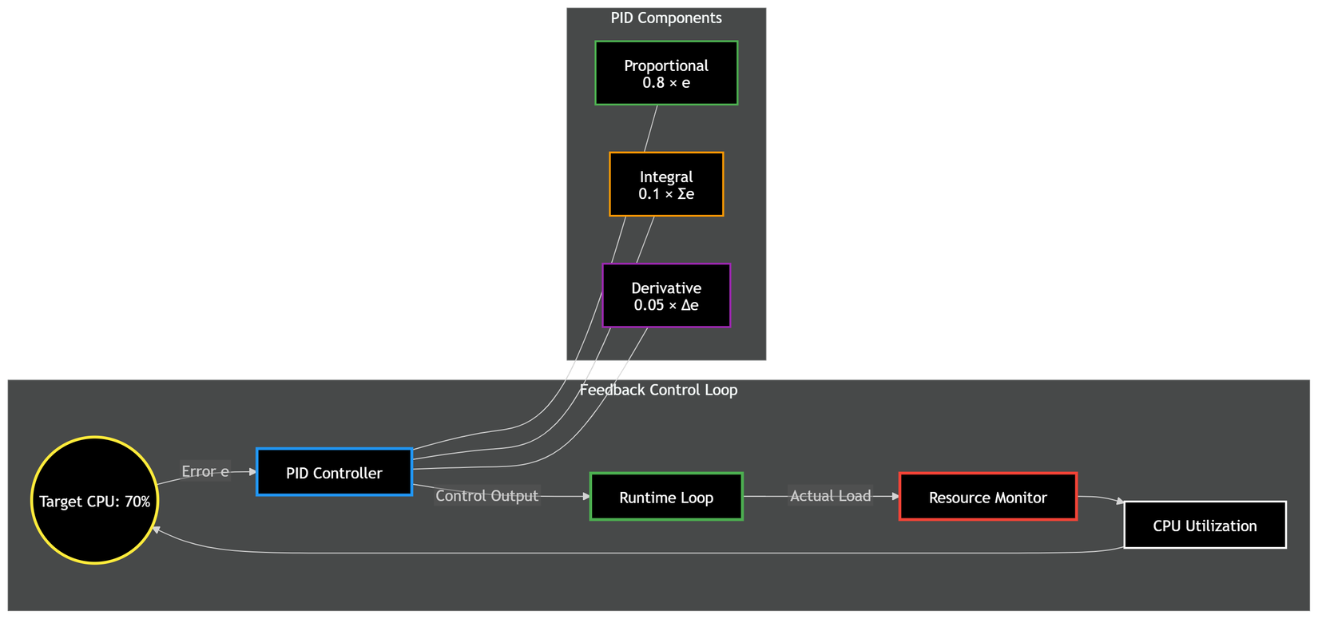
Predictive Guard
Proactive Adaptation
Detects rapid CPU spikes
Switches scheduler mode
Prevents overload early
11
This acts as a safety mechanism to respond before the system becomes unstable.

Slide 12
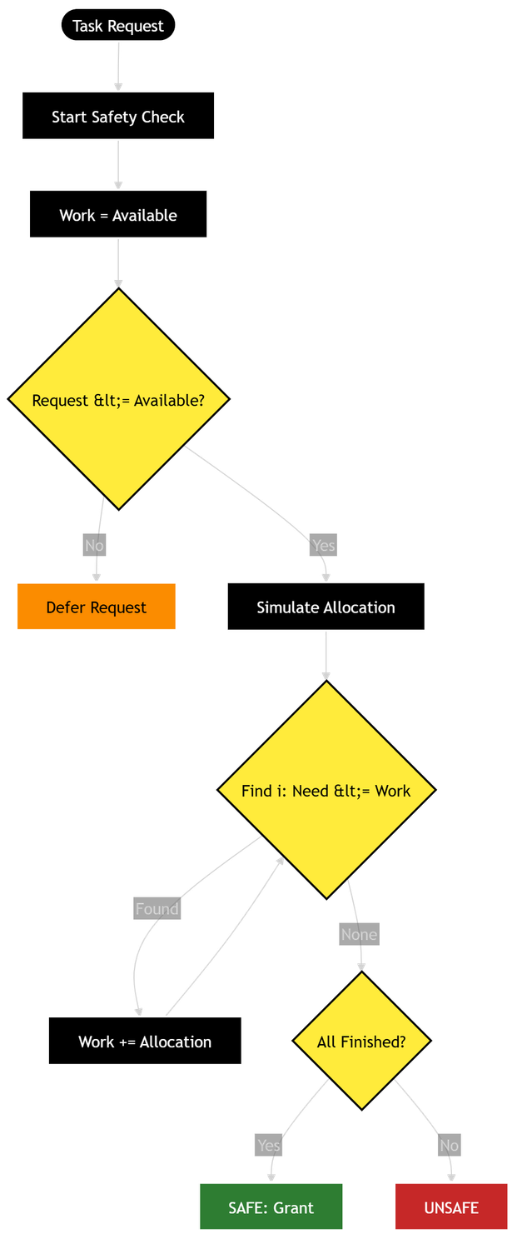
Deadlock Prevention
Safety Mechanism
Banker’s Algorithm (simulation)
Ensures safe resource allocation
11
We simulate resource allocation to avoid unsafe states before scheduling tasks.

Slide 13
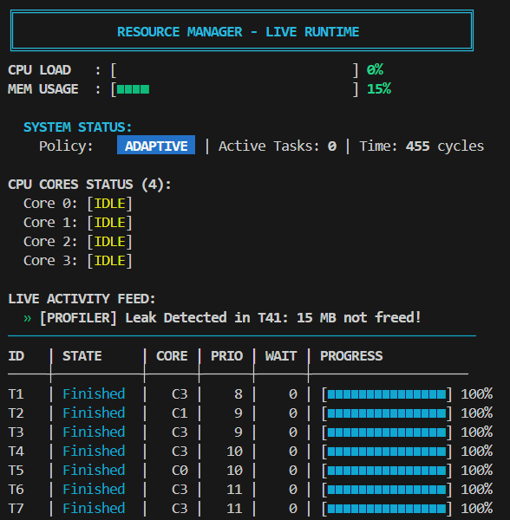
Runtime Dashboard
Observability
Displays:
CPU usage
Memory usage
Active tasks
Scheduling policy
Adaptation events
12
The dashboard provides real-time visibility into system behavior and adaptation decisions.

Slide 14
13
Balanced workload
Fault-injection workload
ID, priority
Type: CPU / Memory / Mixed
CPU stress workload
CPU bursts
I/O bursts
Workloads
These workloads test different system behaviors under realistic and extreme conditions.
Experimental Setup

Slide 15
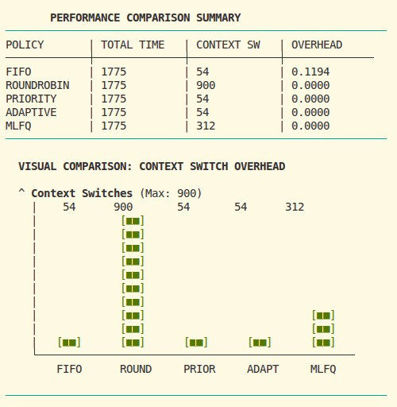
Performance Comparison
Policy Comparison
Content (table):
Policy Time Context Switches Overhead
FIFO 1775 54 0.1245
RR 1775 900 0
Priority 1775 54 0
MLFQ 1775 312 0
Adaptive 1775 54 0
14
Round-Robin has high switching overhead, while Adaptive achieves efficiency with minimal switching.

Slide 16
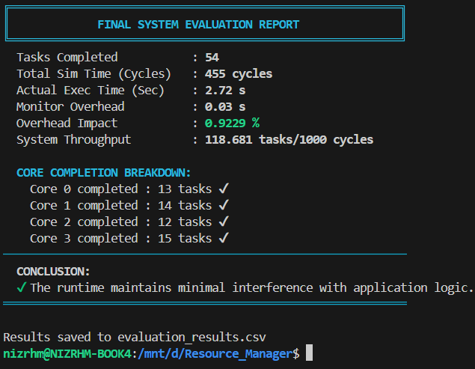
System Metrics
Overall Performance
Tasks completed: 54
Execution time: 93.42 sec
Overhead: 0.7265%
Throughput: 30.423 tasks / 1000 cycles
15
The runtime maintains high throughput while keeping overhead low.

Slide 17
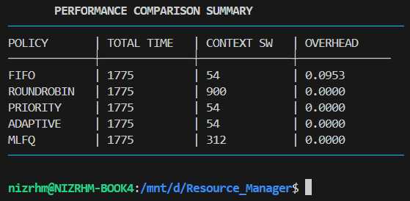
Key Insights
Observations
RR → high overhead
FIFO → low responsiveness
MLFQ → balanced
Adaptive → best stability
16
Adaptive combines efficiency with dynamic control, making it the most robust approach.

Slide 18
Limitations
[Insert screenshot]
Observations
No true preemption
Depends on parameter tuning
Limited memory-aware adaptation
17
These are expected constraints of a user-level system.

Slide 19
18
Conclusion
Fully functional runtime system
Combines OS + control theory
Improves stability under load
The project demonstrates how user-level control can enhance system behavior without kernel modification.

Slide 20
19
Future Work
Memory-aware adaptation
Better predictive models
Visualization tools
There is strong potential to extend this into a more intelligent runtime system.

Slide 21
FINAL PRESENTATION
COD 7001 Project
IIT DELHI
Thank You

