Slide 1
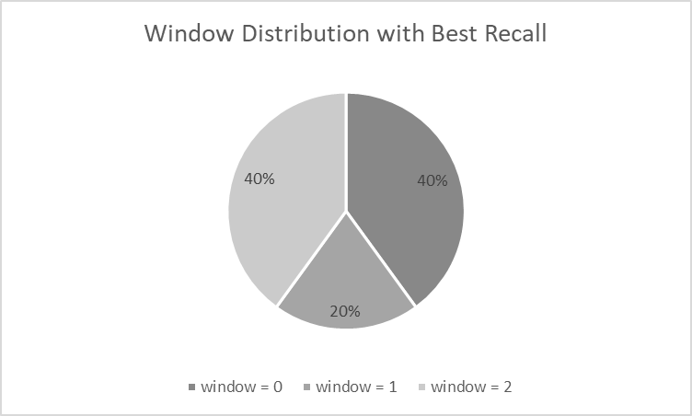
Fix window strategy results
Total conversations
Distribution of best window
Model | Window | Recall@5
BGE-M3 | 无 | 0.5800
BGE-M3 | 1 | 0.6069
BGE-M3 | 2 | 0.5903
BGE-M3 | 3 | 0.4810
BGE-M3 | 4 | 0.5006
BGE-M3 | 5 | 0.3192
BGE-M3 | 6 | 0.3170
BGE-M3 | 7 | 0.1982
BGE-M3 | 8 | 0.1119
BGE-M3 | 9 | 0.1286
The best window varies in different conversation , demanding dynamic window selection based on current conversation

Slide 2
1
Dynamic Window Selector
LLM
Prompt 1: Given the conversation, find the window relate to current text……
Context Generator
……
Maria said:The official opening night is tomorrow. …
John said: Hey Maria, great to chat again! I joined a service-focused online group last week and it's been an emotional ride.
Maria said: Wow, John! That‘s amazing news. …
John said: Thanks, Maria! It's great to have a group of people with the same passion for serving…
Maria said:That's great to hear! It's always inspiring to share those things with like-minded individuals…
John said:We held some events and got to meet some people…
3
Prompt 2: Given the filtered conversation , create some hype instruction…
A:...
B:...
Dynamic Window Select
Instruction 1:
John's community organized a toy drive for kids in need
Instruction 2:
What did john join
Instruction 3:
What kind of events did John hold to make a difference
John said:We held some events and got to meet some people…
A:...
2
Window Refiner
B:...
Step 1:Pair Construct
A:...
Step 2:Caculate Sim Score
Step 3:Filter Conversation
B:...
Backtrack Window
Current Utterance
A:...
John said: Hey Maria, great to chat again! I joined a service-focused online group last week and it's been an emotional ride.
John said:We held some events and got to meet some people …
Current Utterance
B:...
Current Utterance
Embedding Model
Offline Streaming Process

Slide 3
Model | Window | Recall@5
BGE-M3 | 0 | 0.5800
BGE-M3 | 1 | 0.6069
BGE-M3 | 2 | 0.5903
BGE-M3 | 3 | 0.4810
BGE-M3 | 4 | 0.5006
BGE-M3 | 5 | 0.3192
BGE-M3 | 6 | 0.3170
BGE-M3 | 7 | 0.1982
BGE-M3 | 8 | 0.1119
BGE-M3 | 9 | 0.1286
BGE-M3 | Dynamic window | 0.6346

Slide 4
Conv | Fix win best | Dynamic win
0 | 0.6368 | 0.6179
1 | 0.6000 | 0.63
2 | 0.6711 | 0.6579
3 | 0.5438 | 0.5401
4 | 0.7266 | 0.7307
5 | 0.6026 | 0.6859
6 | 0.7238 | 0.6429
7 | 0.7265 | 0.5507
8 | 0.5268 | 0.6451
9 | 0.6261 | 0.6448
VAR | 0.0048 | 0.0029

Slide 5
窗口噪声
{
"qa": "What did Caroline research?",
"answer": "Adoption agencies",
"evidence": [
"D2:8"
],
"evidence_text": [
"Caroline said:Researching adoption agencies — it's been a dream to have a family and give a loving home to kids who need it."
],
"retrieve_text": [
"Caroline said:Cool! What did it look like?",
"Caroline said:Totally agree, Mel. Relaxing and expressing ourselves is key. Well, I'm off to go do some research.",
"Caroline said:Since our last chat, I've been looking into counseling or mental health work more. I'm passionate about helping people and making a positive impact. It's tough, but really rewarding too. Anything new happening with you?",
"Caroline said:Researching adoption agencies — it's been a dream to have a family and give a loving home to kids who need it.",
"Melanie said:Wow, Caroline, that looks amazing! What inspired it?"
]
},

Slide 6
{
"speaker": "Caroline",
"dia_id": "D2:4",
"text": "I totally agree, Melanie. Taking care of ourselves is so important - even if it's not always easy. Great that you're prioritizing self-care."
},
{
"speaker": "Melanie",
"dia_id": "D2:5",
"text": "Yeah, it's tough. So I'm carving out some me-time each day - running, reading, or playing my violin - which refreshes me and helps me stay present for my fam!"
},
{
"speaker": "Caroline",
"dia_id": "D2:6",
"text": "That's great, Mel! Taking time for yourself is so important. You're doing an awesome job looking after yourself and your family!"
},
{
"speaker": "Melanie",
"dia_id": "D2:7",
"text": "Thanks, Caroline. It's still a work in progress, but I'm doing my best. My kids are so excited about summer break! We're thinking about going camping next month. Any fun plans for the summer?"
},
{
"speaker": "Caroline",
"dia_id": "D2:8",
"text": "Researching adoption agencies \u2014 it's been a dream to have a family and give a loving home to kids who need it."
},

Slide 7
{
"conv_id": 0,
"dia_id": "D2:8",
"speaker": "Caroline",
"content": "Caroline said:Researching adoption agencies \u2014 it's been a dream to have a family and give a loving home to kids who need it.",
"time": "1:14 pm on 25 May, 2023",
"hierarchical_content": " | [context] | Caroline said:Researching adoption agencies \u2014 it's been a dream to have a family and give a loving home to kids who need it.",
"h_length": 0
},

Slide 8
Query:What did Caroline research?
Caroline said: That's great, Mel! Taking time for yourself is so important. You're doing an awesome job looking after yourself and your family!
Melanie said:Thanks, Caroline. It's still a work in progress, but I'm doing my best. My kids are so excited about summer break! We're thinking about going camping next month. Any fun plans for the summer?“
Caroline said:Researching adoption agencies \u2014 it's been a dream to have a family and give a loving home to kids who need it.
Window
Noise Information
Ground Truth:

Slide 9
Query: What did Caroline research?
Successfully Recall
Caroline said:Cool! What did it look like?
Caroline said:Totally agree, Mel. Relaxing and expressing ourselves is key. Well, I'm off to go do some research.
Caroline said:Since our last chat, I've been looking into counseling or mental health work more. …
Caroline said:Researching adoption agencies — it's been a dream to have a family and give a loving home to kids who need it.
……
Ground Truth:
Dynamic Context Aware System
Window = 0
Caroline said:Researching adoption agencies — it's been a dream to have a family and give a loving home to kids who need it.

Slide 10
信息截断
{
"qa": "How does John describe the support he received during his journey to becoming assistant manager?",
"answer": "having support at home and his own grit",
"evidence": [
"D19:12"
],
"evidence_text": [
"John said:Yeah, I faced all kinds of hurdles - tech stuff, workplace stuff... but the worst was self-doubt. There were moments when I questioned if I was on the right track. But with support at home and my own grit, I powered through. This promotion is a reward for all the hustle and hardship I put in - a reminder that I'm on the right path."
],
"retrieve_text": [
"John said:Thanks, Maria! I was really excited. It feels like all the hard work I've put in has paid off now that I'm an assistant manager- it's like a stepping stone for bigger things.",
"John said:Yeah, I faced all kinds of hurdles - tech stuff, workplace stuff... but the worst was self-doubt. There were moments when I questioned if I was on the right track. But with support at home and my own grit, I powered through. This promotion is a reward for all the hustle and hardship I put in - a reminder that I'm on the right path.",
"John said:I tried to stay calm and asked for assistance, which helped me handle the situation and make it back safely.",
"John said:Thanks, Maria! It's been tough, but really rewarding. The training was intense and taxing, but it changed my view on helping others. Last Sunday we had our first call-out, and it was intense. We responded to a situation and our team worked together to help those in need. Seeing their relief was awesome.",
"John said:Hi Maria! It's so good to talk again. A lot has changed since last time. I'm really enjoying my new job. My team has been super encouraging and inspiring."
]
},

Slide 11
{
"speaker": "John",
"img_url": [
"https://images.rawpixel.com/image_800/cHJpdmF0ZS9sci9pbWFnZXMvd2Vic2l0ZS8yMDIyLTEyL2ZsNTE4NTQxMzE2ODgtaW1hZ2UuanBn.jpg"
],
"blip_caption": "a photography of a golden trophy on a black surface",
"query": "new office assistant manager sign",
"dia_id": "D19:8",
"re-download": true,
"text": "Thanks, Maria! I was really excited. It feels like all the hard work I've put in has paid off now that I'm an assistant manager- it's like a stepping stone for bigger things."
},
{
"speaker": "Maria",
"dia_id": "D19:9",
"text": "Wow, John! Congrats on the promotion! What's the backstory on that trophy?"
},
{
"speaker": "John",
"dia_id": "D19:10",
"text": "Thanks, Maria! It commemorates my journey. It's a symbol of all the obstacles I had to overcome to get here."
},
{
"speaker": "Maria",
"dia_id": "D19:11",
"text": "Cool, so you have a reminder of all that. It's good to acknowledge what you've been through and appreciate where you are now. Could you tell me more about the challenges?"
},
{
"speaker": "John",
"dia_id": "D19:12",
"text": "Yeah, I faced all kinds of hurdles - tech stuff, workplace stuff... but the worst was self-doubt. There were moments when I questioned if I was on the right track. But with support at home and my own grit, I powered through. This promotion is a reward for all the hustle and hardship I put in - a reminder that I'm on the right path."
},

Slide 12
Query: How does John describe the support he received during his journey to becoming assistant manager
John said:Thanks, Maria! I was really excited. It feels like all the hard work I've put in has paid off now that I'm an assistant manager- it's like a stepping stone for bigger things
Maria said:Wow, John! Congrats on the promotion! What's the backstory on that trophy
John said:Thanks, Maria! It commemorates my journey. It's a symbol of all the obstacles I had to overcome to get here.
Maria said:Cool, so you have a reminder of all that. It's good to acknowledge what you've been through and appreciate where you are now. Could you tell me more about the challenges?
John said:Yeah, I faced all kinds of hurdles - tech stuff, workplace stuff... but the worst was self-doubt. There were moments when I questioned if I was on the right track. But with support at home and my own grit, I powered through. This promotion is a reward for all the hustle and hardship I put in - a reminder that I'm on the right path.
Be Truncated
Window
Ground Truth:

Slide 13
Query: How does John describe the support he received during his journey to becoming assistant manager
Successfully Recall
John said:Thanks, Maria! I was really excited. It feels like all the hard work I've put in has paid off now that…
John said:Yeah, I faced all kinds of hurdles - tech stuff, workplace stuff... but the worst was self-doubt. …
John said:I tried to stay calm and asked for assistance…
……
Ground Truth:
Dynamic Context Aware System
Instruction 1:
What kind of hurdles did John face as an assistant manager?
Instruction 2:
How did John overcome self-doubt?
Instruction 3:
What does the promotion mean to John?
John said:Yeah, I faced all kinds of hurdles - tech stuf…
Window = 4

Slide 14
{
"qa": "What kind of job is Joanna beginning to preform the duties of because of her movie scripts?",
"answer": "filmmaker.",
"evidence": [
"D29:1"
],
"evidence_text": [
"Joanna said:Nate, can you believe it? I'm finally filming my own movie from the road-trip script!"
],
"retrieve_text": [
"Joanna said:Nate, can you believe it? I'm finally filming my own movie from the road-trip script!",
"Joanna said:I am writing another movie script! It's a love story with lots of challenges. I've put lots of hard work into it and I'm hoping to get it on the big screen.",
"Nate said:Congrats, Joanna! Not surprised at all that your hard work paid off. Must feel awesome to see your script come alive in a movie! Pretty cool when something you love brings success, right? Tell me more about your movie!",
"Joanna said:Great to hear! I just finished with the intro to my next movie script, and I decided to include this at the begining.",
"Joanna said:Wow, Nate, I'm on fire! I just set up meetings with movie producers — my dreams are comin' true!"
]
},
深层语义关系

Slide 15
{
"speaker": "Nate",
"dia_id": "D28:29",
"text": "Definitely! I'd love to have you over again. Maybe we can watch one of your movies together or go to the park!"
},
{
"speaker": "Joanna",
"dia_id": "D28:30",
"text": "For sure! I'd love to do either of those things with you!"
},
{
"speaker": "Nate",
"dia_id": "D28:31",
"text": "Sounds good. Well I'll make sure I give the turtles a bath before you get here so they're ready to play."
},
{
"speaker": "Joanna",
"dia_id": "D28:32",
"text": "Alright, see you tomorrow!"
},
{
"speaker": "Nate",
"dia_id": "D28:33",
"text": "Bye Joanna!"
}
],
"session_29_date_time": "12:06 am on 11 November, 2022",
"session_29": [
{
"speaker": "Joanna",
"img_url": [
"https://i.redd.it/l7riz754xlj41.jpg"
],
"blip_caption": "a photo of a person holding a clap board with a dog sleeping in a dog bed",
"query": "movie clapperboard movie set",
"dia_id": "D29:1",
"text": "Nate, can you believe it? I'm finally filming my own movie from the road-trip script!"
},

Slide 16
{
"conv_id": 3,
"dia_id": "D29:1",
"speaker": "Joanna",
"content": "Joanna said:Nate, can you believe it? I'm finally filming my own movie from the road-trip script!",
"time": "12:06 am on 11 November, 2022",
"hierarchical_content": "What is Joanna's movie about?\nJoanna is excited about filming her own movie\nJoanna wrote a road-trip script | [context] | Joanna said:Nate, can you believe it? I'm finally filming my own movie from the road-trip script!",
"h_length": 4
},

Slide 17
Query:What kind of job is Joanna beginning to preform the duties of because of her movie scripts?
Joanna said:Alright, see you tomorrow!"
Nate said:Bye Joanna!
Joanna said:Nate, can you believe it? I'm finally filming my own movie from the road-trip script!.
Window
Ground Truth:
Non-displayed semantic association

Slide 18
Query: What kind of job is Joanna beginning to preform the duties of because of her movie scripts?
Successfully Recall
Joanna said:Nate, can you believe it? I'm finally filming my own movie from the road-trip script!
Joanna said:I am writing another movie script! It's a love story with lots of challenges. …
Nate said:Congrats, Joanna! Not surprised at all that your hard work paid off. …
……
Dynamic Context Aware System
Instruction 1:
What is Joanna's movie scripts about?
Instruction 2:
Joanna is excited about filming her own movie
Instruction 3:
Joanna wrote a road-trip script
Joanna said:Nate, can you believe it? I'm finally filming my own movie from the road-trip script!
Window = 4

Slide 19
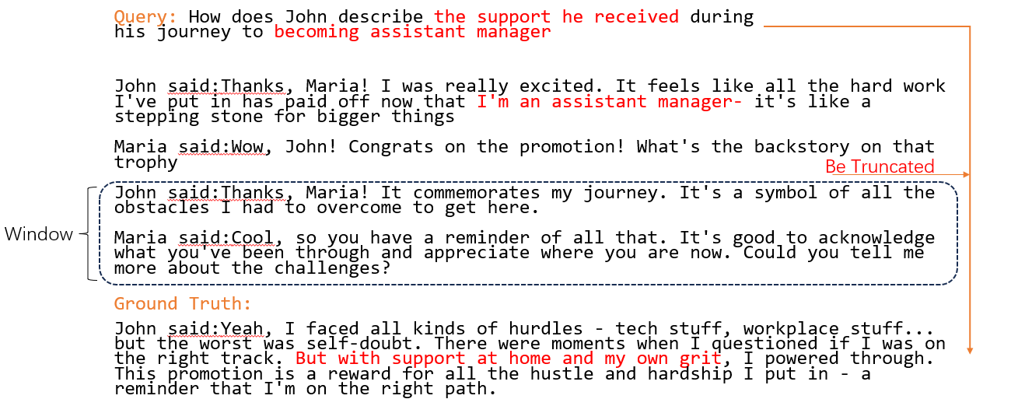
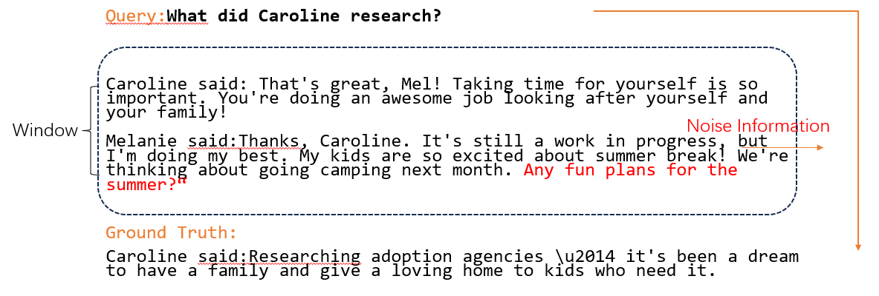
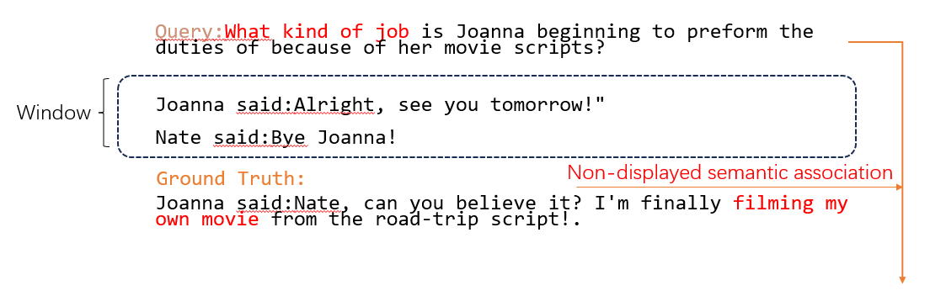
Information Truncation
Information Noise
Non-explicit Semantic Associations

Slide 20
查询：约翰是如何描述自己在晋升为助理经理的过程中所获得的支持的？
约翰说：谢谢，玛丽亚！我当时真的特别激动。现在我当上助理经理了，感觉之前所有的努力都没有白费 —— 这就像是我迈向更高目标的一块垫脚石。
玛丽亚说：哇，约翰！恭喜你升职！这个奖杯背后有什么故事吗？
约翰说：谢谢你，玛丽亚！它是对我这段历程的纪念，象征着我为走到今天所克服的所有困难。
玛丽亚说：太棒了，所以你有个东西能时刻提醒自己这一切……
约翰说：…… 不过，有了家人的支持，再加上我自己的坚持，我还是挺了过来。……
信息截断
固定窗口
标注的召回内容:
Information Truncation

Slide 21
问题：卡罗琳调查了什么？
卡罗琳说：太棒了，梅勒妮！给自己留点时间真的很重要。你把自己和家人都照顾得特别好，做得超棒！
梅勒妮说：…… 我们打算下个月去露营。你夏天有什么好玩的计划吗？……
卡罗琳说：我一直在调研收养机构 —— 这一直是我的梦想……
信息噪声
固定窗口
标注的召回内容:
Information Noise

Slide 22
Query:What kind of job is Joanna beginning to preform the duties of because of her movie scripts?
Joanna said:Alright, see you tomorrow!"
Nate said:Bye Joanna!
Joanna said:Nate, can you believe it? I'm finally filming my own movie from the road-trip script!
Window
Non-explicit semantic association
Ground Truth:
Non-explicit semantic association

Slide 23
Query: How does John describe the support he received during his journey to becoming assistant manager
Successfully Recalled
John said:Thanks, Maria! I was really excited. It feels like all the hard work I've put in has paid off now that…
John said:Yeah, I faced all kinds of hurdles - tech stuff, workplace stuff... but the worst was self-doubt. …
John said:I tried to stay calm and asked for assistance…
……
Ground Truth:
Dynamic Context-Aware Method
Instruction 1:
What kind of hurdles did John face as an assistant manager?
Instruction 2:
How did John overcome self-doubt?
Instruction 3:
What does the promotion mean to John?
John said:Yeah, I faced all kinds of hurdles - tech stuf…
Window = 4

Slide 24
Query: What did Caroline research?
Successfully Recalled
Caroline said:Cool! What did it look like?
Caroline said:Totally agree, Mel. Relaxing and expressing ourselves is key. Well, I'm off to go do some research.
Caroline said:Since our last chat, I've been looking into counseling or mental health work more. …
Caroline said:Researching adoption agencies — it's been a dream to have a family and give a loving home to kids who need it.
Ground Truth:
Dynamic Context-Aware Method
Window = 0
Caroline said:Researching adoption agencies — it's been a dream to have a family and give a loving home to kids who need it.

Slide 25
Query: What kind of job is Joanna beginning to preform the duties of because of her movie scripts?
Successfully Recalled
Joanna said:Nate, can you believe it? I'm finally filming my own movie from the road-trip script!
Joanna said:I am writing another movie script! It's a love story with lots of challenges. …
Nate said:Congrats, Joanna! Not surprised at all that your hard work paid off. …
……
Dynamic Context-Aware Method
Instruction 1:
What is Joanna's movie scripts about?
Instruction 2:
Joanna is excited about filming her own movie
Instruction 3:
Joanna wrote a road-trip script
Joanna said:Nate, can you believe it? I'm finally filming my own movie from the road-trip script!
Window = 4

