Slide 1
Charge Collection
Parallel Pixel
Charge Generation
Serial Pixel
Serial Over-Scan
Additional Serial Pixels (Corner, etc)
Electron-Multiplying Pixel
Pixel.m
y_{img}
Charge Transfer
Charge Measurement
Image Processing
x_{img}
Standard Readout
x_{ser}
Electron-Multiplying Readout
Detector.m
Controller.m

Slide 2

Initial Testing
Performing initial testing of CCD_Sim to check out basic functionality / verify expected behavior / performance
Simulated 1000 read-outs with 0.01 s integration time
Test image used shown below
Red pixels have 10 photons s⁻¹ mean incidence rate
White pixels have 1 photons s⁻¹ mean incidence rate
Detector Property | Value
Parallel Section Width | 12 Pixels
Parallel Section Length | 12 Pixels
Serial Overscan | 2 Pixels
Additional Serial Pixels | 2 Pixels
Multiplication Elements | 50 Pixels
Read Out Noise (RMS) | 3 e-
Vertical Frequency | 0.9e6 Hz
Horizontal Frequency | 1e6 Hz
Parallel Pixel Property | Value
Interacting Quantum Efficiency | 0.9
Quantum Yield | 1.2
Full Well Capacity | 80k e-
CIC Rate | 1e-4 e- tr⁻¹
Serial Pixel Property | Value
Full Well Capacity | 360k e-
CIC Rate | 1e-3 e- tr⁻¹
EM Multiplication Probability | 0.1
Pixel Property | Value
CTE | 0.999999
Dark Current Rate | 0.0015 e- s⁻¹
Pixel Length | 13 μm
Pixel Width | 13 μm
Test Image
As Entered

Slide 3
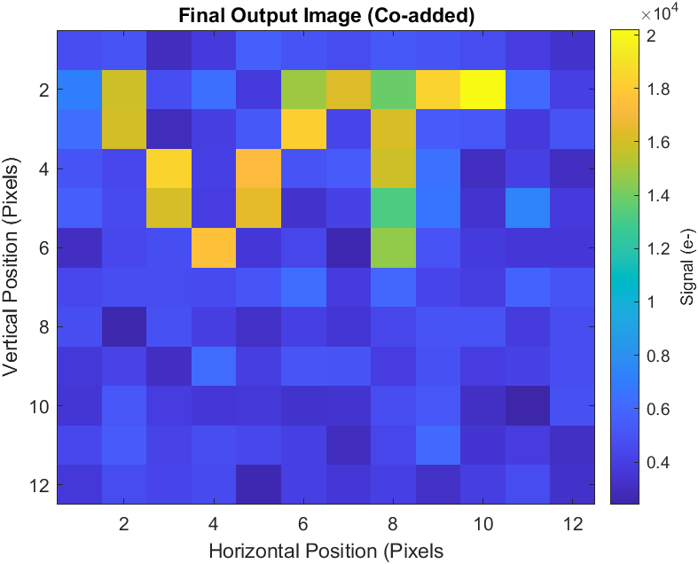
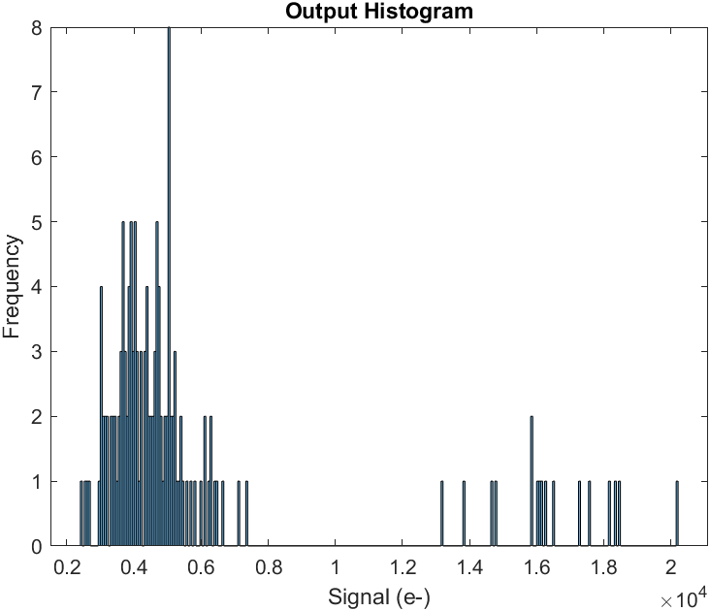
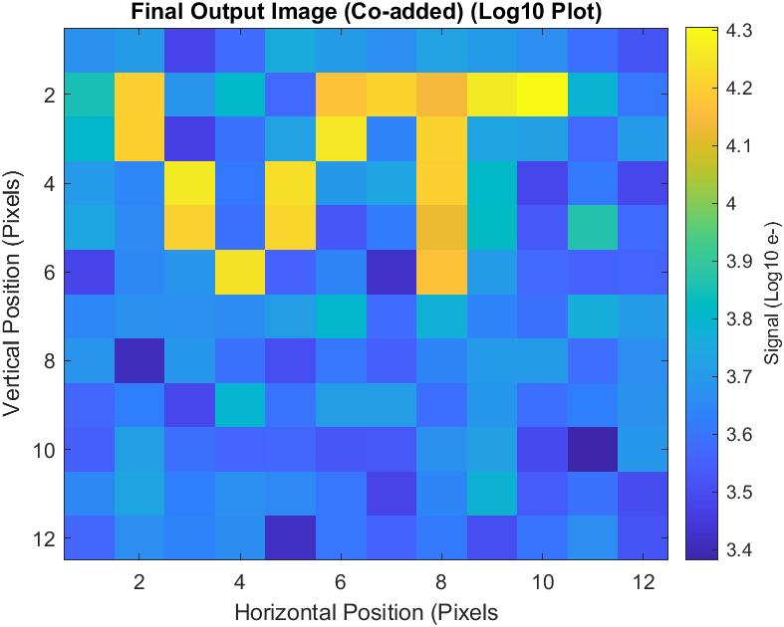
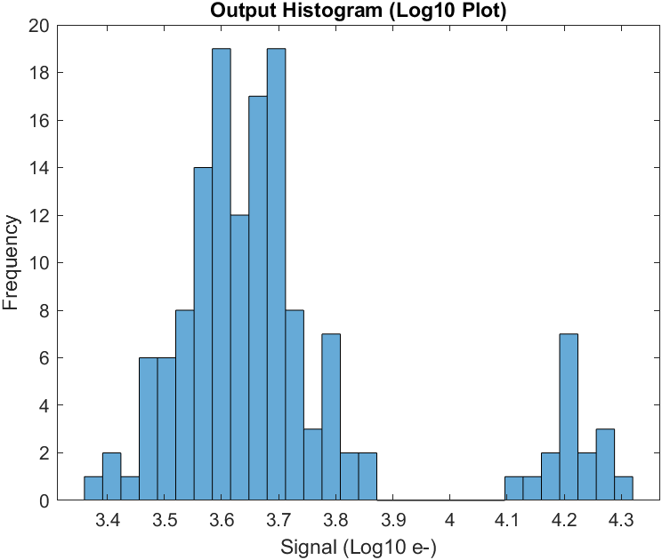
Initial Testing
Results shown are for standard (non-photon-counted) output, coadding the 1000 read-outs to arrive at a final image

Slide 4
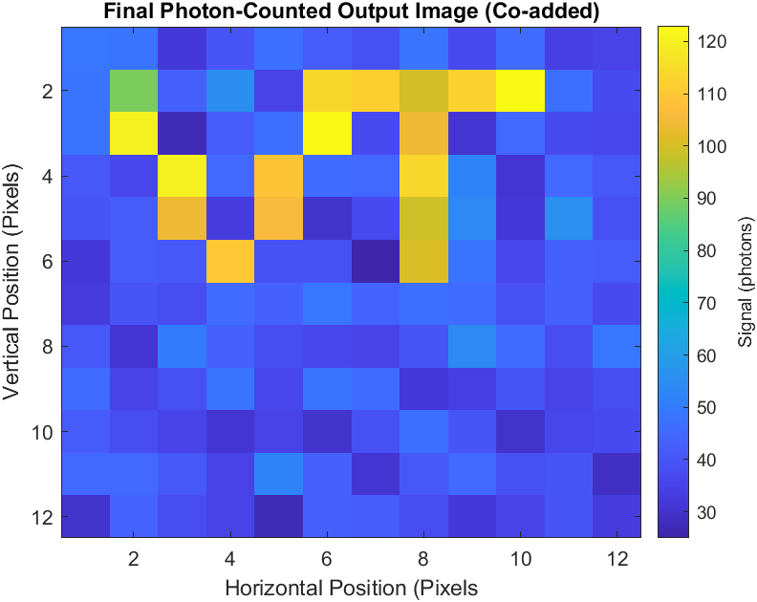
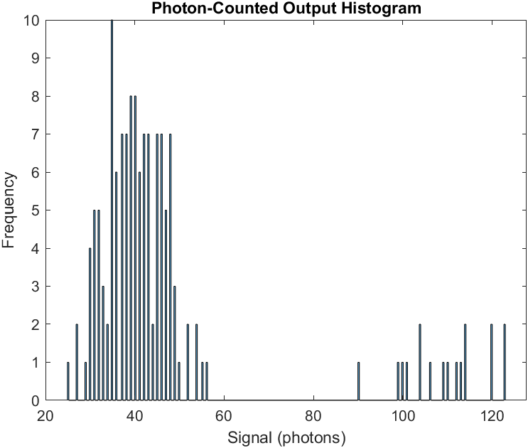
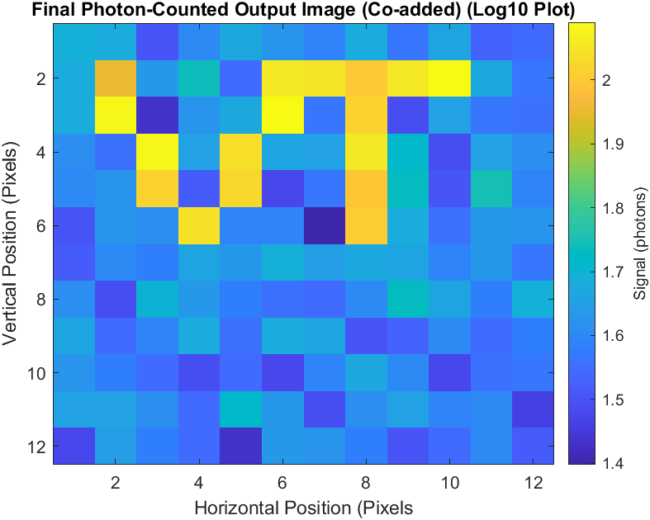
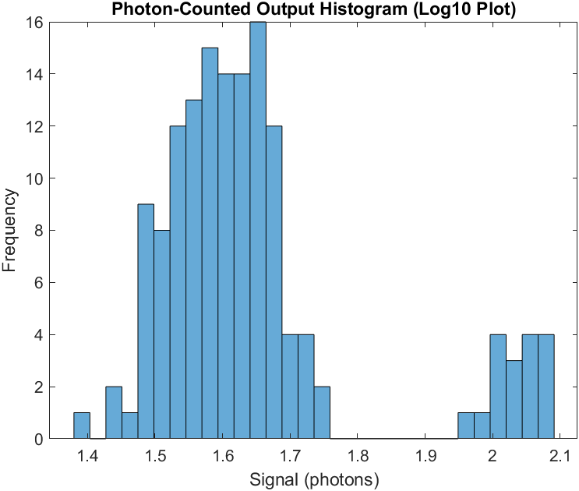
Initial Testing
Results shown are for photon-counting of previous data, using 5-sigma threshold above the read-noise

Slide 5
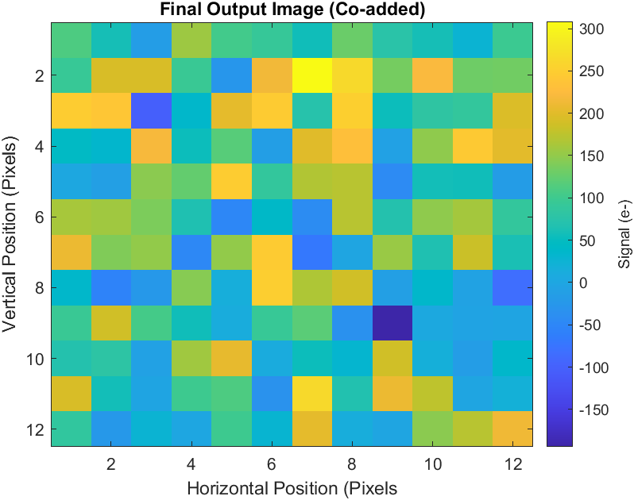
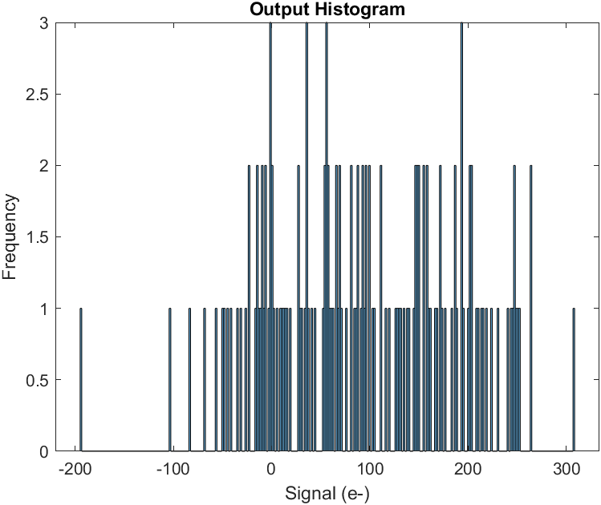
Initial Testing
Results shown are with electron multiplication disabled (read out through the standard register)

Slide 6
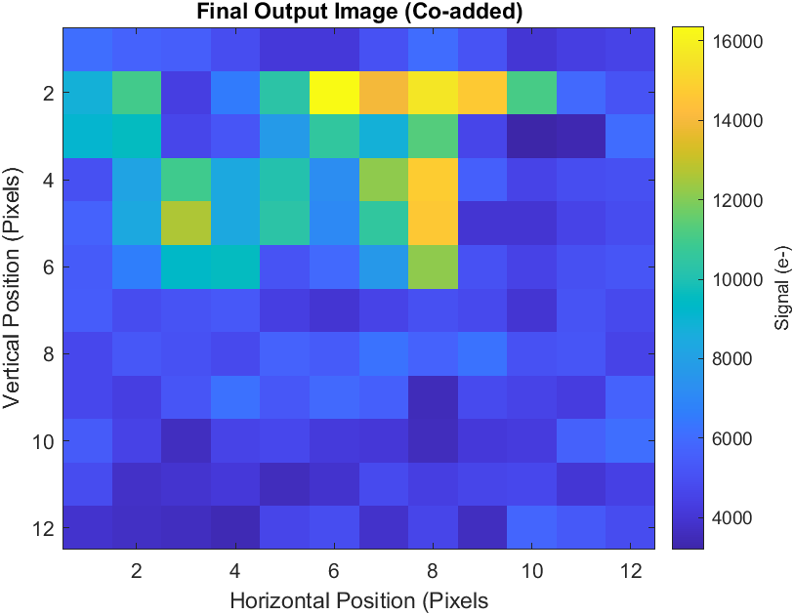
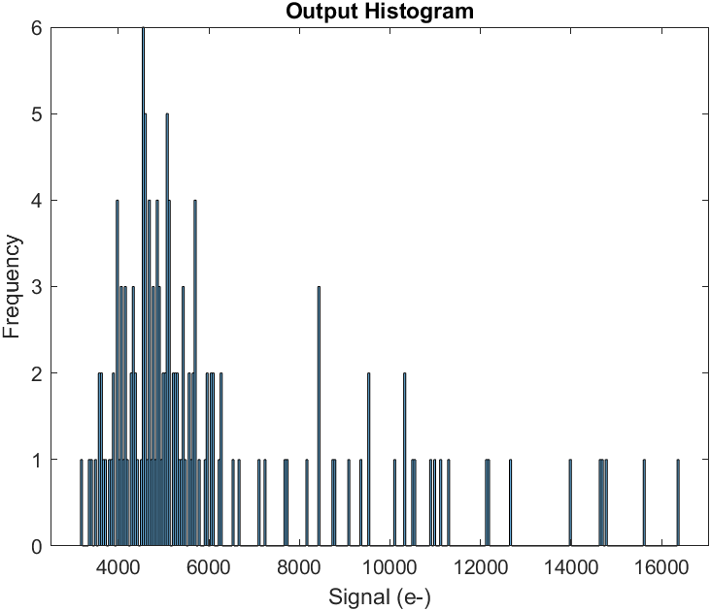
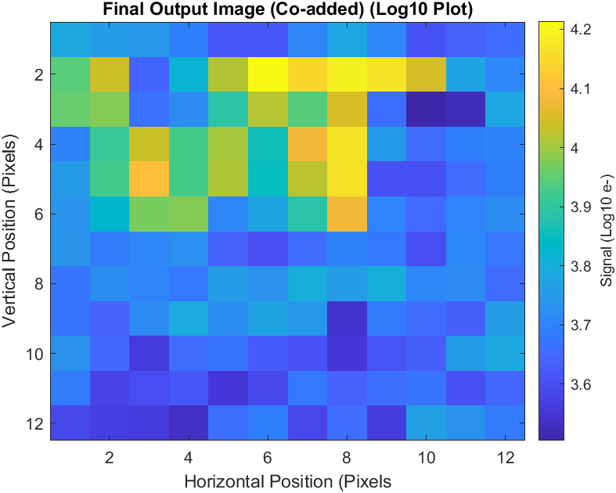
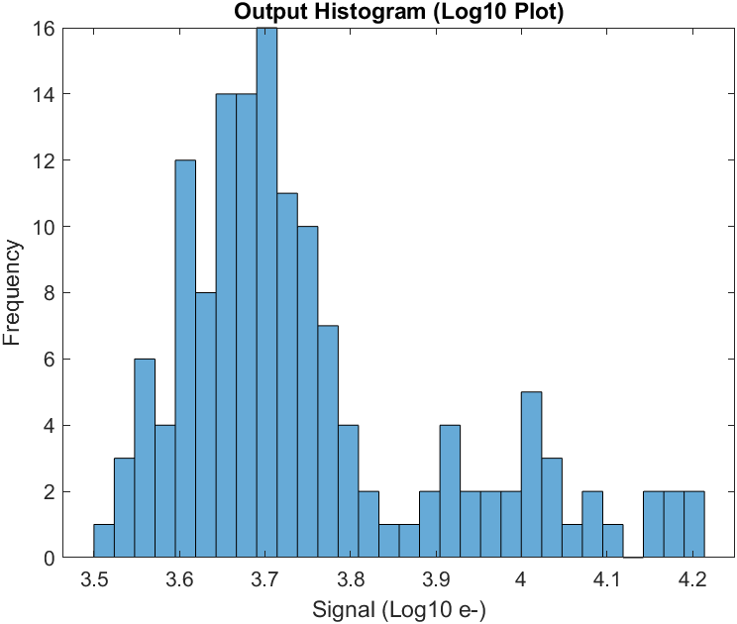
Initial Testing
Results shown are for standard (non-photon-counted) output, coadding the 1000 read-outs to arrive at a final image
CTE has been set to 0.99 for all pixels

Slide 7
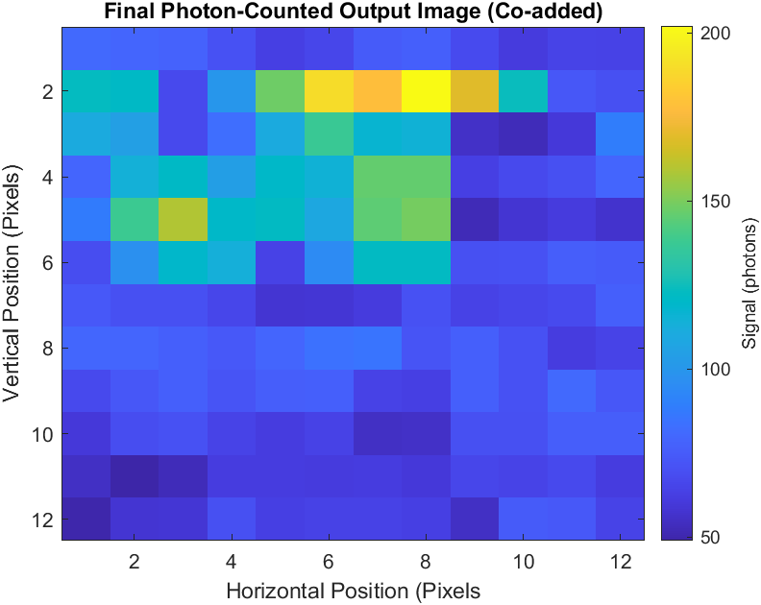
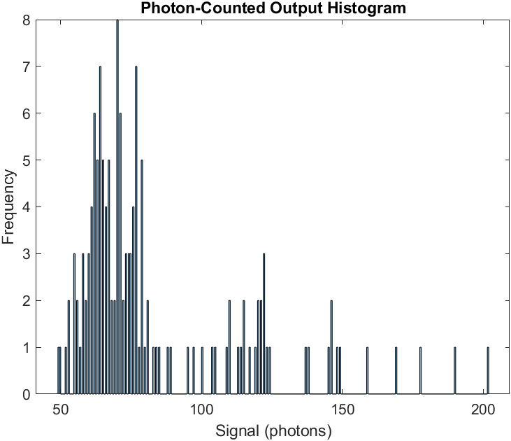
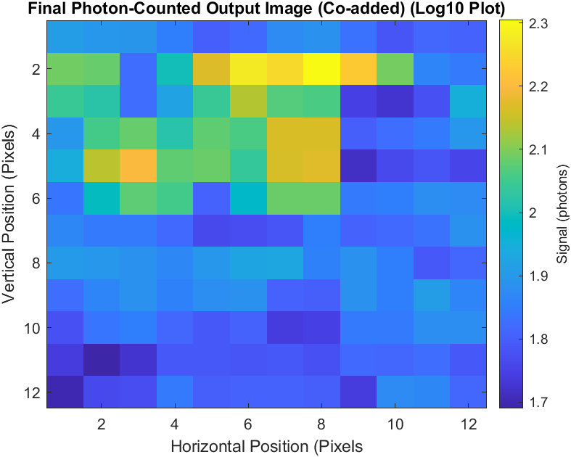
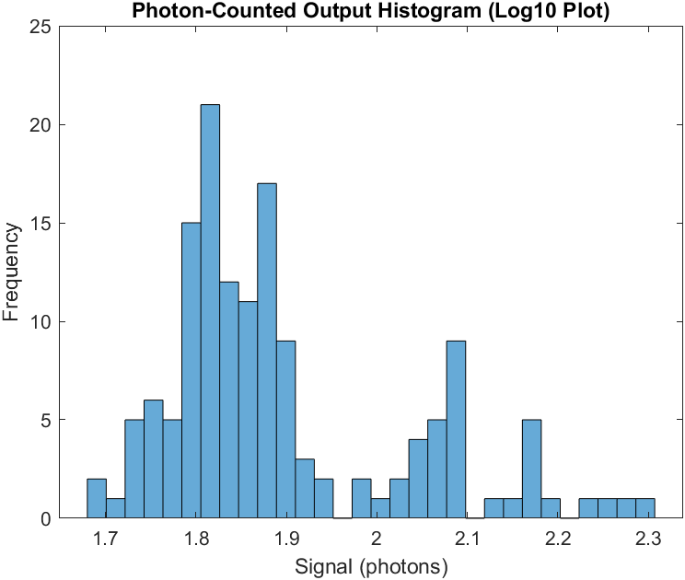
Initial Testing
Results shown are for photon-counting of previous data, using 5-sigma threshold above the read-noise
CTE has been set to 0.99 for all pixels

Slide 8




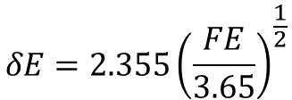
$$λ=\frac{12390}{E\left(eV\right)}$$
$$η_{i}=\frac{E\left(eV\right)}{E_{e−h}}$$
$$δE=2.355{\left(\frac{FE}{3.65}\right)}^{\frac{1}{2}}$$
$$F≈0.1$$
\delta E is the FWHM energy of the observed spread in electrons, E in eV
$$E_{e−h}=3.65\frac{eV}{e^{−}}$$

Slide 9
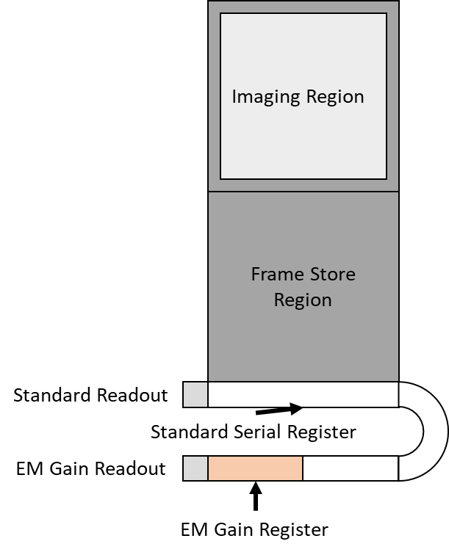
Imaging Region
Frame Store Region
Standard Readout
Standard Serial Register
EM Gain Readout
EM Gain Register

