Slide 1
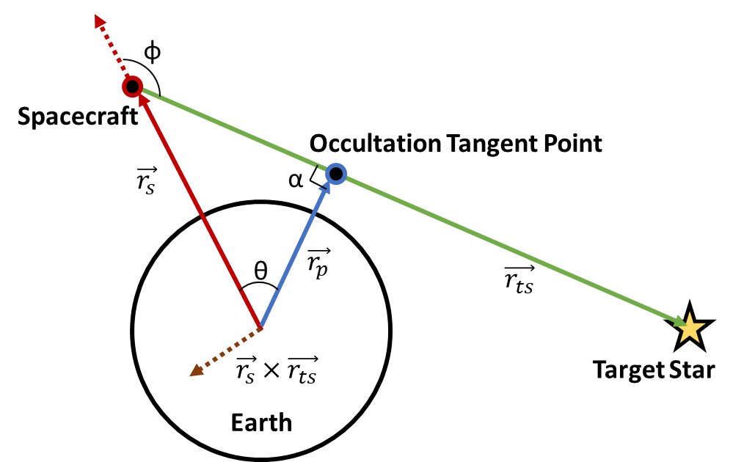
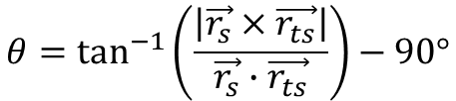

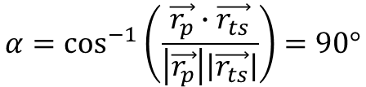








$$θ=\tan^{−1}\left(\frac{\left|\vec{r_{s}}×\vec{r_{ts}}\right|}{\vec{r_{s}}∙\vec{r_{ts}}}\right)−90°$$
φ
$$\left|\vec{r_{p}}\right|=\left|\vec{r_{s}}\right|\cos{θ}$$
Spacecraft
$$\vec{v}=\frac{\vec{r_{s}}}{\left|\vec{r_{s}}\right|}$$
Occultation Tangent Point
$$\vec{r_{s}}$$
α
$$\hat{r}=\frac{\left|\vec{r_{s}}×\vec{r_{ts}}\right|}{\left|\vec{r_{s}}\right|\left|\vec{r_{ts}}\right|}$$
θ
$$\vec{r_{p}}$$
$$\vec{r_{p}}=\left|\vec{r_{p}}\right|[\left(1−\cos{θ)(\vec{v}∙\hat{r}}\right)\hat{r}+\vec{v}\cos{θ}+(\hat{r}×\vec{v})\sin{θ}$$
$$\vec{r_{ts}}$$
$$\vec{r_{s}}×\vec{r_{ts}}$$
Target Star
Earth
$$θ=φ−90°$$
$$φ>90°⇒ \vec{r_{s}}∙\vec{r_{ts}}<0$$
$$α=\cos^{−1}\left(\frac{\vec{r_{p}}∙\vec{r_{ts}}}{\left|\vec{r_{p}}\right|\left|\vec{r_{ts}}\right|}\right)=90°$$

Slide 2



φ
Spacecraft
Occultation Tangent Point
$$\vec{r_{s}}$$
θ
$$\vec{r_{p}}$$
$$\vec{r_{ts}}$$
Earth
Target Star

Slide 3
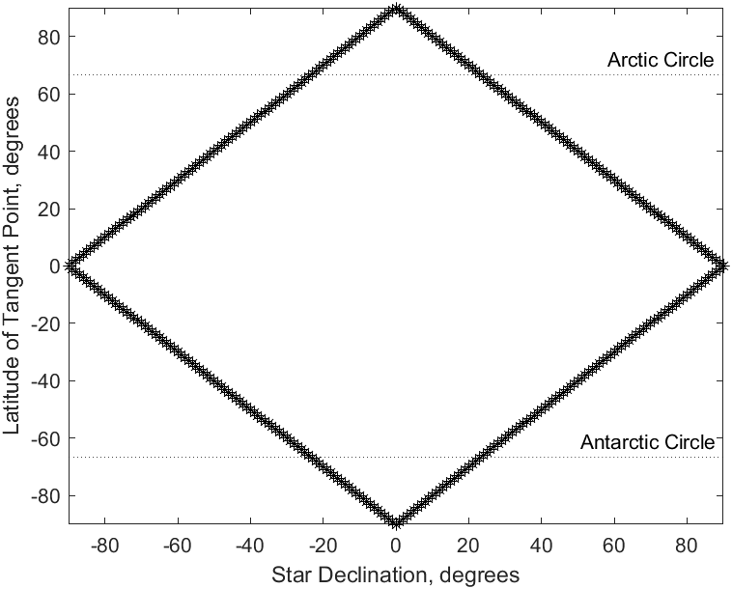
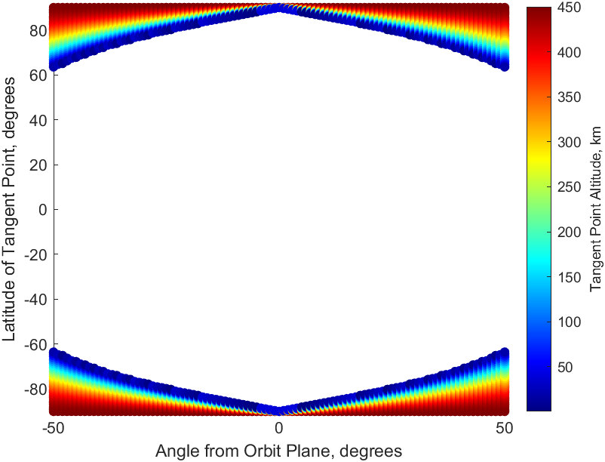

Slide 4


Z
Target Star
Satellite
Y
Z
Target Star
ν
$$\vec{r_{ts}}$$
r
Satellite
λ
X
θ
$$\vec{r_{s}}$$
Y
Earth
X

Slide 5
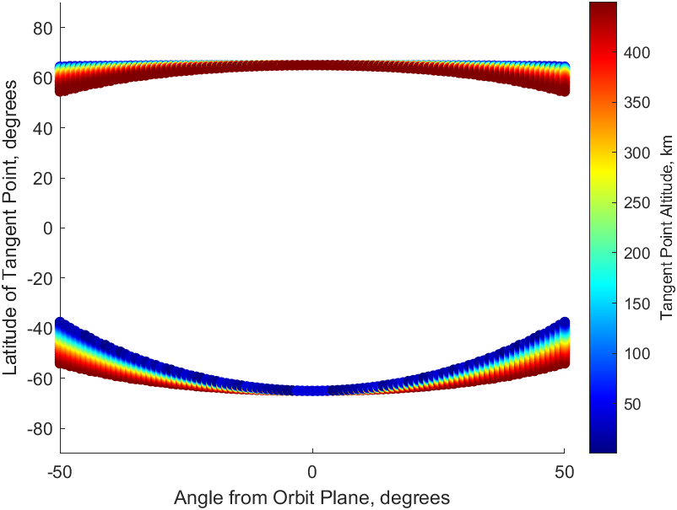
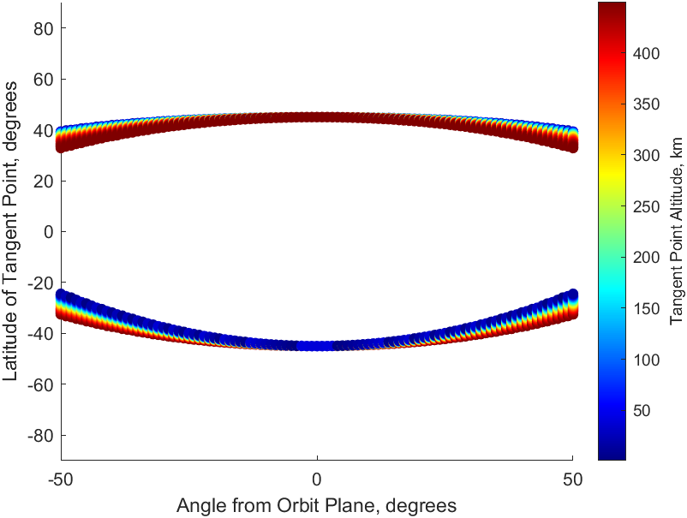
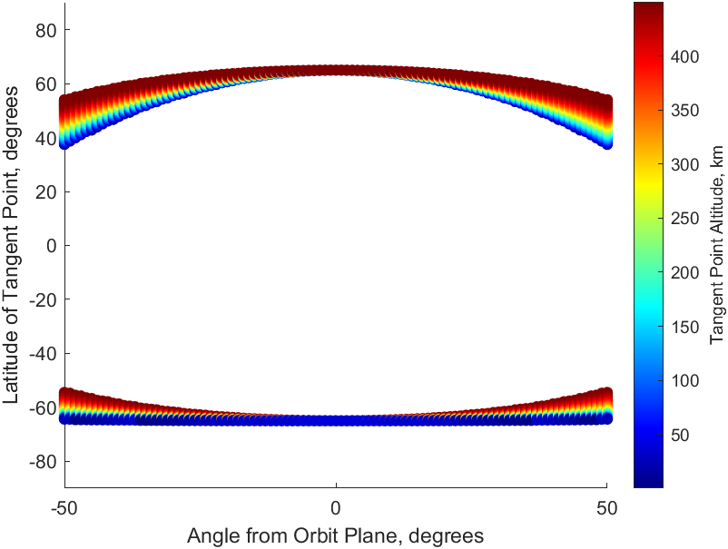
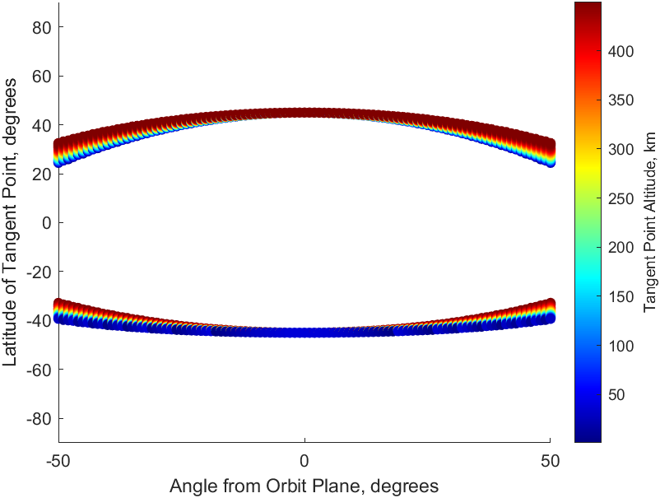

Slide 6
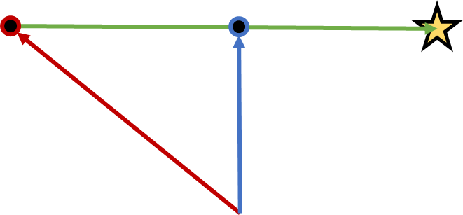





Target Star
Spacecraft
Tangent Point
Target Star
Spacecraft
Tangent Point
θ
$$\vec{r_{ts}}$$
$$\vec{r_{ts}}$$
$$\vec{v_{p}}$$
$$\vec{v_{s}}$$
$$\vec{r_{s}}$$
$$\vec{r_{s}}$$
$$\vec{r_{p}}$$
$$\vec{r_{p}}$$
Earth
Earth

Slide 7
