Slide 1
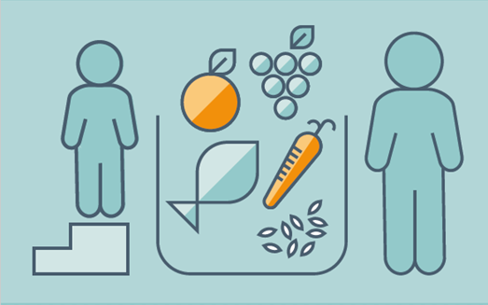
HEALTHY DIET WITH RESPECT TO COVID-19
Prajna Jagannath
Noel Philip
Shubham Khaladkar

Slide 2
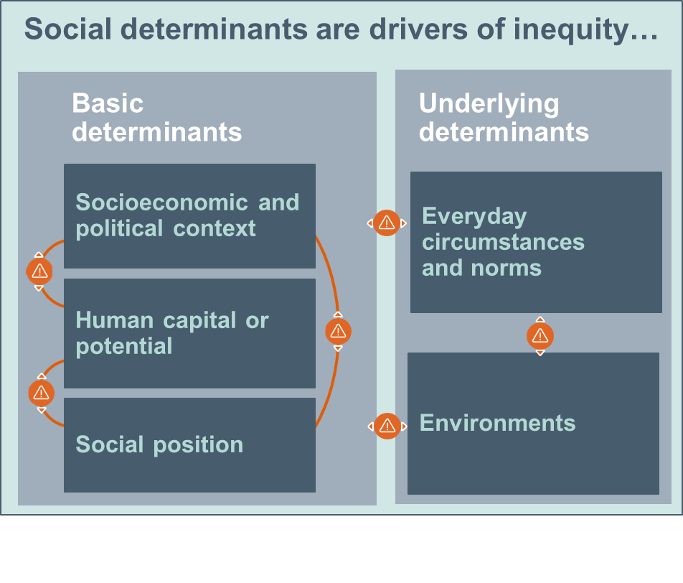
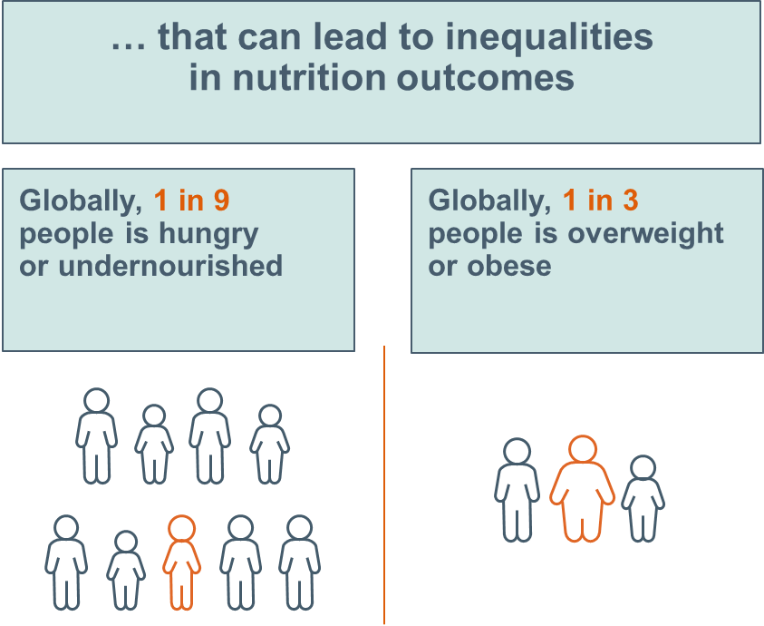
INTRODUCTION
Injustice in food and health system hold people back from healthy diets and lives

Slide 3
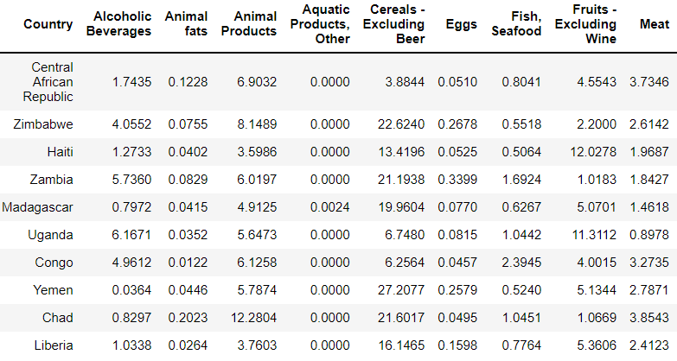
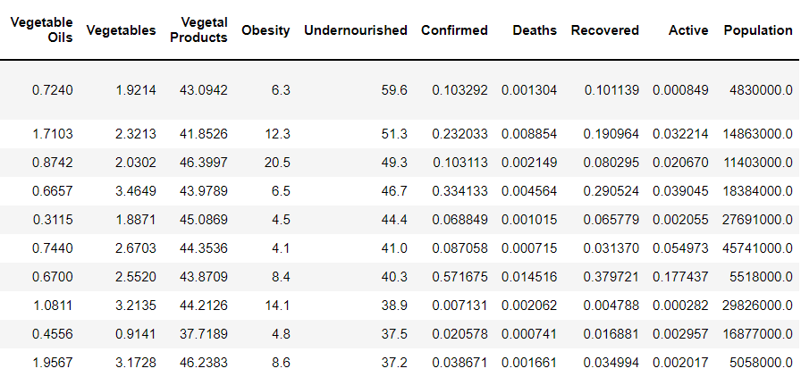
DATASET OVERVIEW

Slide 4
PROBLEM DESCRIPTION
We have subdivided the problem statement into two use cases:
Finding out the obesity rate and undernourished rate by the COVID recovery, confirmed, and death rates.
Finding the correlations between the diet consumption, obesity, and undernourished rates.
Ultimately, this will bring us to our goal of finding out the best diet to lessen the Covid cases.

Slide 5
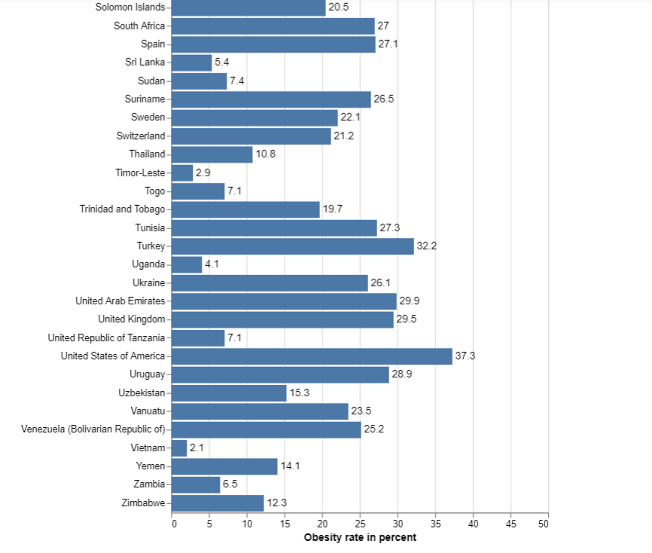
COUNTRY vs. OBESITY RATE

Slide 6
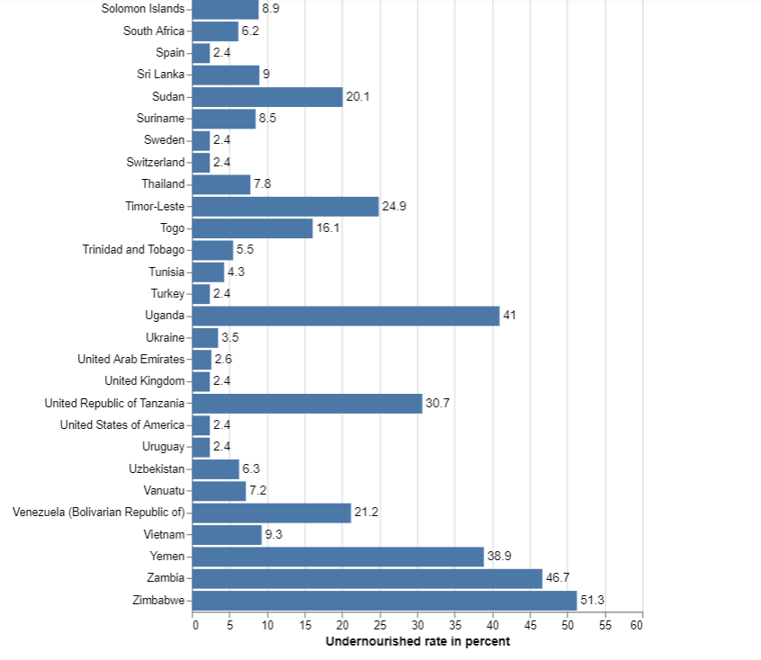
COUNTRY vs. UNDERNOURISHED RATE

Slide 7
CASE I:
Obesity rate, Undernourished rate, and Covid-19 Variables

Slide 8
OBESITY: T-TEST
Variable | p-value | significance
Obesity/ Death | 0.01 | <0.05: significance
Variable | p-value | significance
Obesity/ Recovered | 0.21 | >0.05: no significance
Variable | p-value | significance
Obesity/ Confirmed | 0.046 | <0.05: significance

Slide 9
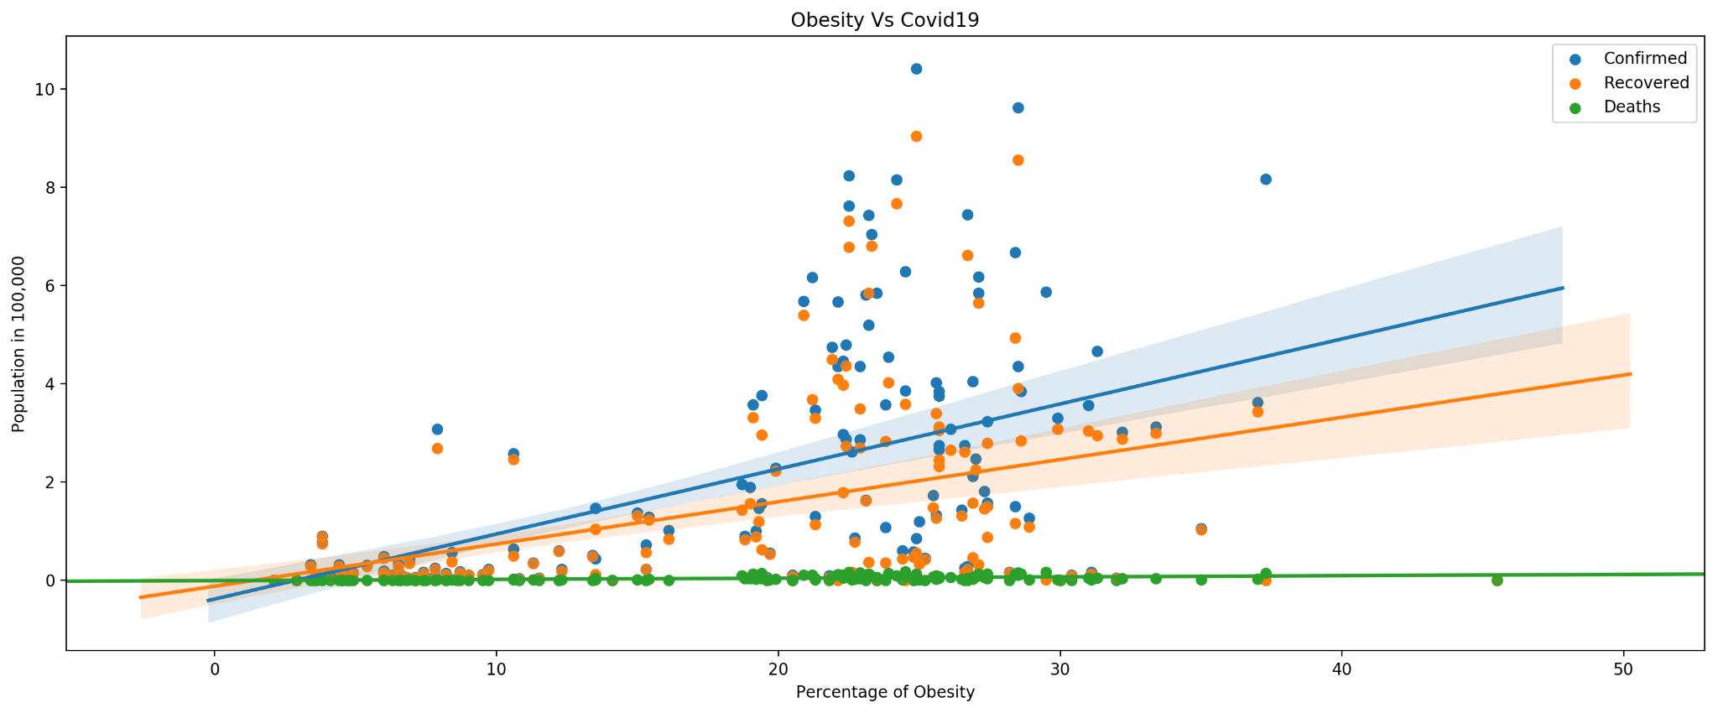
OBESITY vs. COVID-19

Slide 10
UNDERNOURISHED: ANOVA TEST
Variable | p-value | significance
Undernourished/ Death | 0.05 | >0.05: no significance
Variable | p-value | significance
Undernourished/ Recovered | 0.12 | >0.05: no significance
Variable | p-value | significance
Undernourished/ Confirmed | 0.31 | >0.05: no significance

Slide 11
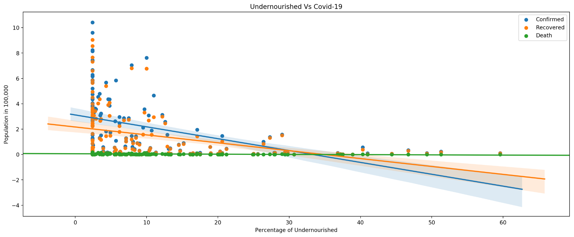
UNDERNOURISHED vs. COVID-19

Slide 12
CASE II:
Obesity rate, Undernourished rate, and Diet Variables

Slide 13
SPEARMAN’S CORRELATION TEST
Choosing Spearman’s test has a reason of being robust and more viable for our dataset i.e. independent quantitative variables.
To find the spearman’s coefficient (rs) - lies between -1 and 1.
The heatmap visual is used in order to get the clear idea of correlations between variables.
Finding correlations between obesity rate and diet variables (alcohol consume, eggs, milk, dairy products, veggies).

Slide 14
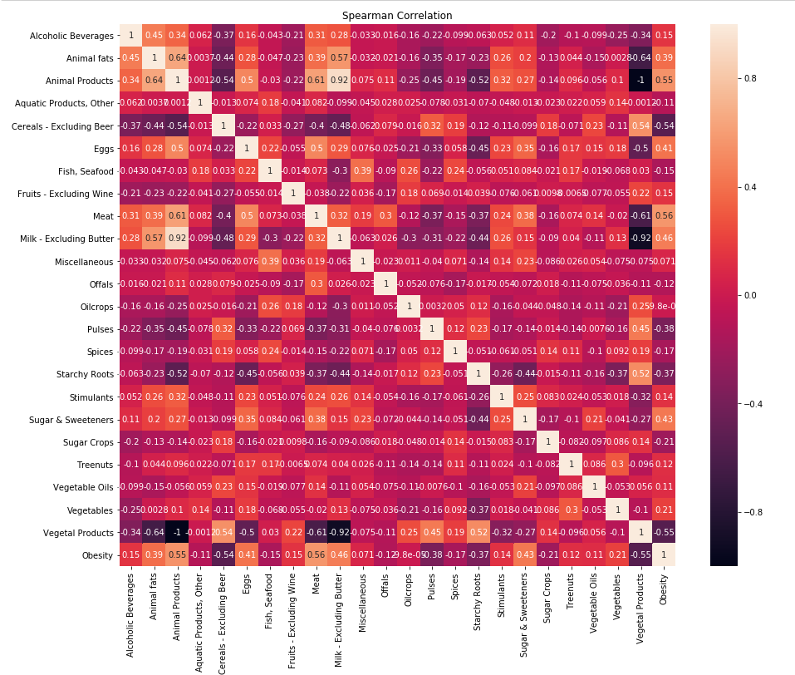
OBESITY: CORRELATION

Slide 15
INSIGHTS
Higher proportions of Sugar & Sweetener, Animal fats, Animal products, Eggs, Meat and Milk-excluding butter in the diet is increasingly found in countries with high obesity rates.
High proportions of Pulses, Starchy roots, Cereals and Vegetable products are found in the diets of countries with low obesity rates.
Obs: positively correlated - Sugar & Sweetener, Animal fats, Animal products, Eggs, Meat, Milk-excluding butter.
Obs: negatively correlated- Pulses, Starchy roots, Cereals, Vegetable products.

Slide 16
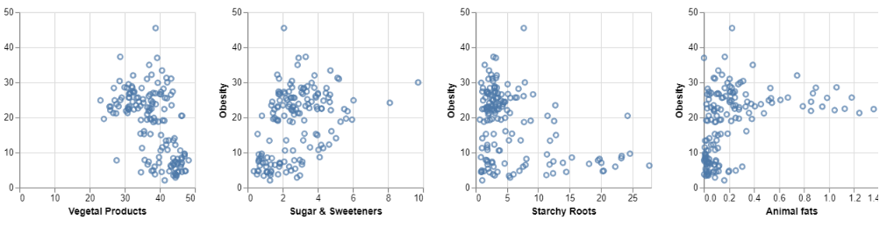
OBESITY BY DIET VARIABLES INSTANCES

Slide 17
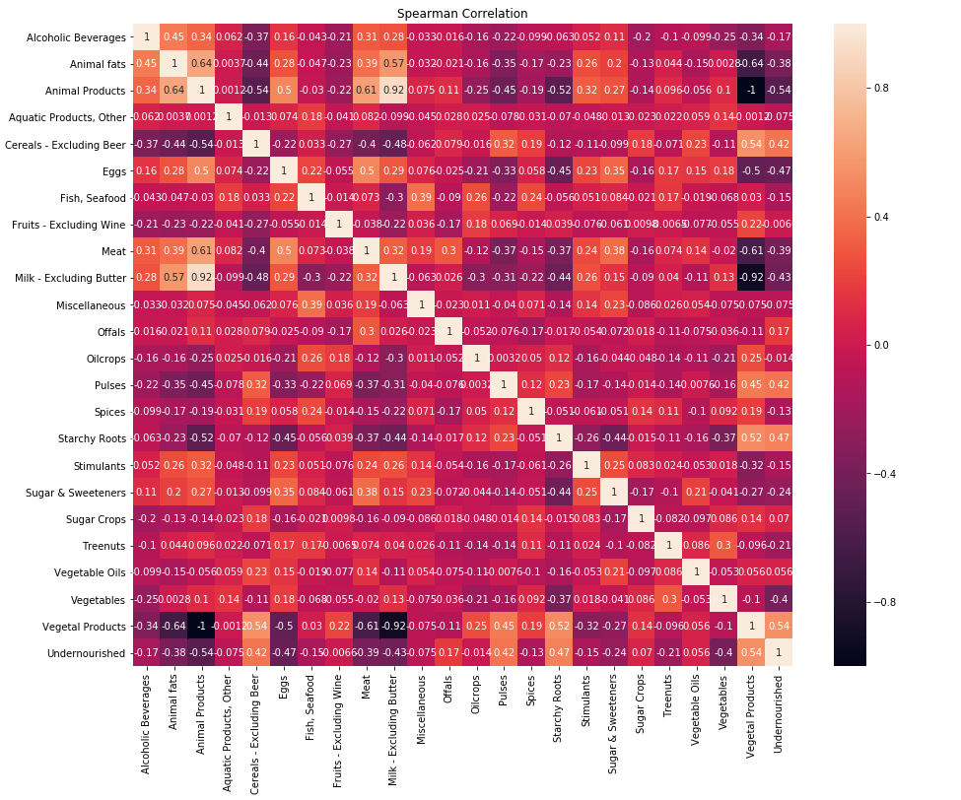
UNDERNOURISHED: CORRELATION

Slide 18
INSIGHTS
Observation: The variables that are highly correlated with 'Undernourished' are Vegetable products, Vegetables, Starchy Roots, Pulses, Milk-excluding butter, Meat, Eggs, Cereals, Animal Products, Animal Fats
-vely correlated : Vegetables, Milk - Excluding beer, Meat, Eggs, Animal Products, Animal fats
+vely correlated: Vegetable Products, Starchy Roots, Pulses, Cereals.
Higher proportions of Vegetal products, pulses and cereals in the diet is increasingly found in countries with high undernourishment.
High proportions of Fruits, Animal fats, Animal products, eggs,meat and milk are found in the diets of countries with low undernourishment.

Slide 19
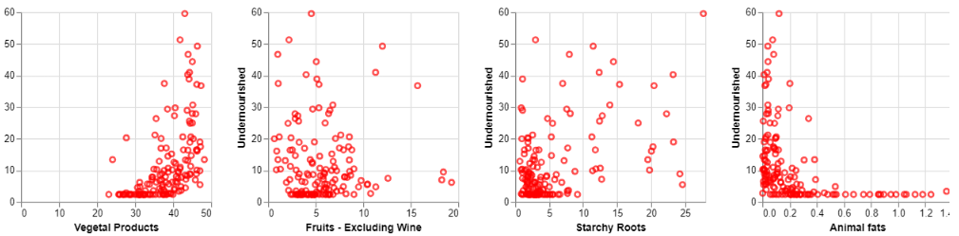
UNDERNOURISHED BY DIET VARIABLES INSTANCES

Slide 20
CONCLUSION
In countries with fewer confirmed cases, when both the obesity and undernutrition rates are low, Therefore, it is important to have a healthy diet plan. For example, vegetable products, cereals, etc.
Avoid eating meat and drinking alcoholic beverages to avoid becoming susceptible to COVID.
The lower the mortality rate, the healthier the diet.

Slide 21


