Slide 1

The Battle of Neighborhoods
Applied Data Science Capstone Project

Slide 2
INTRODUCTION
City of Cape Town receives a high number of young domestic migrants looking to start a new life.
We want to create a map that young people can use to decide which neighbourhood they want to move into based on:
The type of eateries that exist around the neighbourhood.
The number of nightlife spots that are available within a short distance

Slide 3
DATA SOURCES
Food and Nightlife spot venues for each neighbourhood will be obtained from the Foursquare API
Scrape the list of nieghbourhoods in each district from the List of Cape Town suburbs - Wikipedia
Google Maps to obtain the gps coordinates of the each neighbourhood
Ward boundary .json file for South Africa from NYU spatial data repository
List of suburbs in each ward from the city of cape town map viewer

Slide 4
DATA CLEANING
The following data cleaning was done on the list of suburbs data obtained from Wikipedia
 | Dropped Column | Dropped Neighbourhoods | Renamed Neighbourhoods
Column/Neighbourhood | Postal Code, Street Column | Lower Vrede (District Six), Schotse Kloof (Malay Quarter), Kreupelbosch, SouthField | Bo-Kaap(Malay Quarter): Bo-Kaap Devil's Peak Estate: Devils Peak Estate Walmer Estate (District Six): Walmer Estate Woodstock (including Upper Woodstock): Woodstock Zonnebloem (District Six): Zonnebloem
Reason | No need to keep these columns as we won’t be using them in our analysis | All of these neighbourhoods are part of neighbourhoods which are already in our dataframe. | To make it easier to merge our list of suburbs df with the GPS coordinates df later

Slide 5
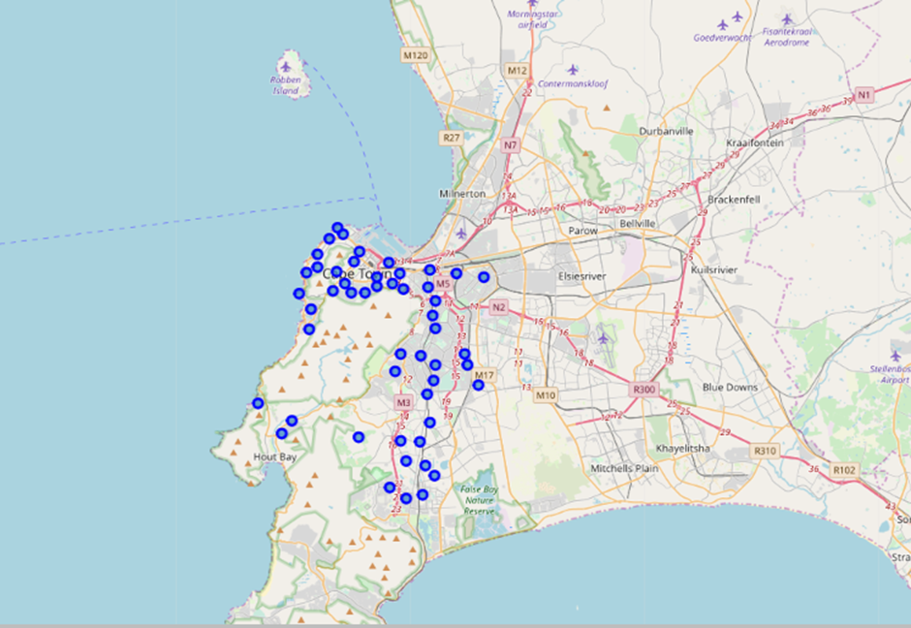
GEO-SPATIAL VIEW OF NEIGHBOURHOODS
After appending the GPS
coordinates of each
Neighbourhood we plot them
on a folium map

Slide 6
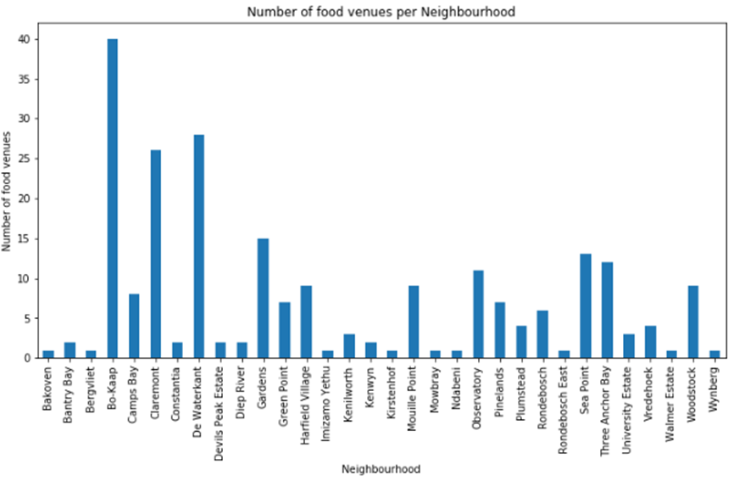
FOOD VENUES PER NEIGHBOURHOOD
For each neighbourhood we get the number of food venues within 500m

Slide 7
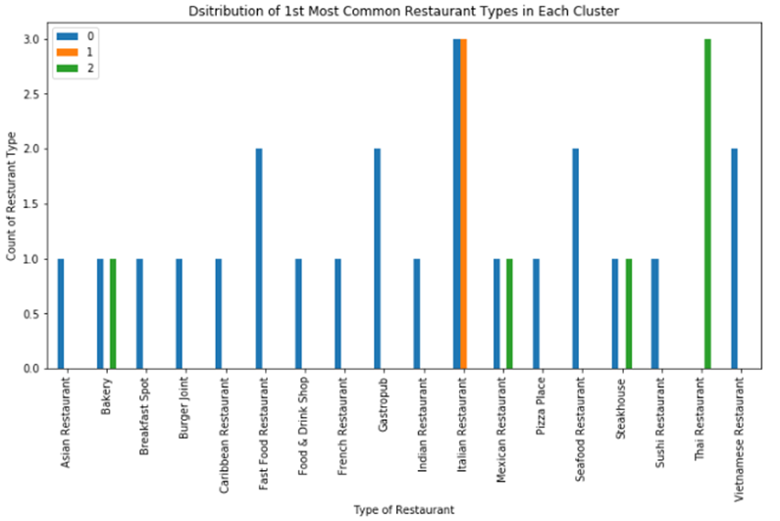
k-MEANS CLUSTERING
The neighbourhoods are then clustered into 3 clusters based on the type of eateries that exist around neighbourhood.
Distribution of most common restaurant
types in each cluster

Slide 8
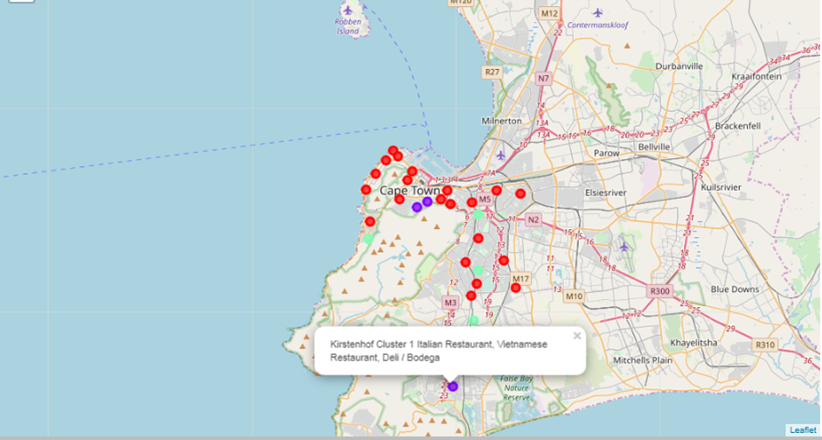
GEO-SPATIAL VIEW OF CLUSTERS
Pop-up label contains 3 most common
eatery types in each neighbourhood

Slide 9
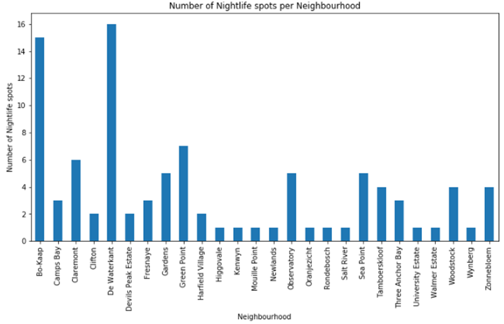
NIGHTLIFE SPOTS PER NEIGHBOURHOOD
Number of Nightlife
spots within 900m

Slide 10
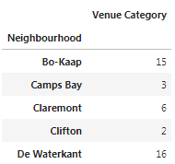
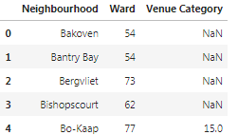
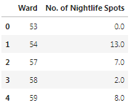
NIGHTSPOTS PER WARD
Each neighbourhood is mapped to a ward in order to determine the number of nightlife spots per ward
Add ward
column
Group by
ward

Slide 11
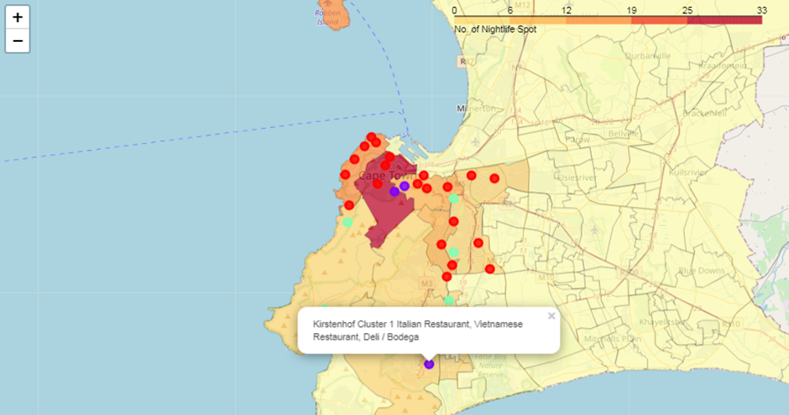
CHOROPLETH

Slide 12
CONCLUSION AND FUTURE IMPORVEMENTS
For accurate comparison of neighbourhoods it is recommended that neighbourhood boundaries in of ward boundaries should be used.
To improve clustering we could create higher level food categories e.g.
Thai, Japanese, Chinese restaurants are mapped to Asian Cuisine
The choropleth map created successfully achieves the goal of using data analytics to assist a young person moving into Cape Town decide which neighbourhood to move into based on:
The type of eateries that exist around the neighbourhood.
The number of nightlife spots that are available within a short distance

