Slide 1
Application Delivery Fundamentals 2.0 B: Java
Junit and Mockito

Slide 2
Goals
Mockito
Mocking Introduction
The Order Processor Usecase
Create the DAO Layer
Create the BO Layer
Add the Mockito Dependency
Stubbing and Setting Expectations

Slide 3
Goals
Verify the results
Test a negative scenario
Mocking Exceptions
Test Cancel Order
Cancel Order Negative Scenario
Cancel Order Exception Scenario
Cancel Order Exception On Update
Mock testing with PowerMock

Slide 4
Goals
Getting and installing PowerMock
Mocking static methods
Verifying method invocation
Mocking final classes or methods
Mocking constructors
Mocking private methods
Partial mocking using spy
Test Spring Framework application with JUnit 5 and Mockito

Slide 5
Junit
JUnit is an open source Unit Testing Framework for JAVA.
It is useful for Java Developers to write and run repeatable tests.
Erich Gamma and Kent Beck initially develop it.
It is an instance of xUnit architecture. As the name implies, it is used for Unit Testing of a small chunk of code.
Developers who are following test-driven methodology must write and execute unit test first before any code.

Slide 6
Junit
JUnit 5 = JUnit Platform + JUnit Jupiter + JUnit Vintage
The JUnit Platform serves as a foundation for launching testing frameworks on the JVM.
It also defines the TestEngine API for developing a testing framework that runs on the platform.
JUnit Jupiter is the combination of the new programming model and extension model for writing tests and extensions in JUnit 5.
The Jupiter sub-project provides a TestEngine for running Jupiter based tests on the platform.

Slide 7
Junit
JUnit Vintage provides a TestEngine for running JUnit 3 and JUnit 4 based tests on the platform.

Slide 8
JUnit 5 Features
Writing Tests in JUnit Jupiter
Migrating from JUnit 4 to JUnit Jupiter
Running Tests
Extension Model for JUnit Jupiter
Advanced Topics
JUnit Platform Launcher API
JUnit Platform Test Kit

Slide 9
Annotations
Annotation | Description
@Test | Denotes that a method is a test method. Unlike JUnit 4’s @Test annotation, this annotation does not declare any attributes, since test extensions in JUnit Jupiter operate based on their own dedicated annotations. Such methods are inherited unless they are overridden.
@ParameterizedTest | Denotes that a method is a parameterized test. Such methods are inherited unless they are overridden.
@RepeatedTest | Denotes that a method is a test template for a repeated test. Such methods are inherited unless they are overridden.

Slide 10
Annotations
Annotation | Description
@TestFactory | Denotes that a method is a test factory for dynamic tests. Such methods are inherited unless they are overridden.
@TestTemplate | Denotes that a method is a template for test cases designed to be invoked multiple times depending on the number of invocation contexts returned by the registered providers. Such methods are inherited unless they are overridden.
@TestMethodOrder | Used to configure the test method execution order for the annotated test class; similar to JUnit 4’s @FixMethodOrder. Such annotations are inherited.

Slide 11
Annotations
Annotation | Description
@TestInstance | Used to configure the test instance lifecycle for the annotated test class. Such annotations are inherited.
@DisplayName | Declares a custom display name for the test class or test method. Such annotations are not inherited.
@DisplayNameGeneration | Declares a custom display name generator for the test class. Such annotations are inherited.

Slide 12
Annotations
Annotation | Description
@TestInstance | Used to configure the test instance lifecycle for the annotated test class. Such annotations are inherited.
@DisplayName | Declares a custom display name for the test class or test method. Such annotations are not inherited.
@DisplayNameGeneration | Declares a custom display name generator for the test class. Such annotations are inherited.

Slide 13
Annotations
Annotation | Description
AfterEach | Denotes that the annotated method should be executed after each @Test, @RepeatedTest, @ParameterizedTest, or @TestFactory method in the current class; analogous to JUnit 4’s @After. Such methods are inherited unless they are overridden.
@BeforeAll | Denotes that the annotated method should be executed before all @Test, @RepeatedTest, @ParameterizedTest, and @TestFactory methods in the current class; analogous to JUnit 4’s @BeforeClass. Such methods are inherited (unless they are hidden or overridden) and must be static (unless the "per-class“ test instance lifecycle is used).
AfterEach | Denotes that the annotated method should be executed after each @Test, @RepeatedTest, @ParameterizedTest, or @TestFactory method in the current class; analogous to JUnit 4’s @After. Such methods are inherited unless they are overridden.

Slide 14
Annotations
Annotation | Description
@AfterAll | Denotes that the annotated method should be executed after all @Test, @RepeatedTest, @ParameterizedTest, and @TestFactory methods in the current class; analogous to JUnit 4’s @AfterClass. Such methods are inherited (unless they are hidden or overridden) and must be static (unless the "per-class" test instance lifecycle is used).
@Nested | Denotes that the annotated class is a non-static nested test class. @BeforeAll and @AfterAll methods cannot be used directly in a @Nested test class unless the "per-class" test instance lifecycle is used. Such annotations are not inherited.
@Tag | Used to declare tags for filtering tests, either at the class or method level; analogous to test groups in TestNG or Categories in JUnit 4. Such annotations are inherited at the class level but not at the method level.

Slide 15
Annotations
Annotation | Description
@Disabled | Used to disable a test class or test method; analogous to JUnit 4’s @Ignore. Such annotations are not inherited.
@Timeout | Used to fail a test, test factory, test template, or lifecycle method if its execution exceeds a given duration. Such annotations are inherited.
@ExtendWith | Used to register extensions declaratively. Such annotations are inherited.

Slide 16
Annotations
Annotation | Description
@RegisterExtension | Used to register extensions programmatically via fields. Such fields are inherited unless they are shadowed.
@TempDir | Used to supply a temporary directory via field injection or parameter injection in a lifecycle method or test method; located in the org.junit.jupiter.api.io package.
@RegisterExtension | Used to register extensions programmatically via fields. Such fields are inherited unless they are shadowed.

Slide 17
Assertions

Slide 18
Mocking in Unit testing
In simple English, Mocking is make a replica or imitation of something.
We use mocking in unit testing. A object that you want to test may have dependencies on other complex objects.
To isolate the behavior of the object you want to test you replace the other objects by mocks that simulate the behavior of the real objects.
So in simple words, mocking is creating objects that simulate the behavior of real objects.

Slide 19
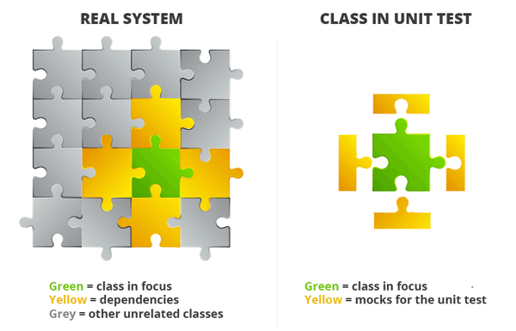

Slide 20
Mocking in Unit testing
In simple terms, providing a controlled instance or implementation of dependency that the code under test depends on in order to test its core logic.
A controlled instance is that the behavior of the dependency can be programmed or controlled as desired for the method or system under test.
let’s take an example of any Business or Ecommerce Application.
Almost every such type of application primarily has 3 layers i.e. User Interface, Business Layer & Data Access layer (which talks to the underlying data store)

Slide 21
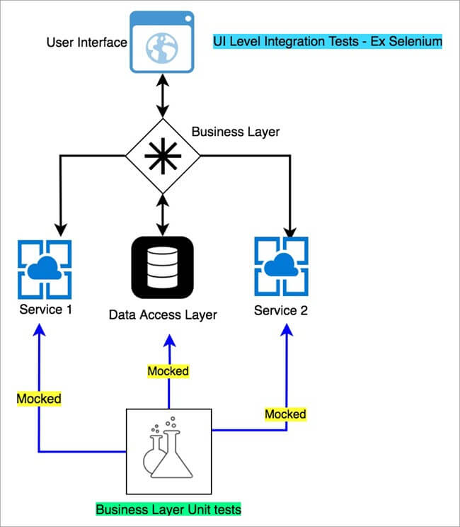

Slide 22
Mocking in Unit testing
Look at it this way – An app like google maps can have dependencies on an
Actual data stores like MySQL or any other no SQL database which stores Map data.
An external service like Coordinate Service which provides latitudes and longitudes of a location.
An external service like traffic service which provides real-time traffic information for a given Coordinate pair.

Slide 23
Mocking in Unit testing
So, if someone is trying to validate the core business logic using unit test, until and unless they have working implementations of these dependencies, the tests could not be run.
Mocks come to rescue in these situations, where no matter your dependency is up and running or not, you are always guaranteed to run your business logic with a programmed response for the dependency that’s being getting called from the code under test.

Slide 24
Types/Categories of Test Doubles
Mock is essentially a type of “Test Double” – it’s a tech jargon.
“Test Double” essentially means an object which is replaced by equivalent real object instance or dependency.
There are different types of Test doubles as mentioned below:
Fakes
Stubs
Spies
Mocks

Slide 25
Fakes:
A fake is a working implementation similar to a real dependency, except the fact that it is local to the system under test.
A Fake is more powerful than Stub.
Fake classes can change the behavior based on input.
Fake class functions can return different output for different inputs unlike that of stub.
Fakes can help us to mimic all the possible behavior of the interfaces.
Example: Instead of hitting a real production DB, the test uses a simple collection/in-memory to store data.

Slide 26
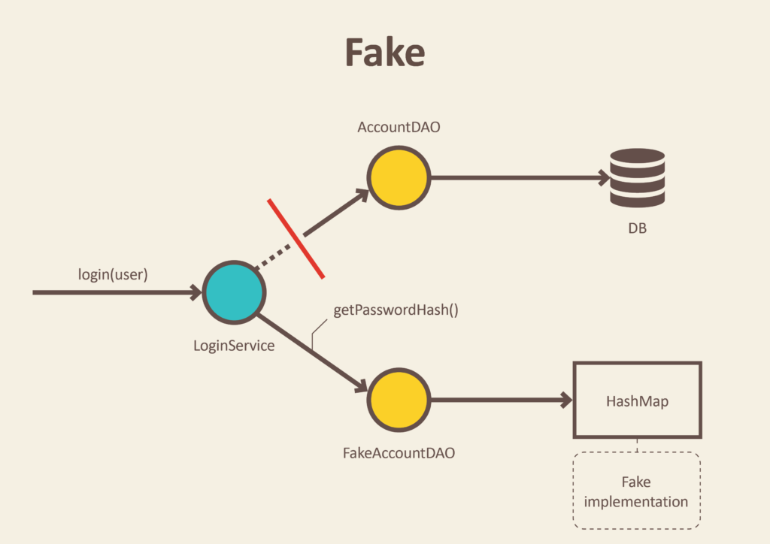

Slide 27
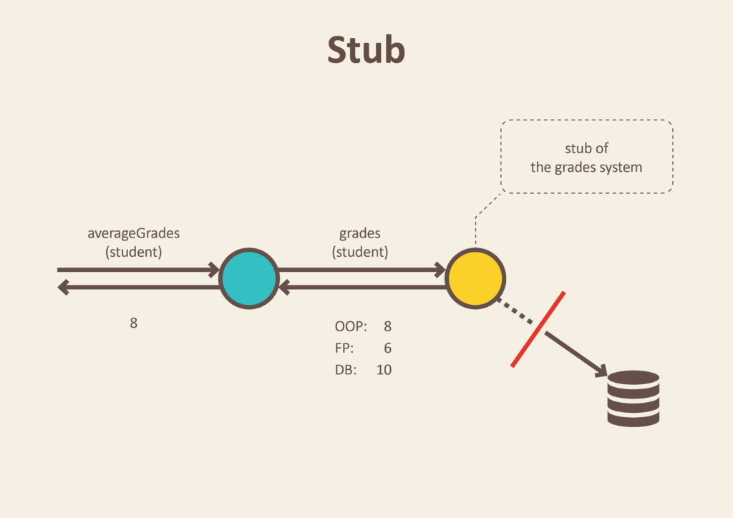
Stubs:
Stubs are pre-configured responses when a dependency is called from the system under test.

Slide 28
Stubs:
A Stub is the lightest and most static version of this chain.
Stub always returns the predefined output regardless of the input.
We can't control the behavior of the stub.
A stub can be useful to mimic the database objects (as shown below).

Slide 29
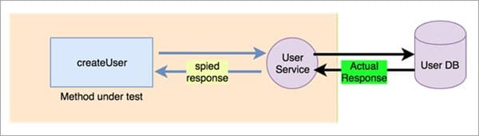
Spies:
As the name suggests, its actually the real function (dependency) call with some watching mechanism. Post the call, it can be verified whether the call was actually triggered or not along with the parameters.

Slide 30
Spies:
Spy is an advanced version of the Fake which can store the previous state of the object.
The spy can be useful to mimic the retry services or to check scenarios like 'if the function called at least once'.
You can also create a spy for loggers to store and validate all the logs logged while running the test case.

Slide 31
Mocks:
Mocks are special instances of objects, on which Stubbed/pre-configured responses can be specified. The fact that the mock got called can be verified as an assert in the test.
There is a report generator function which sends an email to a specified address during execution.
As we don’t want to send actual email, again and again, during testing, the Email Service is mocked (and the email method which sends the email is configured to do nothing when it’s called).
At the end of the test, we can just verify that the email sending method of the email service got called through the mocked object.

Slide 32
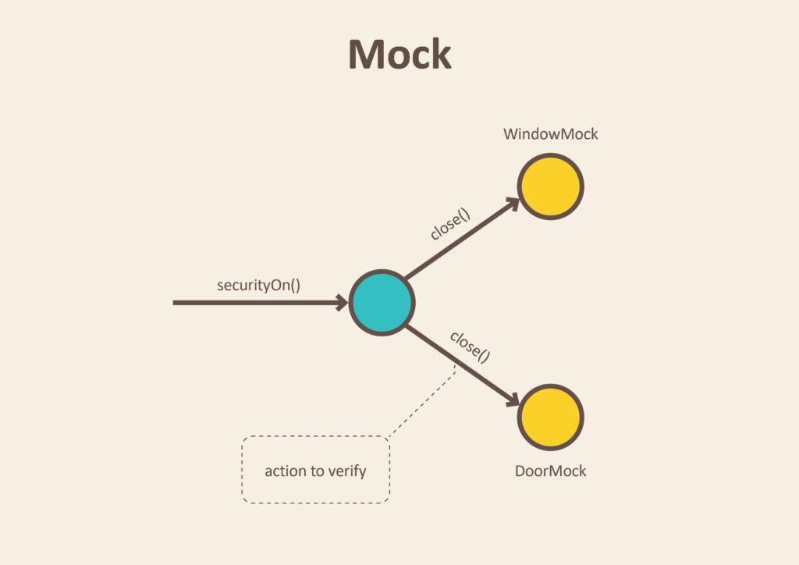

Slide 33
Mocks
A Mock is the most powerful and flexible version in the chain.
The behavior of the mocked interface can be changed dynamically based on scenarios.
We can apply a variety of assertions by creating Mocked objects using mock frameworks, for example - Mockito.
Mock gives the full control over the behavior of mocked objects.

Slide 34
What are the benefits of mocking?
You can create tests in advance; TDD
Teams can work in parallel
You can create proof of concepts or demos.
You can write test for resource not accessible
Mock can be delivered to the customer
You can isolate systems

Slide 35
What are the key mocking concepts?
When it comes to mocking, there are only 3 things you really need to worry about;
Stubbing
setting expectations
verifying.

Slide 36
Stubbing
Stubbing is the process of telling your fake how to behave when it is interacted with.
You can generally stub public properties (those with getters and/or setters) and public functions.
When it comes to stubbing functions, you have a lot of choices typically.
You may wish to return a specific value, throw an error or dispatch an event.
Further, you may wish to indicate that the function behave differently depending upon how it is invoked (i.e. by matching the types or values of the parameters passed to the function).

Slide 37
Stubbing
One great feature of many of the mocking frameworks is that you need not stub void functions.
Nor do you have to stub any functions that are not invoked or properties that are not consulted during the execution of your tests.

Slide 38
Setting Expectations
One of the key features of a fake is the ability to tell the fake what you expect when your test runs.
For example, you may expect that a specific function be invoked exactly 3 times.
You may expect that it never be invoked.
You may expect that it be invoked at least twice, but not more than 5 times.
You may expect that it be invoked with specific types of arguments or specific values or any combination of the above.
The possibilities are endless.

Slide 39
Setting Expectations
Setting expectations is the process of telling your fake what you expect to happen to it.
Remember that since it’s a fake, nothing actually happens.
But, your class under test is none the wiser.
From its perspective, it invoked the function and expects that it did whatever it was supposed to do.

Slide 40
Verifying
Setting expectations and verification go hand in hand.
Setting expectations is done prior to invoking the function(s) on the class under test.
Verification is done after. So, first you set expectations, then you verify that your expectations were met.
From a unit testing perspective, if your expectations were not met, the unit test fails.
For example, if you set the expectation that the ILoginService.login function should be invoked exactly once with a specific username and password, but it was never invoked during the execution of your test, then the fake would not verify and the test should fail.

Slide 41
Mockito framework
Mockito is an open source testing framework for Java released under the MIT License.
Mockito distinguishes itself from other mocking frameworks by allowing developers to verify the behavior of the system under test (SUT) without establishing expectations beforehand.
One of the criticisms of mock objects is that there is a tighter coupling of the test code to the system under test.
Since Mockito attempts to eliminate the expect-run-verify pattern by removing the specification of expectations, the coupling is reduced or minimized.
The result of this distinguishing feature is simpler test code that should be easier to read and modify

Slide 42
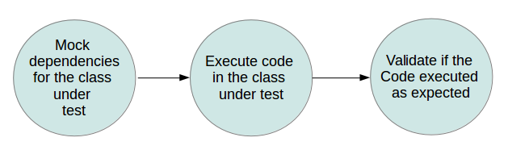
Mockito

Slide 43
Adding Mockito as dependencies to a project
If you use Maven, add the following dependency to the POM.xml.
<!-- https://mvnrepository.com/artifact/org.mockito/mockito-all -->
<dependency>
<groupId>org.mockito</groupId>
<artifactId>mockito-all</artifactId>
<version>1.10.19</version>
</dependency>

Slide 44
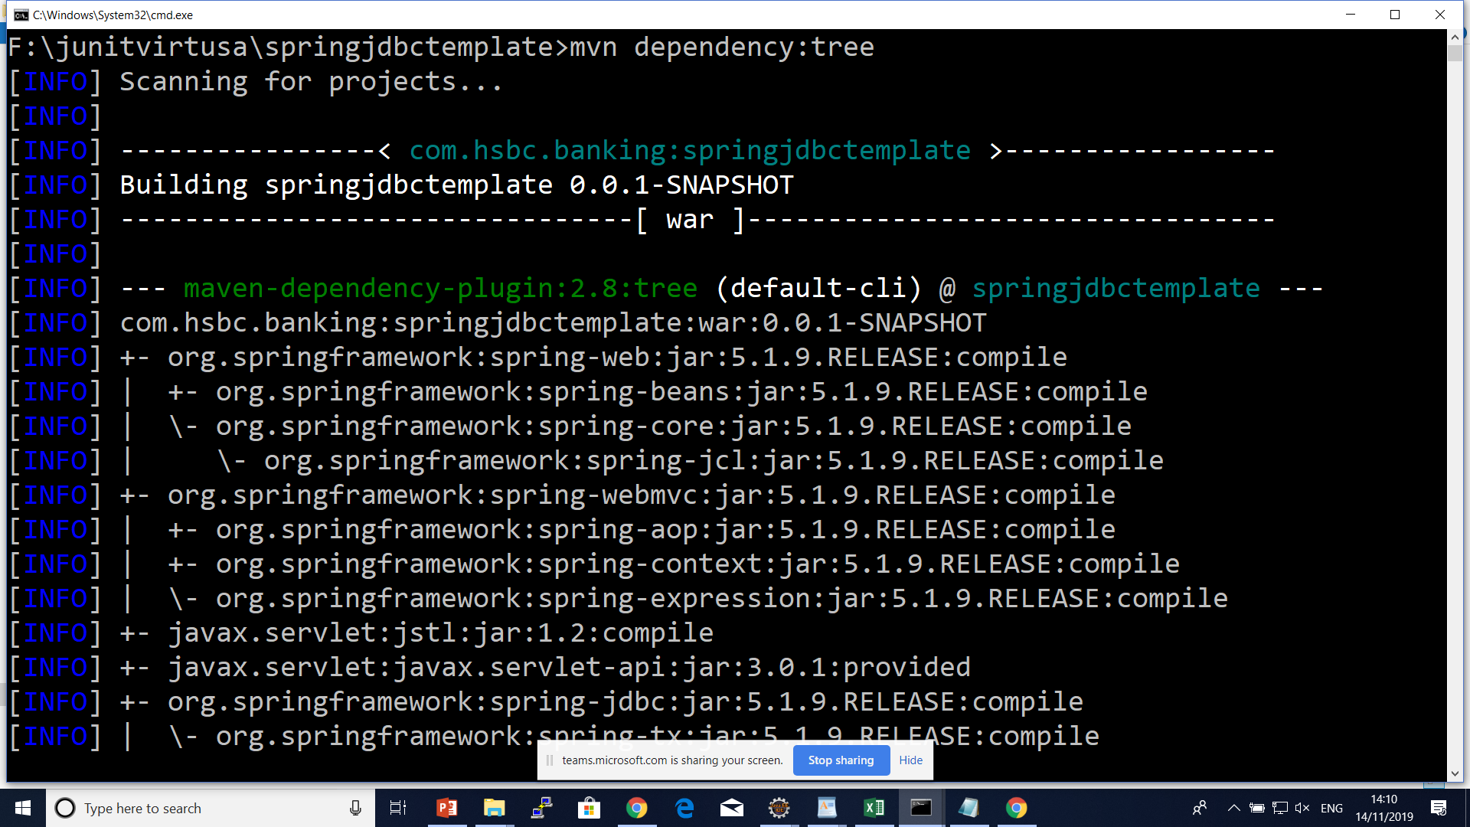

Slide 45
Mockito Annotations
@Mock
@Mock to create and inject mocked instances without having to call Mockito.mock manually.
@Spy
@Captor
@InjectMocks

Slide 46
PowerMock– Mocking the Impossible
With PowerMockito it is possible to mock all the hard cases that Mockito does not support.
Most of the time this means mocking of static methods.
But it is also possible to mock private methods and constructor calls.
Anyway most of time the use case is mocking static methods calls.
PowerMockito is using byte code manipulation and thus it comes with its own JUnit runner.

Slide 47
Questions

Slide 48
Module Summary
Spring Integration Framework.
Message, Channel and Adapter
Understood the different Component Integration
Understood the Event-Driven Architecture

