Slide 1
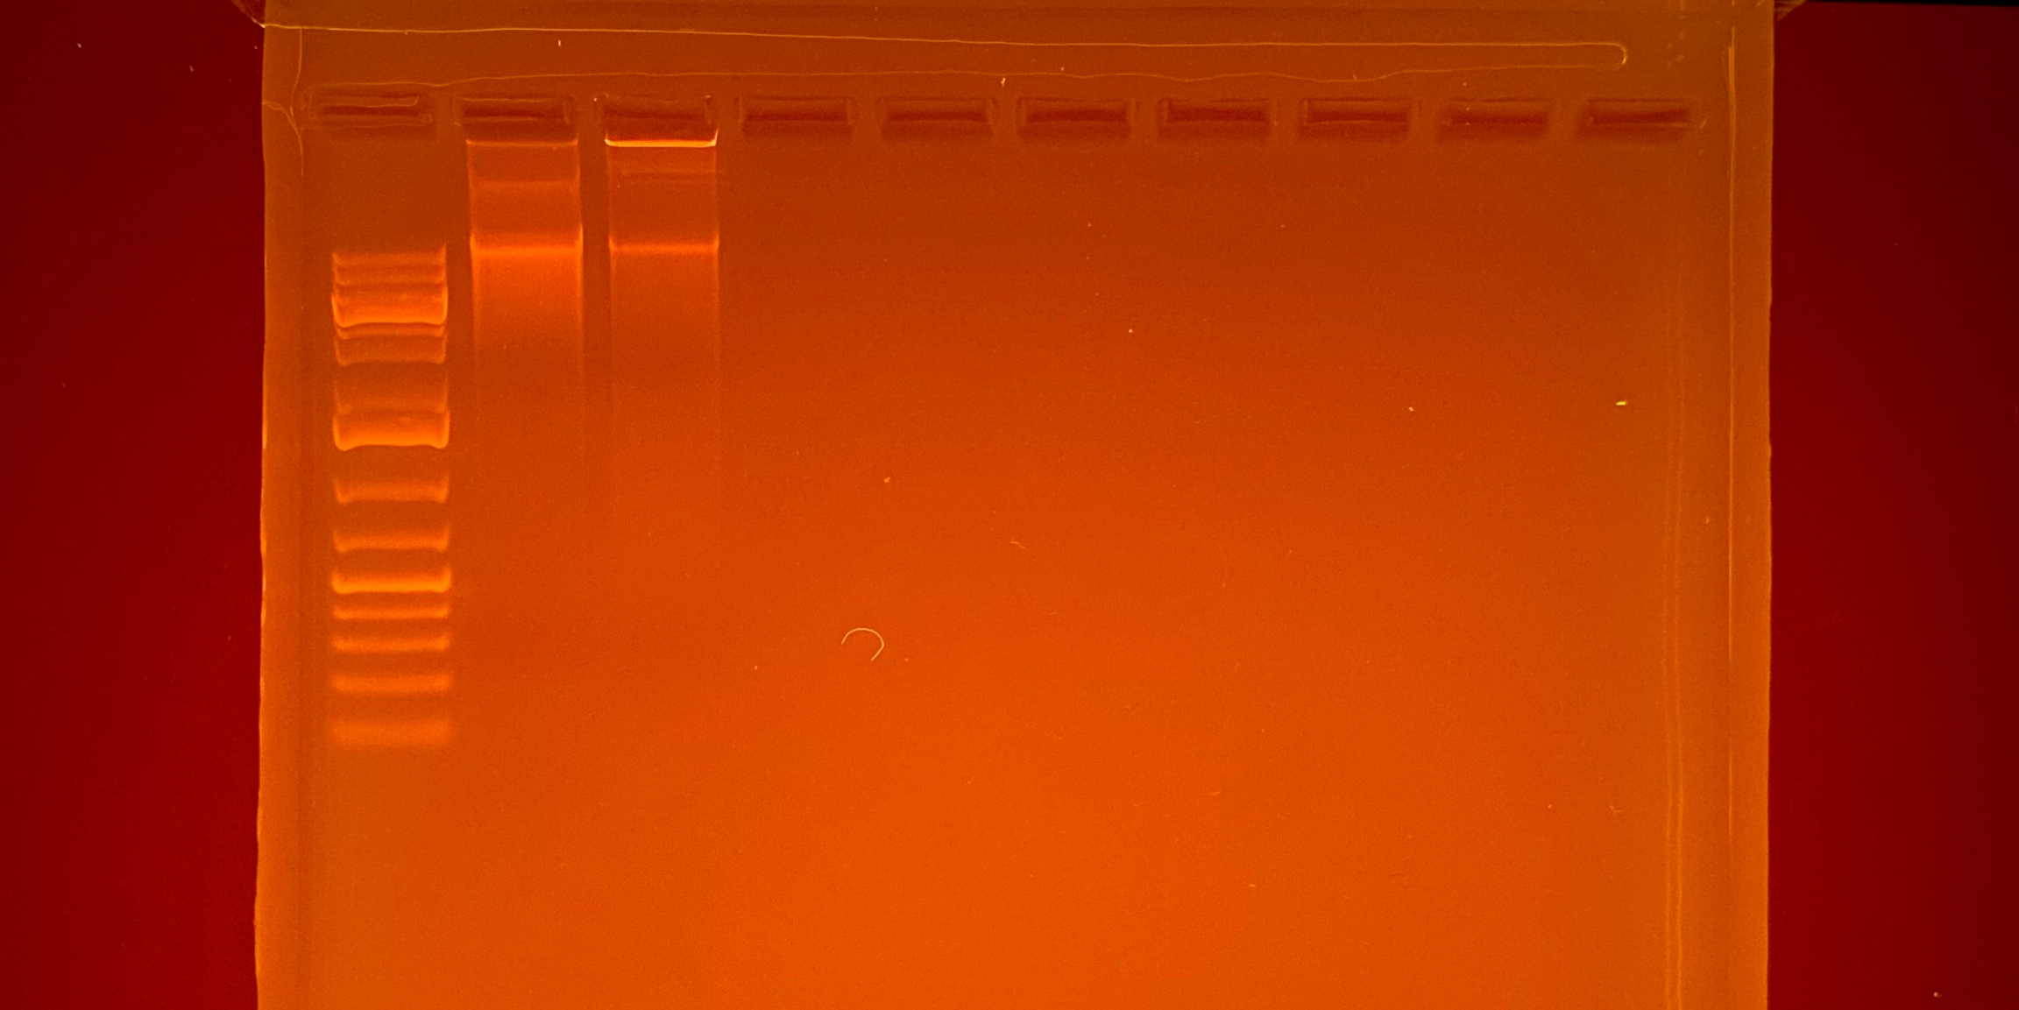
44.9
51.9
1 kb
Plus
Gene
Ruler
464
769
20000
5000
1500
500
75
Average Qubit Assay Value (DNA ng/l) given above sample number

