Slide 1
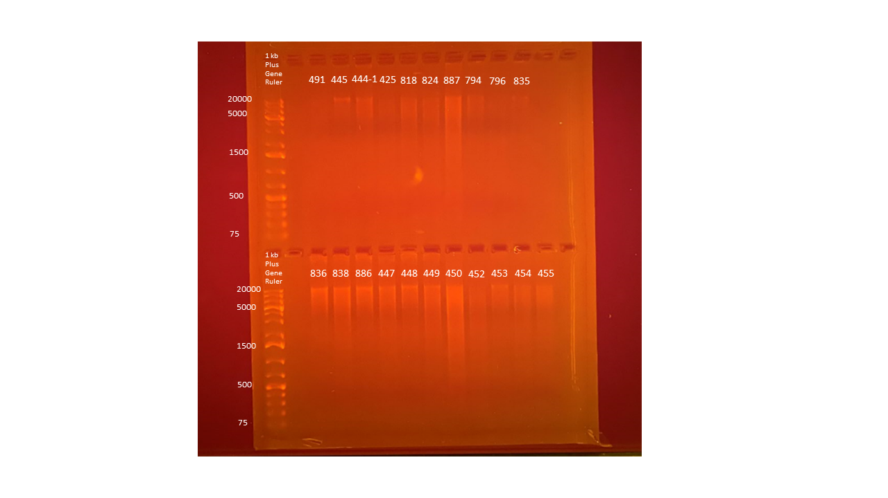
5.79
5.95
8.57
7.51
10.0
8.38
26.1
9.12
4.68
4.37
Average Qubit Assay Value (DNA ng/l) given above sample number
11.9
18.0
13.8
16.4
11.9
14.9
27.8
10.8
10.9
13.4
15.4

