Slide 1
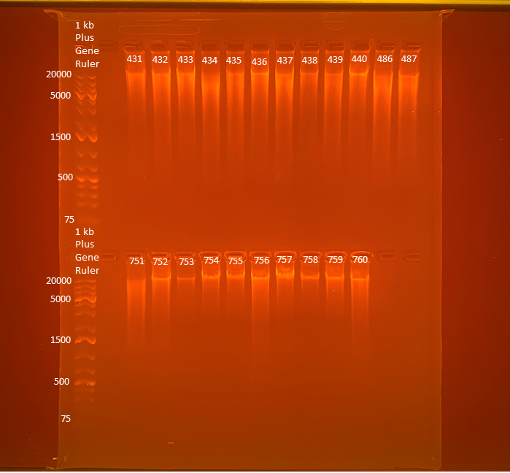
102
116
121
119
124
119
125
92.8
92.8
98.3
131
116
Average Qubit Assay Value (DNA ng/l) given above sample number
61.5
76.6
20.0
63.3
56.2
88.0
80.4
41.8
64.4
89.7

