Slide 1
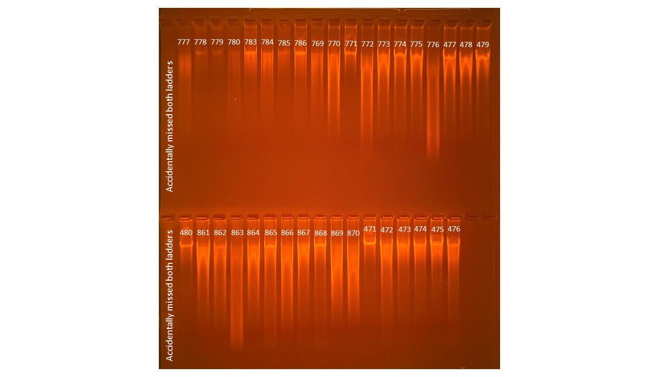
126
110
48.3
108
129
119
118
119
137
145
54.4
117
145
109
134
88.7
137
166
172
Average Qubit Assay Value (DNA ng/l) given above sample number
101
152
119
93.7
126
103
121
135
78.2
185
142
74.8
120
110
92.7
177
138

