Slide 1
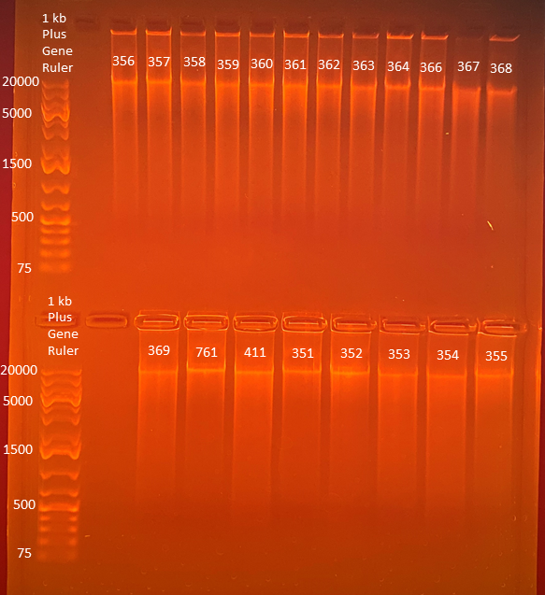
72.4
77.3
90.3
86.4
76.0
86.4
84.2
82.7
79.0
94.7
71.8
62.7
Average Qubit Assay Value (DNA ng/l) given above sample number
86.3
72.7
82.0
90.6
88.1
82.7
77.9
80.2

